Slide 1

Work Readiness in the ai era

Slide 2
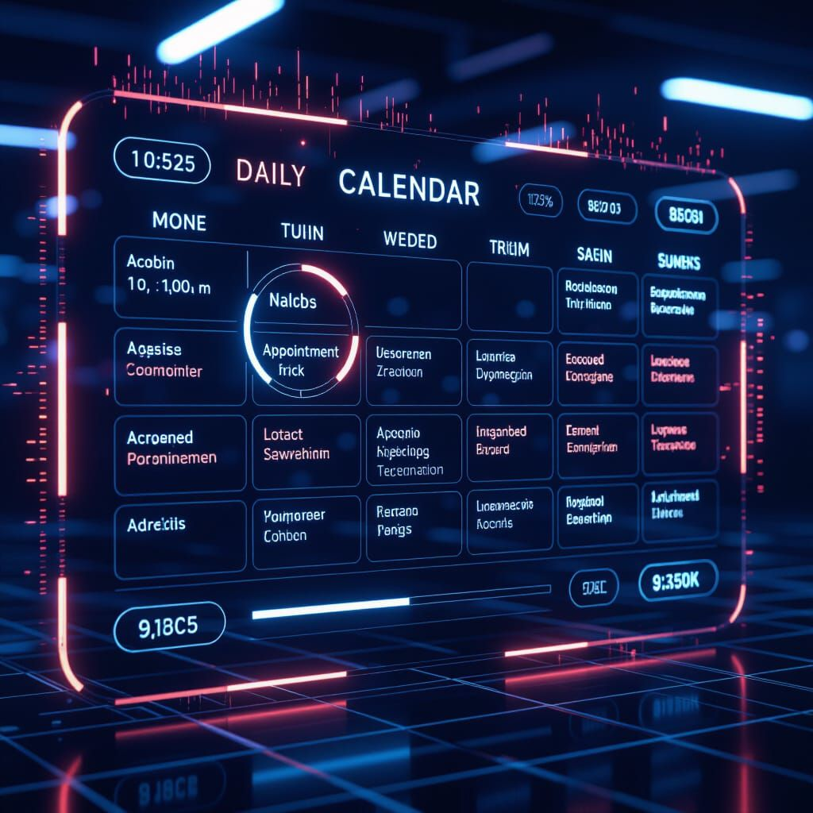
Over the next 30-45 minute I’m going to show you three things:
What opportunities actually exist right now
What skills do you need
How to get started

Slide 3

DEBUNKING THE MYTHS
AI is actually CREATING more jobs than it’s eliminating.
The World Economic Forum did a massive study and found that AI will create 97 million new jobs while only displacing 85 million =12 million MORE jobs.
You do NOT need a college degree in computer science.
Some jobs pay $40k-$80k per year, and all you need is the willingness to learn some basic AI tools.
Companies are desperate for people with AI skills right now.
There aren’t enough people who know how to use these tools. By being in this course, you are ahead of 80% of the workforce.

Slide 4
Here’s what IS true: Jobs are changing
AI is a TOOL. Like a calculator or a computer. It’s not replacing you. It’s making you more powerful.
They just got more powerful and could handle bigger, more complex work.
Think about it:
When calculators came out, accountants didn’t disappear.

Slide 5
HUMAN SKILLS AI CAN’t replace
Critical thinking - AI can give you information, but YOU decide if it makes sense. YOU spot the errors. YOU see what's missing.
Emotional intelligence - Understanding people, reading the room, knowing when a customer needs empathy vs. efficiency. AI can't do this.
Creativity and innovation - AI can remix existing ideas brilliantly. But TRUE innovation - seeing a problem no one else sees, connecting dots in new ways - that's human.
Complex problem-solving - When things break, when situations are messy, when there's no clear answer - you need human judgment.
Relationship building - People buy from people. People trust people. AI can help you be more efficient, but the relationship is YOU.

Slide 6
Here’s a phrase for you to remember: AI won’t replace you, but someone who uses AI might.
WITHOUT AI skills:
Doing everything manually.
Writing emails takes 20 minutes.
Creating a report takes 3 hours.
Analyzing data? You're doing it by hand in Excel.
You're working hard, but you're limited by time and energy.
You're competing with hundreds of other people for the same jobs.

Slide 7
Here’s a phrase for you to remember: AI won’t replace you, but someone who uses AI might.
WITH AI skills:
You're using AI to draft emails in 2 minutes – and edit them.
That 3-hour report? AI pulls the data, creates charts, writes the summary. You review it and make it perfect in 45 minutes.
You're doing the work of 5 people but with better quality. And guess what? You're applying for jobs that pay 30-50% more because you have skills most people don't.
The bottom line: You don't need to become a programmer. You just need to become someone who knows how to work WITH these tools.

Slide 8
How have you been using ai in your work or social life?
Meetings: Fireflies or Otter → summary → paste into Notion
Thinking: Mem or Reflect for daily notes
Projects: Notion for structured workflows
Learning: NotebookLM for deep understanding
If you want one app only → Notion AI
If you hate organizing → Mem
If you’re in meetings all day → Fireflies / Fathom
If you study or research a lot → NotebookLM
If you like deep thinking/journaling → Reflect or Obsidian

Slide 9
Basic data literacy - You don't need to be a data scientist. But you should be able to look at a chart and understand it. Look at a spreadsheet and find patterns. This is learnable in a few weeks. Digital collaboration tools - Tools like Slack, Microsoft Teams, Zoom, Google Workspace, Notion. Modern workplaces use these. If you're not comfortable with them, spend a week learning them. Understanding workflows - How does work flow through a company? If you understand this, you can spot where AI can help. Adaptability - This is the meta-skill. New AI tools come out every month. You need to be comfortable learning new tools quickly. Quality control mindset - AI makes mistakes. Good employees catch them. Great employees prevent them. Develop an eye for quality.
PRACTICAL TECH SKILLS:

Slide 10
BUILD YOUR PORTFOLIO:
Go from I’m learning to I’m Hireable
SYART DOCUMENTING what you do. Create a LinkedIn profile if you don't have one.
POST ABOUT YOUR LEARNING: 'Week 4 of learning AI. Today I used ChatGPT to analyze customer feedback data. Cut my analysis time from 3 hours to 45 minutes. #AI Skills #Learning’
JOIN AI COMMUNITIES: Reddit has r/artificial and r/ChatGPT. Discord has AI servers. LinkedIn has AI groups. Just being in these communities, you'll learn constantly.
Here's a powerful one: VOLUNTEER to help a local small business use AI. Maybe it's your church, your kid's school, a local nonprofit, a friend's business. *** Document everything: 'Helped local bakery create a week's worth of social media posts using AI in 2 hours. Increased their engagement 40%.’ THAT GOES ON YOUR RESUME.
The goal: By month 3, you have:
PROOF THAT YOU CAN USE AI TO CREATE REAL VALUE.
Notes:
***Say 'I'm learning AI. Can I help you automate something or use AI for your marketing?' Do it for free. You're getting experience, they're getting help, and you have a portfolio piece.

Slide 11
TRADITIONAL JOBS + AI
Marketing Assistant + AI:
AI drafts posts in seconds. You edit and add the human touch. AI creates graphics. You refine them.
AI analyzes competitors. You interpret the data and make strategy decisions. Result: You do in 2 hours what used to take 2 days. You're more valuable.
Customer Service Rep + AI:
AI handles simple questions automatically. You handle complex issues. AI suggests solutions to you in real-time. You're like a pilot - the AI is autopilot, but you're in control. Result: You handle 50-60 interactions a day, solve harder problems, and get paid more!
Sales Rep + AI:
AI finds the best prospects. AI tells you exactly when to reach out. AI drafts personalized emails. AI predicts which leads are most likely to buy. Result: You close more deals, earn higher commissions.
Administrative Professional + AI:
AI handles data entry. AI schedules meetings
by reading emails. AI drafts routine emails. AI creates first drafts of reports. Result:
You focus on strategic work, relationship building, and problem-solving. You become
essential.
Notes:
Think about the ways you stated you were utilizing AI currently… look at the ways AI is assisting in these areas.

Slide 12
WHAT’s ONE NEW WAY YOU CAN USE AI… to make life easier? Solve a problem? Save time? Learn something new? Help someone else?
Notes:
Give them time and have each one give an example

Slide 13
How to Stand Out to Employers
UPDATE YOUR RESUME:
Add a 'Technical Skills' or 'AI Tools' section:
Proficient in ChatGPT, Claude, and Microsoft Copilot
Experience with AI-assisted content creation and data analysis
Skilled in prompt engineering and AI output optimization

Slide 14
Then, APPLY IT in your job descriptions and show RESULTS: Instead of: 'Responsible for customer service emails’ Write: 'Managed customer service emails, implementing AI tools to reduce response time by 60% while maintaining 98% satisfaction rating.’ Instead of: 'Created marketing content’ Write: 'Generated marketing content using AI-assisted workflows, increasing output from 5 to 15 high- quality posts per week'

Slide 15
Start Small practice daily build publicly
Don't try to learn everything at once. Start with ChatGPT. Use it for 15 minutes a day. Every day. That's how you build competence.
Then share what you're learning. LinkedIn posts. Conversations with friends. Helping others. When you teach, you learn twice.

Slide 16
CREATIVE TOOLS:
Canva Magic Design - Creates graphics and designs with AI. Free version is great.
DALL-E or Midjourney - Creates images from text descriptions.
Descript - AI video editing. Amazing tool.
PRODUCTIVITY & WORK:
Notion AI - Smart note-taking and knowledge management.
Grammarly - AI writing assistant. Free version catches most errors.
Otter.ai - Records and transcribes meetings automatically. Game-changer.
Zapier - Connects different tools and automates workflows.
LEARNING & ANALYSIS:
Perplexity - Like Google but with AI answers. Great for research.
Julius AI - Upload data, ask questions, get insights.
You don't need all of these. Start with ChatGPT and Grammarly.
Add more as you need them.

Slide 17
I will be reaching ouT TO each of You, but do not wait for me contact you individually: Please email me if you are interested in potential internships (unpaid) with local organizations at the end of the program. Or if you would like help with your resume, interviewing skills, or concerns about the course. casemanager@amamedia.org

Slide 18
THANK YOU!

