Slide 1

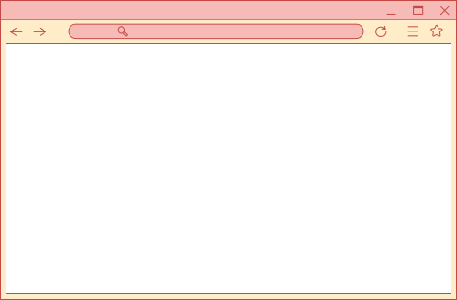

Canva 101
Free Edition

Slide 2

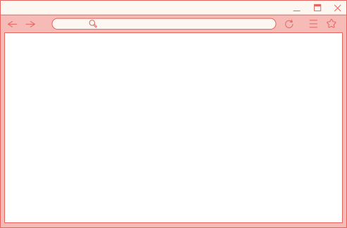

Table of Contents
Topics Covered
CREATING AN ACCOUNT
free functions
Generating Text & Images
Basic, Intermediate& Advanced
Applications/Plug-ins
Exporting & Tips

Slide 3

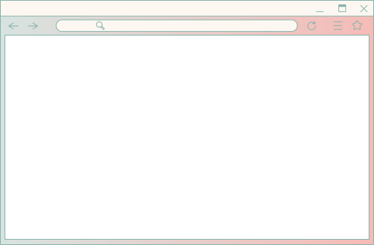
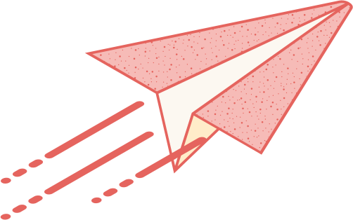

Creating your account
https://www.canva.com/
https://www.canva.com/brand/join?token=BLPeo8fnNjJMeJirLMrk9Q&invitationDestinationType=group
Notes:
How many of you have used Canva before?
What do you normally use Canva for?
What would you like to learn?

Slide 4
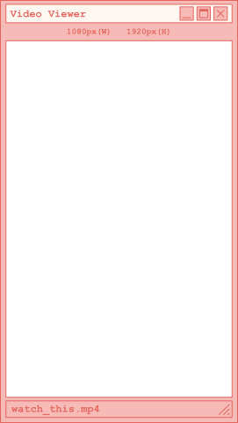



How to personalize the ready made templates
Basic:
Intermediate:
Edit Photos
Advanced:
In the Design Tab: use Layouts & Styles to update the color palette and fonts in 1 click
Using elements to create new graphics, sticking to what is available in canva
Use AI to generate your own photos and edit the photo with drawing, photoshop, etc.
If you find images online and want to make them more unique
Tip for Mac Users: Background remover is free.
For PC users: Adobe Express Cloud has this feature for free

Slide 5
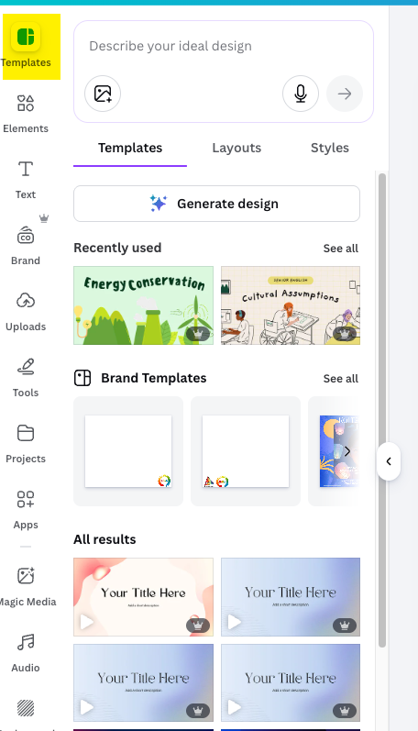
Templates are very beginner-friendly

Slide 6
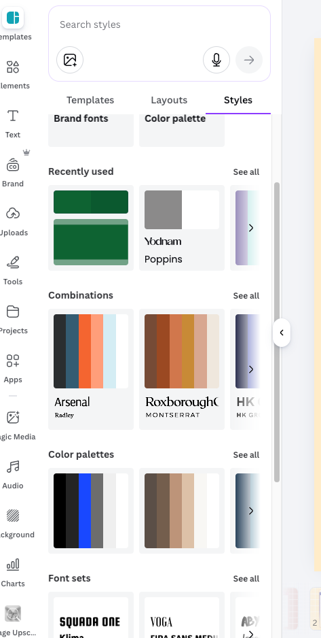

Slide 7


Changing the style

Slide 8
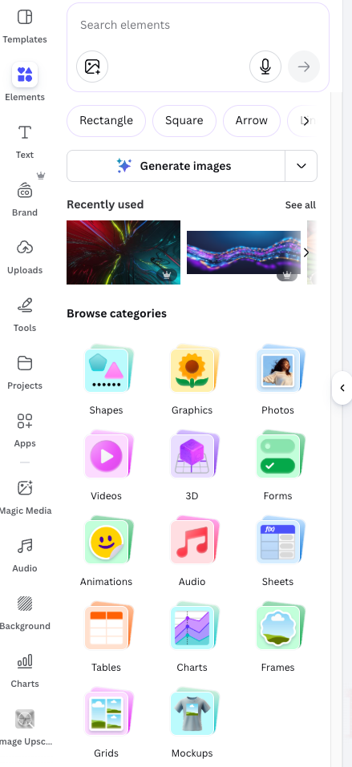

Element Example
In Elements, you can use charts (Pie, bar, etc), Tables, and Frames to help replace basic graphics

Slide 9



The request was to show “connection on social media”
These were the free elements on Canva (a few years ago)
All the ones I wanted to use were only on the premium/paid version of canva

Slide 10


with FREE elements only
The design:
How it was used:

Slide 11

Intermediate

Slide 12
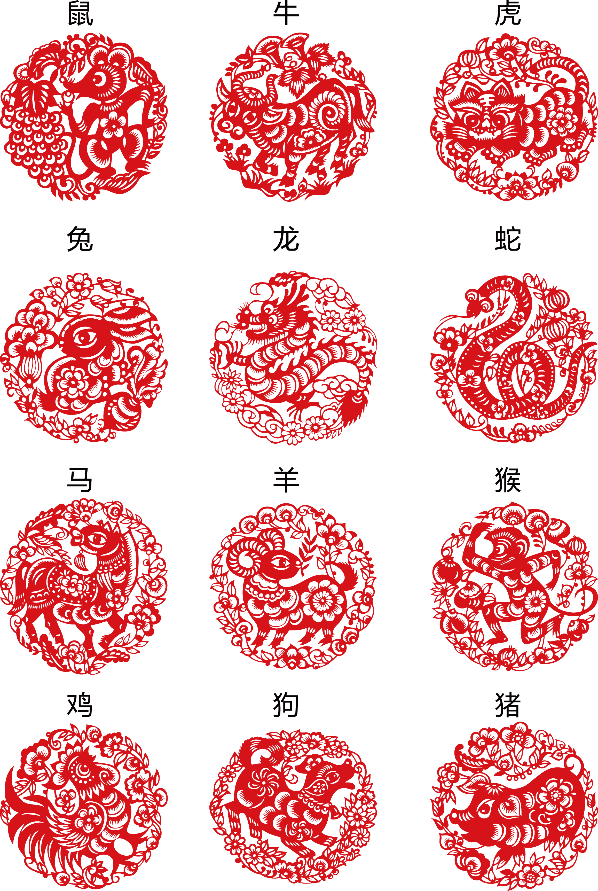

Using Photo edit:
Using a google image
The inspiration to replicate

Slide 13

Using Photo edit:
Click on the image > edit > Filters
Layering filters
Also used:
  Background remover
  Snagit to paint
Using paint tool

Slide 14

How we used it

Slide 15
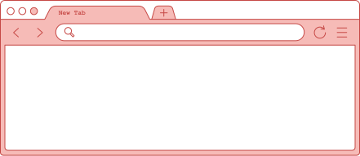
Advanced

Slide 16


BEFORE
AFTER
Using AI to help generate images then using Canva to fix them

Slide 17


BEFORE
AFTER

Slide 18


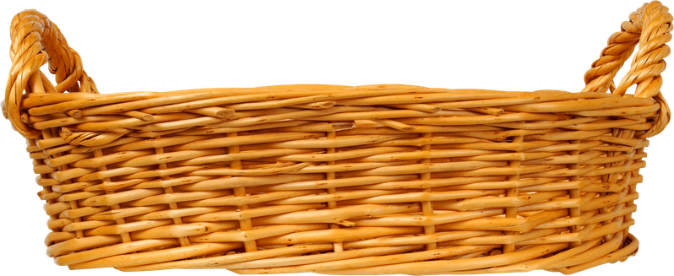
BEFORE
AFTER
Can you spot the differences? Annotate on Zoom!

Slide 19
Fixed the misspelled words
Overlaying images
Used the drawing tool to fix the banner, RX, and Produce Prescription
Used element to find a basket design to cover the words

Slide 20
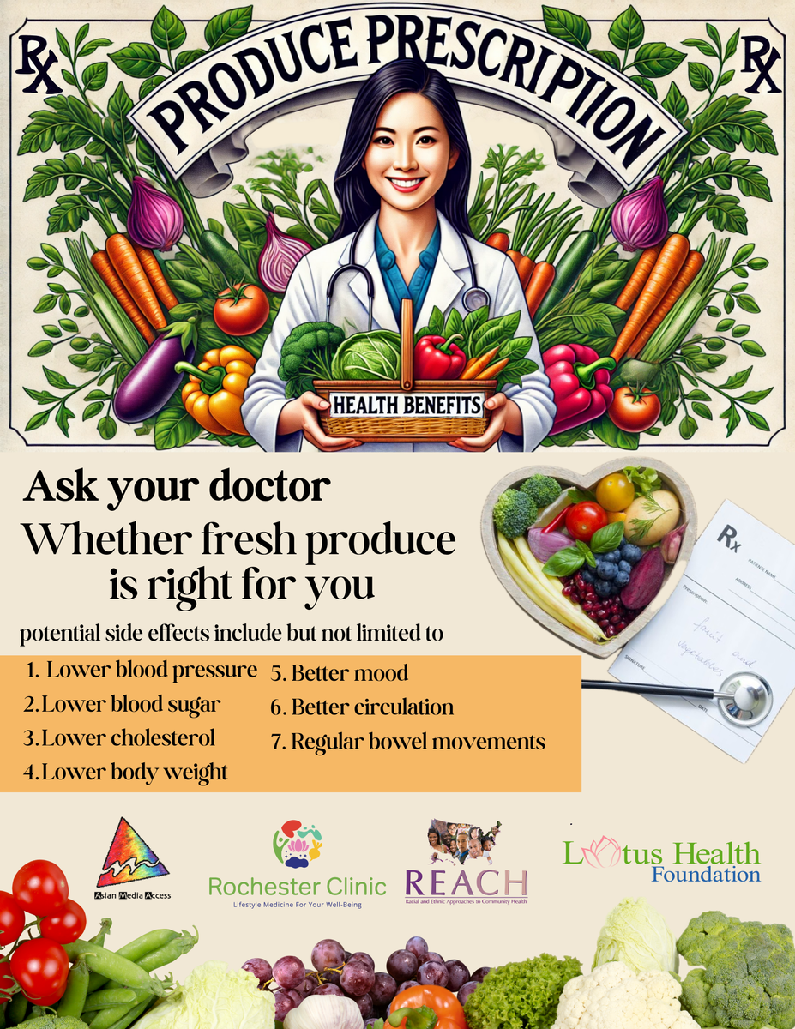
How we used it

Slide 21
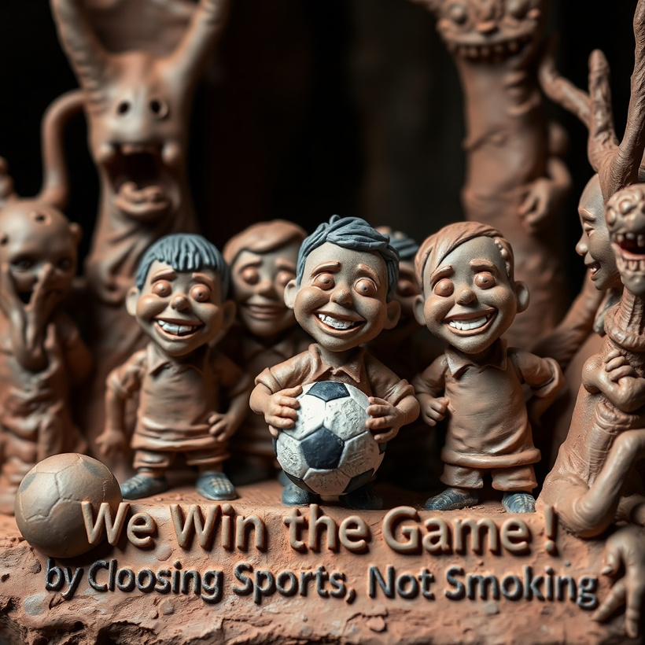
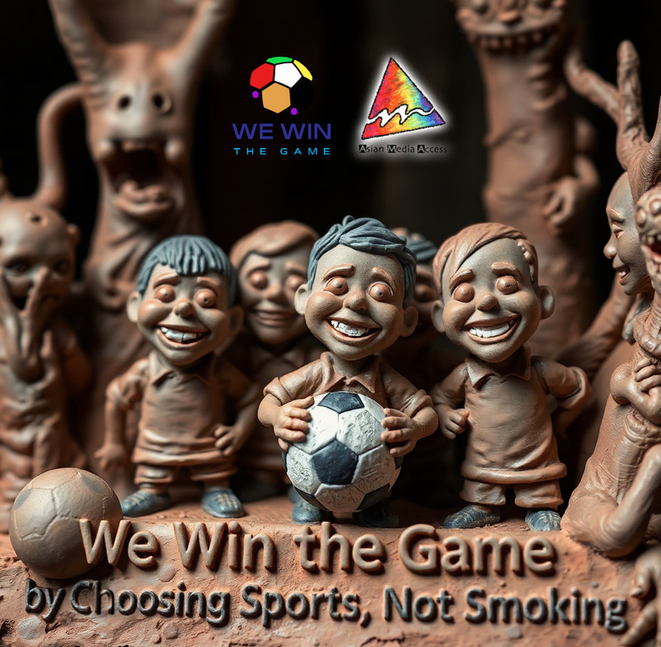
AI Prompt: Sculptural clay art postcard style, with monsters, a little creepy atmosphere, dark tones unsettling details, modeled shapes, textured clay, smiling young BIPOC soccer players at front, text We Win the Game by Choosing Sports, Not Smoking, in bold font

Slide 22
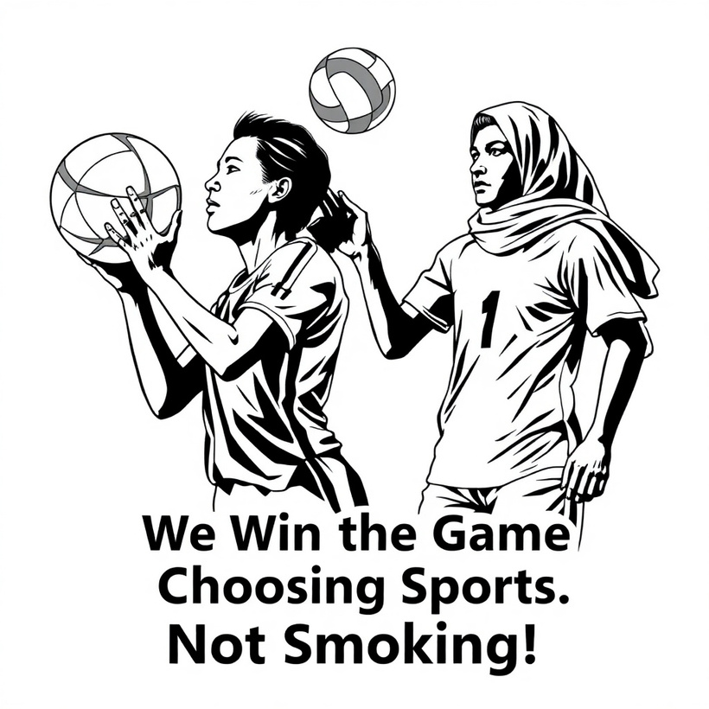
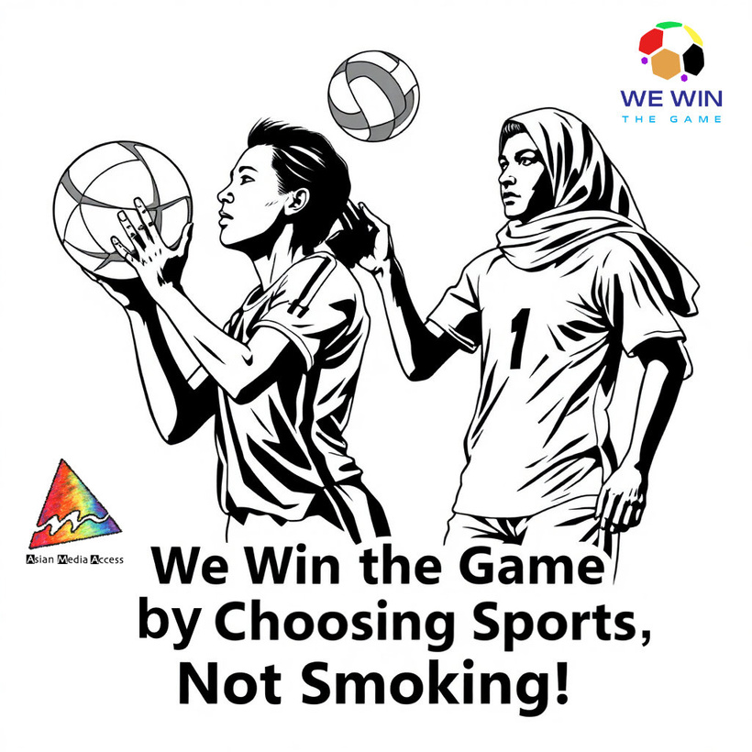
AI prompt: Black and white drawing postcard depicting Hmong and Somali ball players with sharp lines and detailed structures. Bold text We Win the Game by Choosing Sports, Not Smoking!

Slide 23
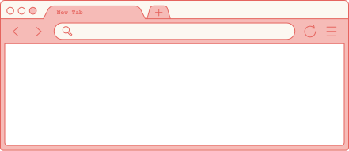


Using apps available

Slide 24

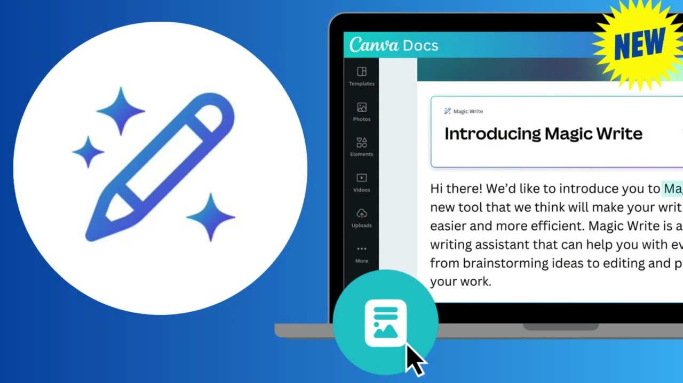
Magic Write
  Provide a prompt (list/bullet points or outline) for Magic Write to provide the information to you
    Can be helpful for presentations, social media posts, blogs, and marketing
    Helpful if you need to generate texts from scratch
  Highlight a field to have Magic Write summarize
Magic Media
  Provide a prompt to generate a image, graphic, or videos

Slide 25
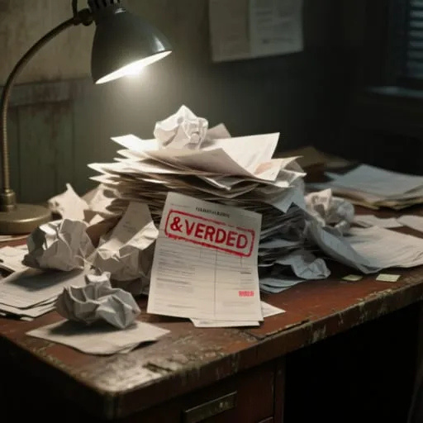
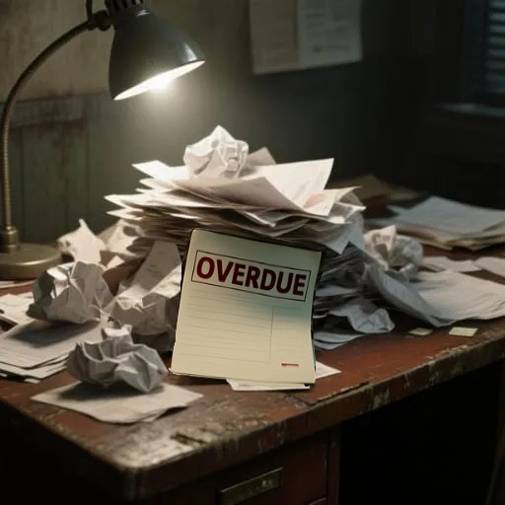

Slide 26
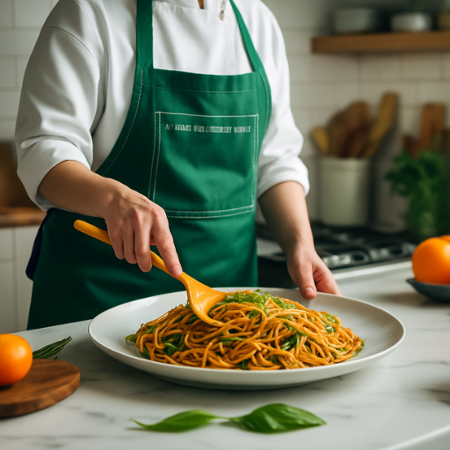
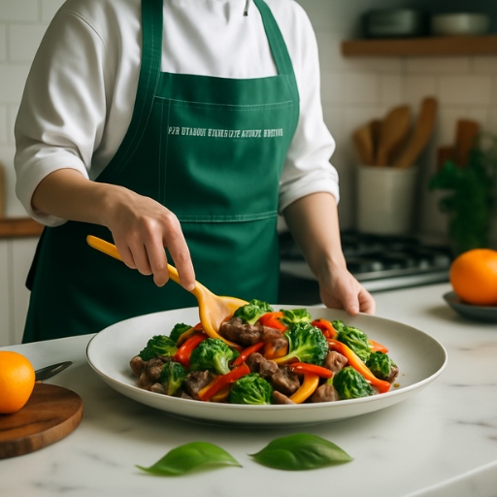
Ai prompt: “Asian food”
Ai prompt: “Broccoli and beef stir fry”

Slide 27
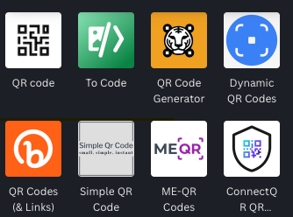
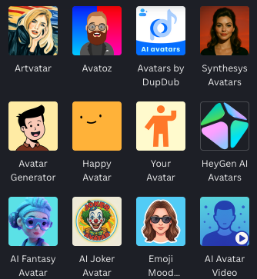
The apps I use the most are
-QR code generators
-Translate
-creating characters/avatars

Slide 28
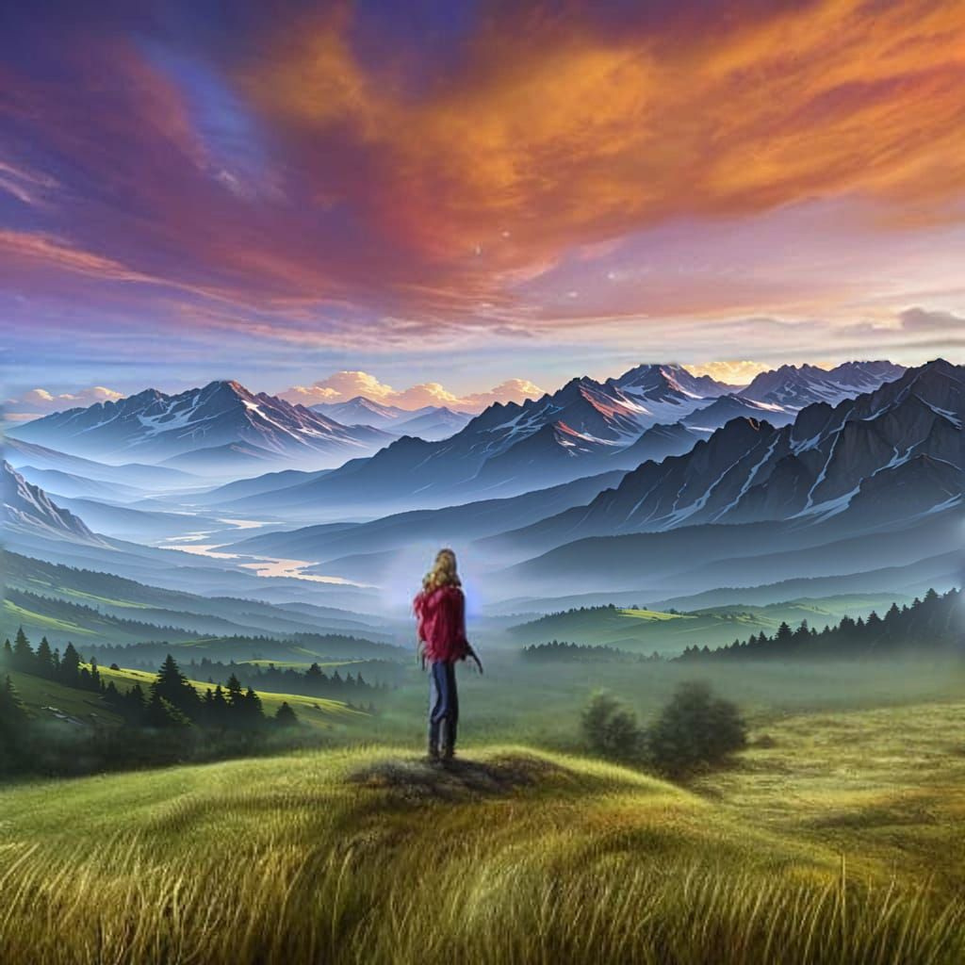
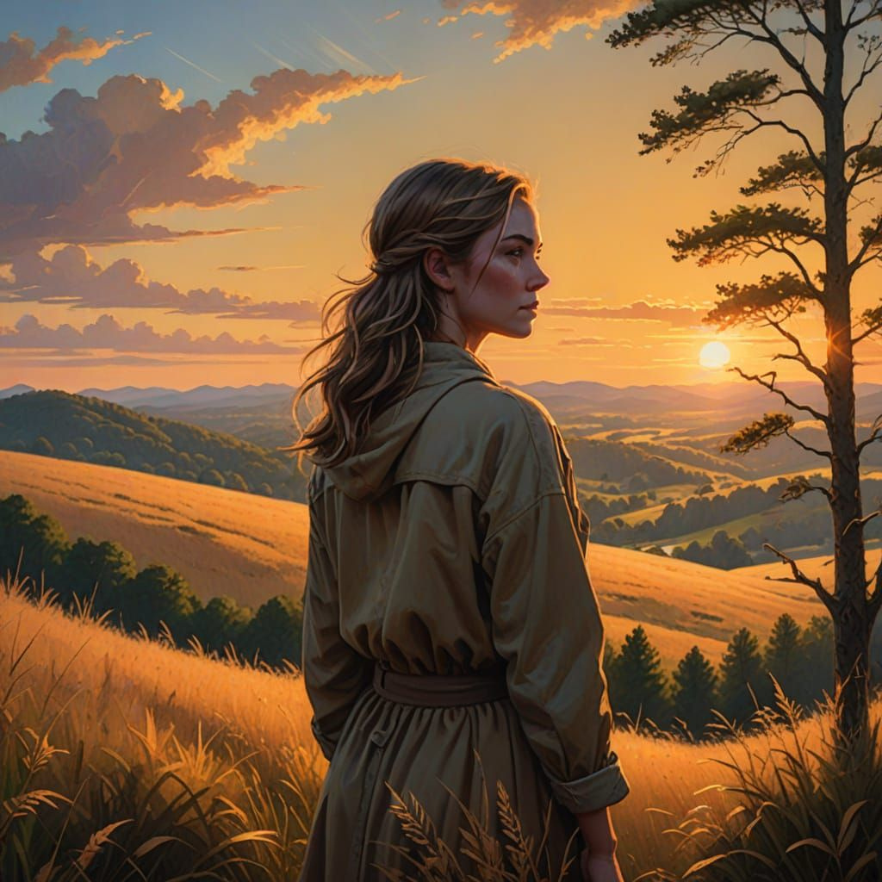

Slide 29
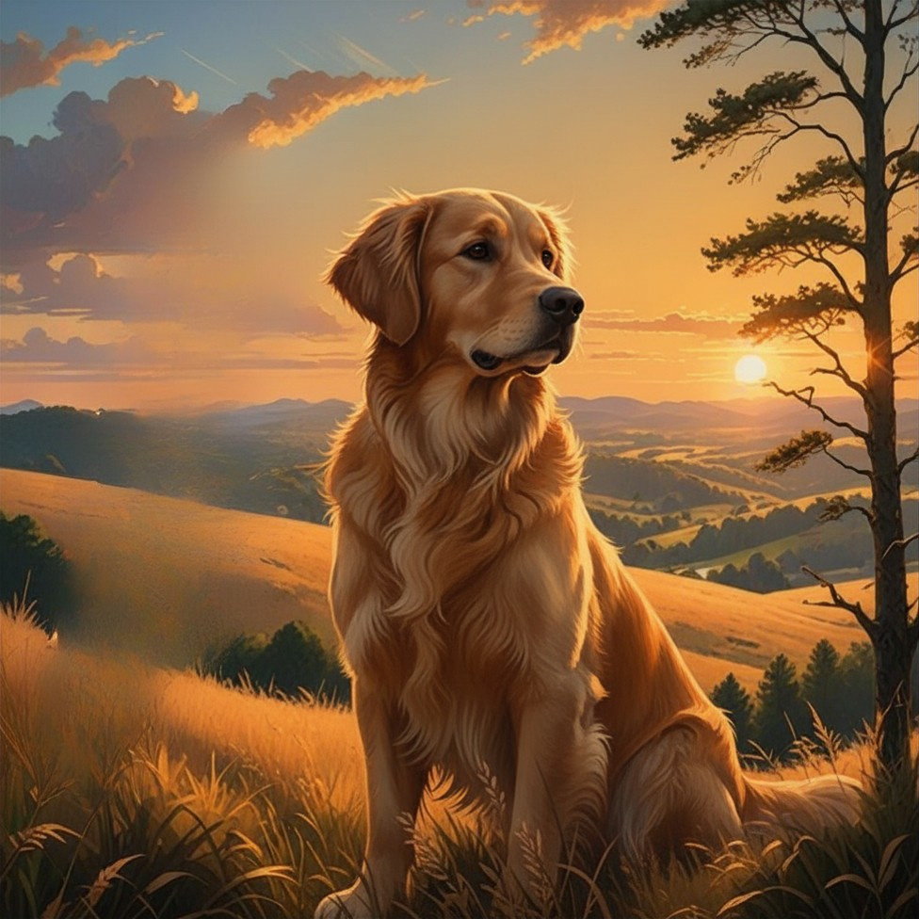
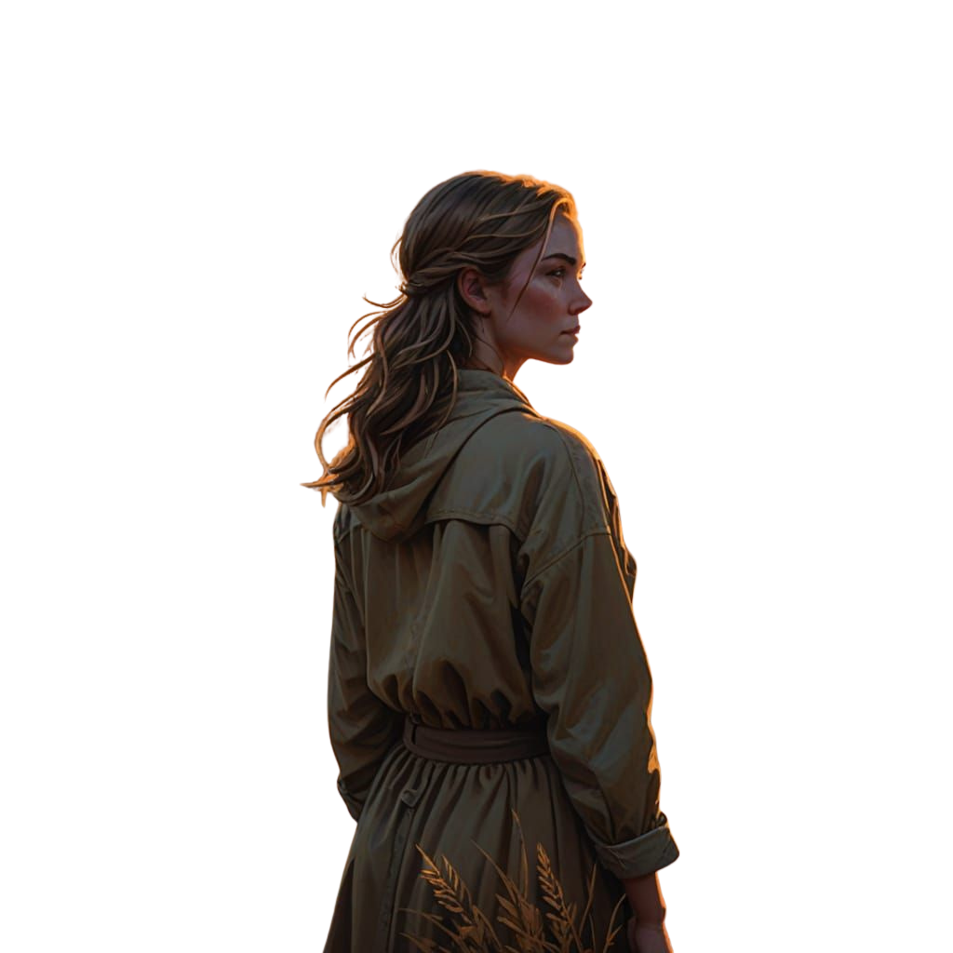

Slide 31

Exporting & Tips

Slide 32
PNG
Image format. Best for sharing on social media, have the capability for transparent backgrounds. Pixel images (can’t enlarge well)
JPEG
Image format. Compressed only. Supported on more devices (because its so old!), Pixel images (can’t enlarge well)
PDF
Document format. Great for clickable information such as links

Slide 33
TIPS that I’ve learned through experience
Duplicate your designs if you make changes often | Use QR Codes for PNGs and JPEGS | Tools that will help enhance your experience | Any tips you want to add?
Why: Because Canva autosaves and has no history versions | Why: Because social media websites typically only support PNG and JPEG i formats | Snagit
 |  | Adobe Cloud Express

Slide 34
Canva Presentation Keys
Press the following keys while on Present mode!
B for blur
C for confetti
D for a drumroll
M for mic drop
O for bubbles
Q for quiet
U for unveil
Any number from 0-9 for a timer

