Slide 1





e-Magine! Initiative
13 weeks, Mondays & Tuesdays - 5:30pm - 8:30pm
February 23, 2026-March 12,2026

Slide 2
Today’s Schedule:
5:30pm-6:30pm Introductions
6:30pm-7:00pm Ice Breaker
7:00-7:15pm Break
7:15pm-8:30pm Paperwork + Assessment
Day 2 - Setting a theme
Examples
Breakout room
Assessments

Slide 3
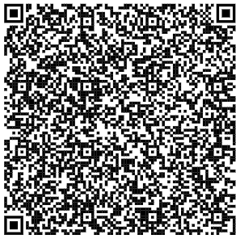
Introduction of Asian Media Access
How We Started
History Of Us
August 1992, Asian Media Access, Inc. (AMA) is a comprehensive, multimedia-based, community advocacy agency. AMA is dedicated to using multimedia arts and technology as tools for social betterment. AMA recognizes that multimedia and technology are essential for advocacy, communication and education, in order to mobilize communities, and young people; to engage in understanding and communicating of Pan Asian issues; and to arrive at a participatory decision-making process for a safe, supportive environment for all.
Asian Media Access
Who We Are
We believe the multimedia arts and information technology empower all of us with critical thinking and promote good citizenship—especially important as we prepare young people to be tomorrow’s leaders. Our thought-provoking multimedia education, productions, exhibitions, stage performances, resourceful educational products and youth programs encourage deep reflection, challenge previous assumptions, provide solace, and allow participants to develop their own way of connection in timeless works of creation, communication and community building.
Subscribe to our eNewsletter and Ball e-magazine

Slide 4
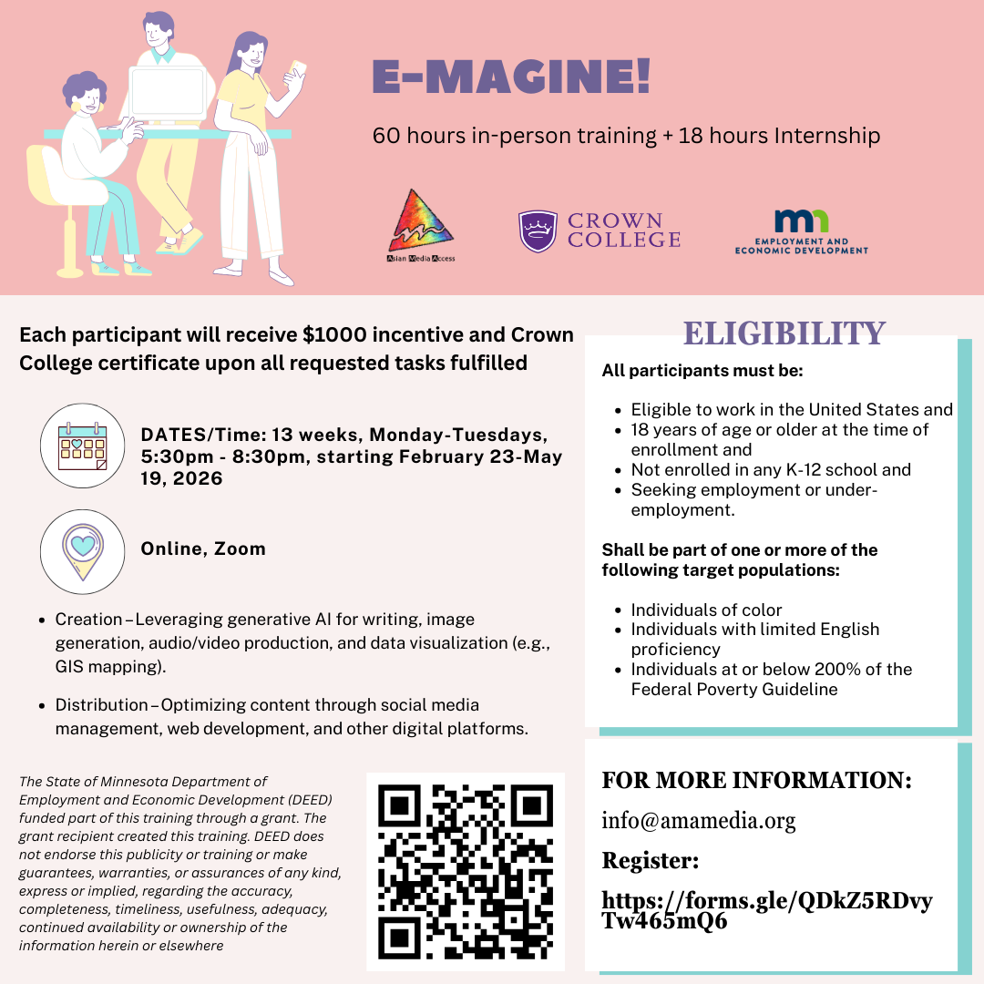

Slide 5
Expectations:
Participate in 60 hours of training, 18 hours internship, and 2 hour closing ceremony
Required 80% attendance rate, if you might miss a class, please e-mail Maya at casemanager@amamedia.org
4 classes can be missed
Complete all assignments to receive incentive and Crown College certificate
We will start with AI training, then website building, and end with digital marketing

Slide 6
No Expensive Software Needed!
Free Tools You'll Use
ChatGPT (writing)
Canva (design)
WordPress (websites)
Your smartphone (video/audio)
Google Analytics (tracking)

Slide 7
What Technical Skills you will gain:
AI Content Creation: ChatGPT, NightCafe, Leonardo AI
Design Mastery: Canva for professional graphics
Web Development: WordPress from basics to deployment
Multimedia Production: Video, audio, and podcast creation with AIs
Digital Marketing: Social media strategy and analytics

Slide 8
Portfolio & Deliverables
Professional Web Presence
1 issue assigned by AMA
10 AI-generated images
8 design pieces (4 postcards + 4 infographics)
2 AI videos (including landing page intro)
2 AI podcasts for multimedia integration
2 original music compositions
Complete e-Magazine showcasing all work
WordPress website with three pages:
Landing page with video/music intro
Image gallery showcase
Multimedia content hub
Social media marketing campaigns
Analytics tracking and optimization

Slide 9
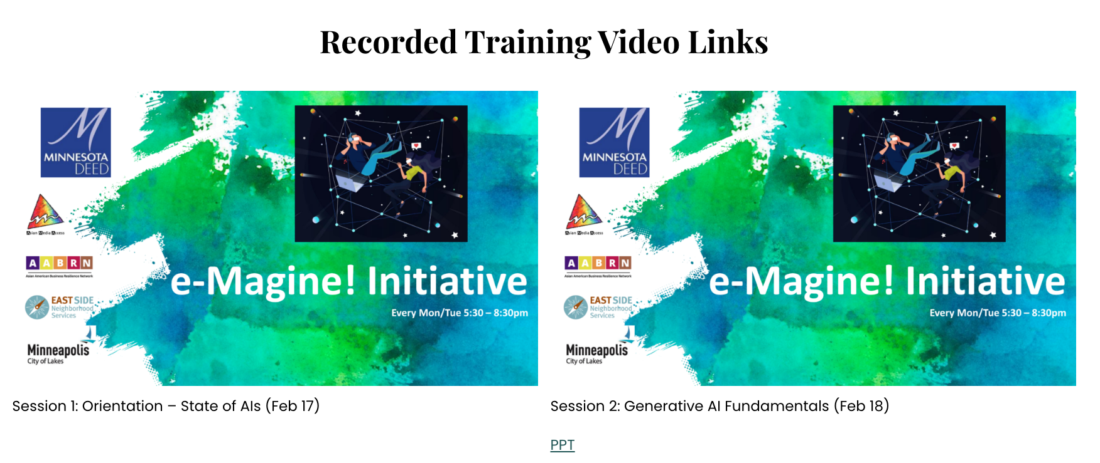
E-magine Website
Use to find slides, training handouts, curriculum, etc: https://ww1.amamedia.org/online-e-magine/

Slide 10
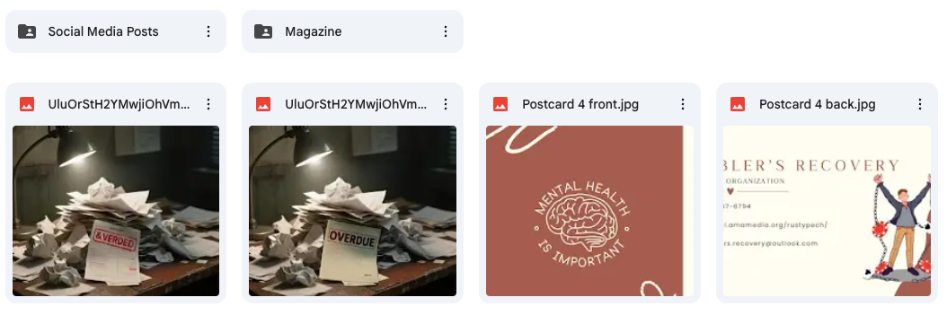
Google Drive
Google Drive:
https://drive.google.com/drive/folders/1HEQ_jGovqrctXjiB4MiAH247CAm5fhJW?usp=drive_link

Slide 11
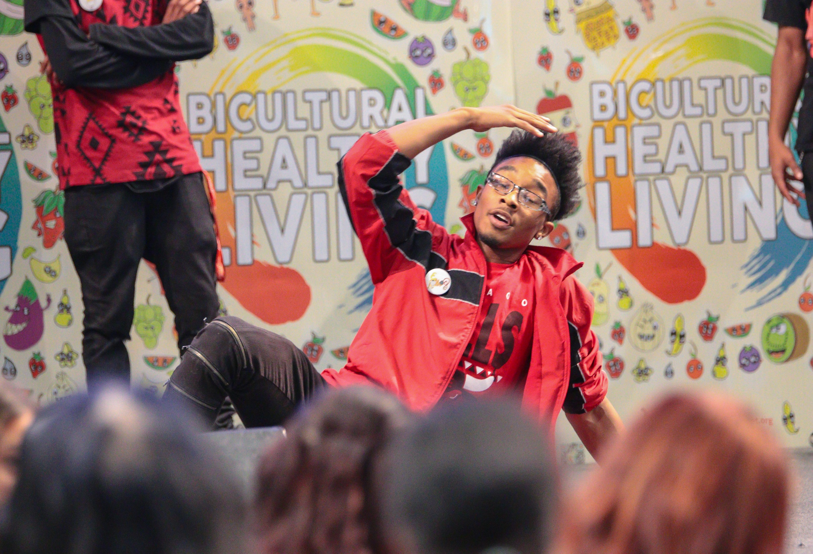
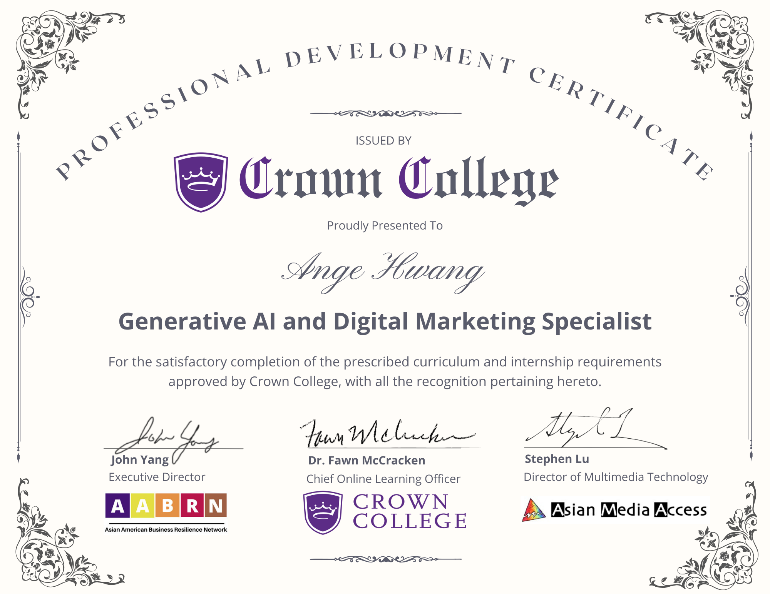

Slide 12
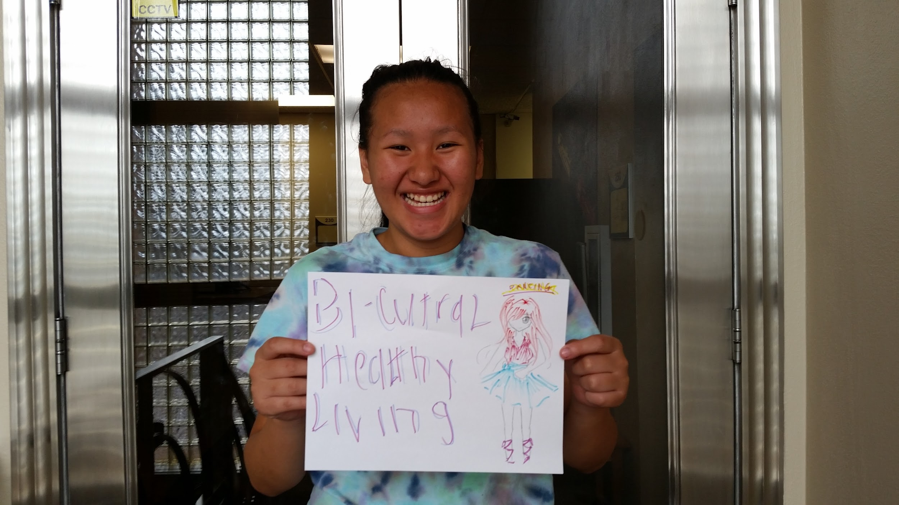
Typical Schedule (5:30pm-8:30pm)
5:30pm-6:00pm - Attendance and checking in
6:00pm-7:00pm - First Training
7:00pm-7:15 pm Break
7:15pm-8:30pm - Second Training and Reflections

Slide 13
Ice Breaker

Slide 14
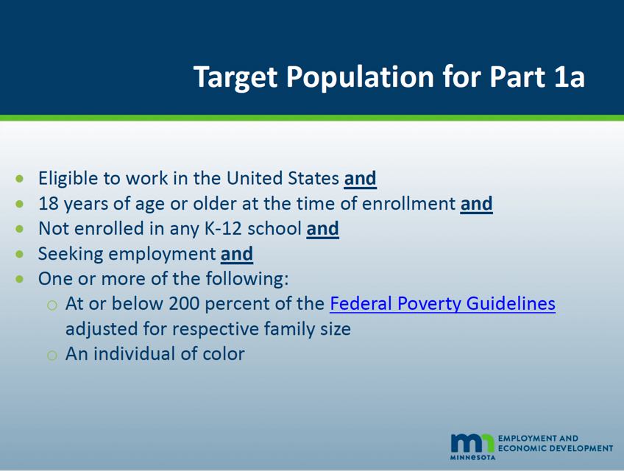
E-Magine
Eligibility requirements

Slide 15
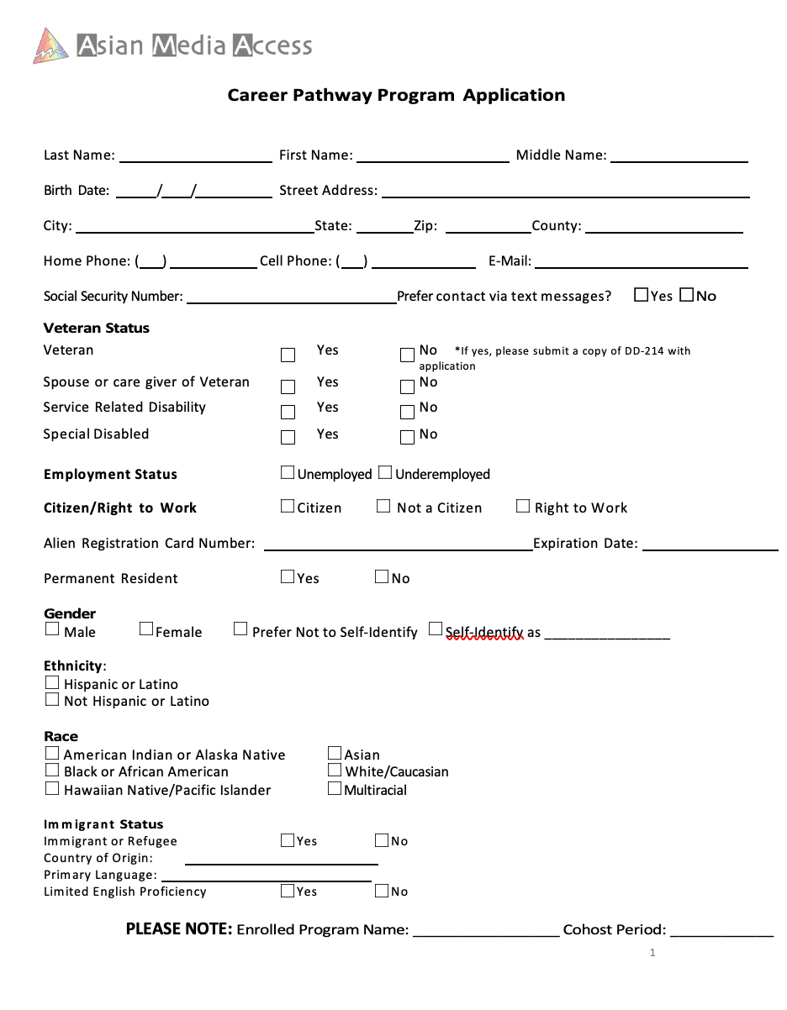
Application, page 1
Program: E-magine, Cohort February 2026

Slide 16
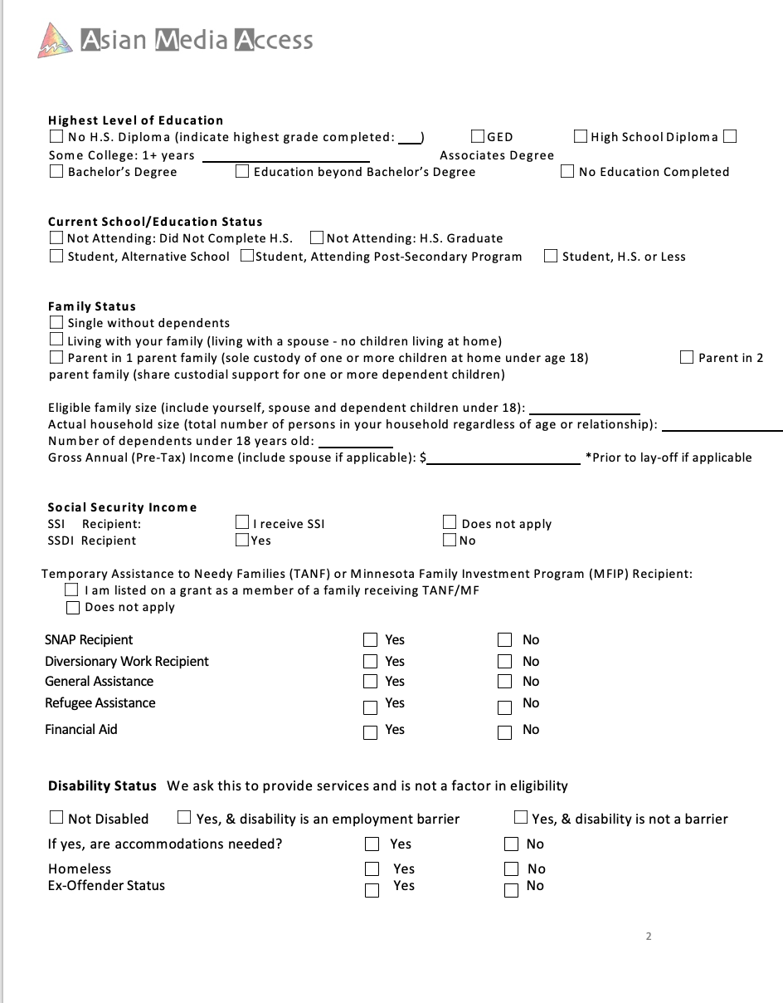
Application, page 2
Family size
Number of depends under 18
Gross annual can be $0+
example:
4 family members, 2 dependents under the age of 18

Slide 17
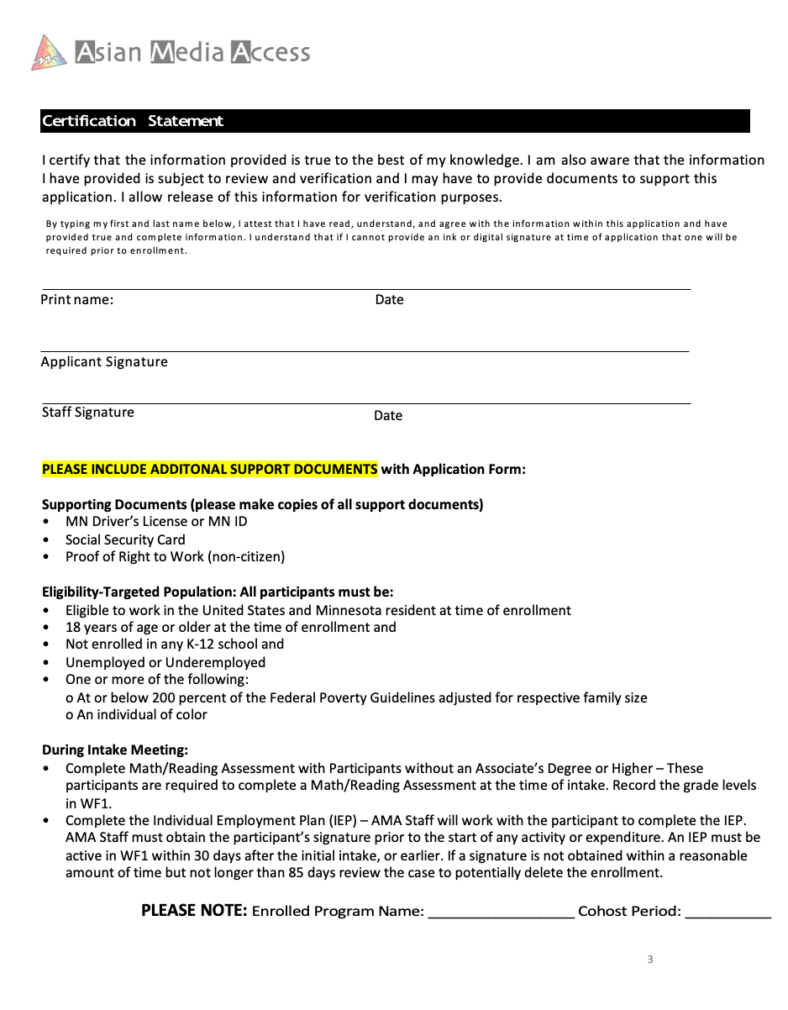
Today’s date, start of the class

Slide 18
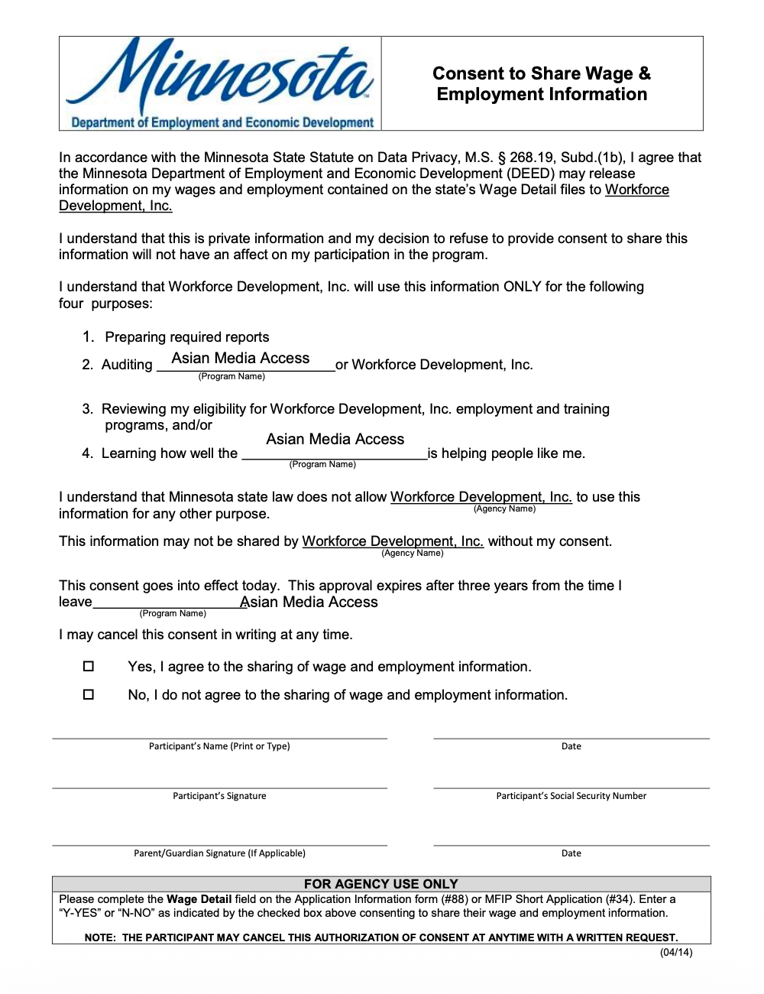
DEED consent, page 1
Check Yes or No
Print your name, date with today’s date
Sign, date with today’s date

Slide 19
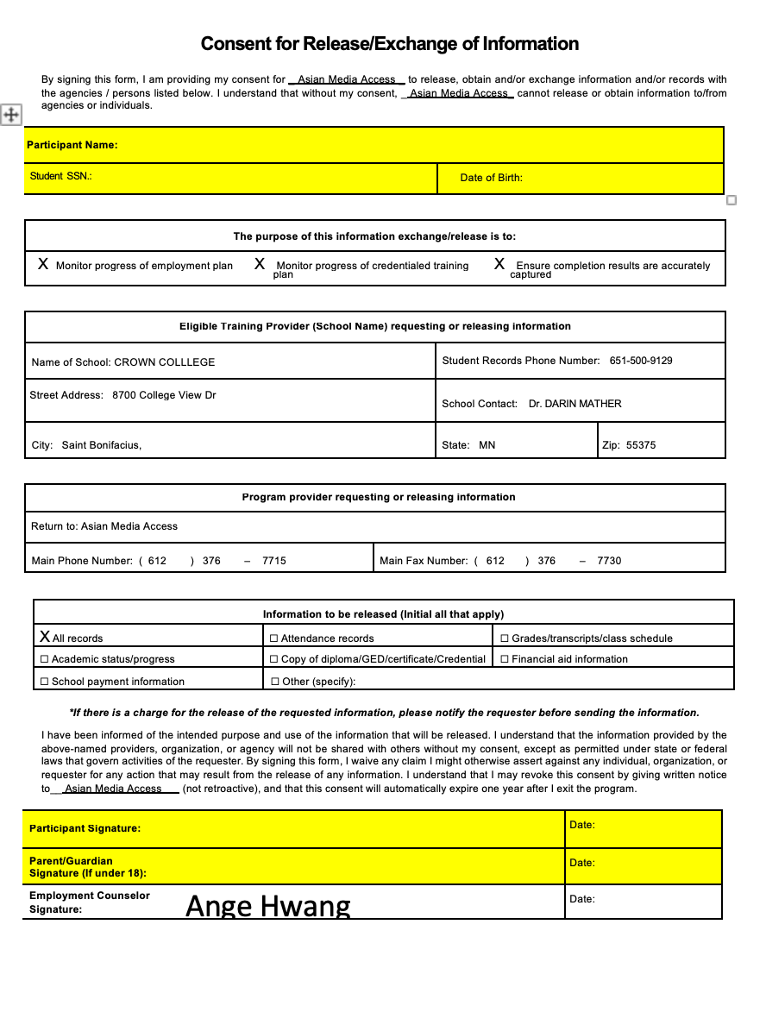
Only the highlighted parts need to be filled out.
This is for Crown College to create your and publish your certificate.

Slide 20
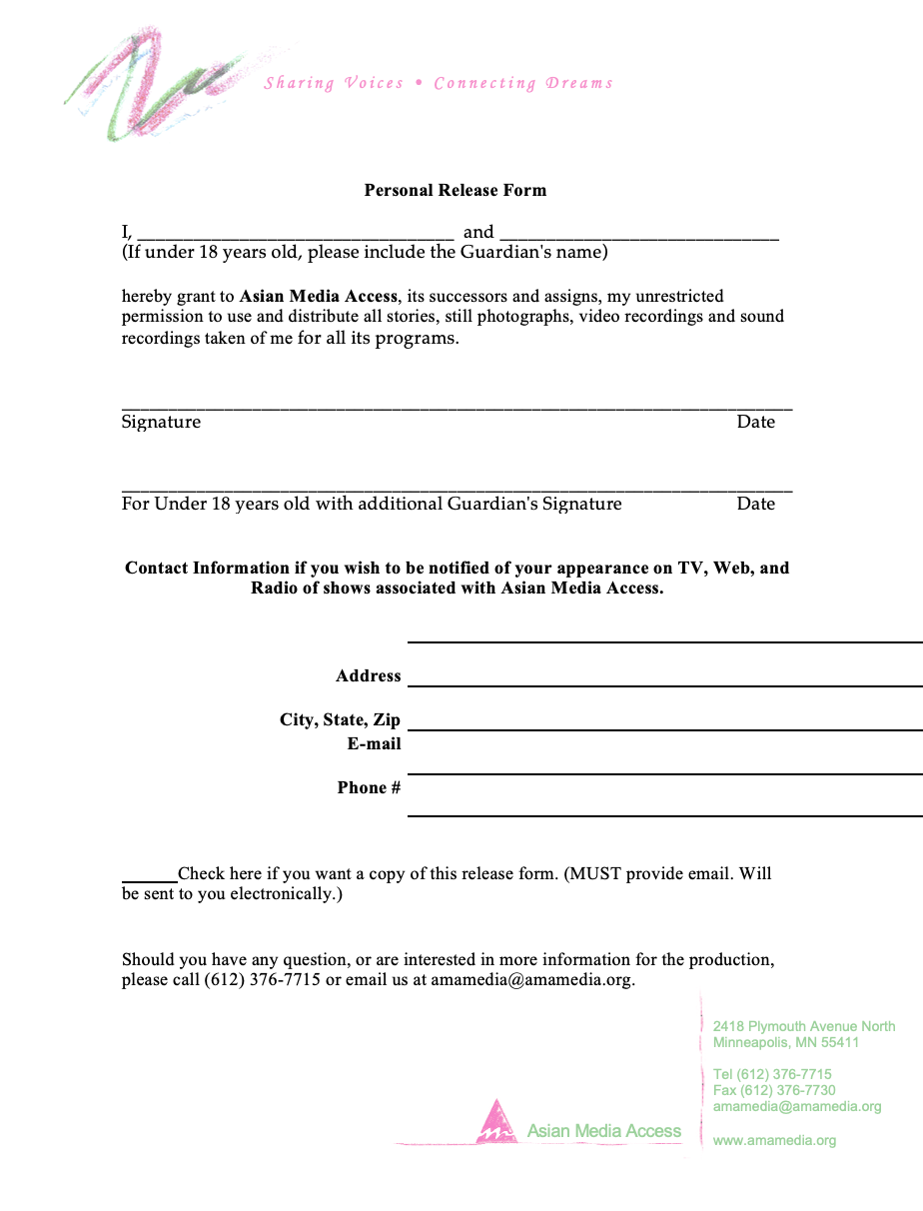
Use:
in-person celebration event, where we will take a photo of you and your certificate and occasional zoom screenshots if we have guest speakers.
The meetings are recorded for your review
Screenshot taken for attendance

Slide 21
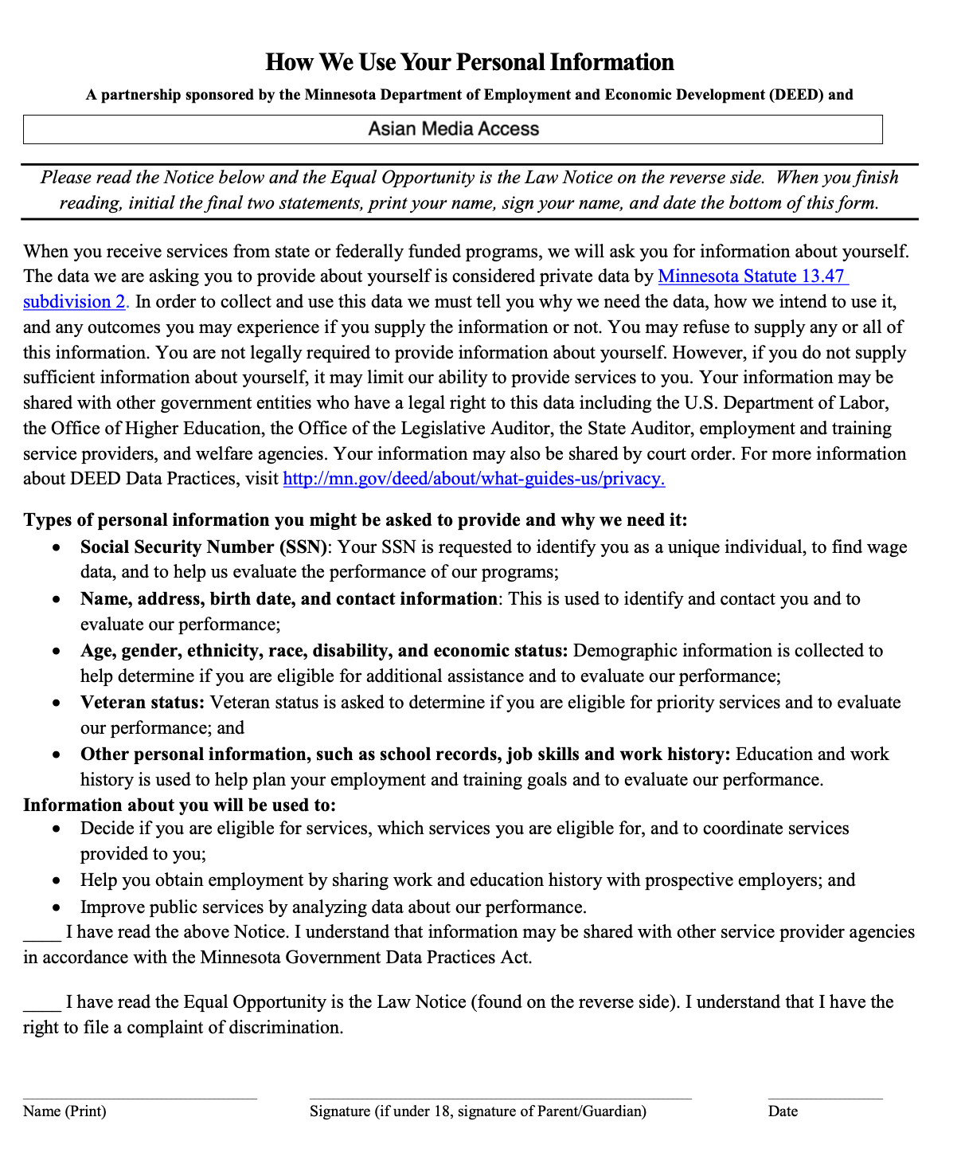
How we use your personal information: this allows us to collect your information. Only page 1 needs to be filled out
initial
initial
Print your name
Sign your name
Date:

Slide 22
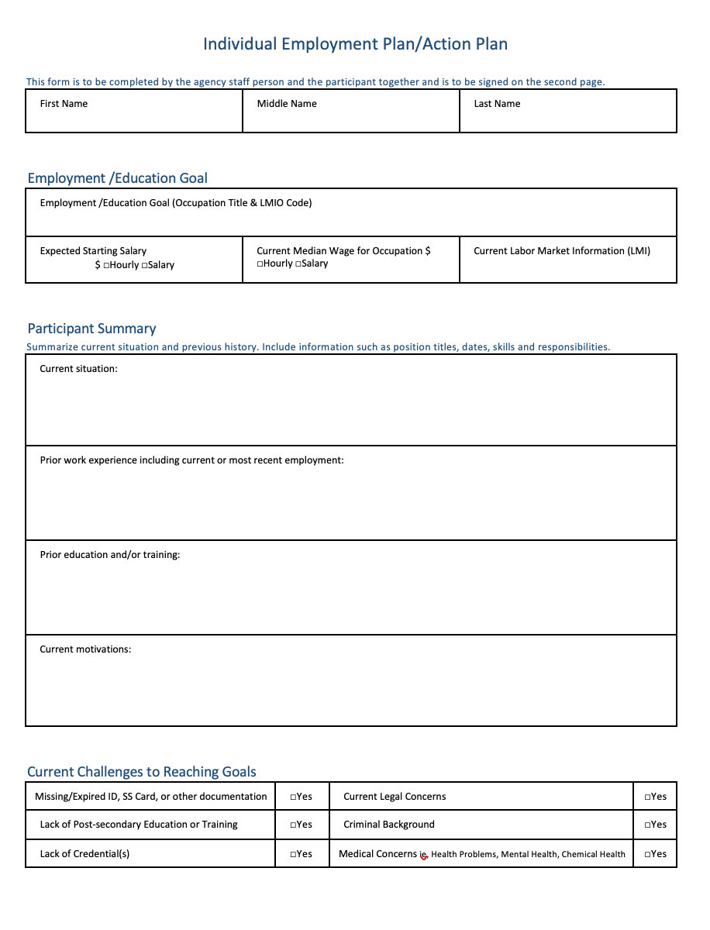
Individual Employment Plan, you will hear us call it an “IEP”.
Helps outline your goals
3 pages
Your experience in Generative AI, Digital Marketing, and Web Development

Slide 23
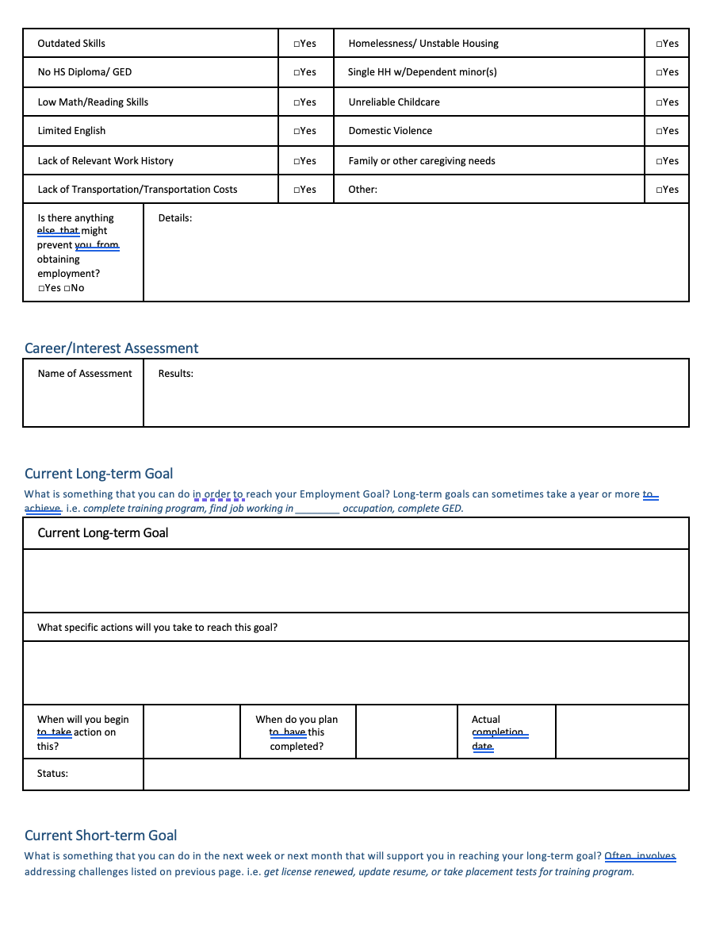

Slide 24
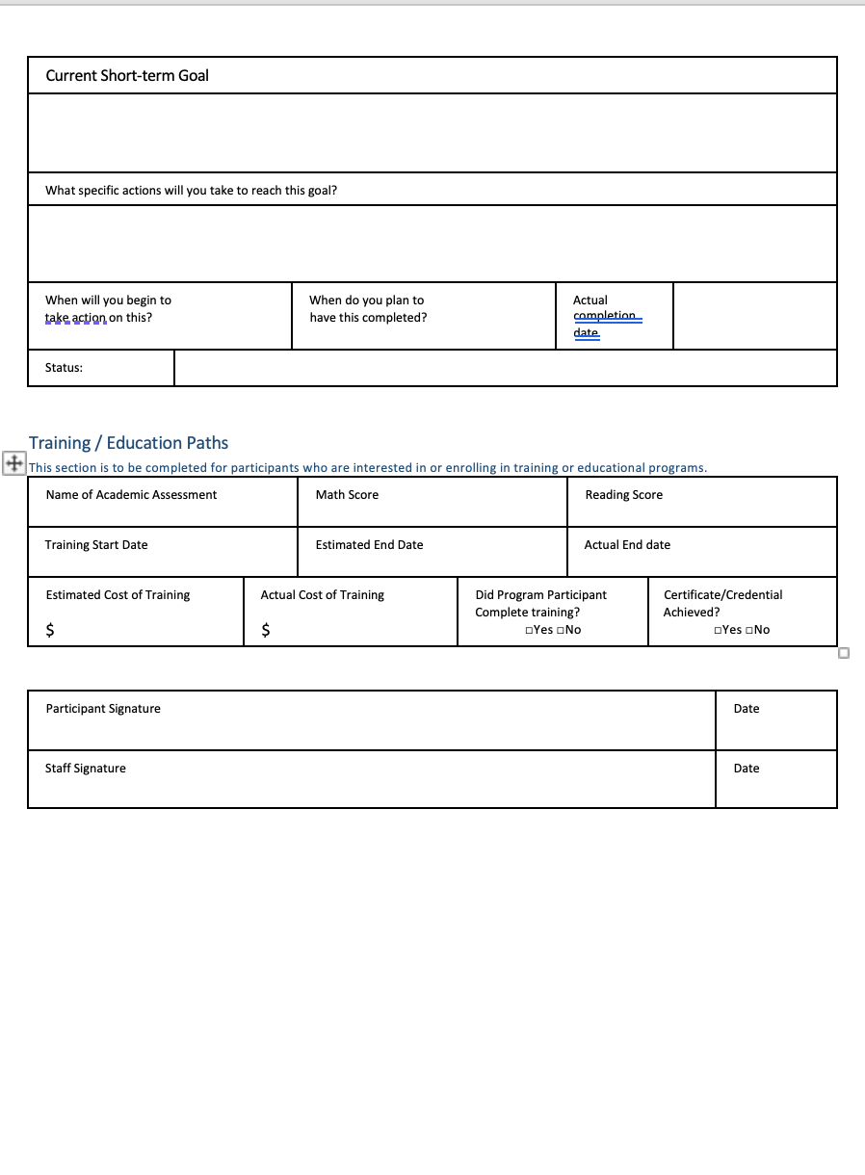

Slide 25
Sharing your paperwork and documents, please notify us which option you prefer:
Options:
Over email to Lily at lily.do@amamedia.org and/or Maya at casemanager@amamedia.org
Google Drive: https://forms.gle/4vdHyju2kj7Z2QWr5
At our Minneapolis office, 2418 Plymouth Ave. N., Minneapolis, MN 55411, Office Phone (612) 376-7715
Wednesdays, 5:00pm-9:00pm with Maya
Thursdays, 9:00am-5:00pm with Sian

Slide 26
Wonderlic Math & Reading Assessment
https://nursehub.com/courses/wonderlic-sle/lessons/introduction-13/quizzes/free-wonderlic-sle-practice-test/
For those who have less than an Associate’s degree (2 year higher education)

Slide 27
Databricks
https://www.databricks.com/learn/training/generative-ai-fundamentals-accreditation
Pre-work - This module provides all the necessary tools for your learning journey and establishes a solid foundation in AI and its applications.
This Orientation provides a comprehensive introduction to understanding of how Large Language Models work.
Generative AI, such as ChatGPT and Dolly, has undoubtedly changed the technology landscape and unlocked transformational use cases, such as creating original content, generating code and expediting customer service. And the technology's applications are growing daily. Organizations that harness this transformative technology successfully will be differentiated in the market and be leaders in the future. Get up to speed on generative AI with this free on-demand training from Databricks.
Here is how it works:
● Watch 4 short tutorial videos
● Pass the knowledge test
● Earn a badge for Generative AI Fundamentals you can share on your LinkedIn profile or résumé
Videos included in this training:
● Welcome and Introduction to the Course
● LLM Applications
● Finding Success With Generative AI
● Assessing Potential Risks and Challenges
Earn your badge today and share your accomplishment on LinkedIn or résumé.

Slide 28
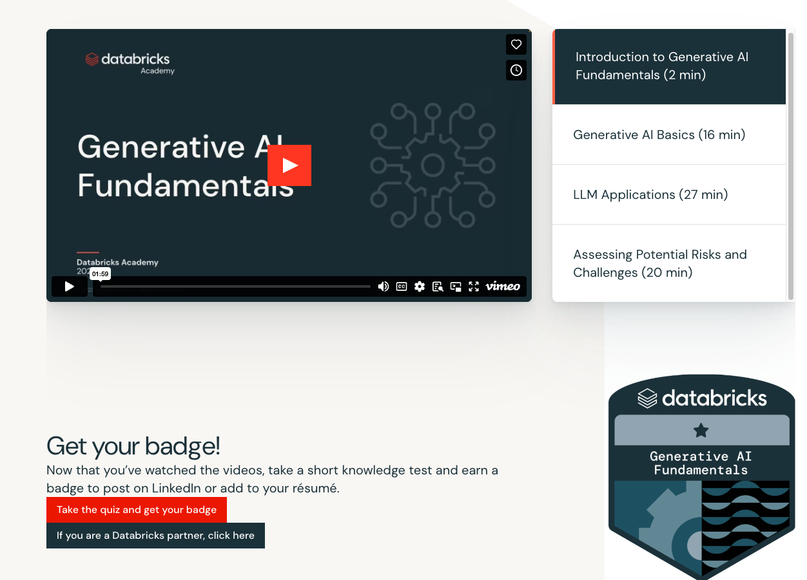

Slide 29
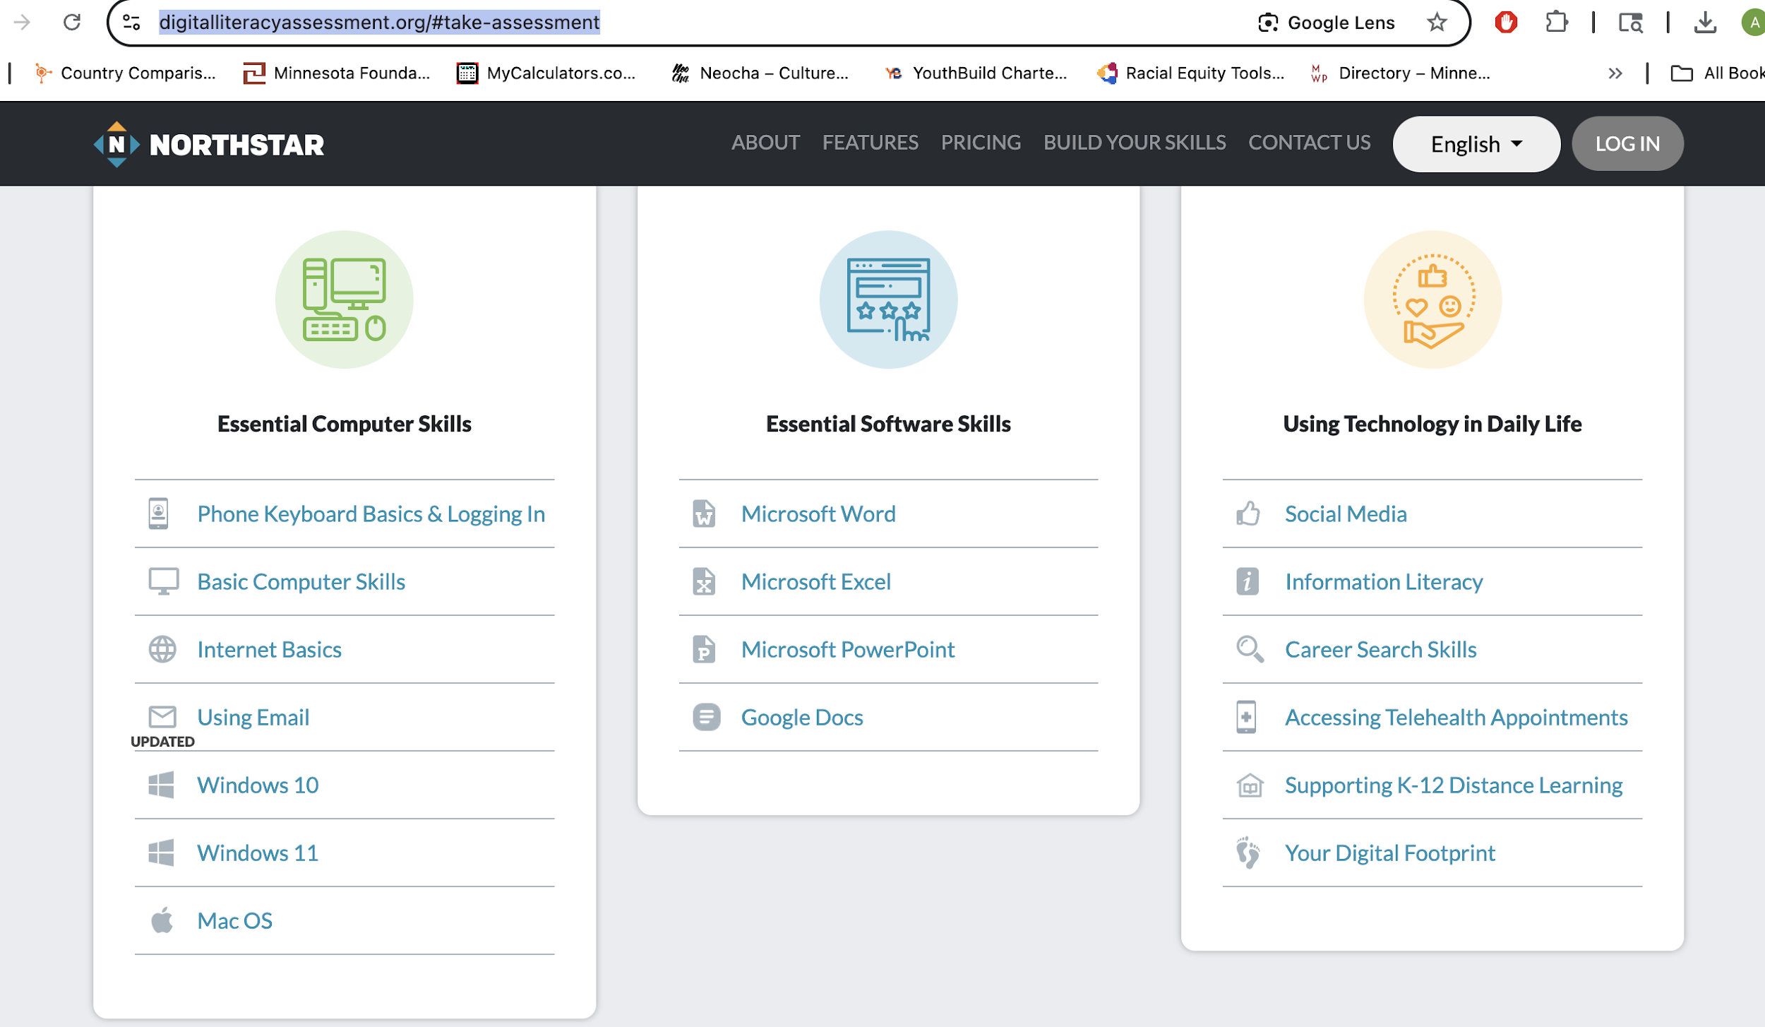
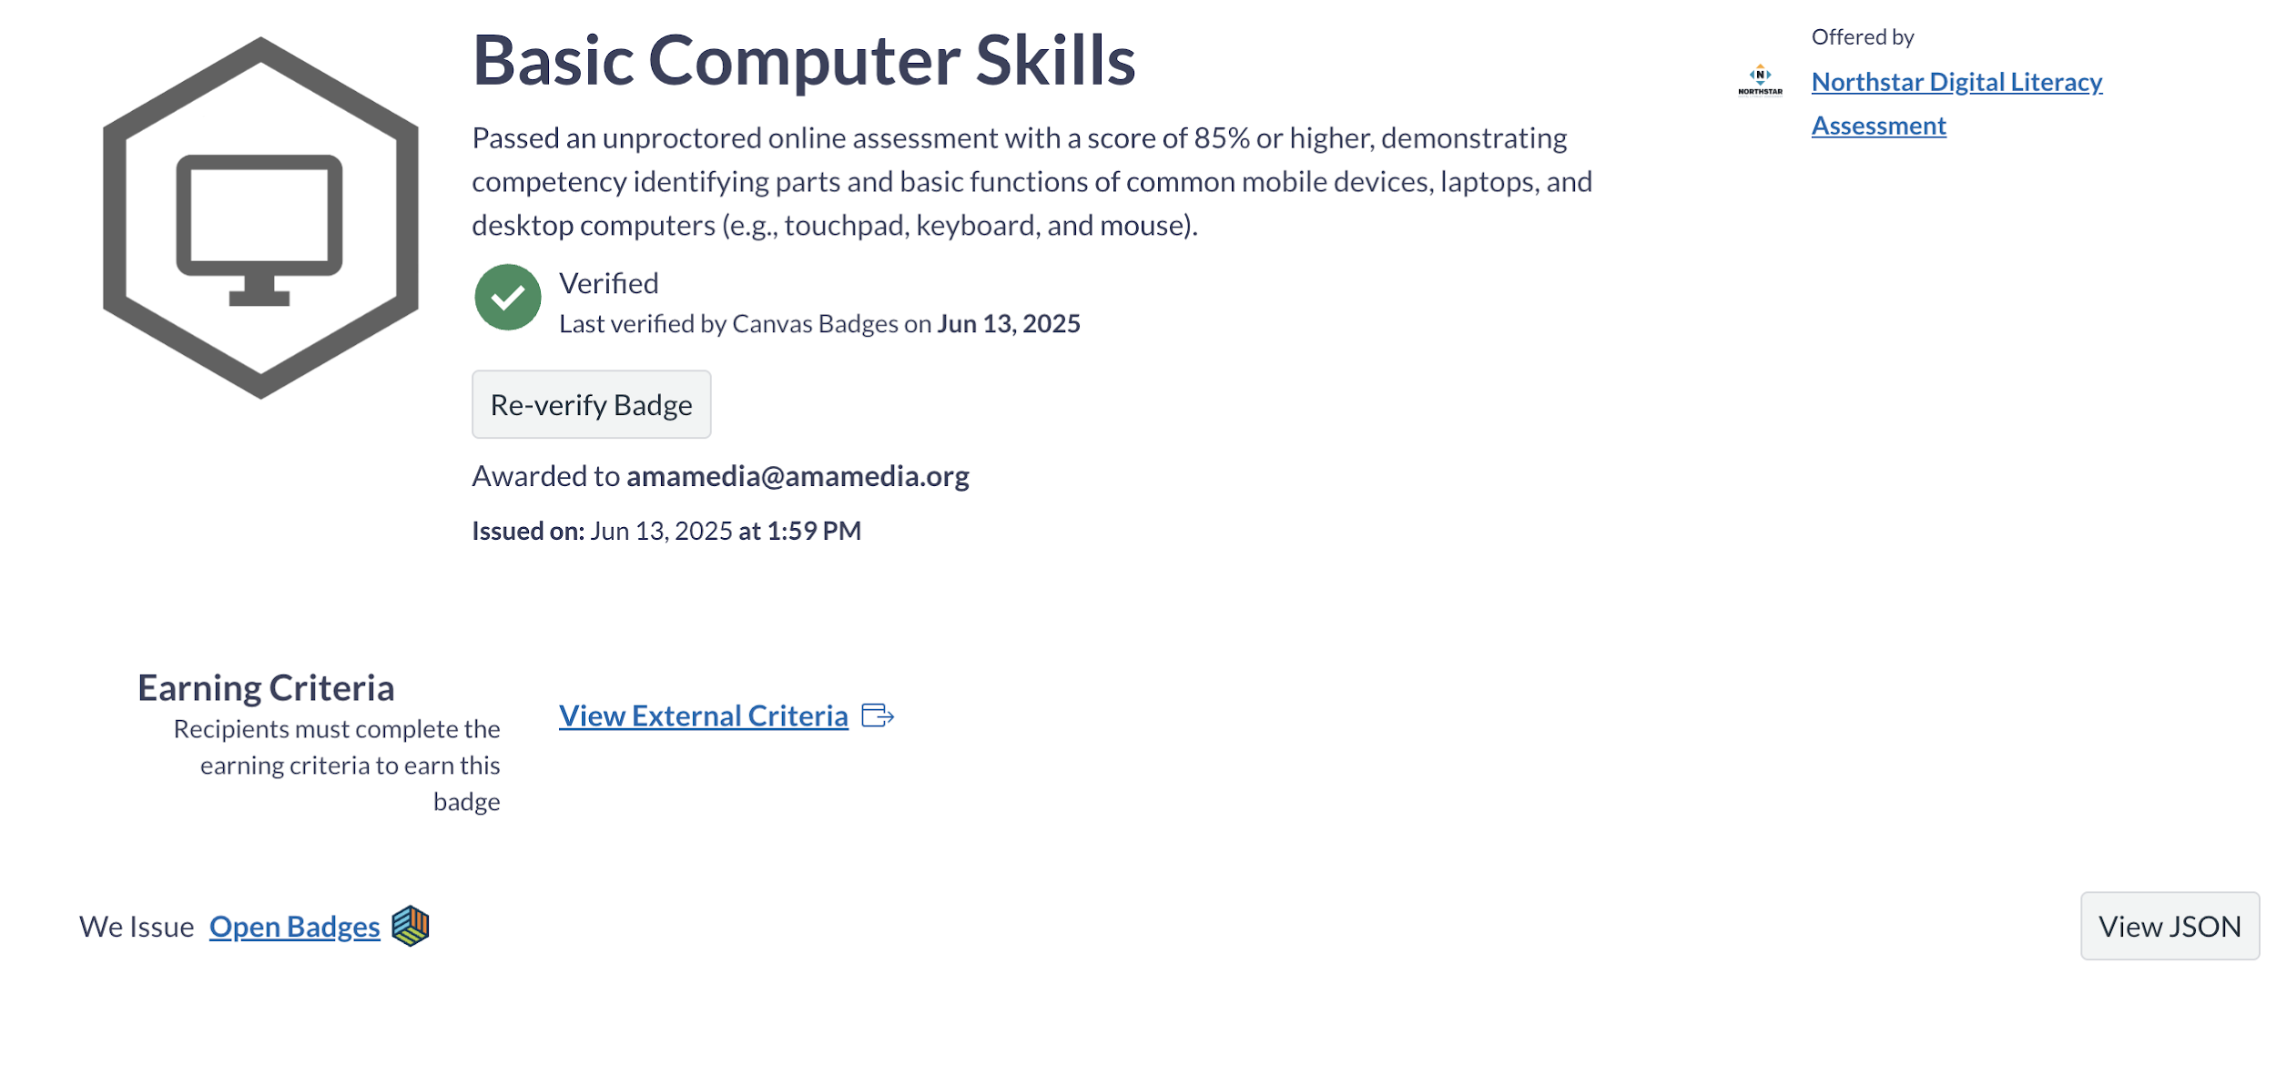
Computer Literacy
Assessment Tools
https://www.digitalliteracyassessment.org/#take-assessment
https://edu.gcfglobal.org/en/computerbasics/basic-parts-of-a-computer/1/
Badges

Slide 30
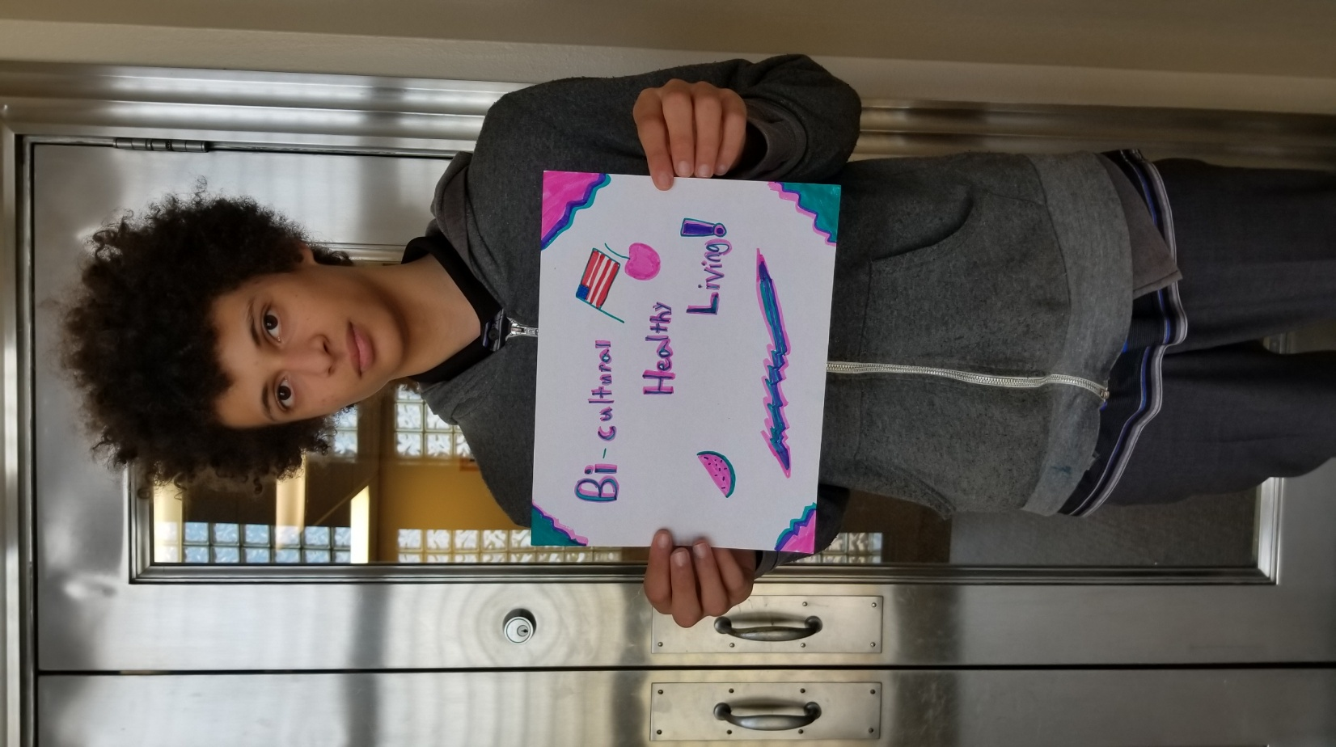
casemanager@amamedia.org
612-477-4682

Slide 31
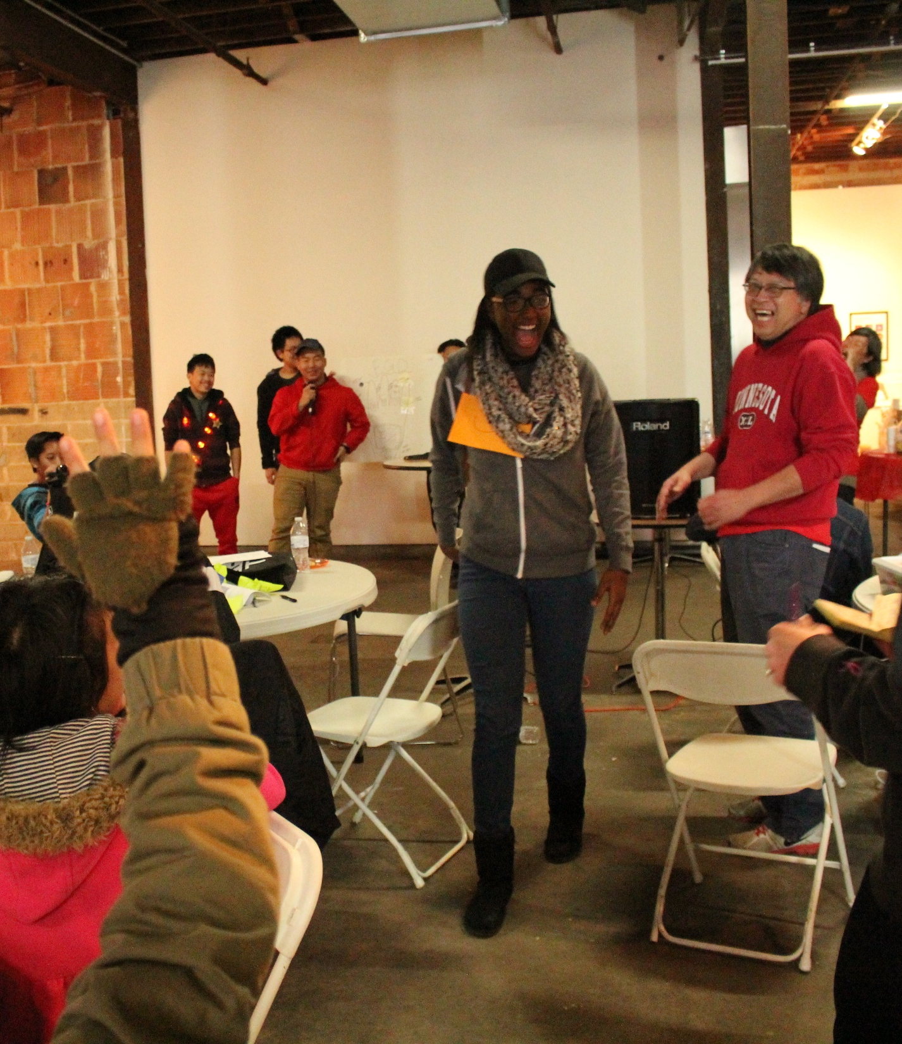
E-Magine Curriculum
Generative AIs – Writings, Images, Pod-castings, Videos
Digital Marketing – Keyword Search, and Google Analytics
Wordpress Web Design
AI platforms:
https://creator.nightcafe.studio/
http://leonardo.ai
OPEN AI
https://huggingface.colmstudio
https://lmstudio.ai
CONTENT PUBLICATION
mailchimp.com
https://www.clearscope.io
https://deepmind.google

Slide 32
Getting Started
Financial Literacy
What is AI and Why it Matters
Writing with AI - ChatGPT basics
Making pictures with AI
Simple graphic design with Canva
Making Audio and Podcast
Making Simple Videos
Telling Stories with Multiple Tools
Learning From Real Professionals
Marketing Basics with AI Help
SEO Basics (Getting Found on Google)
Social Media Management Made Simple
Google Analytics and Ads (Simplified)
Advanced Social Media Strategy
Website Basics for Beginners
WordPress for Beginners
WordPress Customization Made Easy
Simple Online Store Setup
Future of the Internet (Web3 Basics)
Weekly Lesson Plans

Slide 33
Introductions to Computer Basics
Basic Computer Skills
File organization on your computer (30 mins)
Taking screenshots (15 mins)
Basic internet browsing tips (15 mins)

