Slide 1
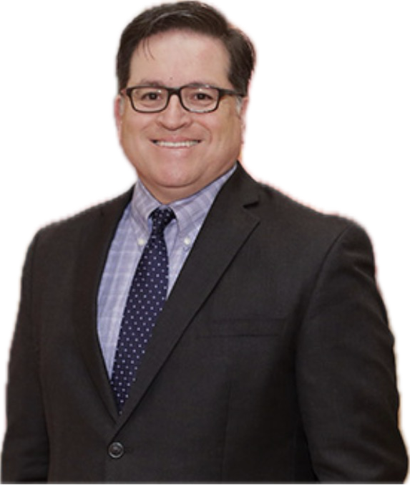

Your Rights & Resources
Hao Nguyen Attorney
Jorge Saavedra Attorney

Slide 2
Your Rights
4th Amendment: Right to privacy. ICE and Police CANNOT enter a person’s home without permission or a warrant signed by a judge.
5th Amendment: Right to remain silent. You can refuse to sign documents or provide documents.
6th Amendment: Right to seek legal counsel. You have the right to be advised on criminal and immigration consequences.

Slide 3
4th Amendment
Don’t open the door.
Don’t give permission to enter.
Ask for proof of warrant.
If you rent –you have the authority over your home. Landlord cannot consent to a search of your home.

Slide 4
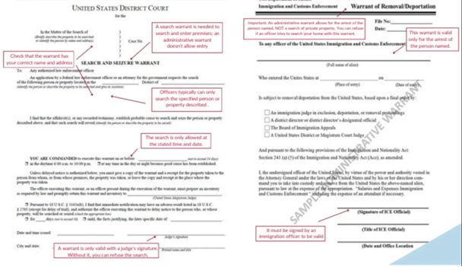
Warrant- Court, Judge’s Signature, correct name and spelling of individual, and correct address.

Slide 5
If I encounter ICE what can I do?
At Risk Individuals (supreme court ruled that people can be stopped and questioned based on skin color and accent):
Should have a copy of your paperwork on you (never provide false documents).
A trusted person who is less at risk should know where your originals are safely hidden.
Right to remain silent.
Right to an attorney. Memorize 24/7 number or write on your body.
For example the National Lawyers (612) 444-2654
Right to shelter in your home or a private space that you are welcomed.
Places that aren’t private: Rec Centers, places public can enter.
Don’t open the door. Review Warrant through the window.

Slide 6
If I encounter ICE what can I do?
Less at Risk Individuals
Do not obstruct.
You may be a constitutional observer- legally recognized but must not obstruct, stay 10 feet back and don’t engage.
Any documentation written or video that you take should be shared with that person’s family or with IDN.

Slide 7
Constitutional Observer
S.A.L.U.T.E.
When documenting, practice S.A.L.U.T.E.
Size: How many people and/or vehicles do you see?
Activity: What, specifically, are they doing that’s suspicious?
Location: What address, cross streets, or landmarks
Uniform: What are they wearing, whether it’s fatigues, nondescript
civilian clothes, or something else entirely?
Time: What date and time did you observe them?
Equipment: What guns, weapons, or devices do they appear to be
carrying?

Slide 8
What about Protesting
Let’s chat:
Risks!
Plan!
Safety!

Slide 9
Resources
This document from the Immigrant Law Center of MN is short but holds a lot of important information—including creating a safety plan and what documents to carry.
MN Family Deportation Preparedness Manual: topics include Children, Delegating Parental Authority, Housing Issues, Debt, Cars, and more.
Immigrant Law Center of Minnesota Know Your Rights Resources: this is a comprehensive resource list to help individuals know their rights, prepare for the future, and meet basic needs.
MN Immigration Legal Services Hub Initiative: is a group of organizations working together to increase access to immigration legal services in Minnesota. The Hub puts on regular legal clinics in Minnesota. At the clinics, people can talk to immigration lawyers about their immigration cases for free. There are opportunities statewide.

Slide 10
Ready Now! App
Key features of the app include:
One-click emergency alerts via SMS to pre-selected contacts
Personalized emergency plans for childcare, medical needs, legal support, and more
Option to share key information with National Immigration Legal Response Alliance (NILRA) if faced with arrest, a national network of pro bono immigration attorneys
Currently available in six languages: English, Spanish, Korean, Mandarin, Haitian Kreyol, and French

