Slide 1

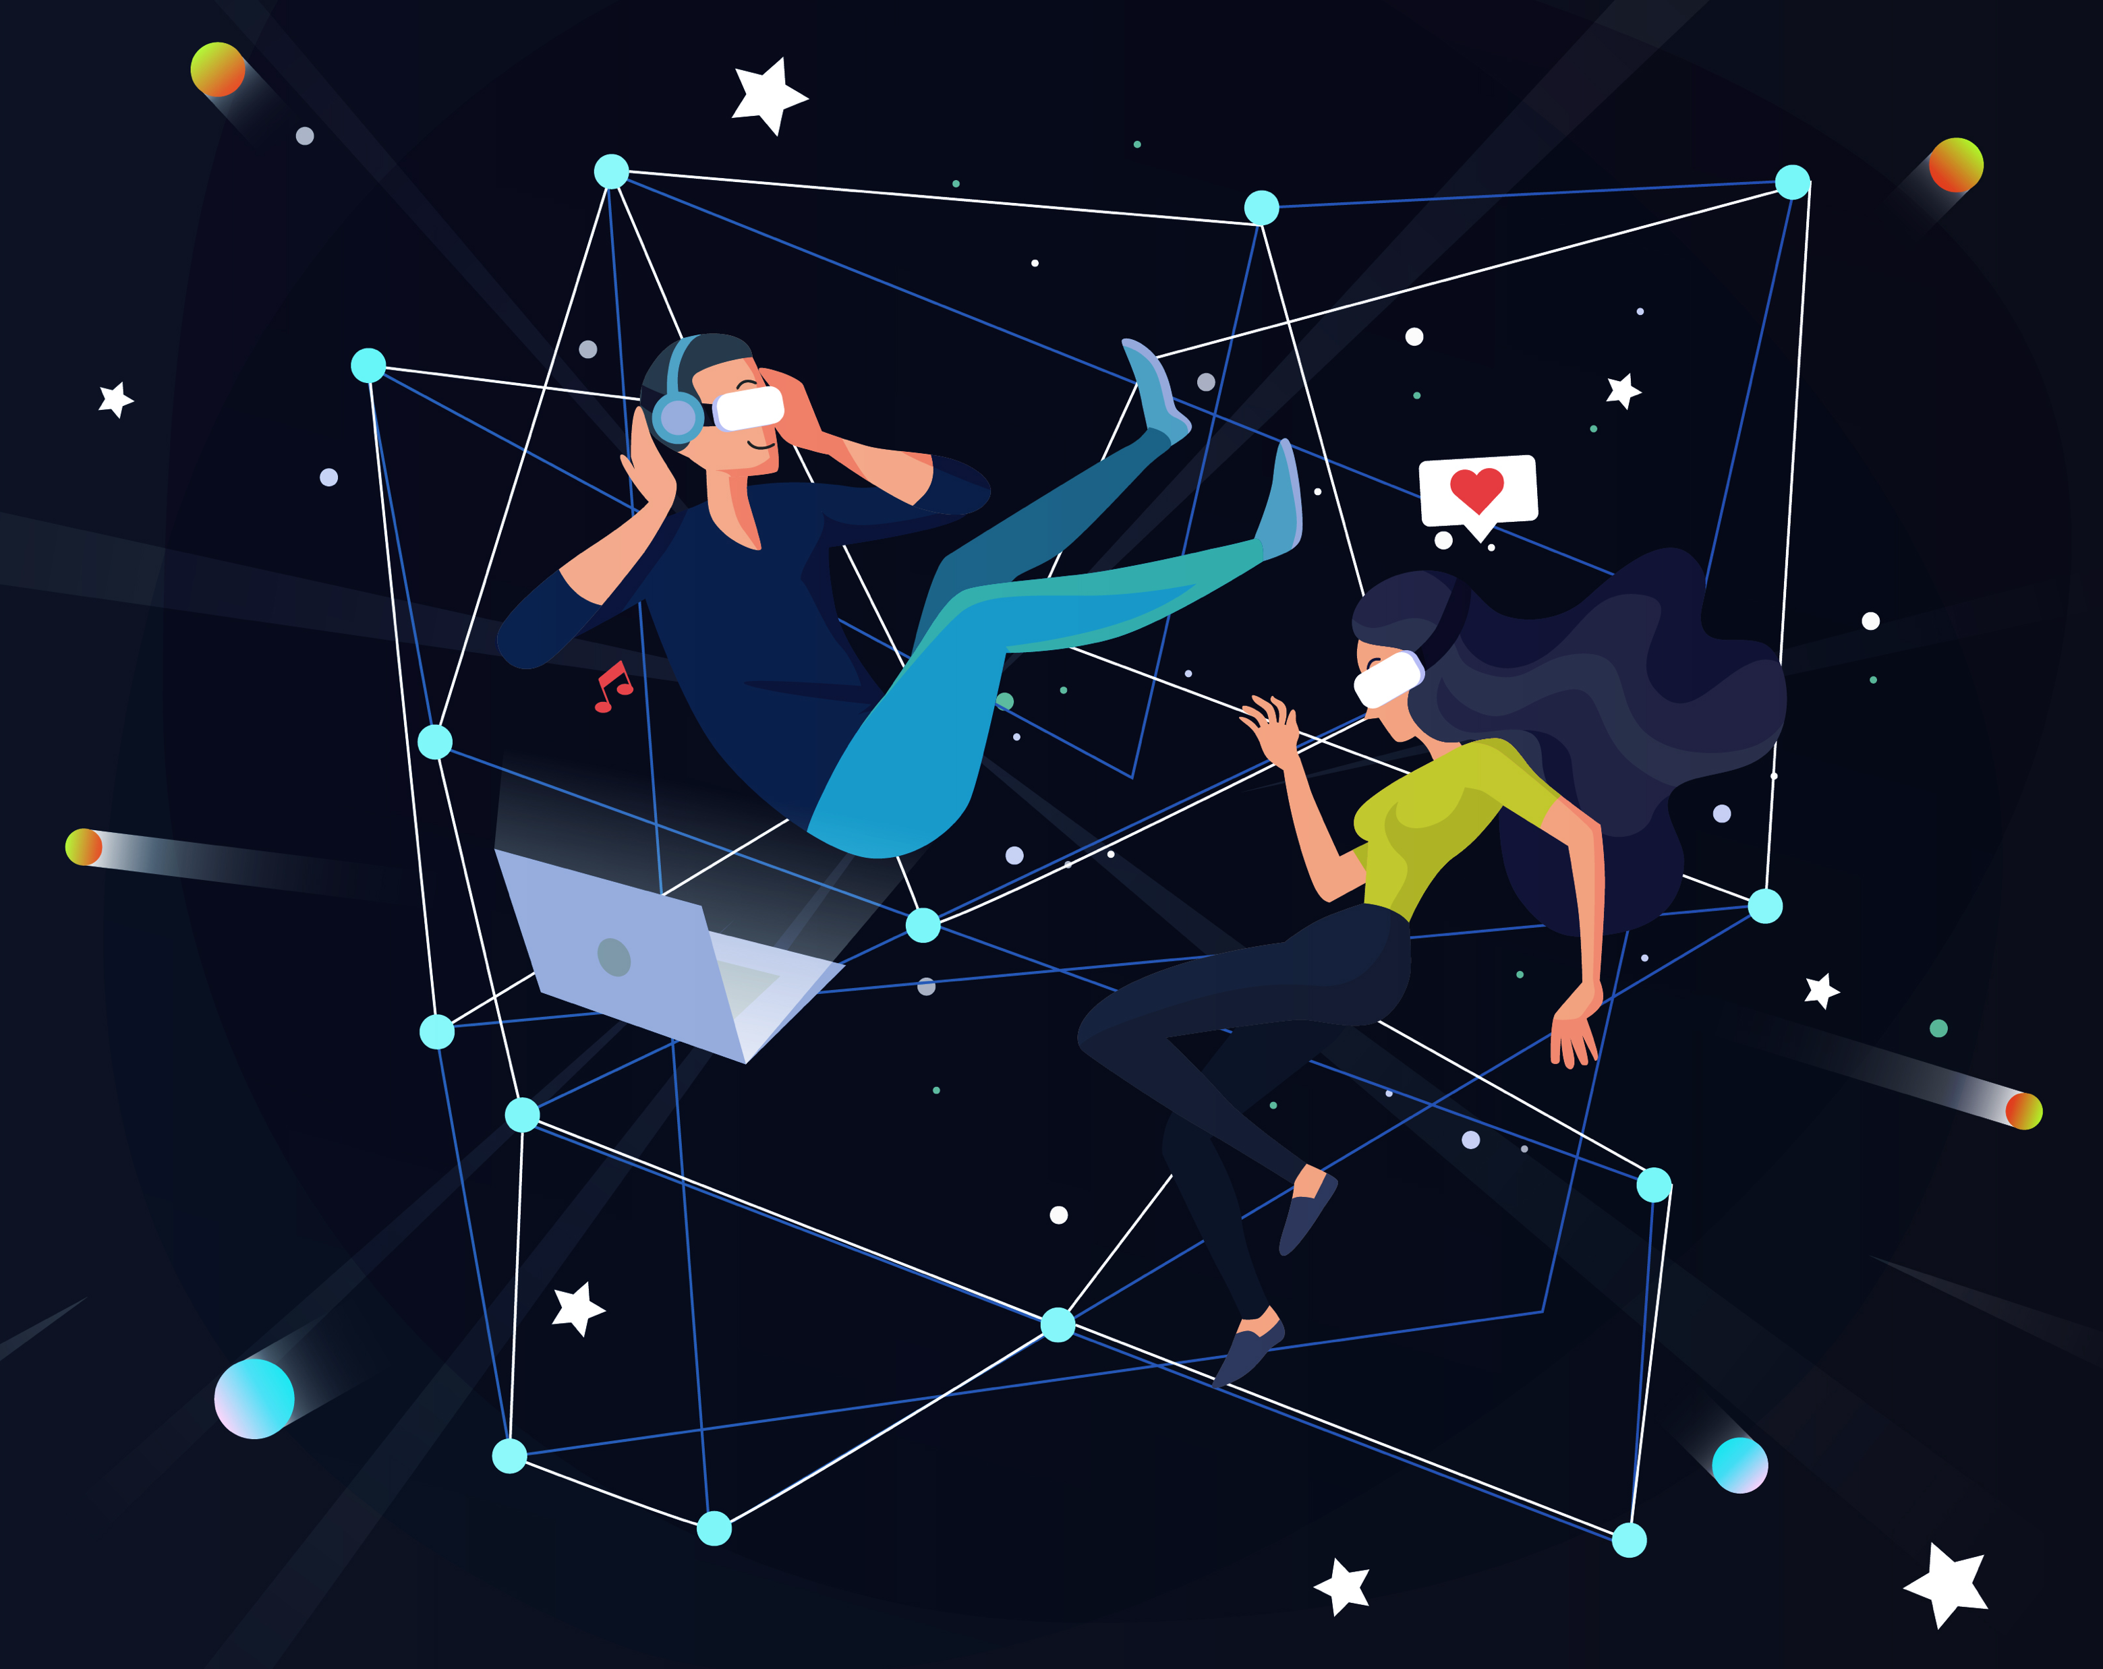



e-Magine! Initiative
Advanced Cohort - Every Sat 9am – 3pm

Slide 2
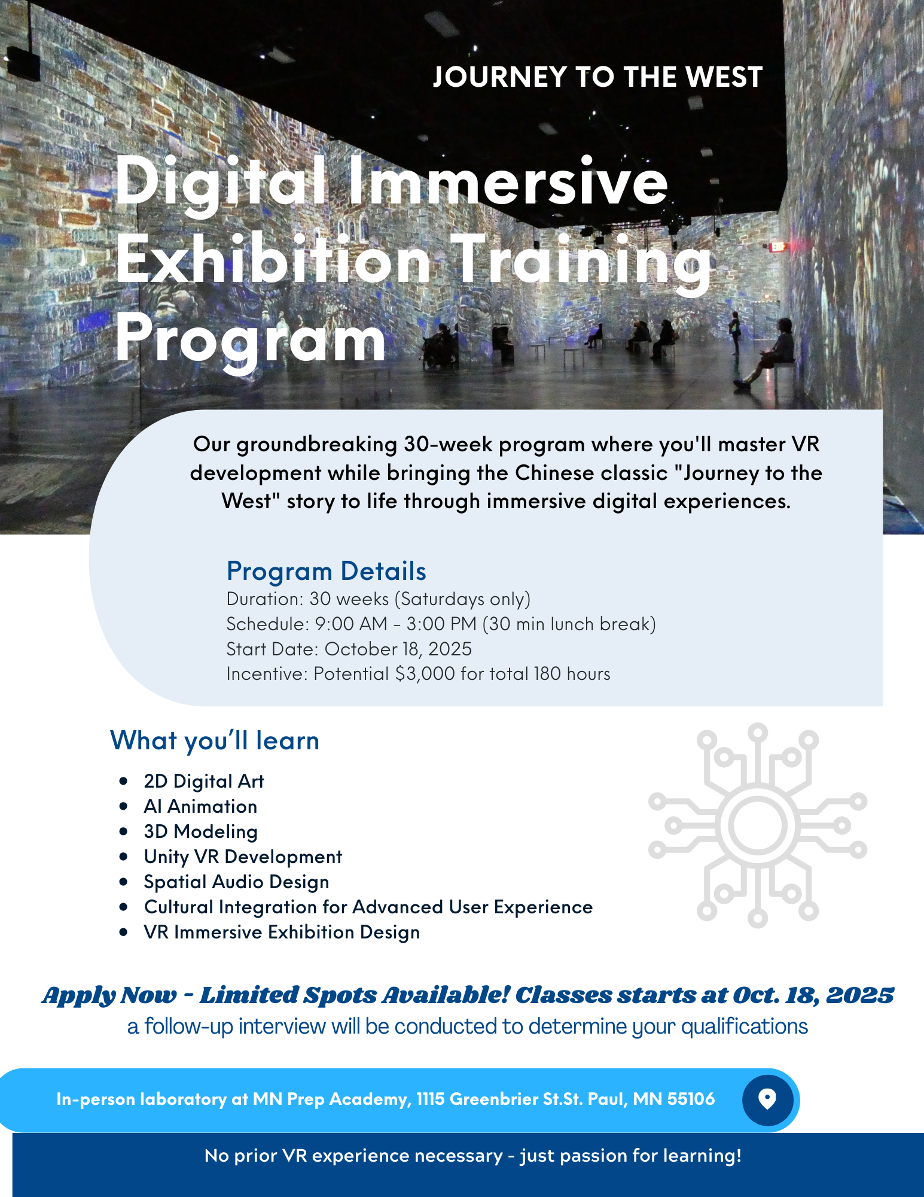

Slide 3
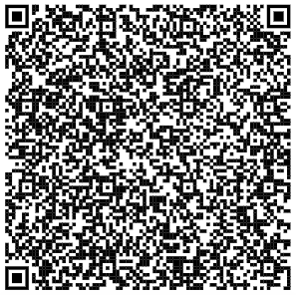
Introduction of Asian Media Access
How We Started
History Of Us
August 1992, Asian Media Access, Inc. (AMA) is a comprehensive, multimedia-based, community advocacy agency. AMA is dedicated to using multimedia arts and technology as tools for social betterment. AMA recognizes that multimedia and technology are essential for advocacy, communication and education, in order to mobilize communities, and young people; to engage in understanding and communicating of Pan Asian issues; and to arrive at a participatory decision-making process for a safe, supportive environment for all.
Asian Media Access
Who We Are
We believe the multimedia arts and information technology empower all of us with critical thinking and promote good citizenship—especially important as we prepare young people to be tomorrow’s leaders. Our thought-provoking multimedia education, productions, exhibitions, stage performances, resourceful educational products and youth programs encourage deep reflection, challenge previous assumptions, provide solace, and allow participants to develop their own way of connection in timeless works of creation, communication and community building.
Subscribe to our eNewsletter and Ball e-magazine

Slide 4
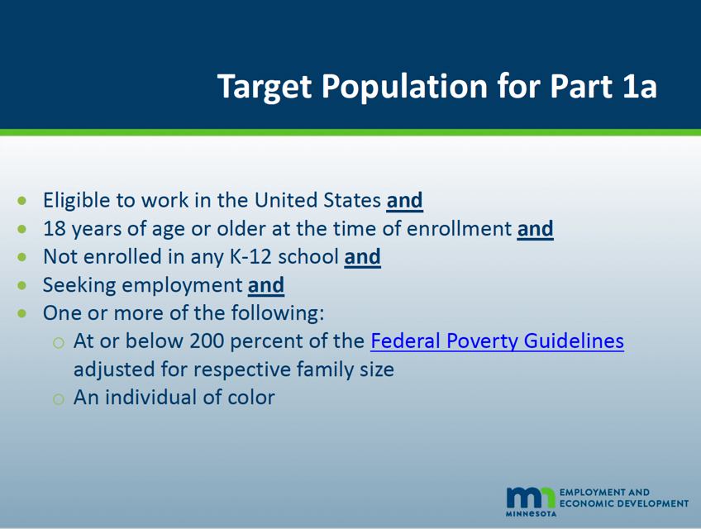
e-Magine
Eligibility requirements

Slide 5
Today’s Schedule
9:00am – 10:00am * Introductions and Paper Works
10:00am – 11:15am * AMA Projects and Immersive Exhibition Project
11:15am – Noon * Instructors’ Presentation
Noon – 12:30pm * Lunch (provided by the Frogtown/Rondo Black Church Alliance)
12:30pm - 2:00pm * AI Video Testing and Trainees’ Showcase
2:00pm – 5:00pm * Immersive Exhibition at Royalston Square, 501 Royalston Ave.,
Minneapolis, 55405

Slide 6
Training Details
Duration: 30 weeks (Saturdays only)
Schedule: 9:00 AM - 3:00 PM (30 min lunch break)
Start Date: October 25, 2025
Incentive: Potential $3,000 for total 180 hours – every 10 weeks with 80% attendance rate will earn $1,000, and if Trainees not be able to catch up, we will suggest to end the participation every 10 weeks.
Certificates
Earning 3 Certificates from the Crown College:
1) “Generative AI and Digital Marketing Specialist” skills with 80% attendance rate, and all lab assignments completed, in order to earn both certificates and incentives.
2) “Augmented Reality and Virtual Reality Specialist” skills with 80% attendance rate, and all lab assignments completed, in order to earn both certificates and incentives.
3) “Digital Experience (UX) Specialist” skills with 80% attendance rate, and all lab assignments completed, in order to earn both certificates and incentives.

Slide 7
What Technical Skills you will gain:
2D Digital Art/AI Video Animation
3D Modeling/Unity VR Development
Spatial Audio Design
Cultural Integration for Advanced User Experience
VR Immersive Exhibition Design
Projection Mapping for a 3D Theme Park – “Journey to the West.”

Slide 8
“Journey to the West” Immersive Exhibition
Chinese Classic Novel - A mischievous monkey king joins a Buddhist monk on an epic pilgrimage to India, battling demons and learning virtues along the way.
In the Journey, they battling the White Bone Demon's three disguises, surviving the Flaming Mountains with Princess Iron Fan's banana leaf fan, escaping the Spider Web Cave's seductive spider demons, and overcoming 81 tribulations before finally achieving enlightenment and Buddhahood.
Why this Story?

Slide 9
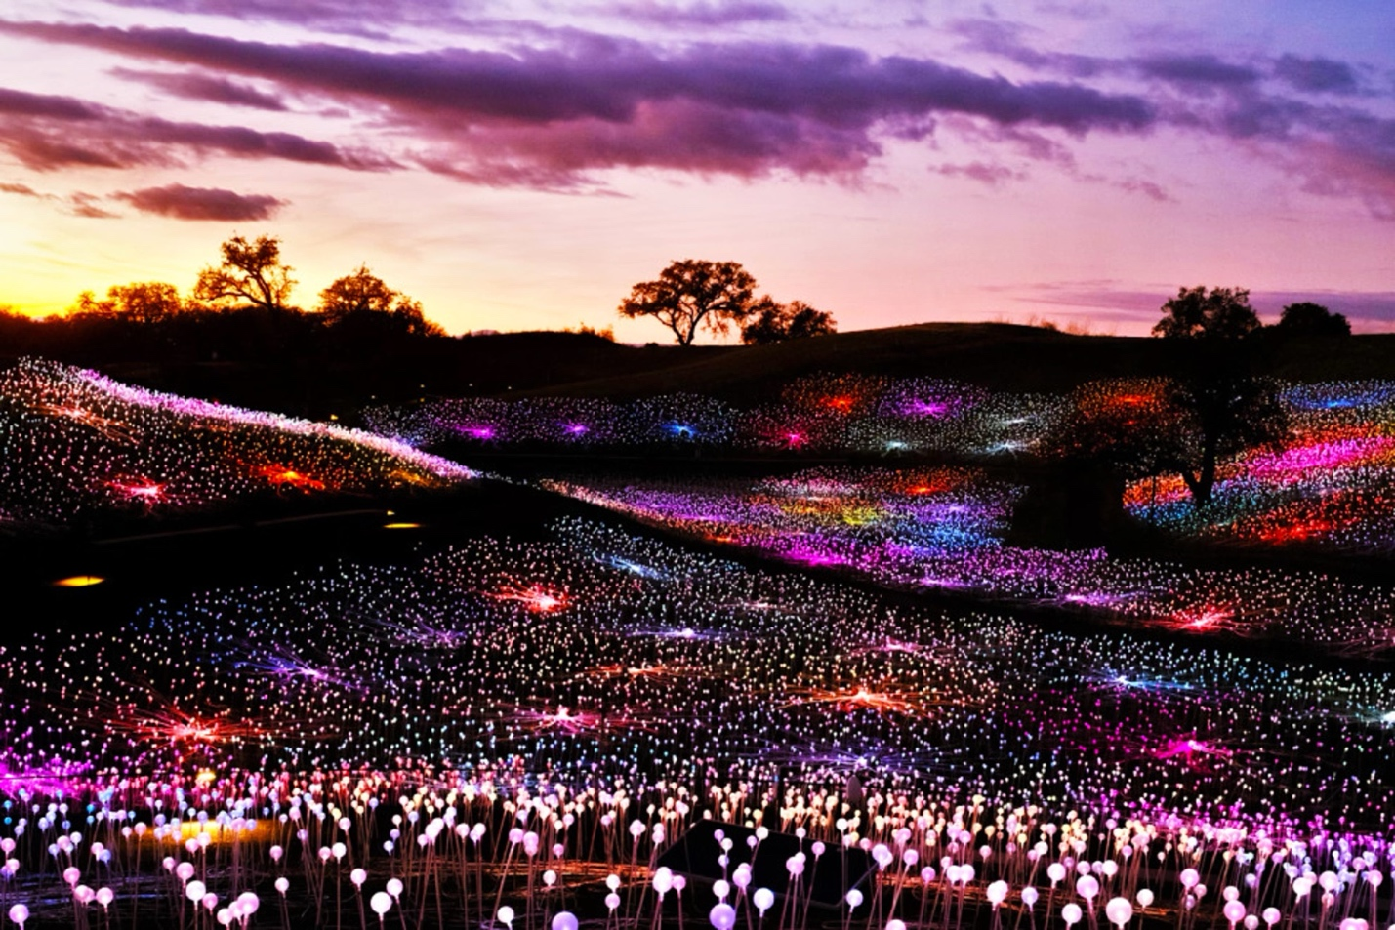
No. 10: Sensorio
Paso Robles, California
British artist Bruce Munro created the Sensorio "Field of Light" outdoor installation back in 2019, a nighttime field of bioluminescent flowers in the Central California wine country of Paso Robles. An immediate and huge success, this exhibition has grown to incorporate additional light creations like "Fireflies," "Gone Fishing," and "Light Towers," as well as exhibits by new artists, such as "DIMENSIONS" by HYBYCOZO. Seeing the Milky Way in the area's usually-clear night sky is often part of the transcendental experience, all of which pairs well with a glass of excellent wine.

Slide 10
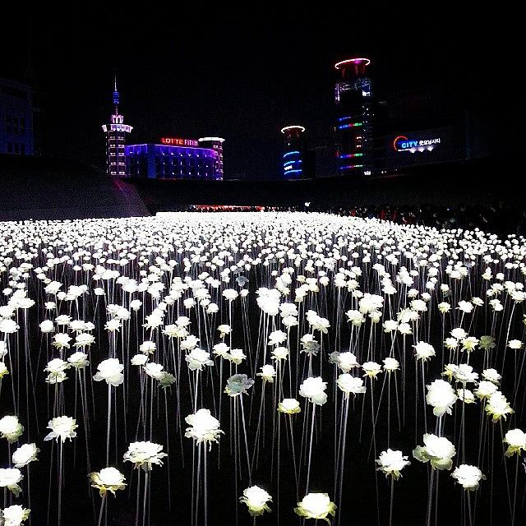

Slide 11
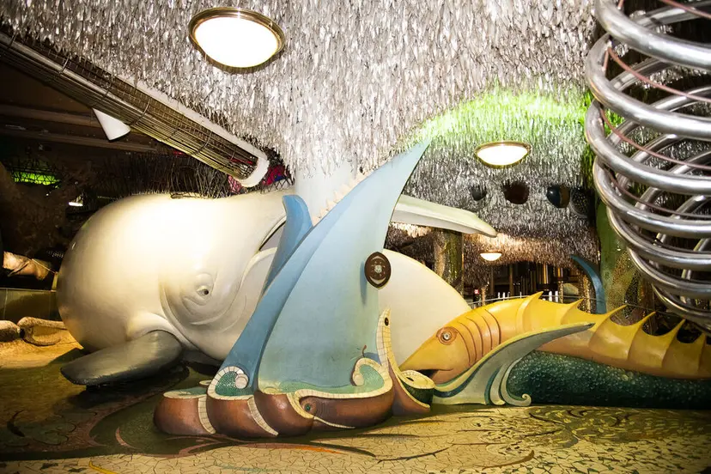
Photo courtesy of City Museum
No. 9: City Museum
St. Louis, Missouri
City Museum in St. Louis, Missouri, is home to a 10-story spiral slide, one of the world's largest jungle gyms, and a rooftop garden that offers amazing city views. Some 20 artists created the large-scale features of this interactive museum well before the term 'immersive art' became a thing.

Slide 12
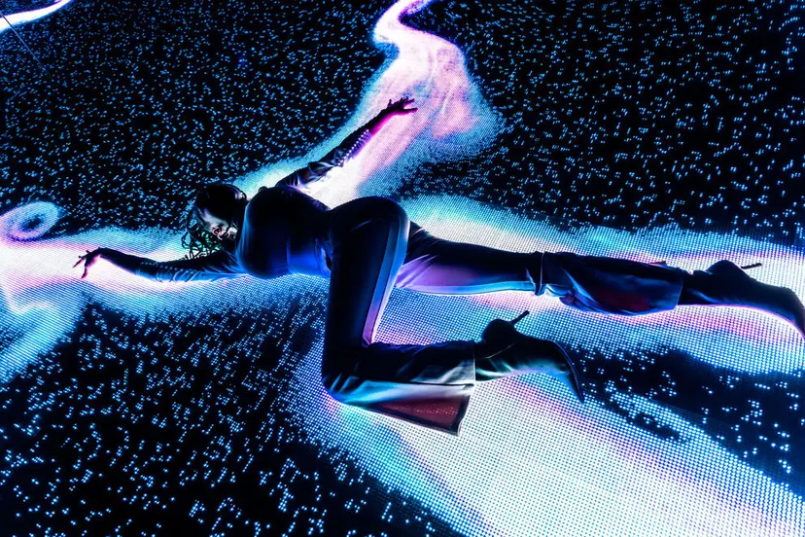
No. 8: WNDR Museum
Multiple locations
The WNDR Museum hosts immersive art and technology installations by artists, studios, and collectives from around the globe. The experience, which has locations in Chicago, San Diego, and Boston, engages multiple senses and seeks to inspire wonder, creativity, and curiosity.

Slide 13
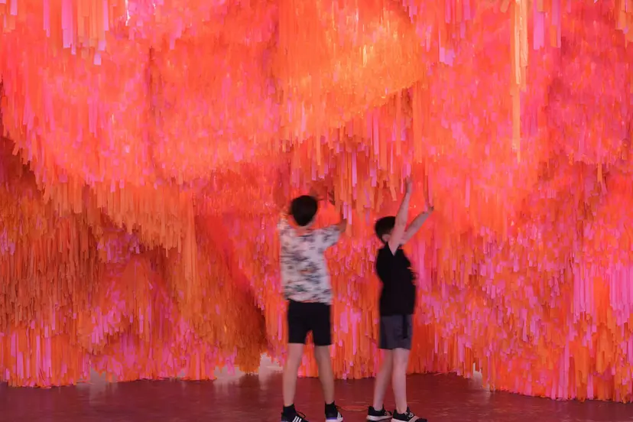
No. 7: Wonderspaces
Multiple locations
As an interactive and immersive art show, Wonderspaces aims to empower people to connect with art and each other. Wonderspaces collaborates with artists, arts institutions, cultural organizations, schools, and businesses to create exhibitions in places that aren’t traditionally created to display art, serving those who might not otherwise seek art. Wonderspaces can be found in multiple cities such as Scottsdale and Austin, and partnering with cultural organizations, festivals, and fairs across North America.

Slide 14
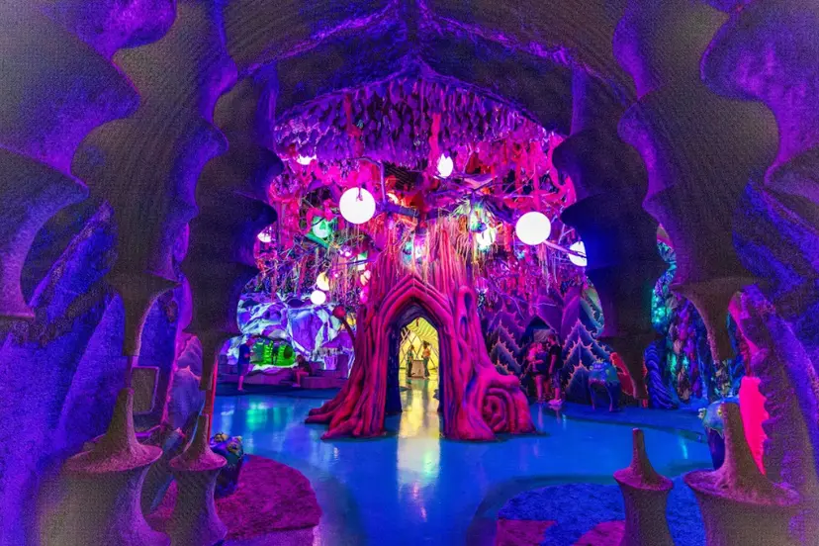
No. 6: Otherworld
Multiple locations
Otherworld, an immersive art experience in Columbus, Ohio, and Philadelphia, Pennsylvania, offers dozens of rooms of interactive art, secret passageways, and mixed reality playgrounds. Visitors can enjoy eye-catching visuals and dazzling storytelling as they make their way through the spaces.

Slide 15
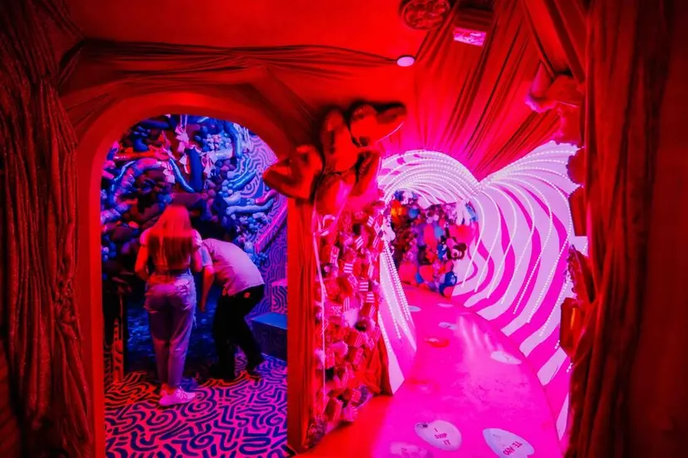
No. 5: Factory Obscura
Oklahoma City, Oklahoma
This art collective in Oklahoma City crafts immersive experiences that “awaken wonder, build community, and make the world better.” The 6,000-square-foot space houses rotating installations. Mix-Tape, the current experience, took nearly a year to design and install by a team of some 30 artists.

Slide 16
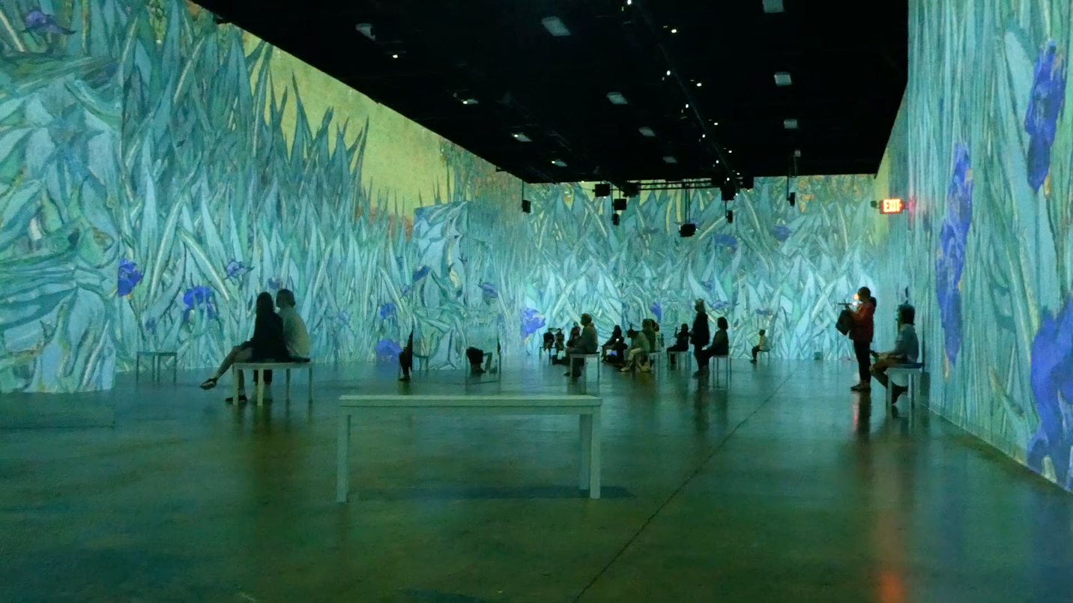
No. 4: Van Gogh Exhibition: The Immersive Experience
Multiple locations
Since its inception in 2008, Van Gogh: The Immersive Experience has captured the world's imagination. Large exhibition rooms are filled with 360-degree, floor-to-ceiling projections of Van Gogh's famous works, and accompanying sound and virtual-reality headsets are available for those who desire to be more deeply submerged into the experience. This popular installation travels regularly throughout the globe, so if it comes to a city near you, don't miss it!

Slide 17
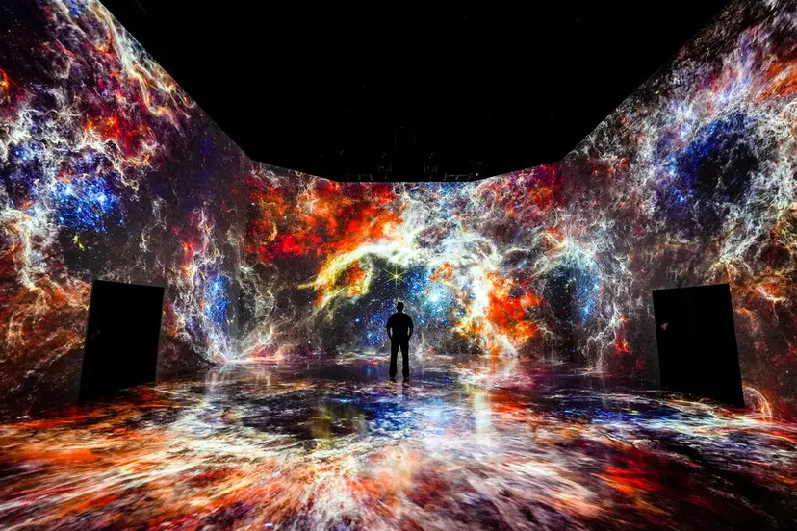
No. 3: ARTECHOUSE
Multiple locations
With shows in big cities like Washington, D.C., New York City, and Houston, ARTECHOUSE creates experiences that play at the intersection of art, science, and technology. Visitors are encouraged to utilize an app that adds another layer to the experience. The app can also be used by those who can’t attend in-person exhibits and would still like to enjoy their innovative art.

Slide 18
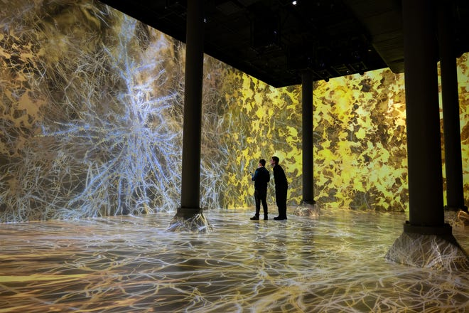

Slide 19
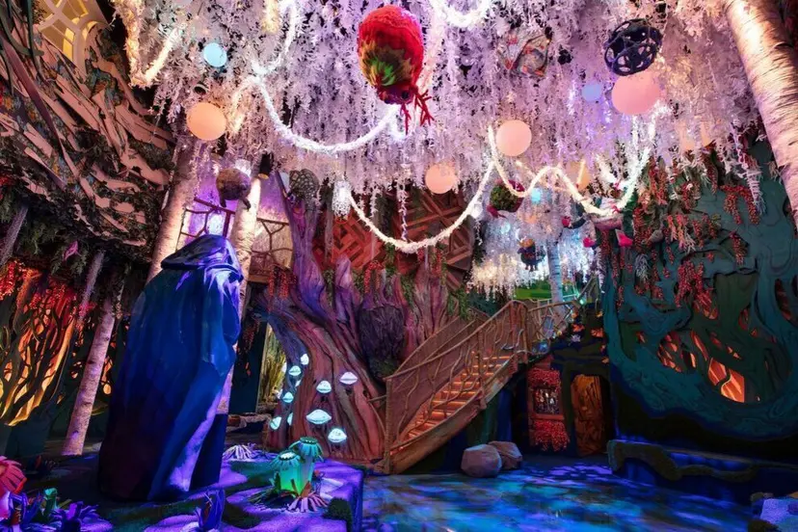
No. 2: The Real Unreal
Grapevine, Texas
A part of the Meow Wolf universe, The Real Unreal follows an ordinary family that faces extraordinary circumstances. During this adventure game, this interactive artscape will challenge your imagination as you seek clues to solve the mystery of the disappearance of the protagonist, 10-year-old Jared.

Slide 20
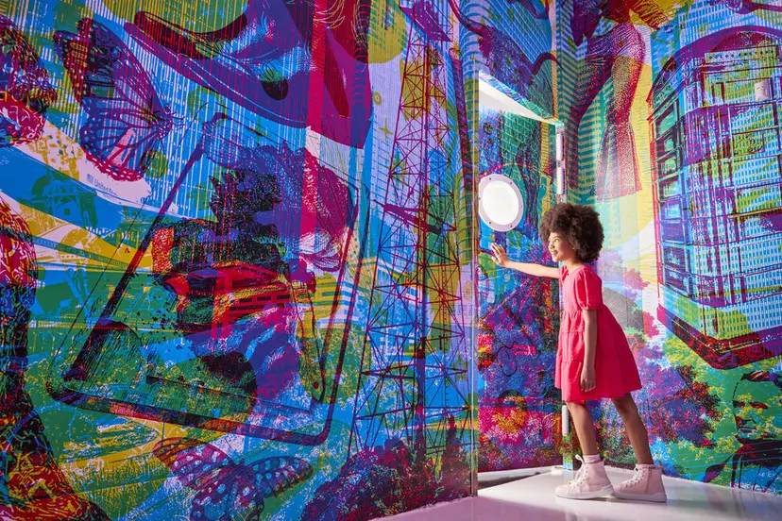
No. 1: Color Factory
Multiple locations
Become one with color at the Color Factory, where you can participate in more than a dozen immersive art exhibits. With locations in Chicago, Houston, and New York City, visitors can enjoy engaging their senses and indulging in play. You even get sweet treats, city keepsakes, and digital images throughout your journey.

Slide 21
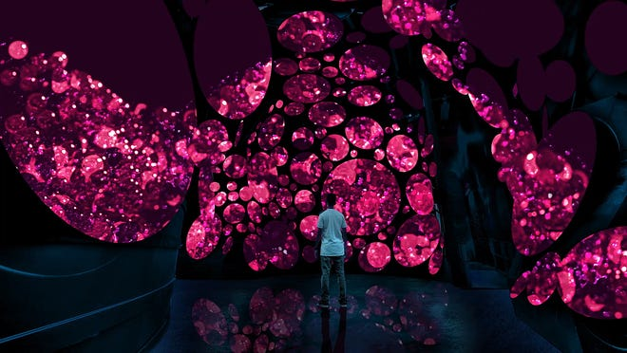
Seismique - Houston, Texas. Visitors to Seismique in Houston can explore more than 40,000 square feet of immersive art – the collaborative work of more than 30 artists. The west side “museum” has some 40 rooms, including a rain room and an all-ages jungle gym, meant to be explored in an open-form way.

Slide 22
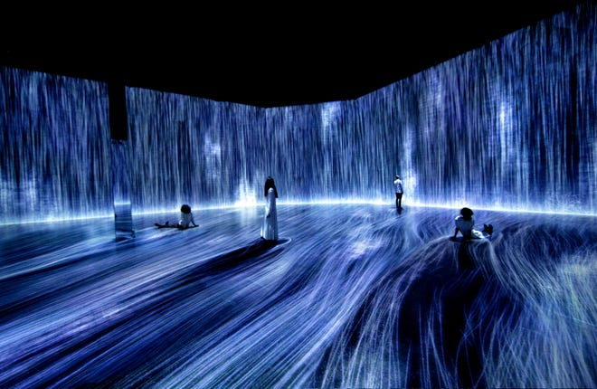
Superblue Miami - Miami, Florida. Superblue Miami is a brand-new immersive installation created by a team of experimental artists. In this space directly across from the Rubell Museum, be enveloped in light, wander through a maze of mirrors and become engrossed in a digital environment.

Slide 23
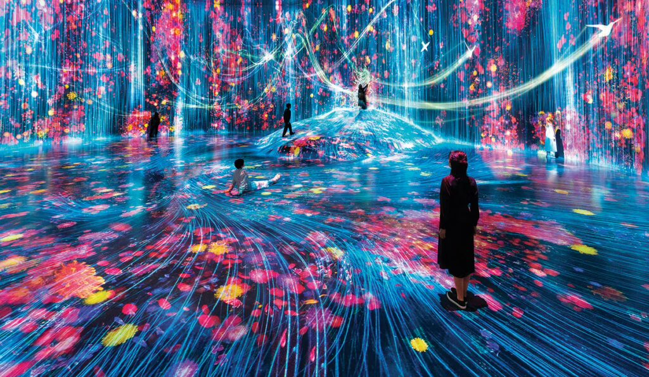
teamLab Planets TOKYO (Tokyo, Japan)
Experience: This large-scale, interactive art museum features a number of rooms that provide a powerful multisensory experience. One such space, Drawing on the Water Surface Created by the Dance of Koi and People - Infinity, allows visitors to wade in water with projected digital koi that react to their movements.
Elements: It combines immersive projections and visuals with physical interaction and a meditative sound design.

Slide 24
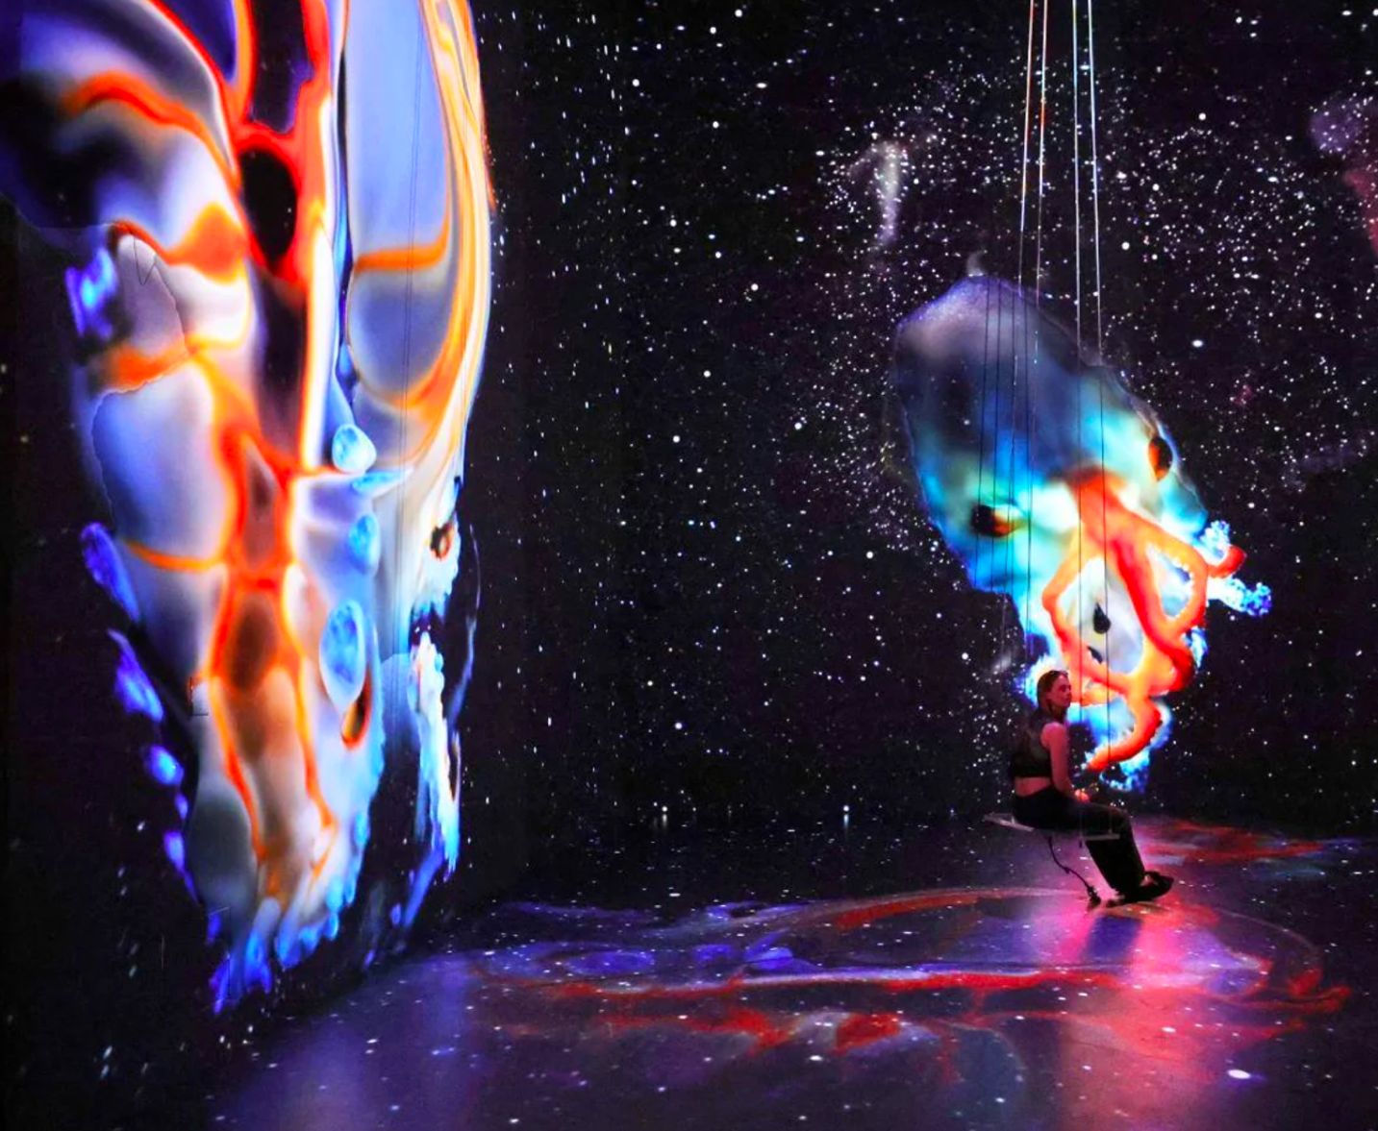
Mercer Labs (New York, USA)
Experience: An interactive museum that uses technology, light, and sound design to create immersive artistic experiences. Reviewers have highlighted the soothing visuals and audio in certain installations.
Elements: The rooms include large-scale projections, soundscapes, and scents to create a complete sensory journey.

Slide 25
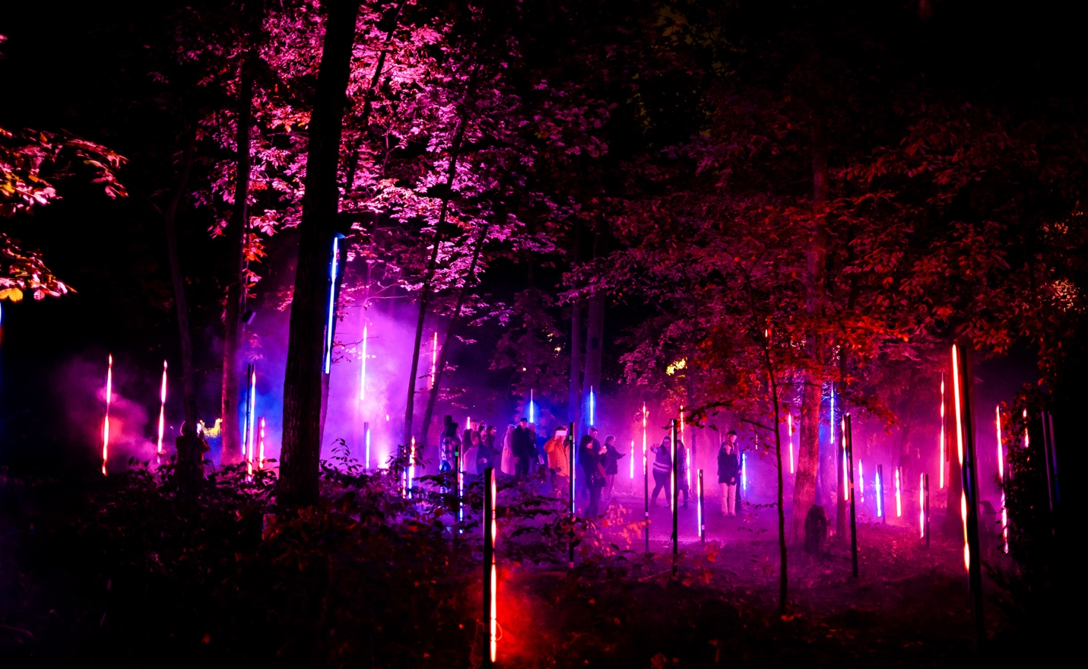
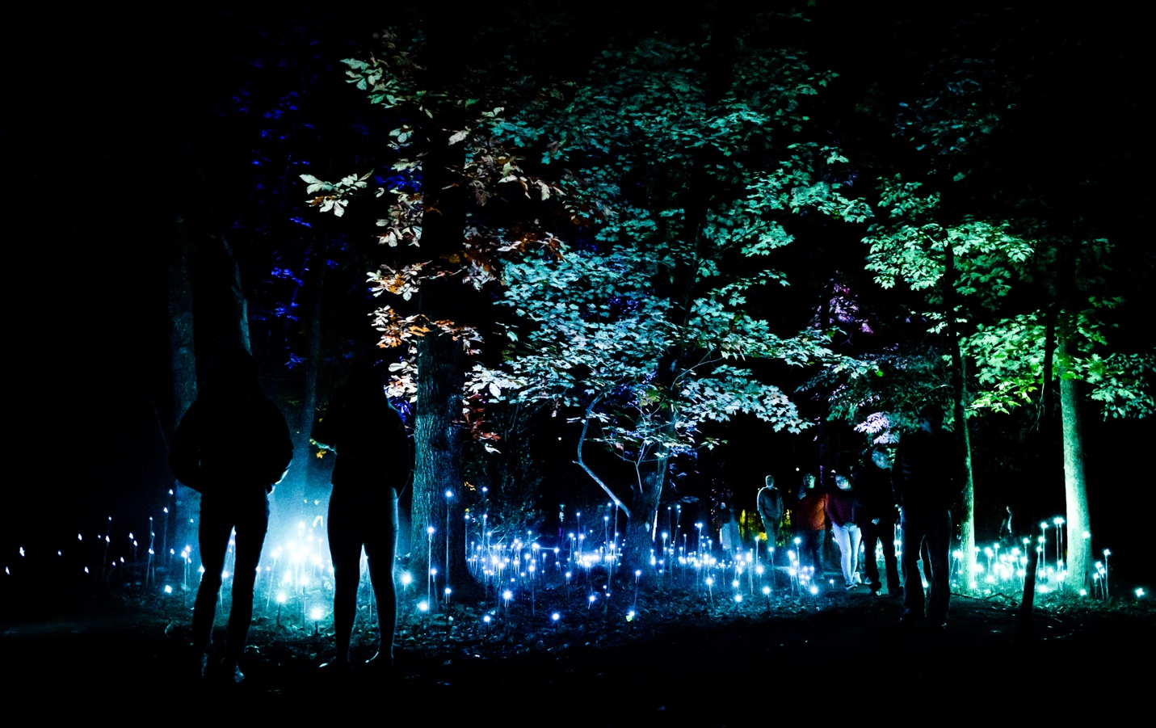
Crystal Bridges Museum of American Art in Bentonville, Arkansas, and the installation is a version of Rafael Lozano-Hemmer's "Listening Forest". This exhibit features several interactive biometric and light-based artworks, including "Pulse Forest," where visitors' heartbeats are translated into the flashing of 3,000 lightbulbs in the woods.

Slide 26
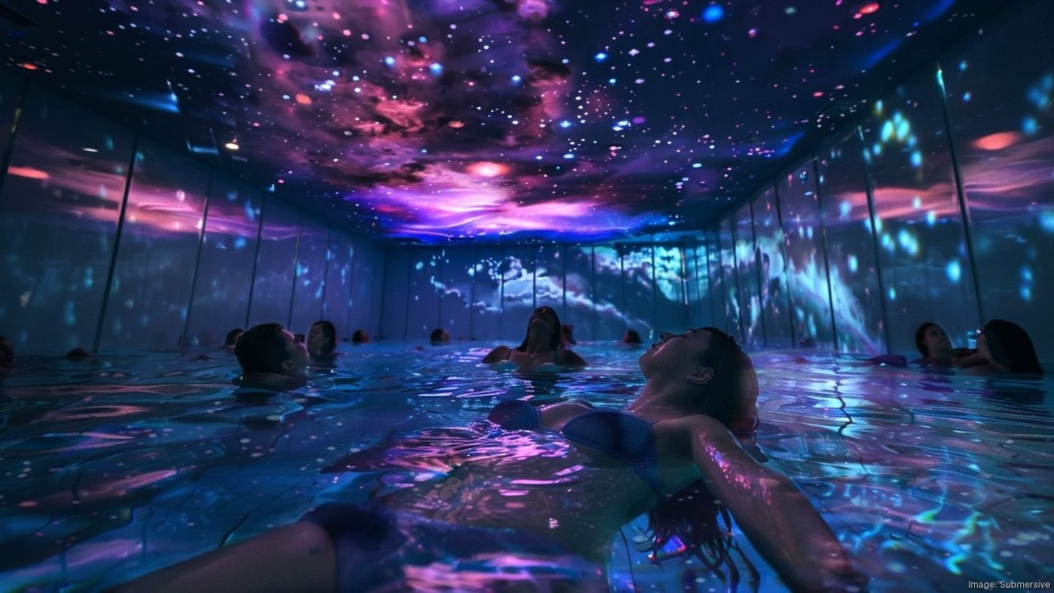

Slide 27
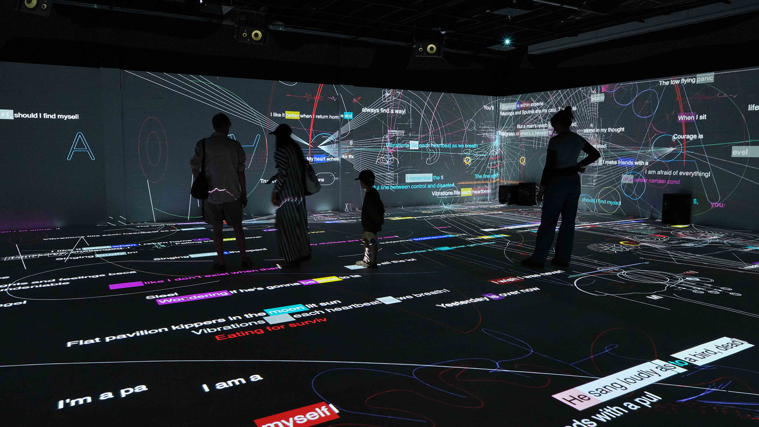
The immersive “On Being” exhibit at MAD Arts - Located in a 50,000-square-foot facility in Dania Beach, FL, MAD Arts is at the forefront of merging art and technology. As an immersive art museum and community hub, it supports visionary projects that push the boundaries of creativity.

Slide 28
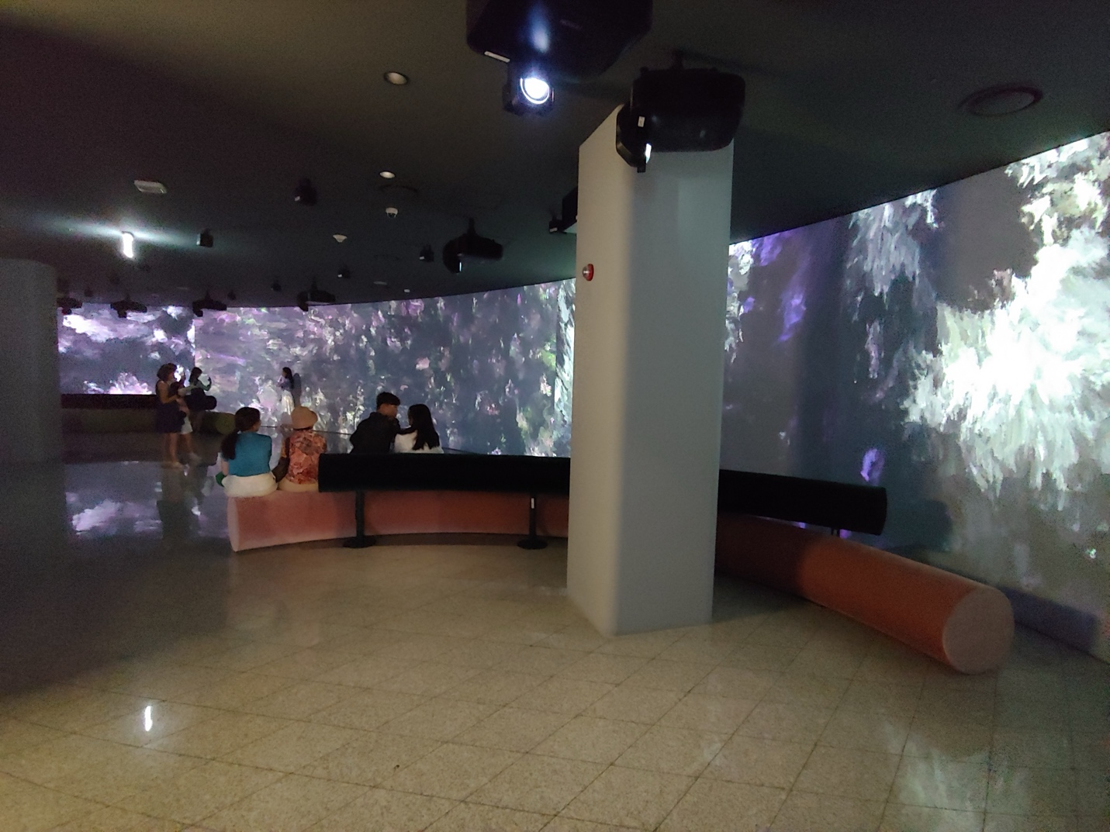
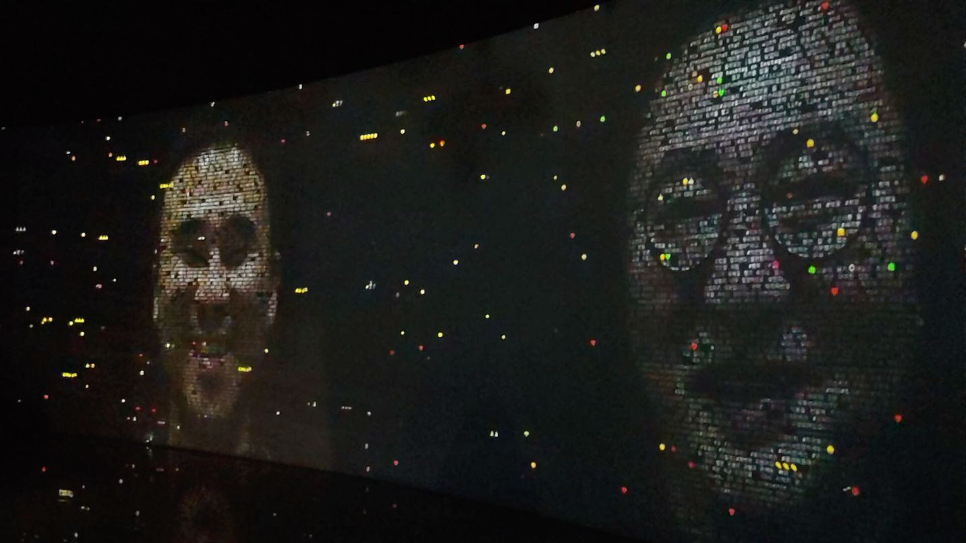
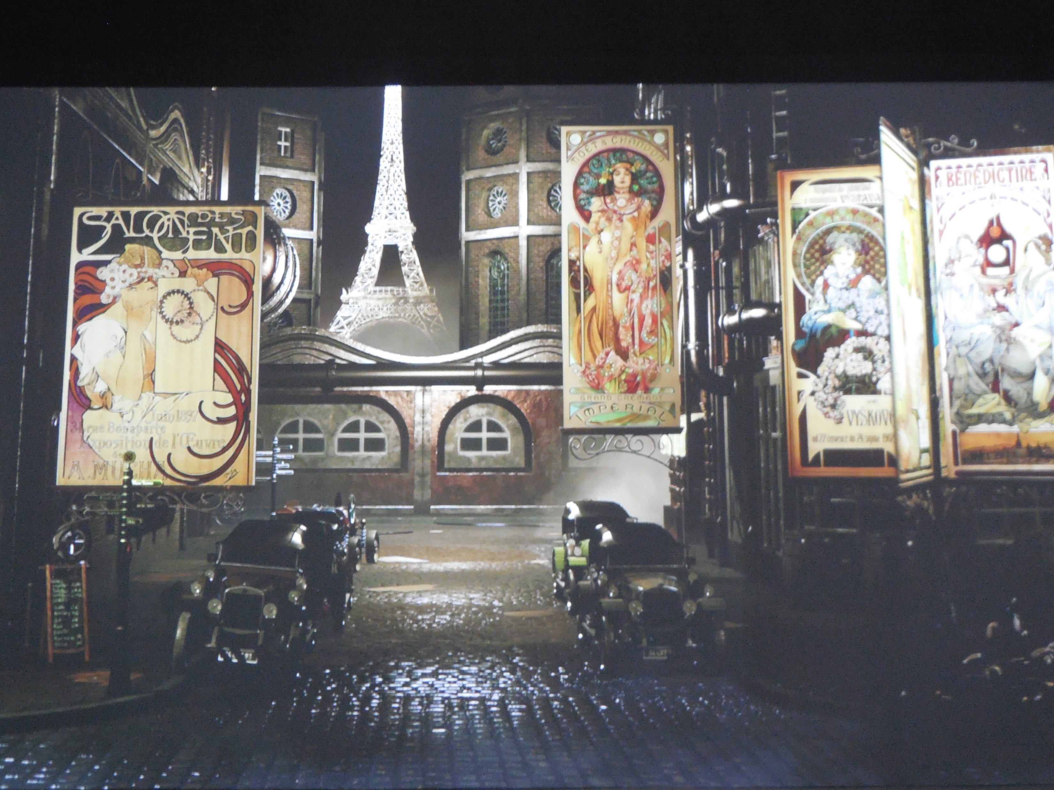
Korean Immersive Experience at hotels, libraries, shopping malls
  Aurora: A 150-meter long "entertainment street" with high-resolution LED screens on the ceiling, walls, and pillars, displaying immersive digital content like marine life and otherworldly landscapes.
https://www.youtube.com/watch?v=D223br7vnpk

Slide 29
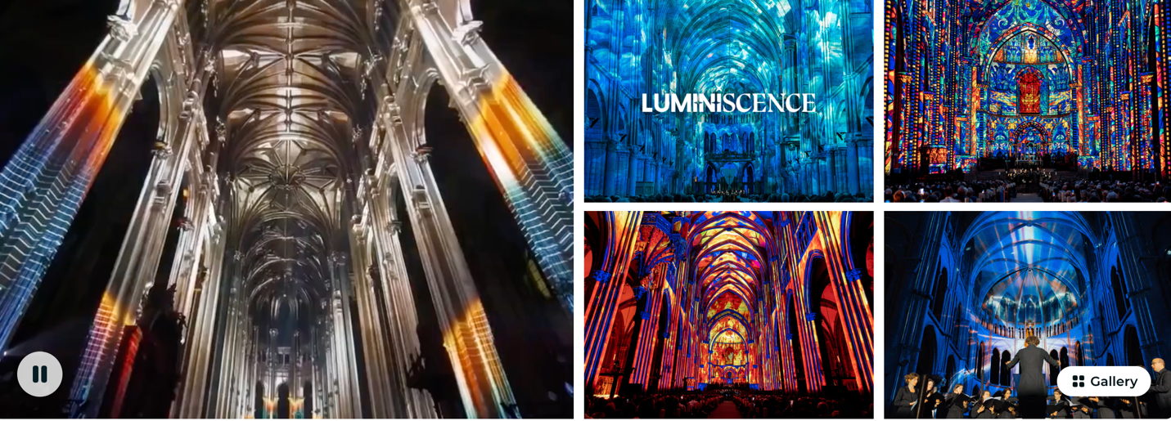
LUMINISCENCE Minneapolis: An Immersive Celebration of
Light, Sound and Story

Slide 30
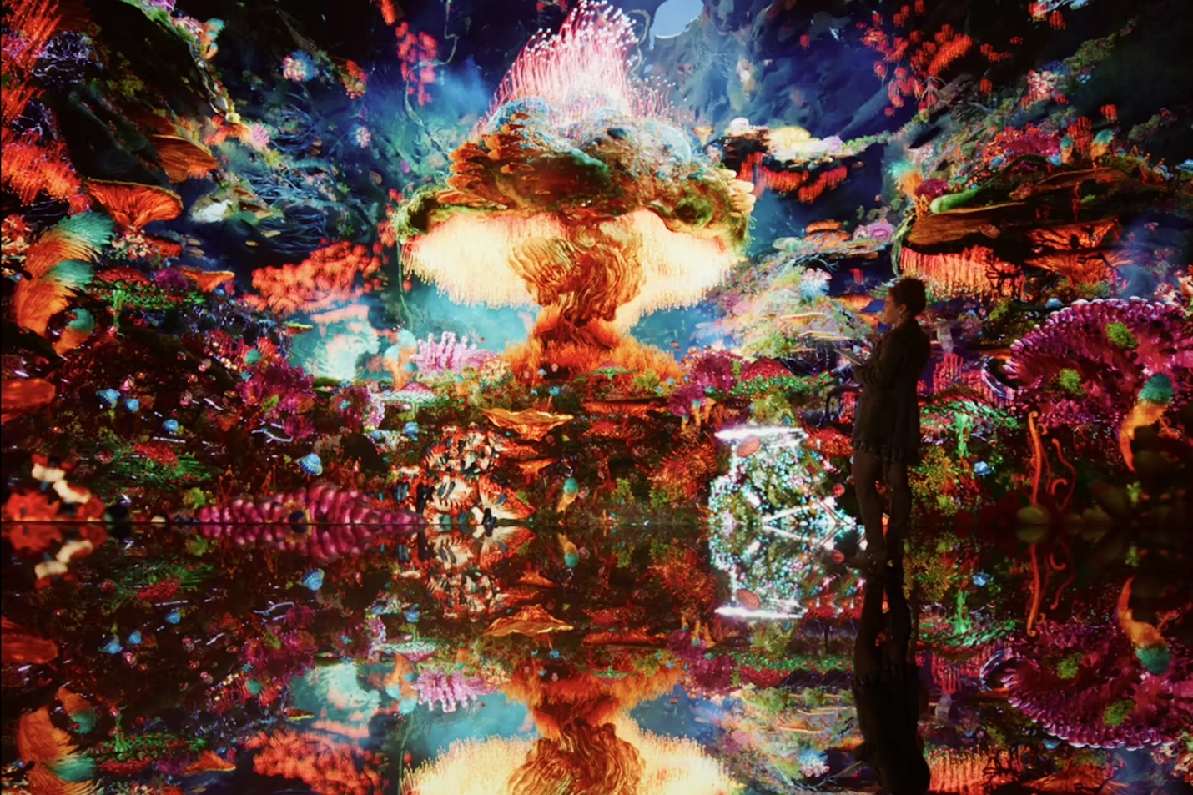
The world’s first Museum of AI Arts and digital ecosystem dedicated to data visualization and AI-based creativity.
Refik Anadol Introduces World’s First Open-Source Generative AI-Model Dedicated to Nature
https://www.dataland.art/collections/biome-lumina

Slide 31
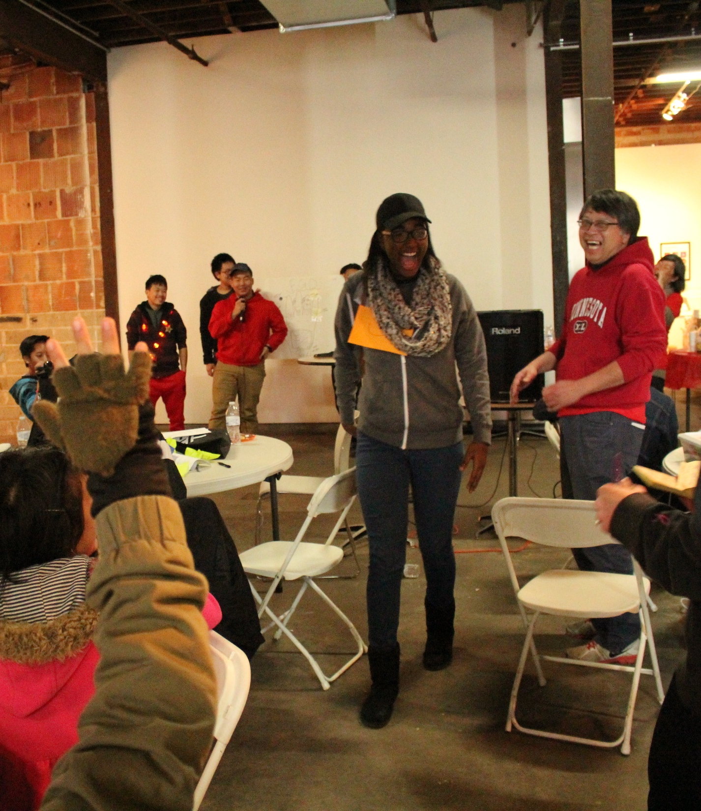
We have 2 plans:
Developing a 30,000SF 3D Theme Park in Minneapolis
Developing a VR Projection Calming Room as wellness technology at this Church

Slide 32
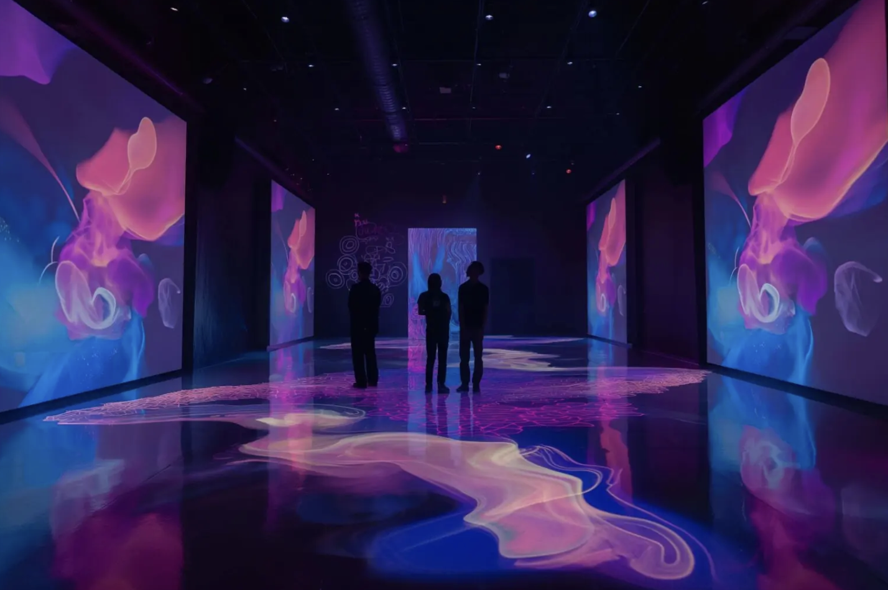
First Step – creating a Calming Wall for the Church, featuring our trainees’ works
Notes:
Most Asian traditional cultures are based on Confucius philosophy and Buddhism. The traditional view of the human body is as a derivative of the natural world, and need to be in balance between Yin and Yang, and promotes self-sustaining, workout according to seasons, and simple living philosophies.
Confucian culture also shapes family structure, in which the family relationship is hierarchical in nature. Consequently the male who is head of household has more power than the female, than the children. Familial decision-making usually includes extended family members, such as grandparents and other significant relatives. Children are expected to obey elders and to put the family’s needs above their own.

Slide 33
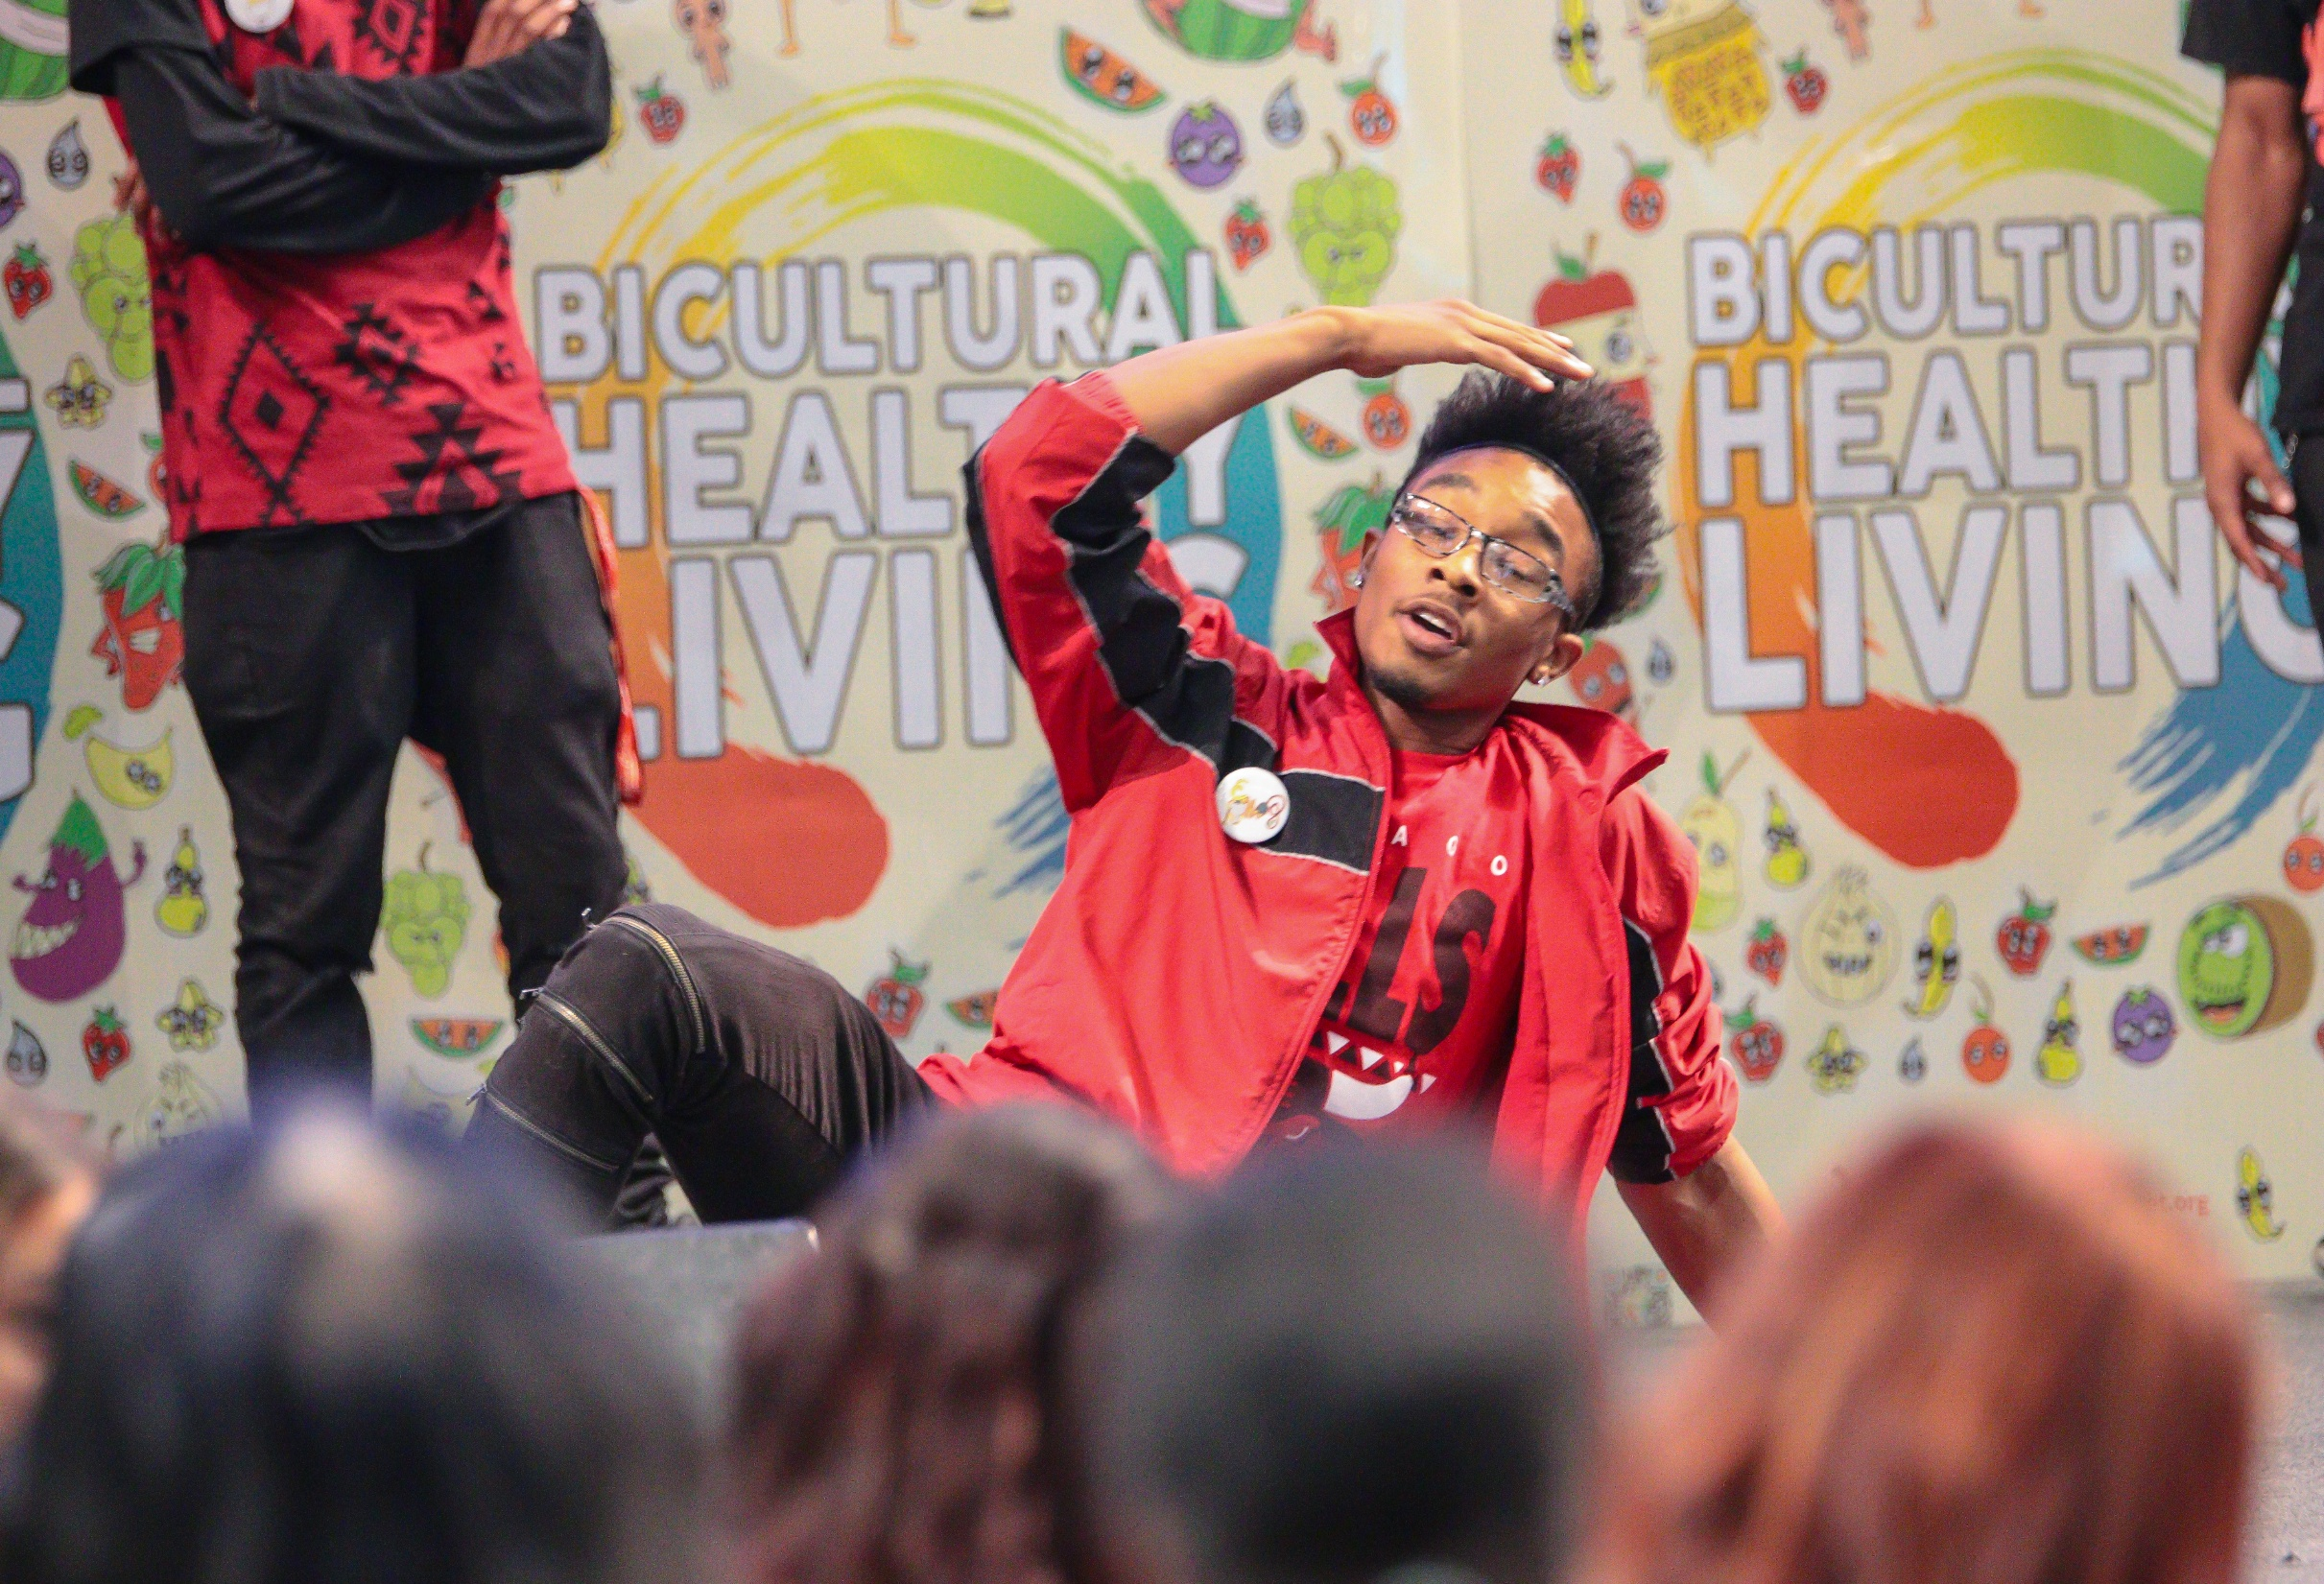
How We See All These Get Done???

Slide 34
We are lucky to have 3 artists and tech guru with us:
Suyao Tian. She is the founder and owner of Viewpoint Gallery, an Executive Board member of Art Buddies, and a board member of the Northeast Minneapolis Arts Association (NEMAA). She earned her BA from the University of Central Arkansas and her MFA from the Minneapolis College of Art and Design.
Vivek Raman contributes over eleven years of IT expertise in AR/VR development, 3D modeling, immersive technologies using Unity, drone programming, and generative AI tools including OpenAI, Claude, and LangChain, currently serving as Senior Gen AI Engineer at Minneapolis/St. Paul International Airport. His expertise bridges creative digital arts and technical programming, providing BIPOC youth with essential skills in game design, virtual reality, and emerging technologies that combine artistic vision with technical innovation for career pathways in Minnesota's growing tech sector.
Dr. Cong Liu brings a unique blend of traditional musical artistry and cutting-edge AI technology, holding a Ph.D. in Music Composition from the University of Minnesota with over a decade of experience in classical composition, electronic music production, multimedia scoring, and advanced music software development. Through his diverse portfolio spanning symphonic works, film scoring, and cross-cultural musical traditions, Dr. Liu teaches youth how AI and technology intersect with the arts to create new possibilities in music production, digital arts, and AI-assisted creative fields.

Slide 35
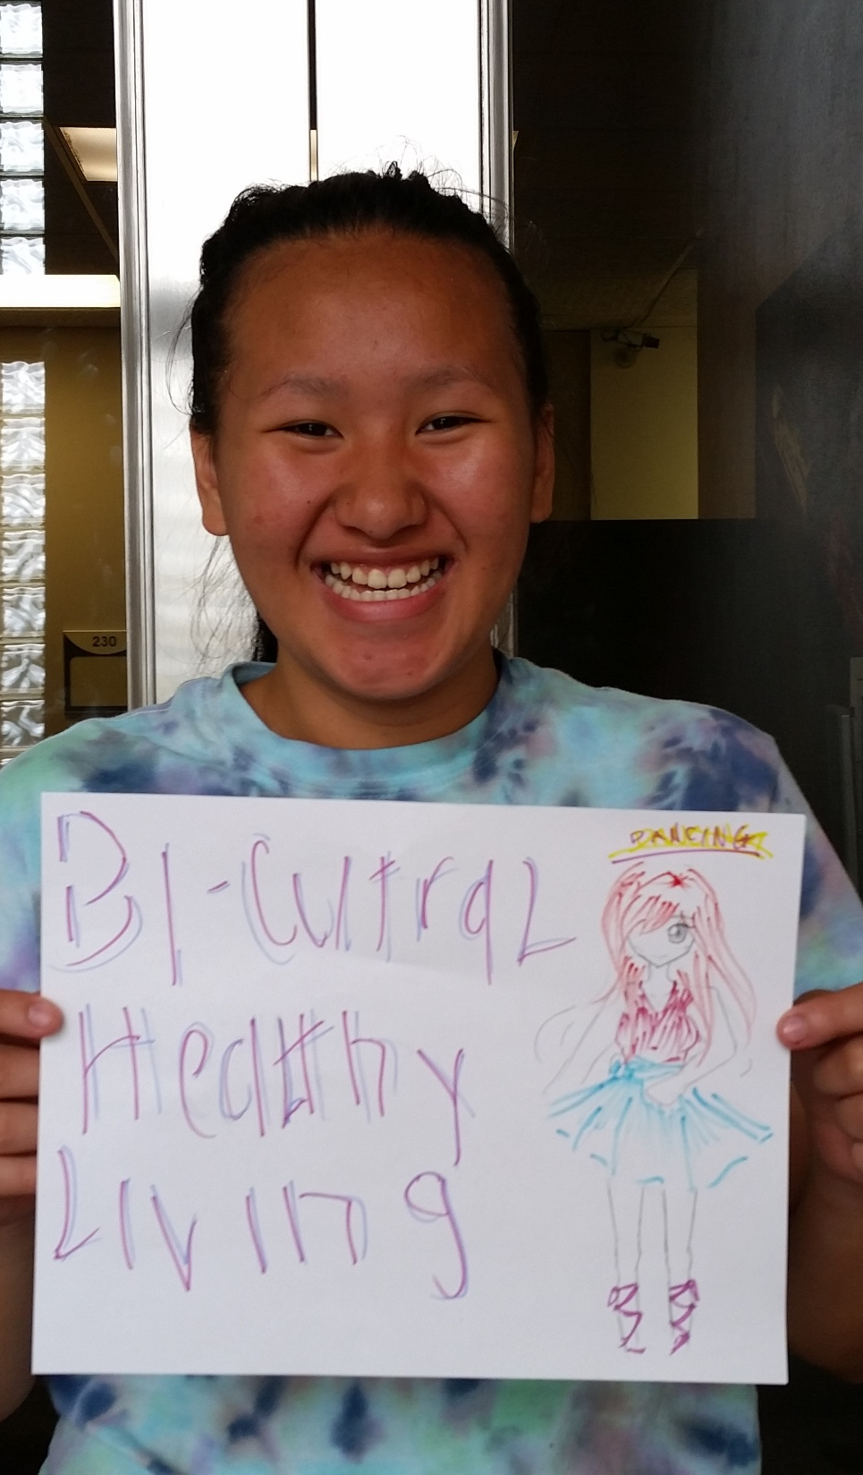
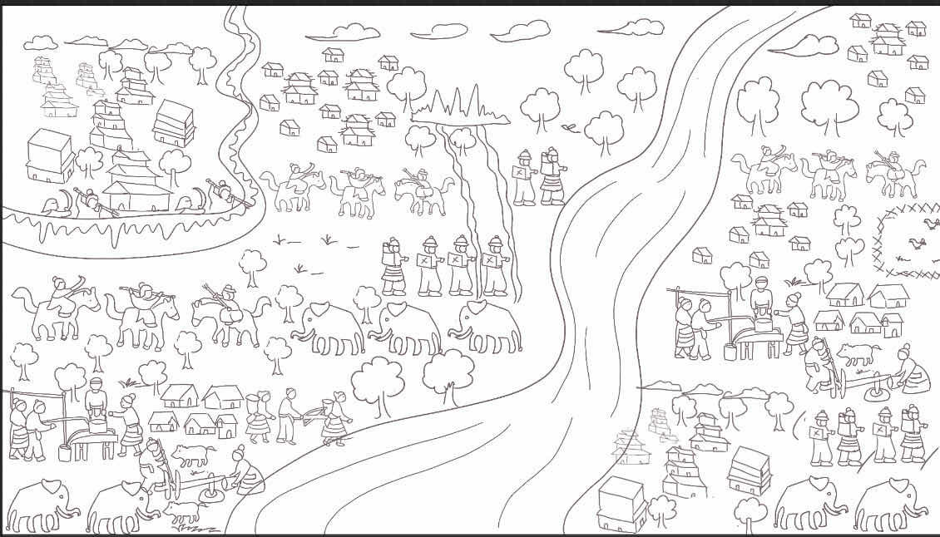

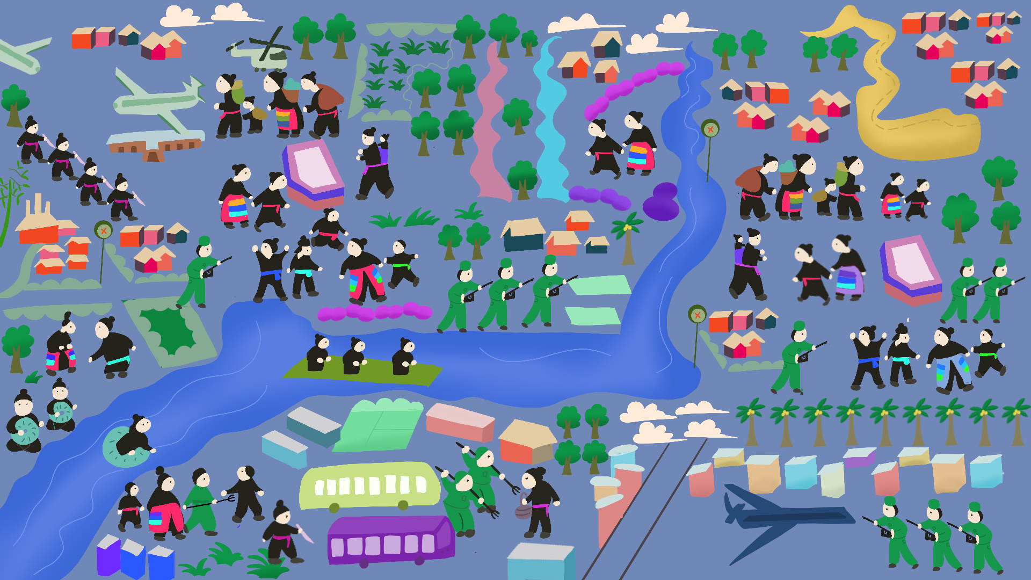
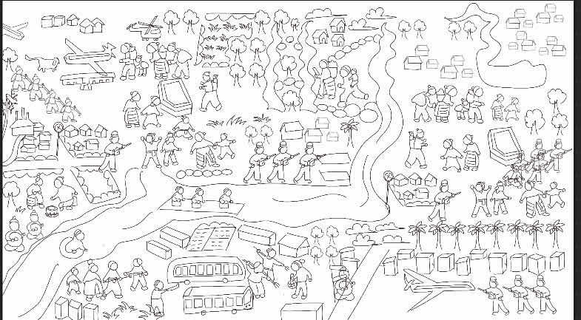
Asian Media Access’ Arts Integration Experience

Slide 36
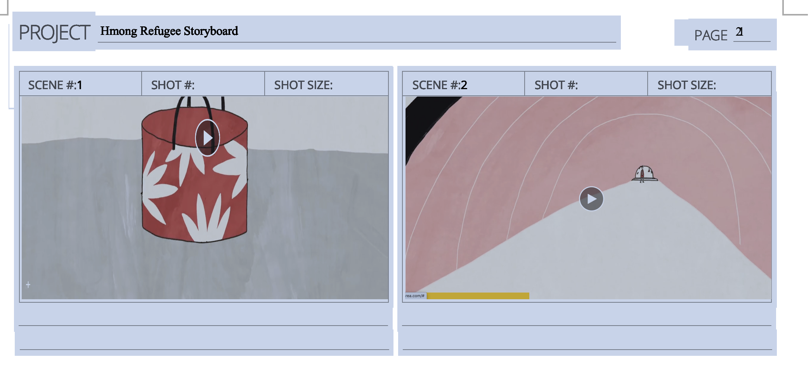
https://vimeo.com/143307366
Hmong Refugee Story
https://drive.google.com/drive/folders/1C-v2idoVbLyJu-wlfUnqoDCW3VFrnFvU?usp=sharing
https://vimeo.com/142769553?autoplay=1&muted=1&stream_id=Y2xpcHN8NDQ5NjQ4Mjl8aWQ6ZGVzY3xbXQ%3D%3D

Slide 37
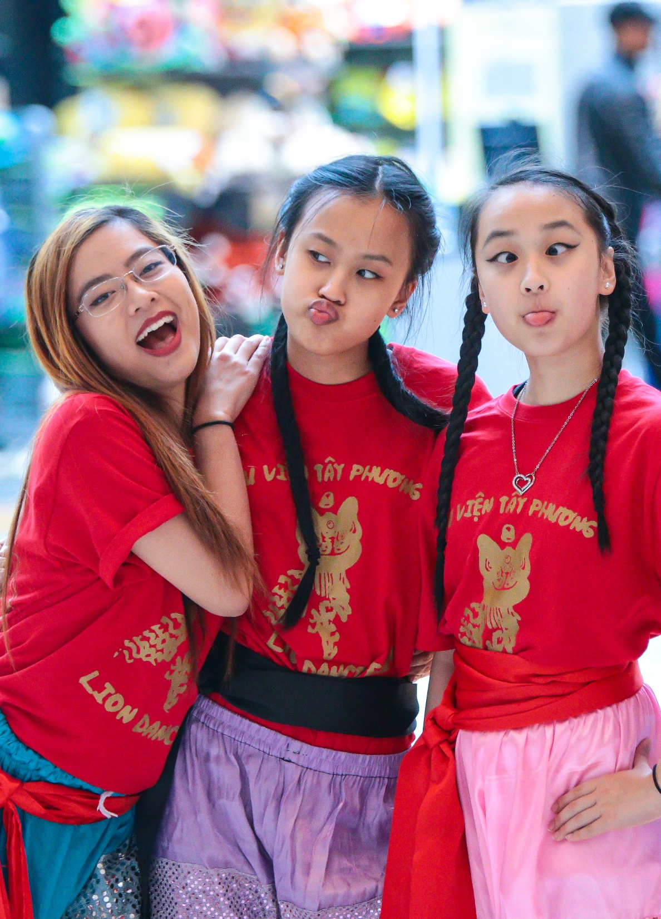
We can do this!!!!!!

Slide 38
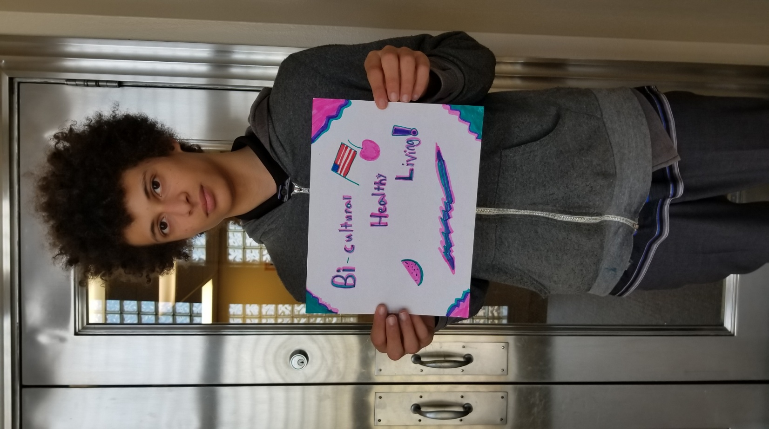
casemanager@amamedia.org
612-477-4682

