Slide 1

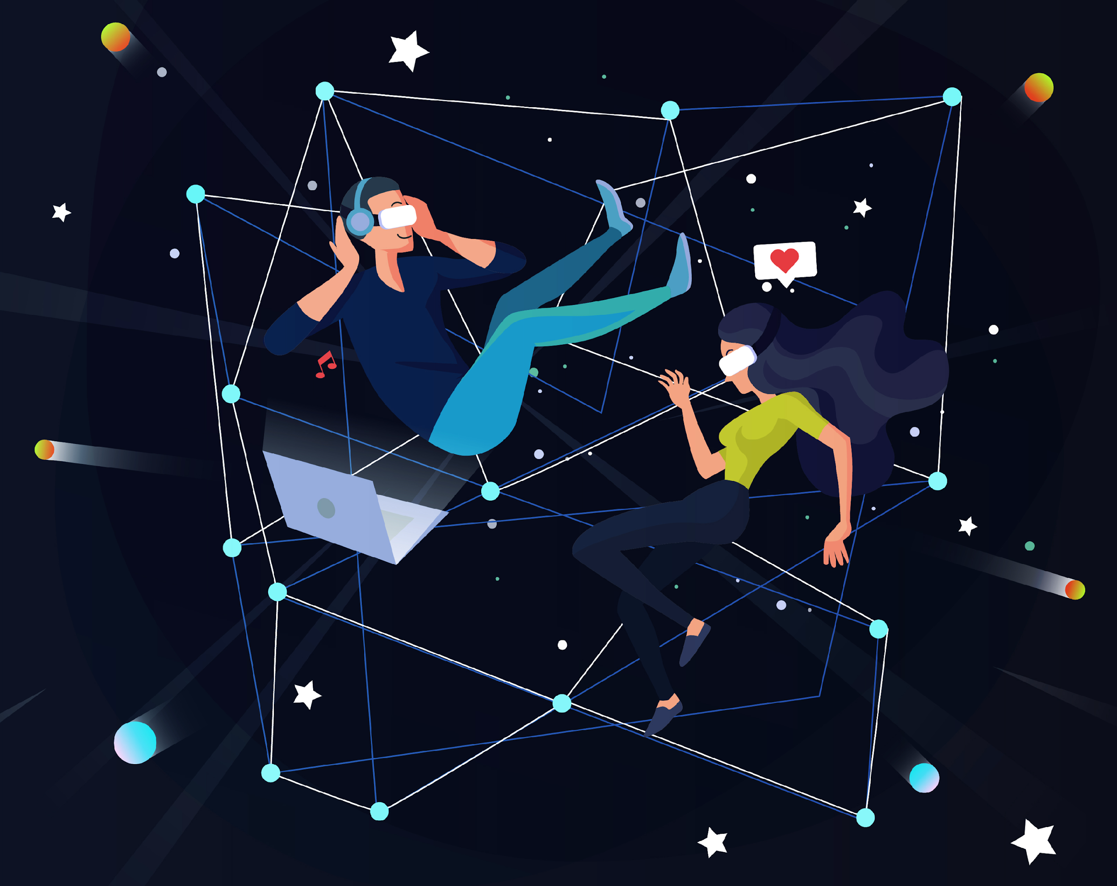




e-Magine! Initiative
13 weeks, Thursdays and Fridays - 5:30pm - 8:30pm
September 25, 2025 - January 9,2025 (Thanksgiving, Christmas, and New Years week off)

Slide 2
Today’s Schedule:
5:30pm-6:30pm Introductions
6:30pm-7:00pm Paperwork
7:00pm-7:30pm Assessment
7:30pm-7:45pm Break
7:45pm-8:30pm Basic Computer Skills

Slide 3
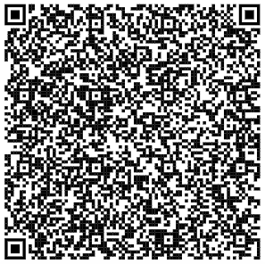
Introduction of Asian Media Access
How We Started
History Of Us
August 1992, Asian Media Access, Inc. (AMA) is a comprehensive, multimedia-based, community advocacy agency. AMA is dedicated to using multimedia arts and technology as tools for social betterment. AMA recognizes that multimedia and technology are essential for advocacy, communication and education, in order to mobilize communities, and young people; to engage in understanding and communicating of Pan Asian issues; and to arrive at a participatory decision-making process for a safe, supportive environment for all.
Asian Media Access
Who We Are
We believe the multimedia arts and information technology empower all of us with critical thinking and promote good citizenship—especially important as we prepare young people to be tomorrow’s leaders. Our thought-provoking multimedia education, productions, exhibitions, stage performances, resourceful educational products and youth programs encourage deep reflection, challenge previous assumptions, provide solace, and allow participants to develop their own way of connection in timeless works of creation, communication and community building.
Subscribe to our eNewsletter and Ball e-magazine

Slide 4
Ice Breaker

Slide 5
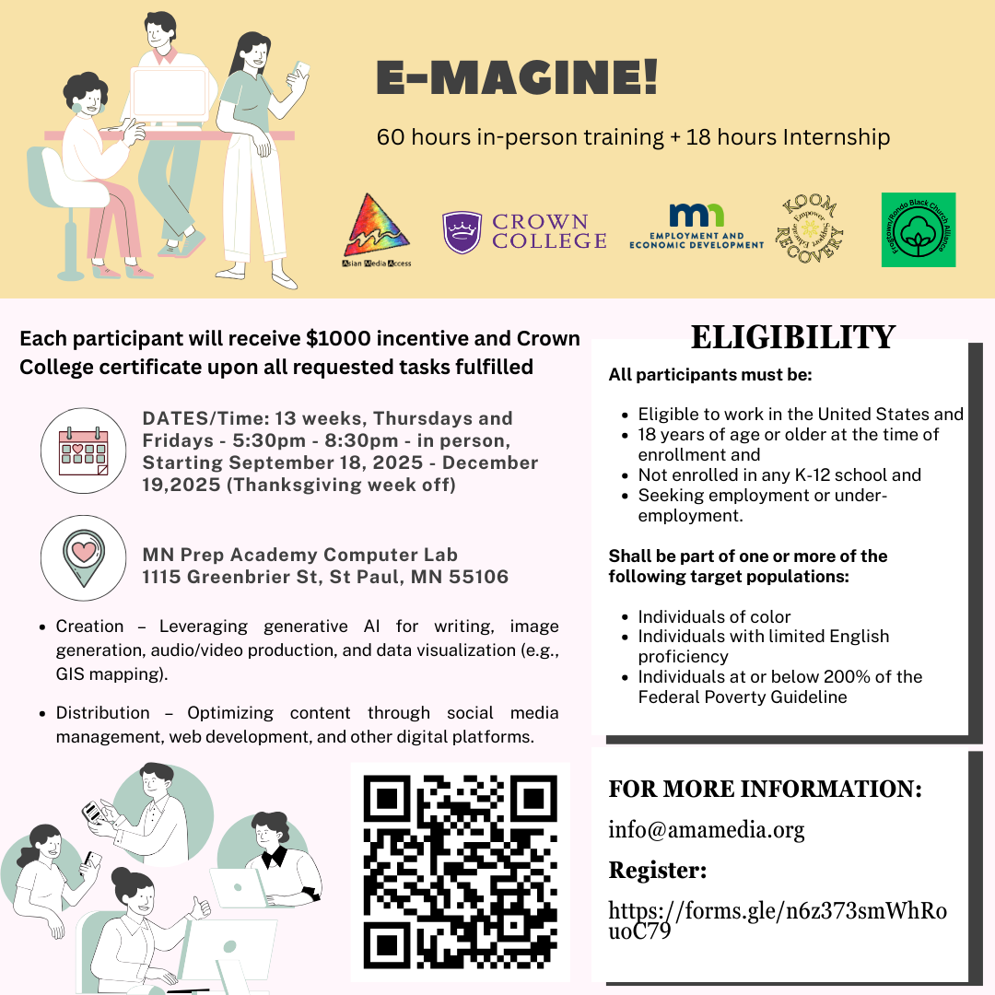

Slide 6
No Expensive Software Needed!
Free Tools You'll Use
ChatGPT (writing)
Canva (design)
WordPress (websites)
Your smartphone (video/audio)
Google Analytics (tracking)
Laptop login: E-Magine
Password: em2025

Slide 7
What Technical Skills you will gain:
AI Content Creation: ChatGPT, NightCafe, Leonardo AI
Design Mastery: Canva for professional graphics
Web Development: WordPress from basics to deployment
Multimedia Production: Video, audio, and podcast creation with AIs
Digital Marketing: Social media strategy and analytics

Slide 8
Portfolio
Professional Web Presence
1 issue assigned by AMA
10 AI-generated images
8 design pieces (4 postcards + 4 infographics)
2 AI videos (including landing page intro)
2 AI podcasts for multimedia integration
2 original music compositions
Complete e-Magazine showcasing all work
WordPress website with three pages:
Landing page with video/music intro
Image gallery showcase
Multimedia content hub
Social media marketing campaigns
Analytics tracking and optimization

Slide 9
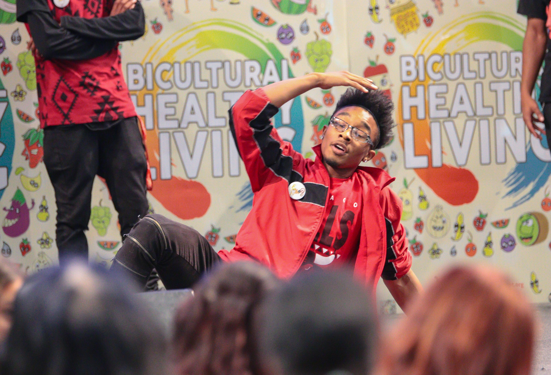
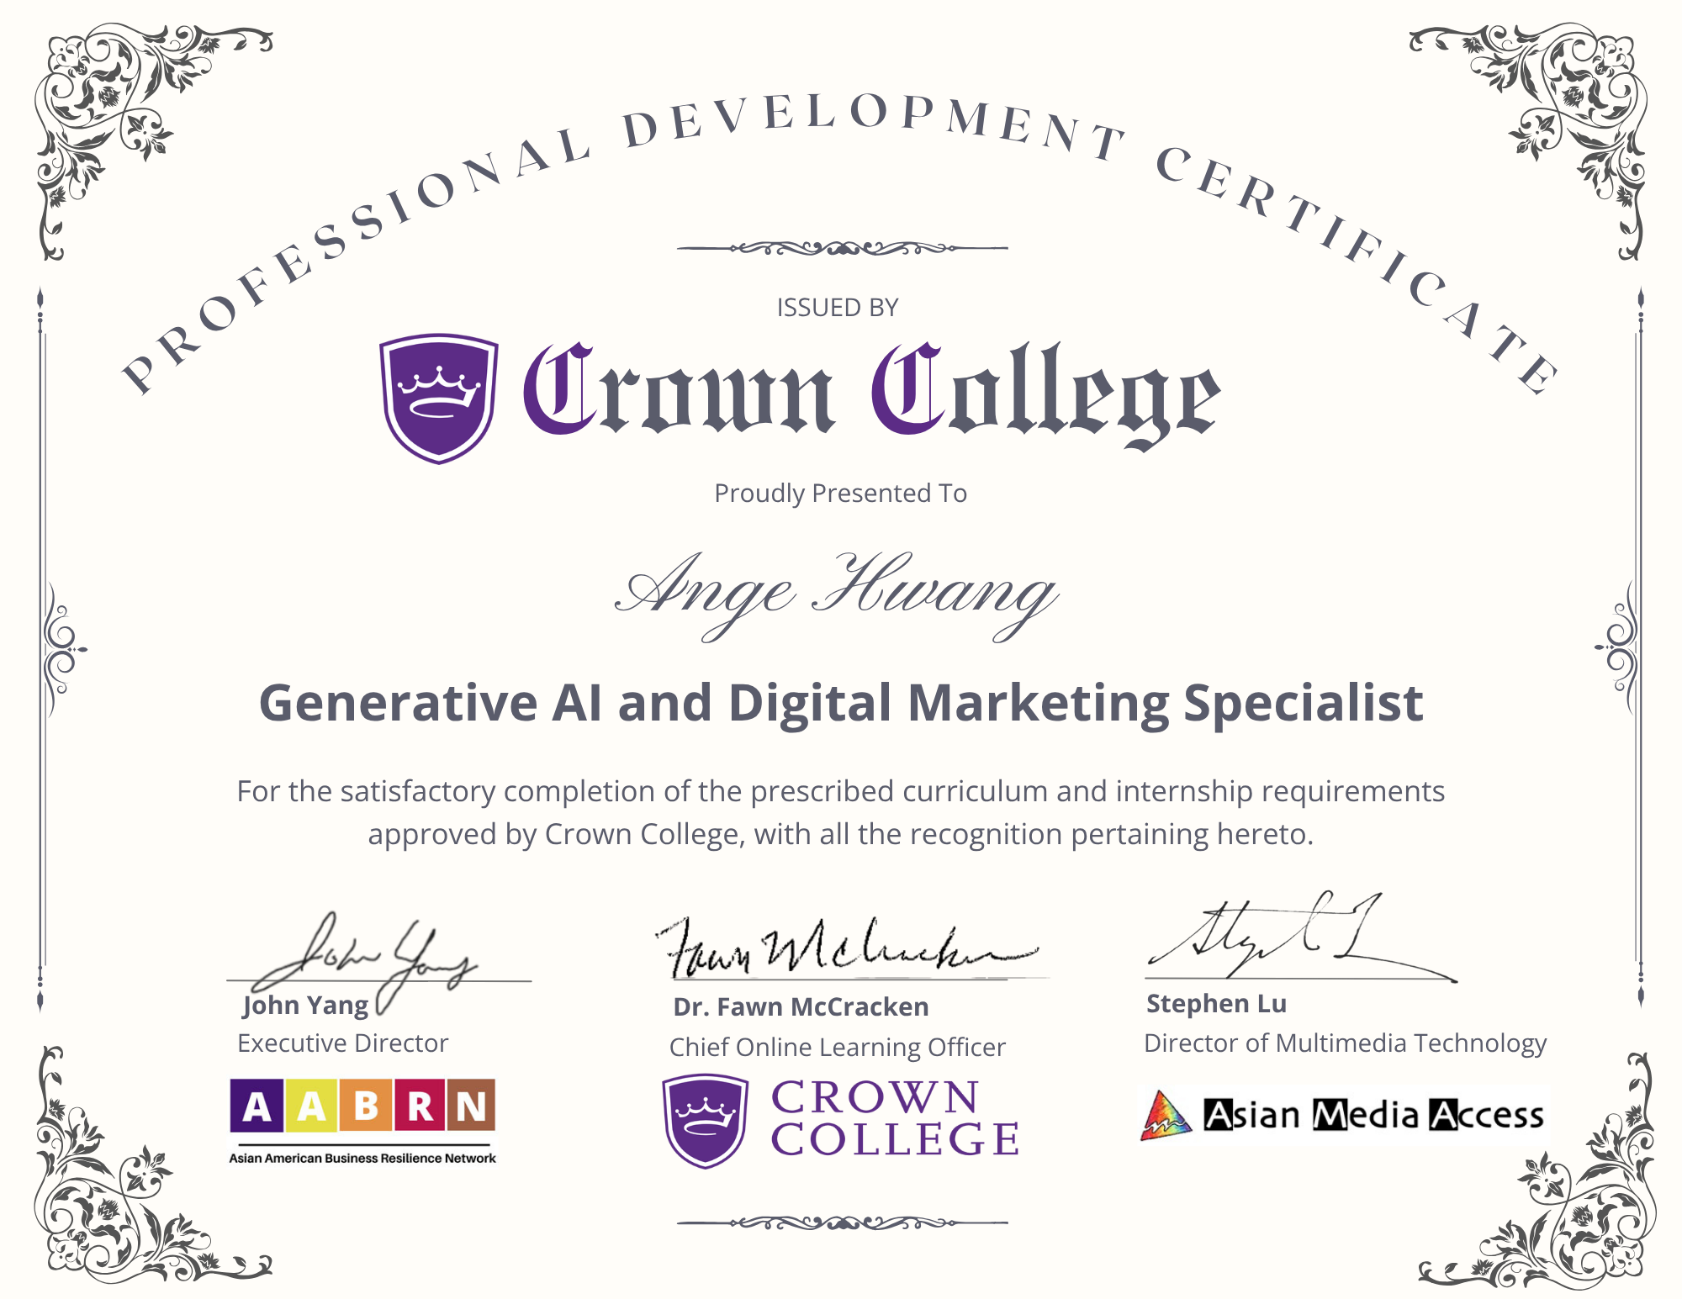

Slide 10
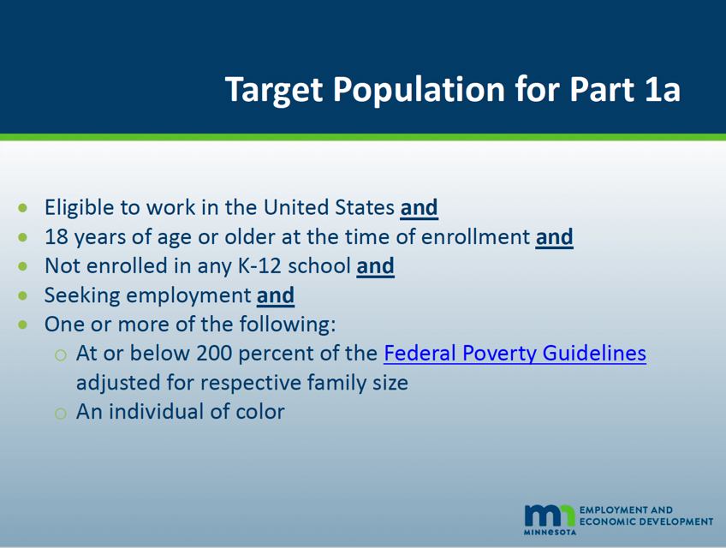
E-Magine
Eligibility requirements

Slide 11
Expectations:
Participate in 60 hours of training, 18 hours internship, and 2 hour closing ceremony
Required 80% attendance rate, if you might miss a class, please e-mail Maya at casemanager@amamedia.org
Complete all assignments to receive incentive and Crown College certificate
Graphics
Videos
Website

Slide 12
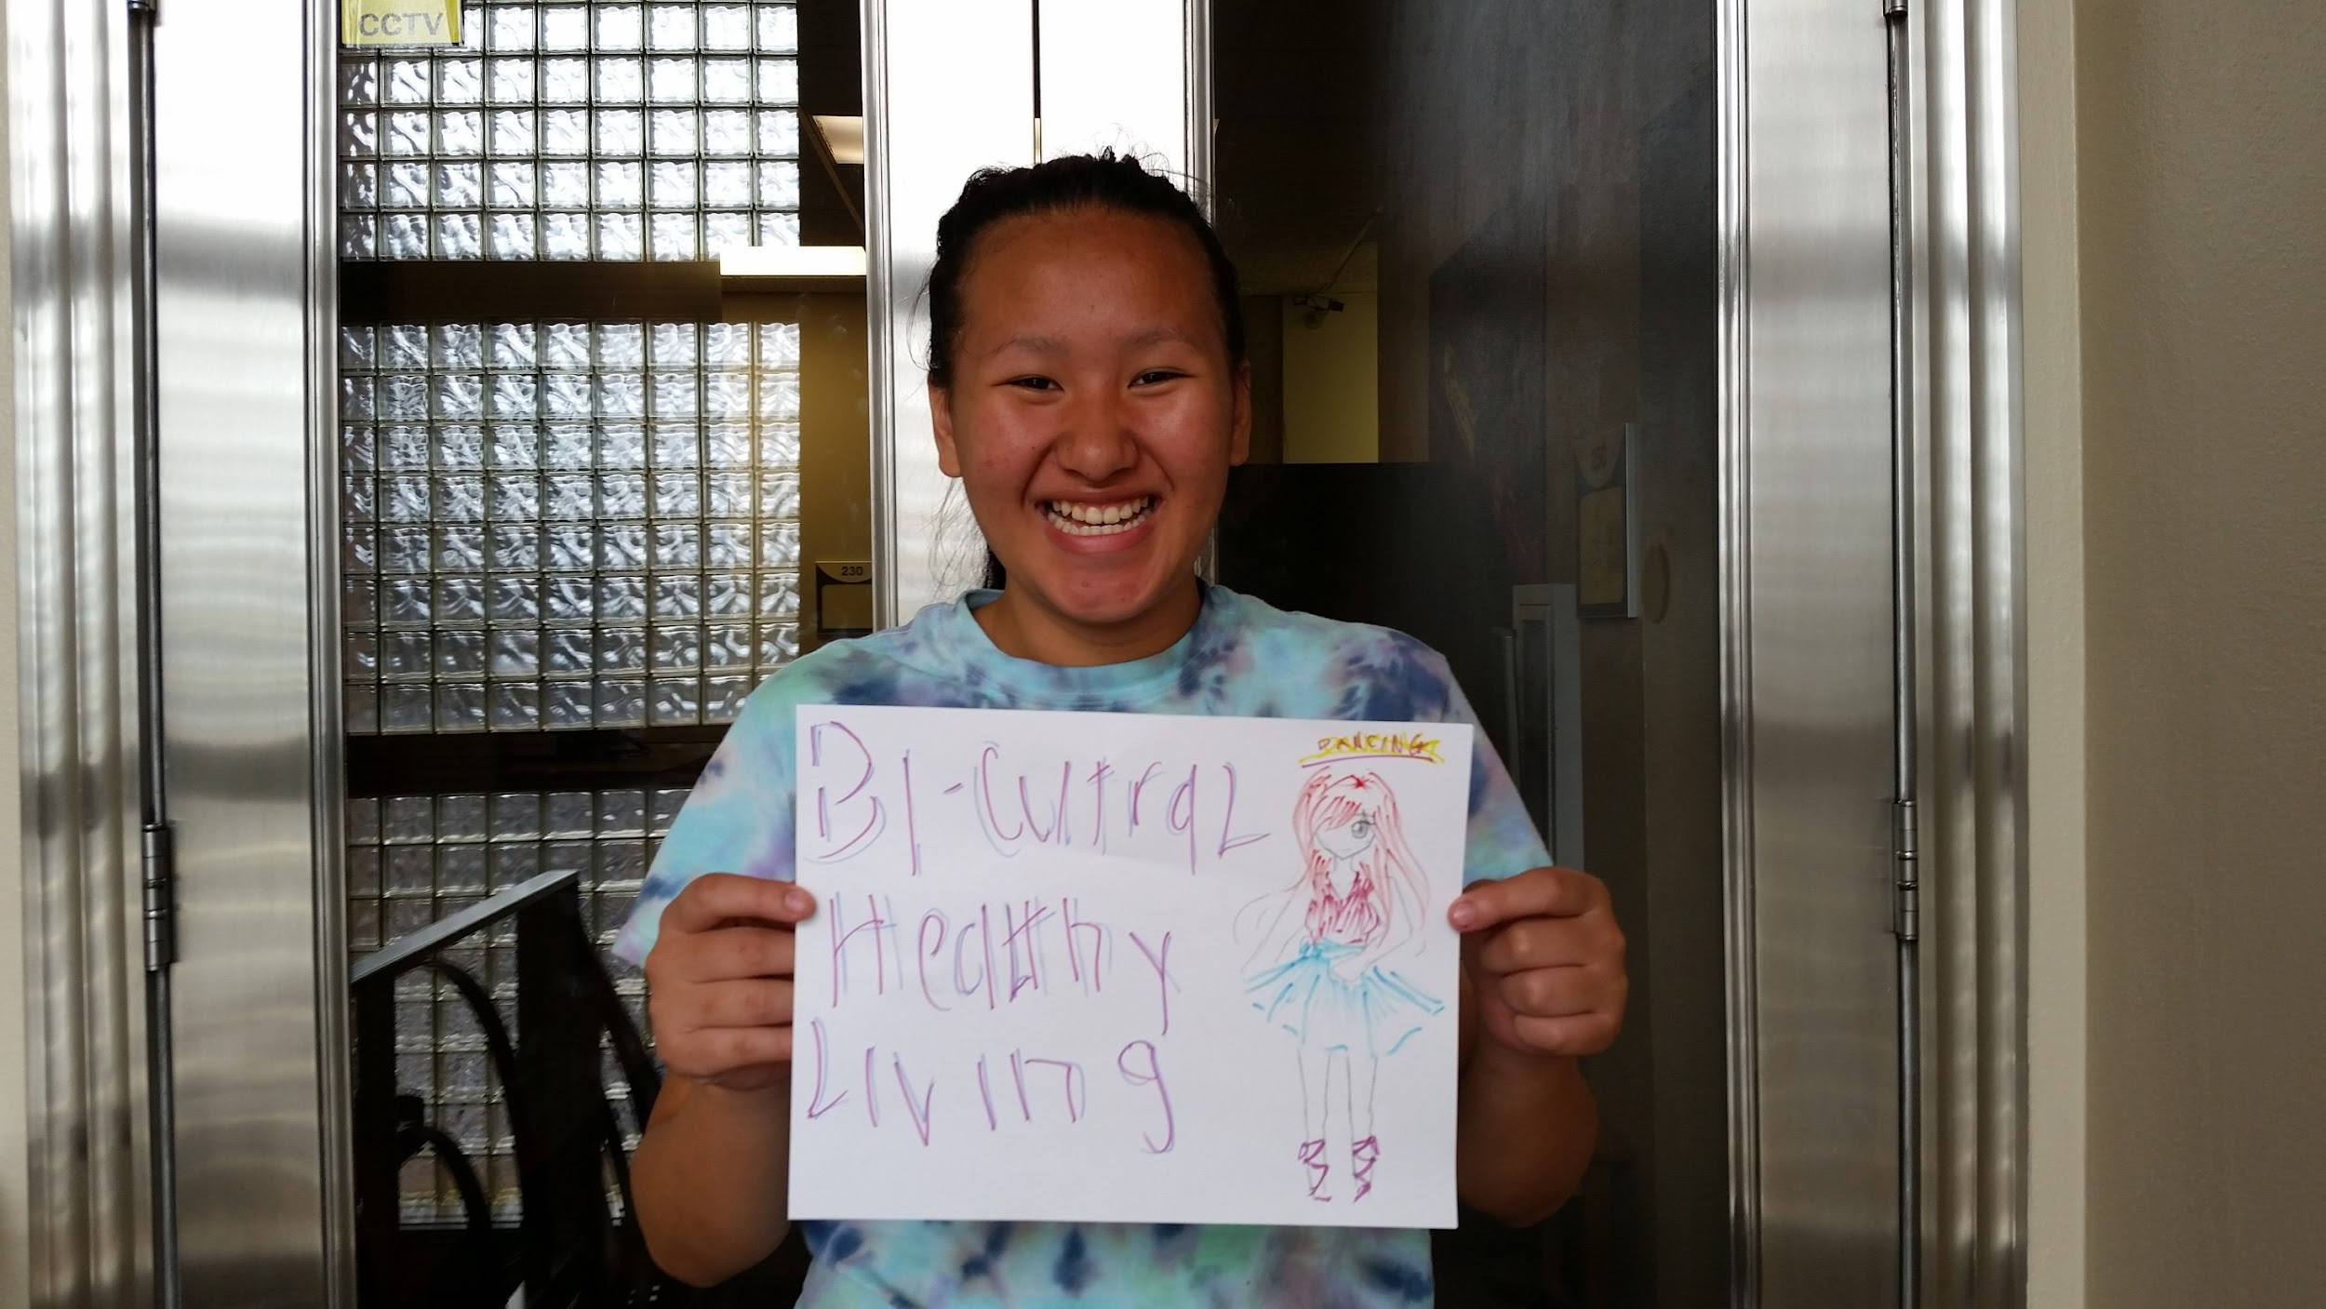
Typical Schedule (5:30pm-8:30pm)
5:30pm-6:00pm - Attendance and checking in
6:00pm-7:00pm - First Training
7:00pm-7:15 pm Break
7:15pm-8:30pm - Second Training and Reflections

Slide 13
E-magine Website
https://ww1.amamedia.org/introduction/
Use to find slides, training handouts, curriculum, etc.

Slide 14
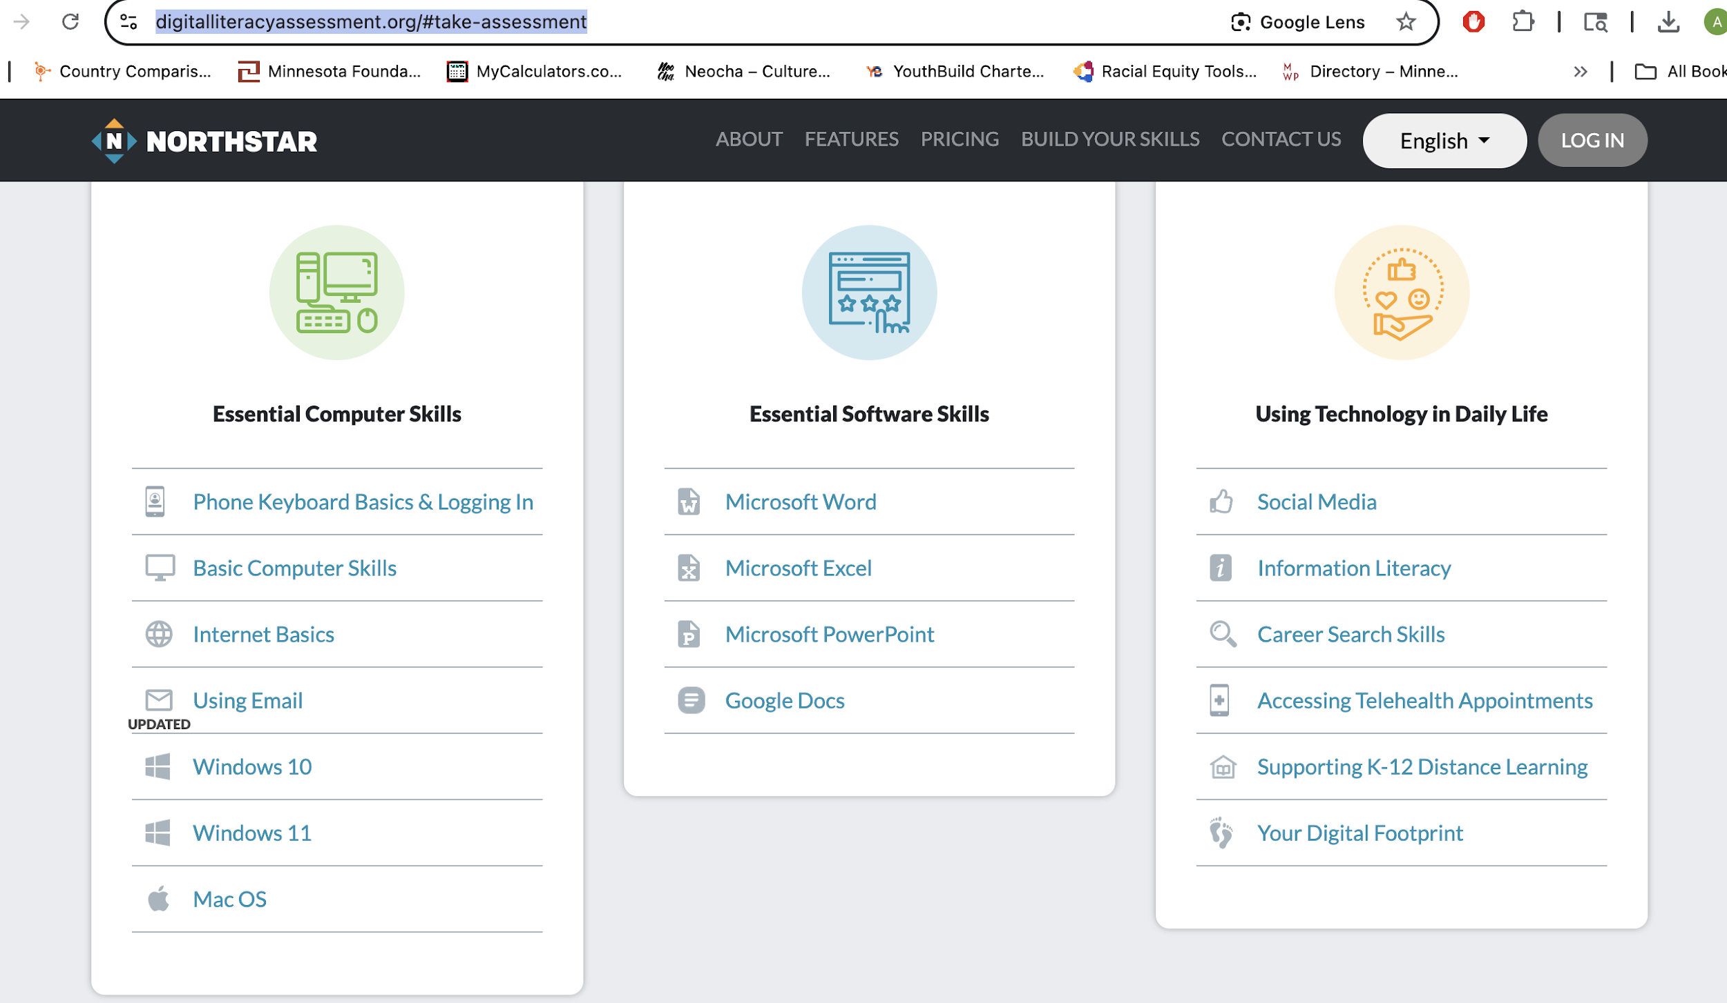
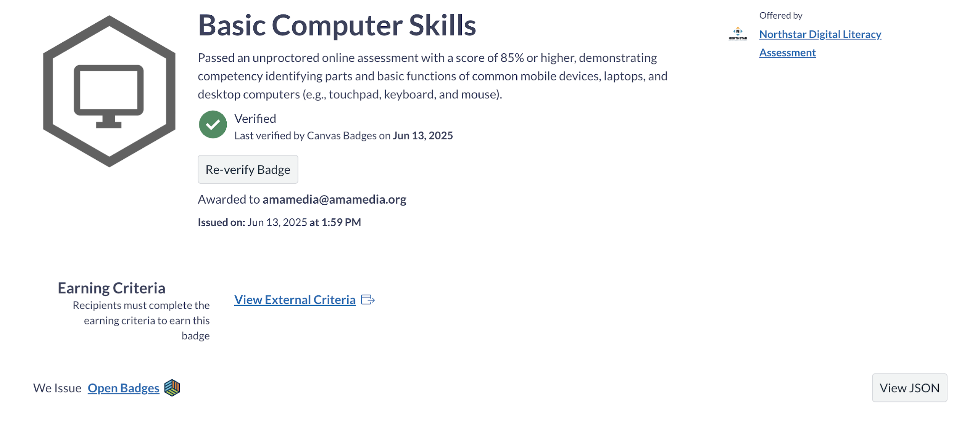
Computer Literacy
Assessment Tools
https://www.digitalliteracyassessment.org/#take-assessment
https://edu.gcfglobal.org/en/computerbasics/basic-parts-of-a-computer/1/
Badges

Slide 15
Databricks
https://www.databricks.com/learn/training/generative-ai-fundamentals-accreditatin
o
Pre-work - This module provides all the necessary tools for your learning journey and establishes a solid foundation in AI and its applications.
This Orientation provides a comprehensive introduction to understanding of how Large Language Models work.
Generative AI, such as ChatGPT and Dolly, has undoubtedly changed the technology landscape and unlocked transformational use cases, such as creating original content, generating code and expediting customer service. And the technology's applications are growing daily. Organizations that harness this transformative technology successfully will be differentiated in the market and be leaders in the future. Get up to speed on generative AI with this free on-demand training from Databricks.
Here is how it works:
● Watch 4 short tutorial videos
● Pass the knowledge test
● Earn a badge for Generative AI Fundamentals you can share on your LinkedIn profile or résumé
Videos included in this training:
● Welcome and Introduction to the Course
● LLM Applications
● Finding Success With Generative AI
● Assessing Potential Risks and Challenges
Earn your badge today and share your accomplishment on LinkedIn or résumé.

Slide 16
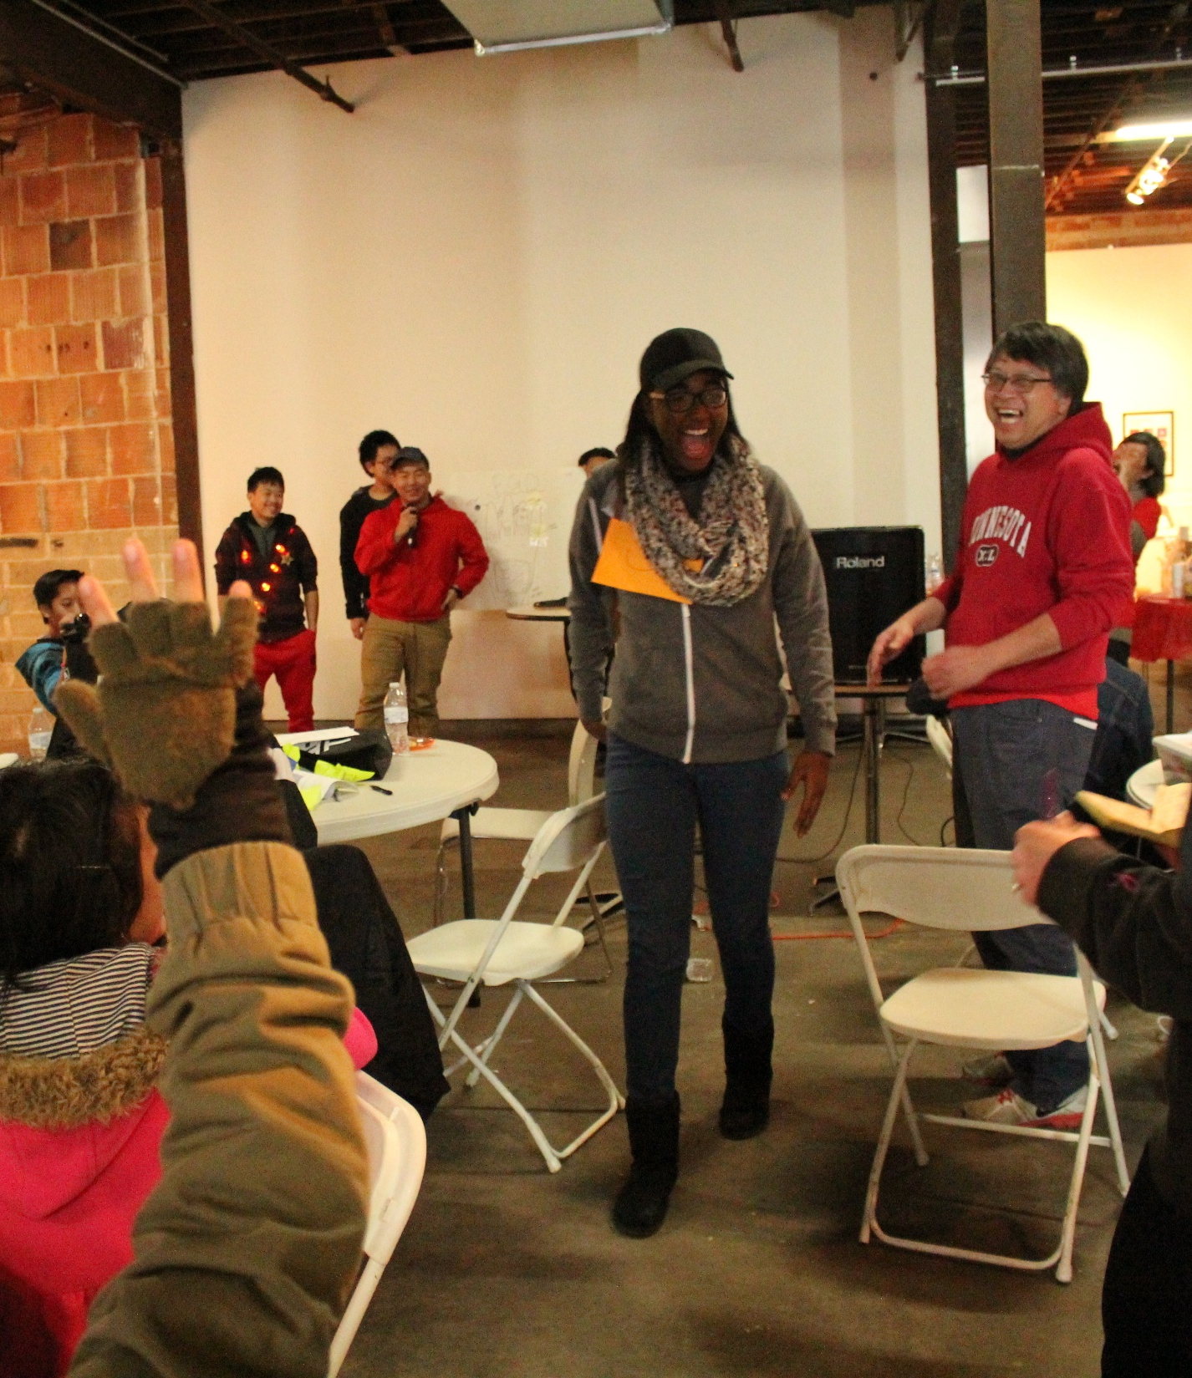
E-Magine Curriculum
Generative AIs – Writings, Images, Pod-castings, Videos
Digital Marketing – Keyword Search, and Google Analytics
Wordpress Web Design
AI platforms:
https://creator.nightcafe.studio/
http://leonardo.ai
OPEN AI
https://huggingface.colmstudio
https://lmstudio.ai
CONTENT PUBLICATION
mailchimp.com
https://www.clearscope.io
https://deepmind.google

Slide 17
Getting Started
Financial Literacy
What is AI and Why it Matters
Writing with AI - ChatGPT basics
Making pictures with AI
Simple graphic design with Canva
Making Audio and Podcast
Making Simple Videos
Telling Stories with Multiple Tools
Learning From Real Professionals
Marketing Basics with AI Help
SEO Basics (Getting Found on Google)
Social Media Management Made Simple
Google Analytics and Ads (Simplified)
Advanced Social Media Strategy
Website Basics for Beginners
WordPress for Beginners
WordPress Customization Made Easy
Simple Online Store Setup
Future of the Internet (Web3 Basics)
Weekly Lesson Plans

Slide 18
Introductions to Computer Basics
Basic Computer Skills
File organization on your computer (30 mins)
Taking screenshots (15 mins)
Basic internet browsing tips (15 mins)
Google Drive

Slide 19
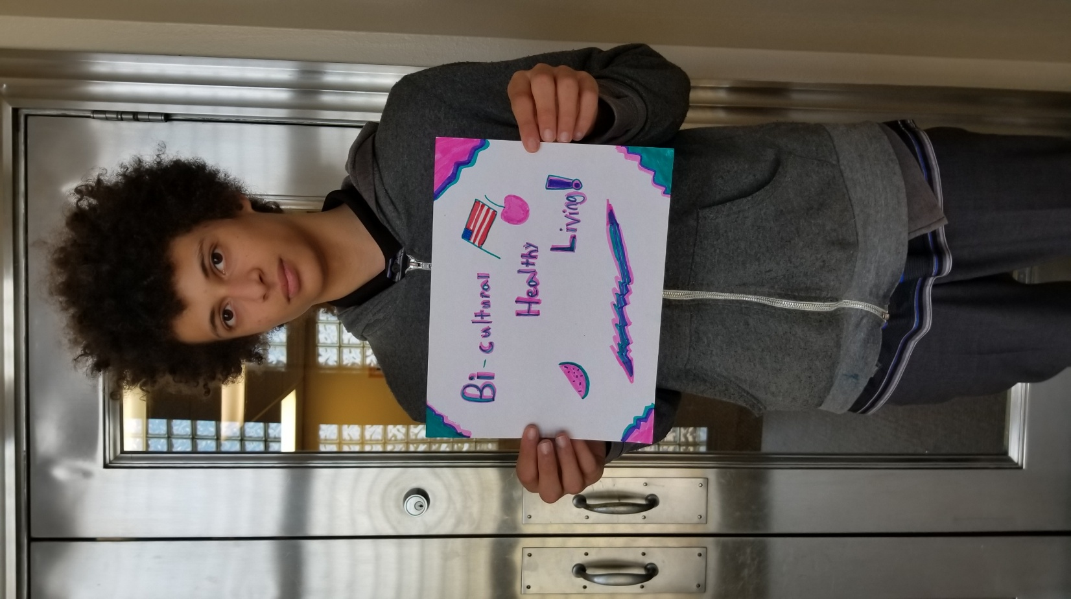
casemanager@amamedia.org
612-477-4682

