Slide 1
Module Overview
This presentation gives student co-researchers a narrative frame for why food—with examples of rice and native grains—matters as a global story of resilience, cultural identity, and land-based innovation. It provides cultural grounding, historical parallels, and cross-continental examples that mirror the work students are doing through community engagement and food system mapping in North Minneapolis.

Slide 2
Rice as a Native and Diasporic Connector
"Manoomin to Marshlands: Rice as a Native and Diasporic Connector"
Minnesota (Anishinaabe - Manoomin | Zizania palustris):
Wild rice, or manoomin, grows naturally in shallow lakes and slow-moving streams across Minnesota and parts of Canada.
It is a native aquatic grass that is hand-harvested using traditional cedar canoes and rice knockers.
Anishinaabe oral tradition describes migrating westward until they found “the food that grows on water.”
Wild rice habitats are deeply sensitive to water levels, pollution, and development—making them an ecological and social justice concern today.
Southeastern U.S. (Gullah Geechee Nation - Carolina Gold | Oryza glaberrima and O. sativa):
Enslaved Africans from West Africa brought deep knowledge of cultivating Oryza glaberrima, the African domesticated rice species.
These agricultural skills included water management, bunding, and field terracing—critical to growing rice in the marshy Lowcountry.
The success of Carolina Gold rice depended on this West African expertise, and entire economies were built upon it.
Source: https://lowcountrygullah.com/the-lowcountry-story-of-rice/
China and Asia (Oryza sativa - Asian Rice):
Asian rice (Oryza sativa) was first domesticated over 9,000 years ago in the Yangtze River basin.
Two main subspecies—indica and japonica—spread to Southeast Asia, India, and beyond.
Developed in parallel with innovations in irrigation, terrace farming, and monsoon-based planting cycles.
Rice became central not only to sustenance but also to social and spiritual systems throughout Asia.
Student Link:
These examples show how land, skill, and identity are tied to rice across 3 continents. As you collect stories about food access in North Minneapolis, you are documenting a living continuation of place-based food knowledge and cultural resilience.

Slide 3
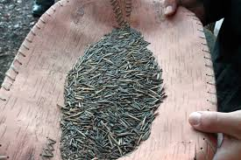
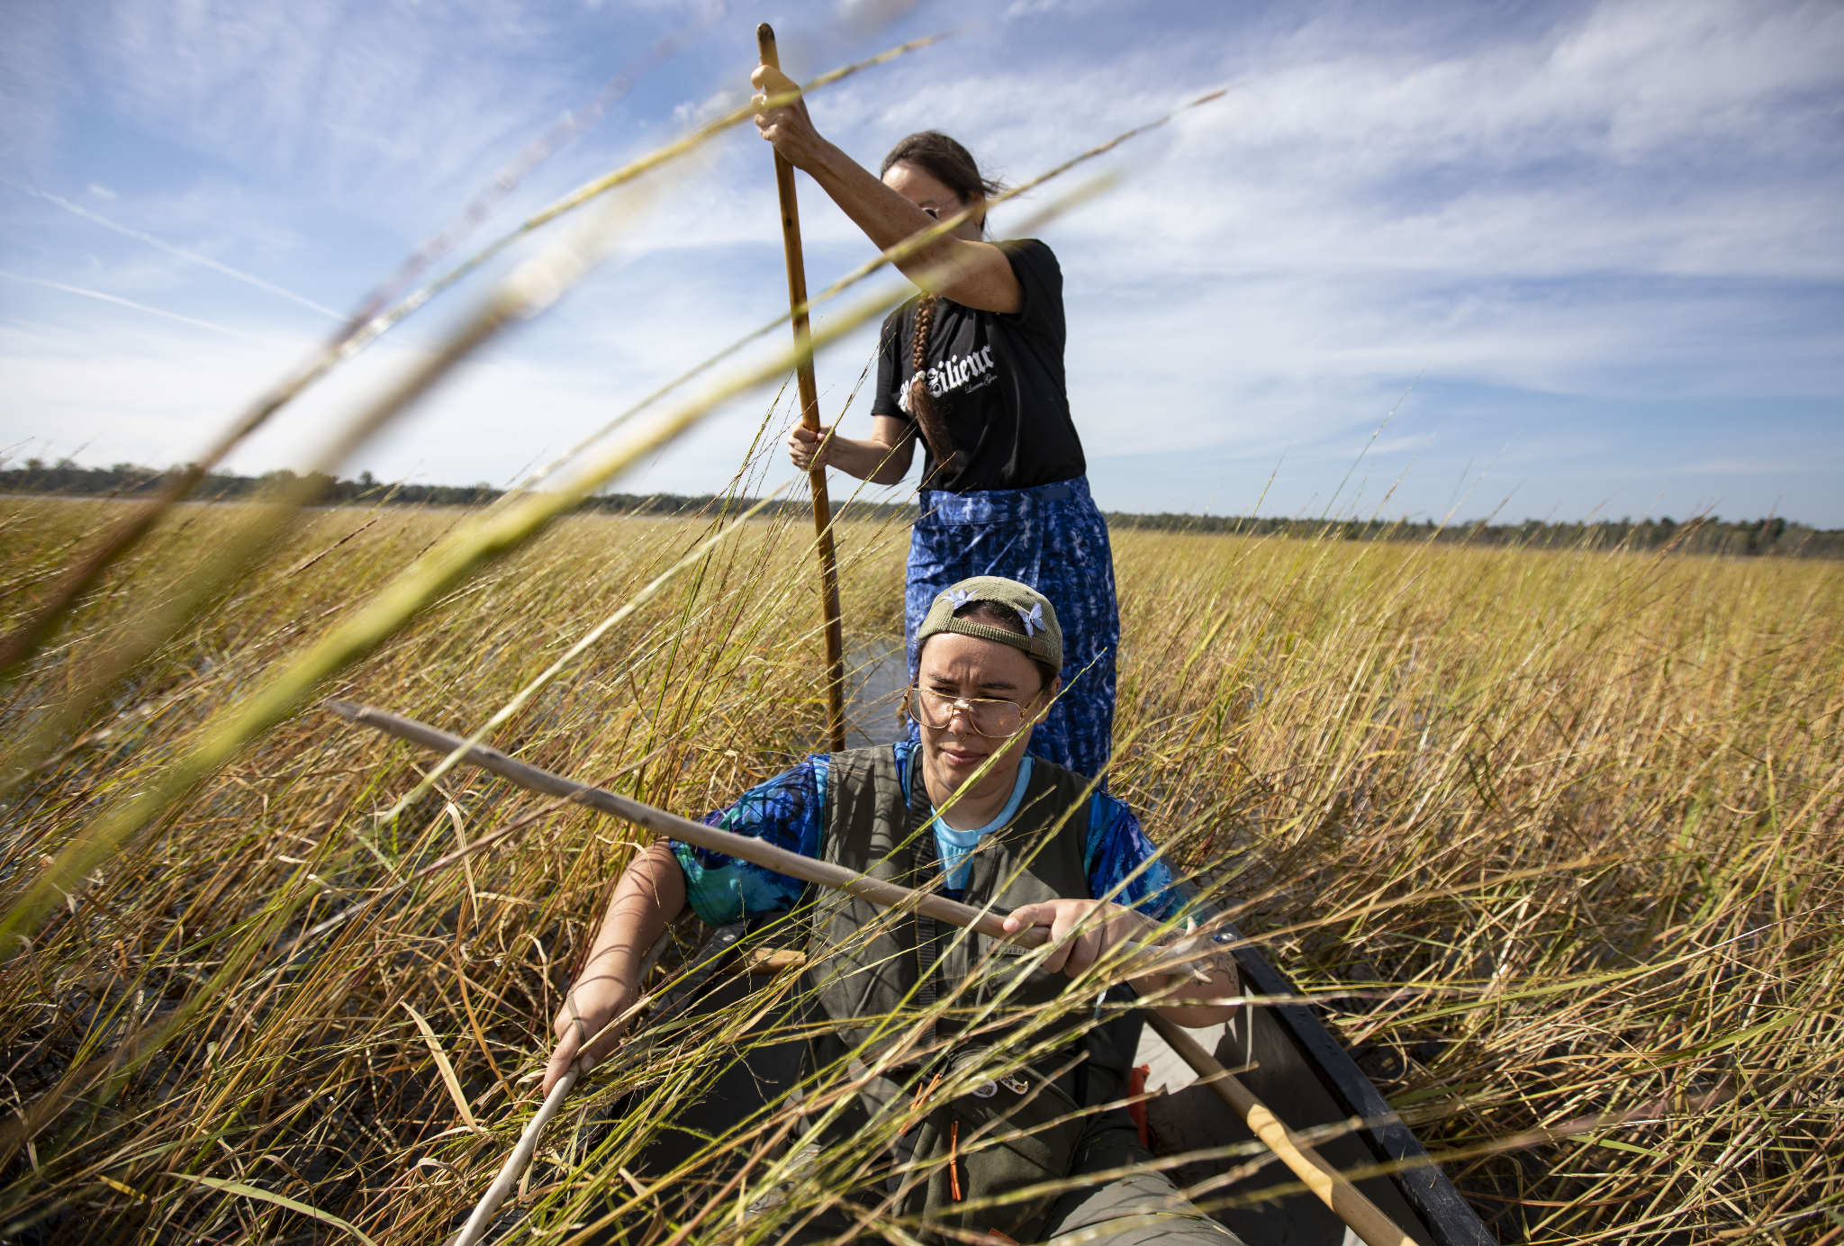
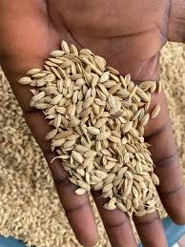
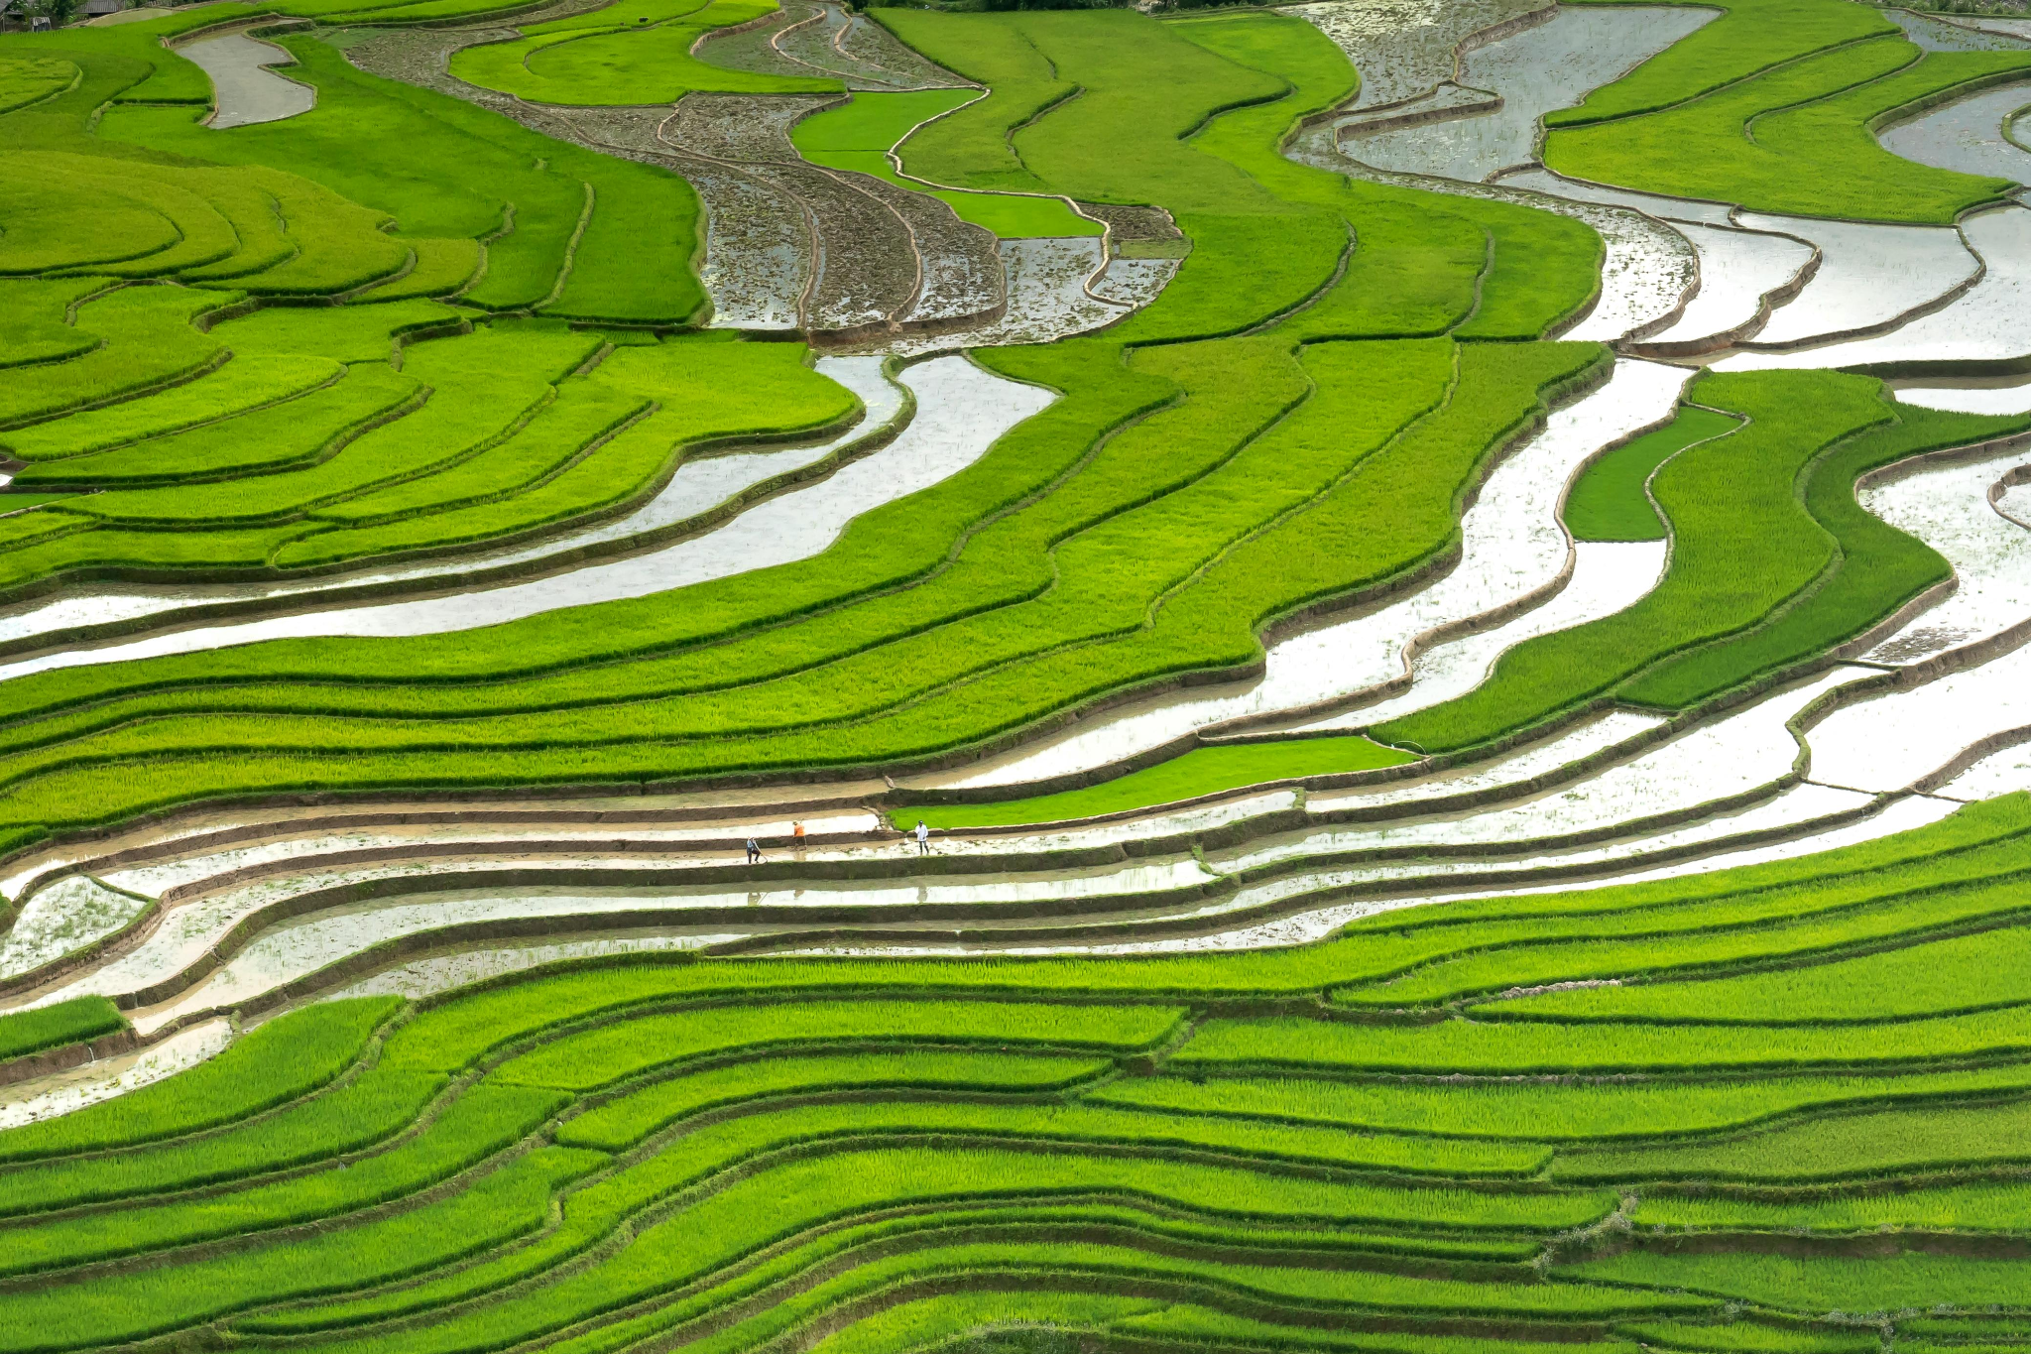
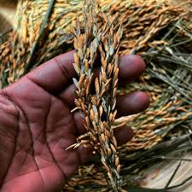

Slide 4
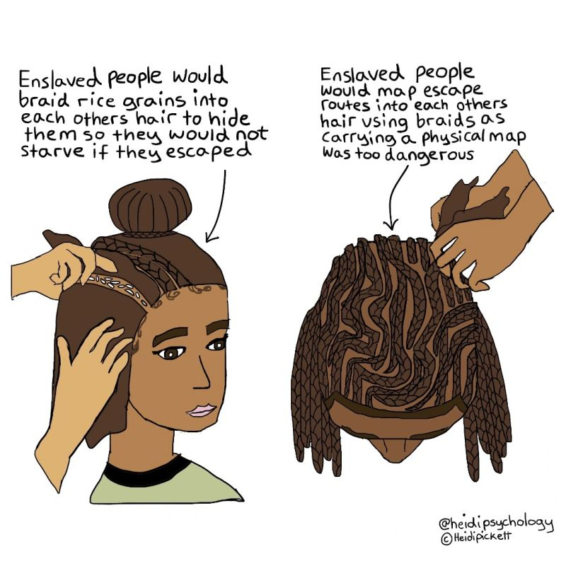
Freedom Farmers and the Black Agrarian Tradition
Fannie Lou Hamer and the Freedom Farm Cooperative (1969):
A pioneering Black-led initiative to secure land and grow food collectively in Mississippi.
Focused on economic independence, nutrition, and resistance to racialized poverty.
Provided vegetables, livestock, and even housing for dozens of families.
George Washington Carver’s Jessup Wagon and Agricultural Bulletins:
Carver’s mobile agricultural classroom taught soil restoration, crop rotation, and household food preservation.
These bulletins reached thousands of Black farmers with practical knowledge.
Advanced both food security and land stewardship across the South.
Book Reference: Freedom Farmers by Monica White:
Documents how Black agricultural cooperatives were central to civil rights and community resilience.
Emphasizes food sovereignty as a strategy of liberation—not just survival.

Slide 5
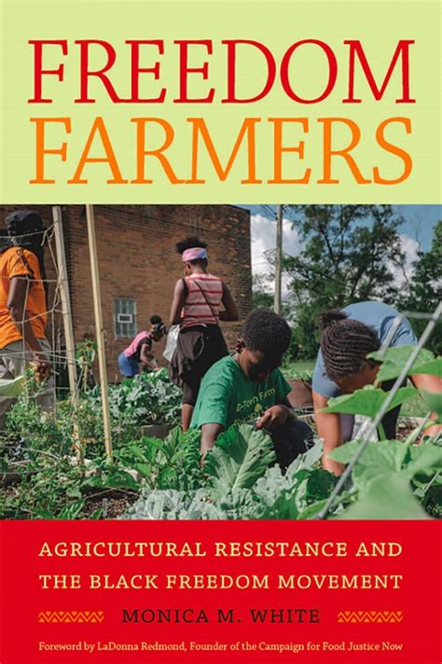
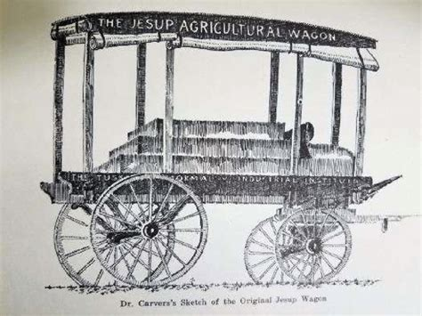
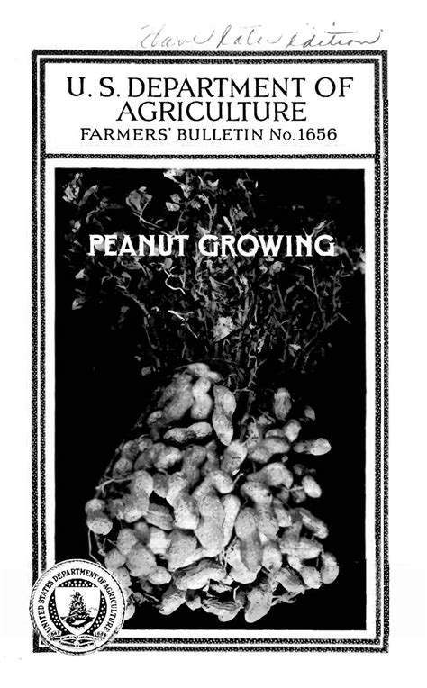
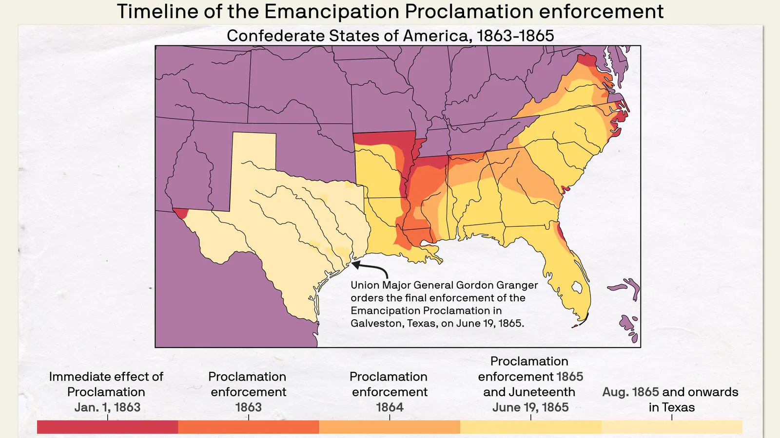

Slide 6
Food Sovereignty in Action: South to Norht to Now
Detroit’s Agrihood:
A community-driven farm and housing model revitalizing Black neighborhoods.
Blends agriculture, education, and affordable housing in a formerly abandoned neighborhood.
Project Sweetie Pie (North Minneapolis):
Builds youth leadership through gardening, storytelling, and workforce development.
Partners with schools and nonprofits to foster a green economy rooted in cultural pride and food justice.
Juneteenth as a Food Sovereignty Milestone:
A celebration not only of emancipation, but also of reclaiming land and food autonomy.
These case studies show the long arc of freedom work—from field to fork, from past to present.

Slide 7
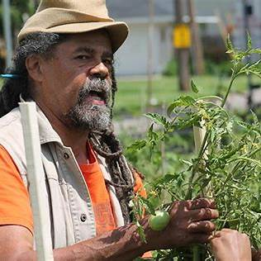
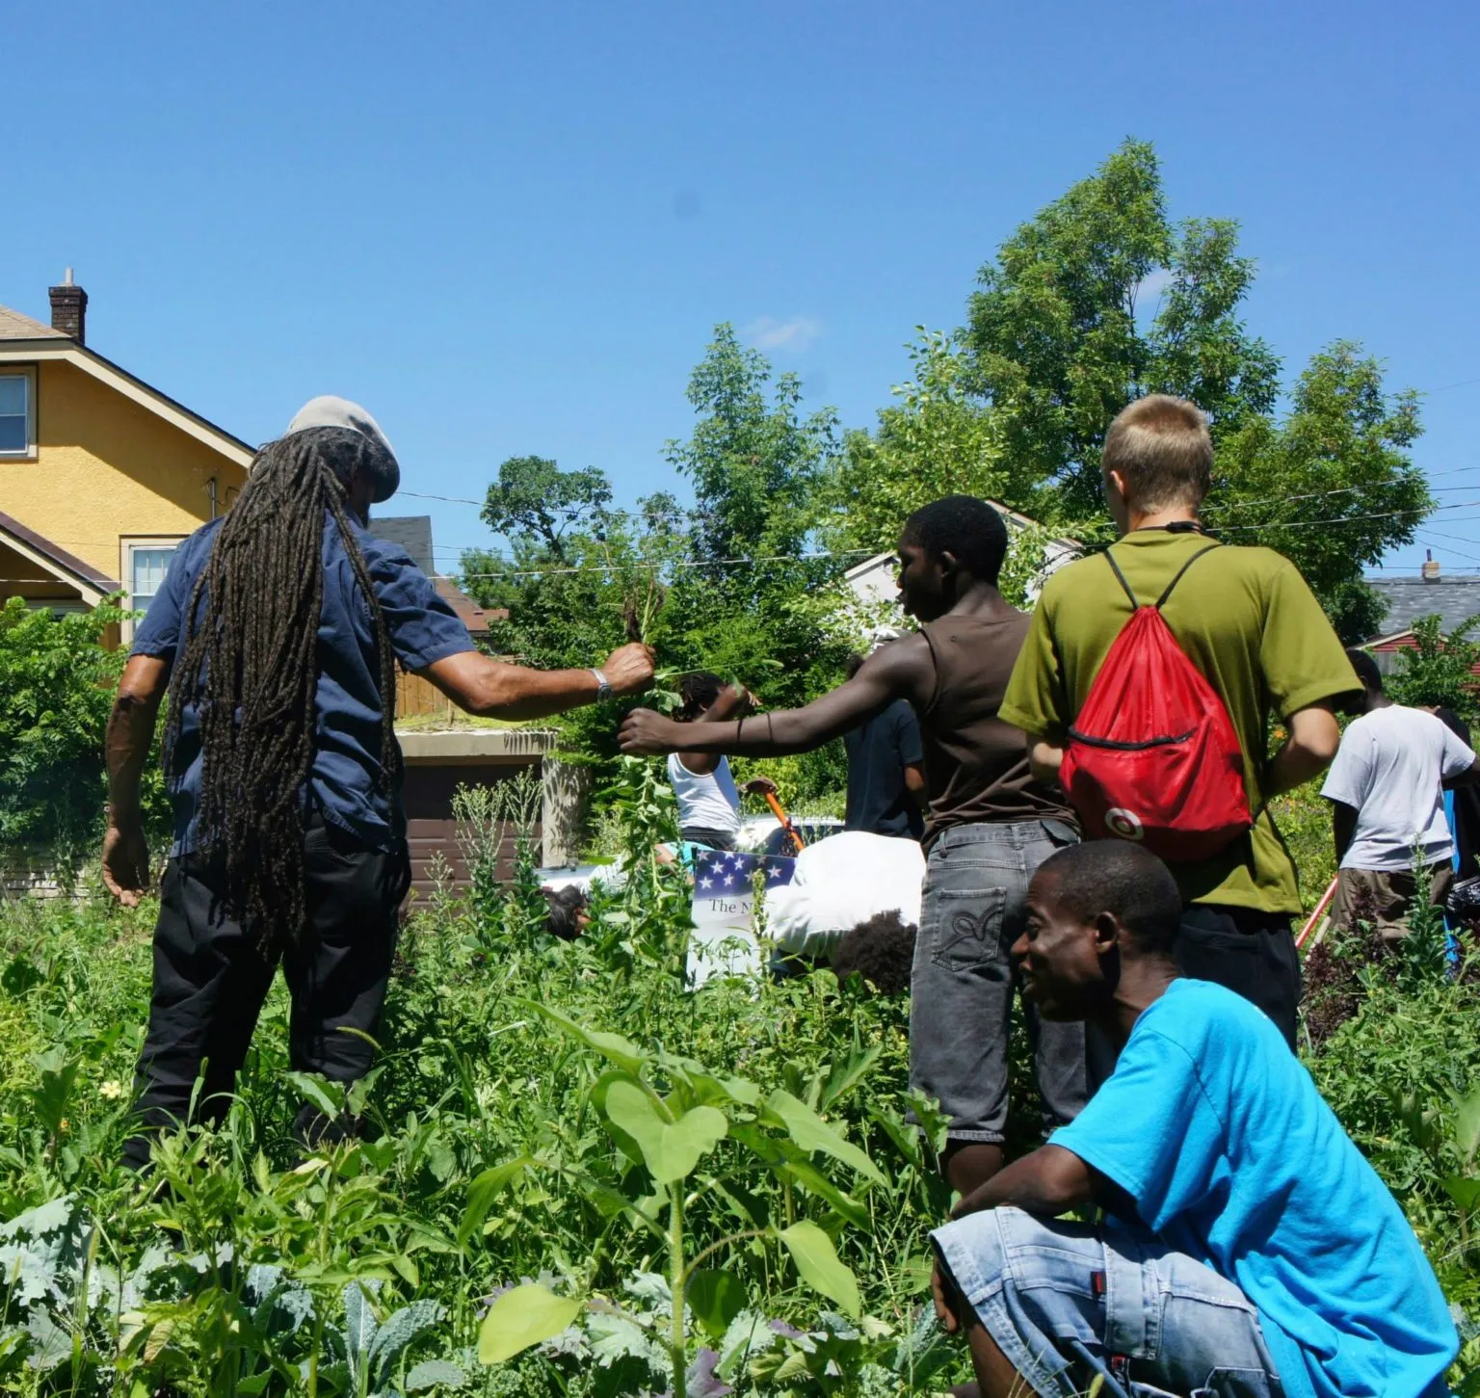
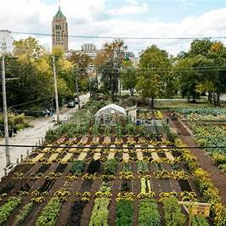

Slide 8
Growing Growers to Grow Power
Naakpa Collective (Kakadu Plum Co.):
Aboriginal-led initiative advancing both the economic and cultural value of native foods like Kakadu plum.
Focuses on regenerative harvesting, ethical supply chains, and cultural preservation.
An inspiring model for how marginalized communities can shape their own economies through food systems.
Bruce Pascoe & Dark Emu / Black Duck Foods:
Pascoe’s work in Dark Emu and with Black Duck Foods challenges colonial myths by documenting Aboriginal farming traditions.
Revives use of native grains like kangaroo grass and native millet, adapted to Australia’s soil and climate.
Offers a powerful example of food sovereignty through the restoration of suppressed knowledge.
Source: https://theconversation.com/bruce-pascoes-black-duck-is-a-healing-and-necessary-account-of-a-year-on-his-farm-following-a-difficult-decade-after-dark-emu-224971
Call to Action for Students:
Think of rice and grain not just as food, but as carriers of memory and dignity.
Use your Juneteenth interviews to trace local knowledge that might otherwise go undocumented.
Ask: What can we learn from those who’ve fed their communities with limited resources, rich culture, and deep-rooted care?
Closing Reflection: Whether in the marshes of Carolina, the paddies of Southeast Asia, the grasslands of Australia, or the lakes of Minnesota, food carries the histories of migration, land care, and survival. By listening to your neighbors at Juneteenth, you are helping surface the North Minneapolis chapter in this ongoing, transnational story.

