Slide 1
e-Magine! Initiative
Every Mon, Tue, Thurs, Fri from 9am – 2:30pm at West Metro Chinese Church

Slide 3
Every Day, we will have below schedule for the E-Magine!! – Generative AIs and Digital Marketing
9am - 9:30am - Checking in
9:30 - Noon - First Training
Noon – 12:30pm - Lunch
12:30-2:30pm - 2nd Training

Slide 4
Eligibility
You must be the Minnesota residents

Slide 5
Payment will be made as an $1,000 incentive check (deducting the lunch expenses) to members who completed 60 hours learning and 18 hours internships with required products
With 80% attendance rate and all required products to earn the Crown College’s certificates
Notes:
Most Asian traditional cultures are based on Confucius philosophy and Buddhism. The traditional view of the human body is as a derivative of the natural world, and need to be in balance between Yin and Yang, and promotes self-sustaining, workout according to seasons, and simple living philosophies. Confucian culture also shapes family structure, in which the family relationship is hierarchical in nature. Consequently the male who is head of household has more power than the female, than the children. Familial decision-making usually includes extended family members, such as grandparents and other significant relatives. Children are expected to obey elders and to put the family’s needs above their own.

Slide 7
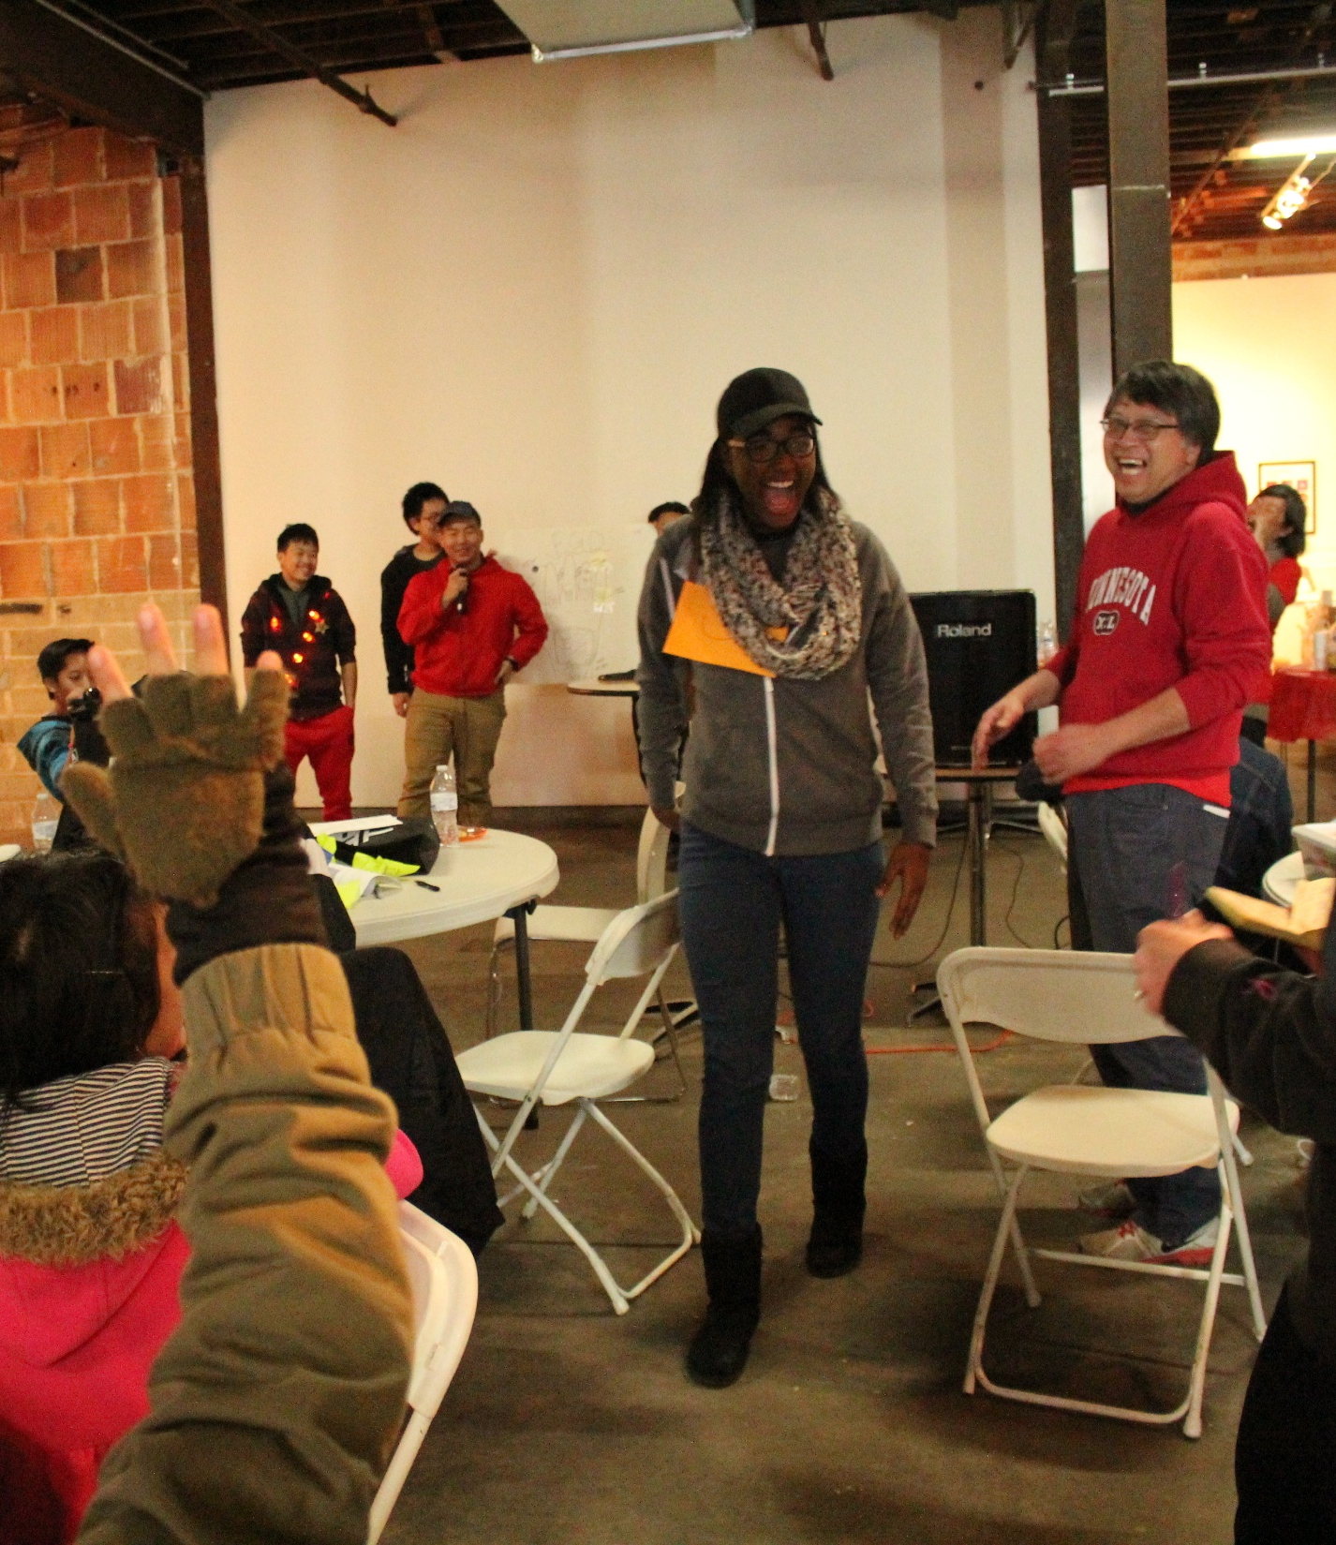
E-Magine Curriculum
Generative AIs – Writings, Images, Pod-castings, Videos
Spatial Data Science & AI, ex. GIS Mapping
Digital Marketing – Keyword Search, and Google Analytics
Wordpress Web Design
Final Service Learning Project:
Developing 4 GIS Maps
Develop Food Sectors’ related AI Portfolio – 10 images, 4 postcards, 4 infographics, 2 podcasting, and 2 videos
Developing own AI Portfolio – putting all products into 1 eMagazine and 1 Website

Slide 8
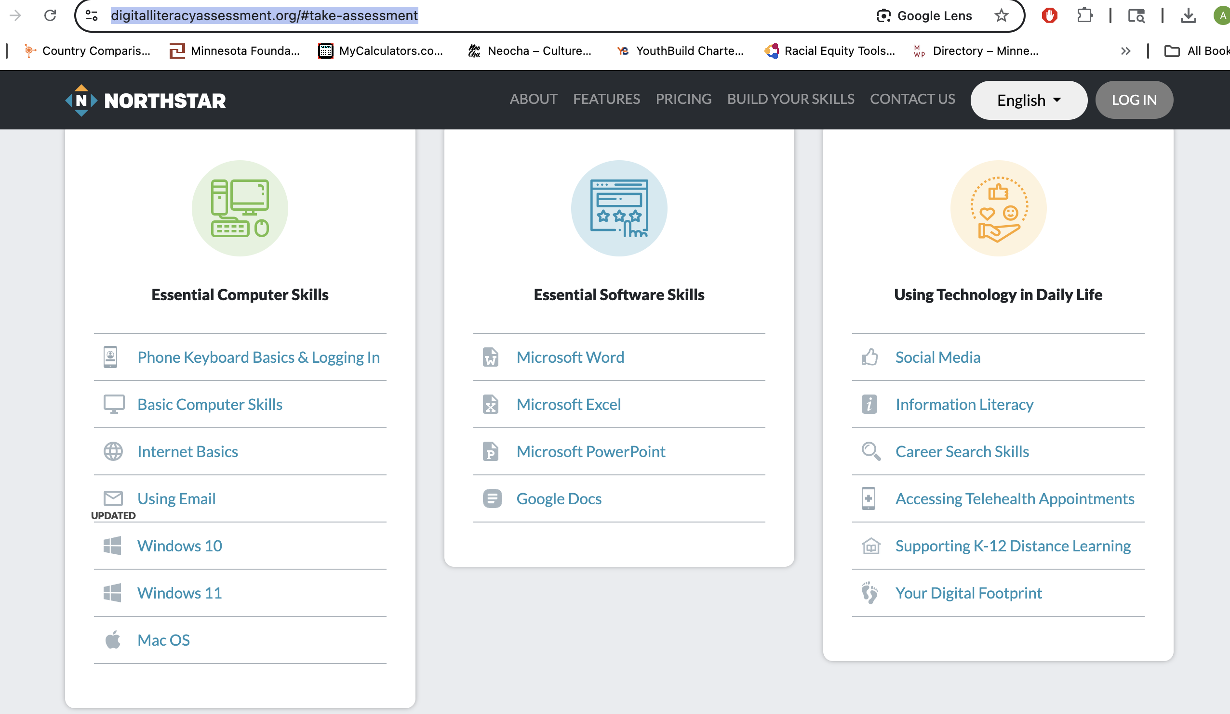
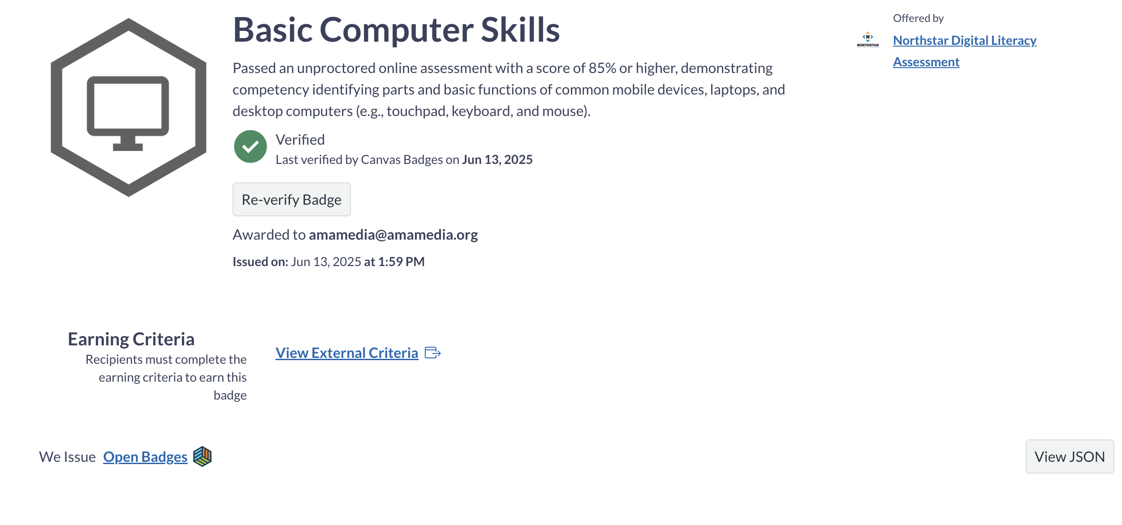
Computer Literacy
Assessment Tools
https://www.digitalliteracyassessment.org/#take-assessment
https://edu.gcfglobal.org/en/computerbasics/basic-parts-of-a-computer/1/
Badges

Slide 9
Service Learning Project:
Sankofa Power

Slide 10
Multi Cultural Community Alliance
presents
SANKOFA
PAGE 1
A Digital Platform for Northside Food Ecosystem
Led by MN 350

Slide 11
SankofaPOWER
ABOUT OUR
PROJECT
As part of SankofaPOWER, we’re developing The NorthStar Urban Farm & Food Digital Platform—a community-powered website that connects North Minneapolis (zip codes 55411, 55412, and 55407) through food. It works like a digital map of our local food ecosystem, combining GIS maps, ACS data charts, and multimedia stories—all in one place. The site includes a community directory, like a modern-day phonebook, highlighting people and groups who are sharing food, teaching classes, or running community gardens.
Similar to Facebook Marketplace, it lets neighbors post what they have, find what they need, and message each other directly to exchange resources and information. Instead of relying on large companies or outside grocery chains, we’re building a local, sustainable, and environmentally friendly food system —one that celebrates traditional cultural crops, food preservation, and the stories behind what we grow and eat. It’s a resource you won’t find on other sites. Sign up to start connecting with your neighbors digitally and physically.
PAGE 2

Slide 12
SankofaPOWER
NORTHSTAR URBAN FARM & FOOD DIGEST ("YELLOW PAGES")
A dynamic multimedia resource providing real-time food information through interactive GIS maps to find food access points, environmental data, and demography. It also features community-created videos, AR/VR experiences, and podcasts documenting food traditions. The platform includes resource matching capabilities, connecting food surplus with community needs across urban farms and backyard growers.
NORTHSTAR URBAN FARM & FOOD REGISTRY ("WHITE PAGES")
A comprehensive directory cataloging every food-related entity including community gardens, farmers' markets, food shelves, restaurants, and urban farms. The registry serves as a contact and collaboration hub facilitating connections between neighbors, organizations, and businesses for community food system development.
PAGE 3
THE NORTHSTAR TRADING POST (BUSINESS & INVESTMENT HUB)
A marketplace for economic empowerment, offering opportunities for residents to start food businesses, access entrepreneurship training, and participate in collective investment in real estate including market spaces and commercial kitchens. The platform provides comprehensive business development support from startup guidance to funding acquisition for community-driven enterprises.
MINNEAPOLIS COMMUNITY BEAM (BUILDING ECONOMIC ASSETS & MEMORY)
A community-controlled database preserving cultural foods, oral histories, and economic progress through searchable archives of interviews, photos, and documents with AI-assisted relationship mapping. The platform provides information, resources, policy advocacy tools for tracking local food/environmental policies and establishes such Community Data Hub for overall neighborhood wellbeing.

Slide 13
SankofaPOWER
PLANNING PROCESS
PAGE 4

Slide 14
SankofaPOWER
Led by MN 350
PAGE 5

Slide 15
SankofaPOWER
DIVERSE FOOD SECTORS
GIS MAPS * DEMOGRAPHICS
SANKOFA
BUS AND BIKE ROUTES
PAGE 6
POWER
COMMUNITY GARDEN & FOOD BANK LOCATOR
THE DATA
CULTURAL FOOD STORIES
PODCASTING * PHOTOS
VIDEOS
Led by MN 350

Slide 16
SankofaPOWER
SANKOFAPOWER
DIGITAL PLATFORM
PAGE 7
community Garden
Food Bank
Farmer Market
Grocery Store
Led by MN 350

Slide 17
SankofaPOWER
PAGE 8
Led by MN 350

Slide 18
SankofaPOWER
FOOD ECOSYSTEM AT NORTHSIDE
PAGE 9
MORE TO COME.....
Led by MN 350

Slide 19
EXAMPLES
www.findhelp.org
https://experience.arcgis.com/experience/802905182bf641f5af83b2136a3f80df/page/BLE-Map?views=Map-layers
https://aidigital.amamedia.org/cindyxiongai/

Slide 20
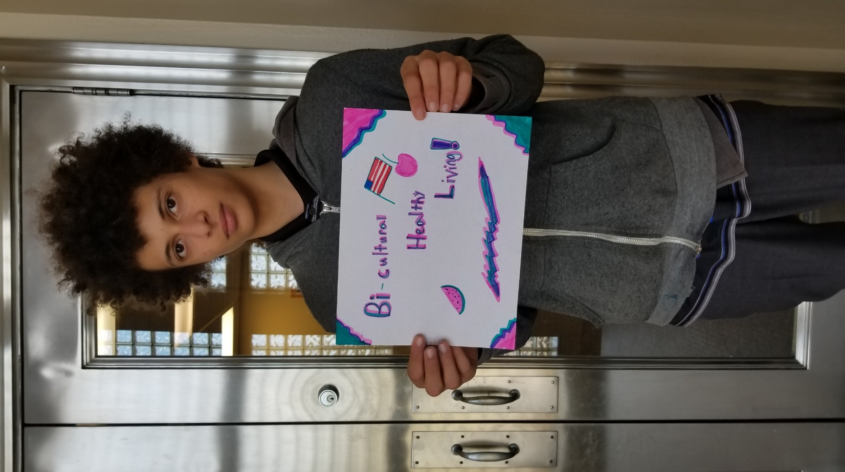
Asian Media Access’ Contacts
Ange Hwang at angehwang@amamedia.org
Stephen Lu at stevelu@amamedia.org
Maya Park at casemanager@amamedia.org
612-376-7715

Slide 21
Bring a Positive Mind
Ask a lot of Questions
Try Tons of New Things
Support Your Team
Have Fun, Be Silly
Make a lot of Mistakes
We are here for YOU ☺

Slide 22
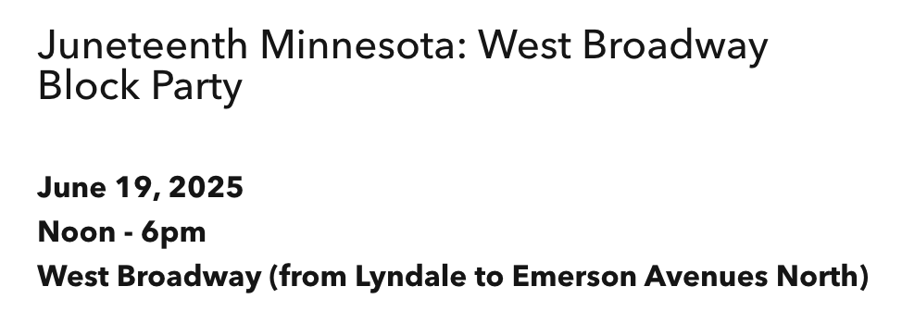
Juneteenth Day
STEVE’s CELL PHONE at 952-451-7960

Slide 23
06/17 Assignments
3 images for each food sector you chosen in 55411, 55412, 55407 with diverse ethnicities in the images:
One as Cubist and one as Watercolor, and one as Picasso style
E-mail to: casemanager@amamedia.org
Sian.xiong@amamedia.org

