Slide 1
e-Magine! Initiative
Every Sat 9am – 5pm at FreedomWorks

Slide 3
Every Week, we will have below schedule for the E-Magine!! – Generative AIs and Digital Marketing
9am - 9:30am - Checking in
9:30 - Noon - First Training
Noon - 2pm - Lunch and ”Food Is Medicine" - Rochester Clinic
2-4:30pm - 2nd Training
4:30 - 5pm - Reflections

Slide 4
Eligibility
You must be the City of Mpls residents

Slide 5
1st – Computer Literacy 101
1st – State of AIs
2nd – Generative AIs PART 1 & 2 – Writing, Images
2nd - Generative AIs PART 3 – Graphic Design
3rd – Financial Literacy 101
3rd – Generative AIs, PART 4 – Podcasting/Video Production and Video Enhancement with Davinci
4th – Project Overview, Interview Skills, and Data Research, Storytelling
4th – Spatial Data Science, PART 1: Introduction to GIS, Spatial Data Collection
5th – Spatial Data Science, PART 2: Online Portals for Spatial Data
5th Spatial Data Science, PART 3: Spatial Data Management, Visualization, & Analysis
6th - Prep for Field Interview and Production
6th - Field Interview and Production
7th – Digital Marketing, PART 1
7th – Digital Marketing, PART 2
8th – Website Development, PART 1
8th – Website Development, PART 2
9th – Internship: Finalizing Products
9th – Internship: Finalizing Products
10th- Internship: Finalizing Products
10th- Internship: Finalizing Products
Weekly Lesson Plans

Slide 6
Payment will be as Monthly Wages with timesheets – to build track work records for everyone
Hourly Rate at $16.50 per hour for 60 hours, with volunteer 20 internship hours
7.5 hours per week for 8 weeks = 60 hours, then the last 2 weeks would be volunteering to create your own stories
With all products to earn the Crown College’s certificates
Notes:
Most Asian traditional cultures are based on Confucius philosophy and Buddhism. The traditional view of the human body is as a derivative of the natural world, and need to be in balance between Yin and Yang, and promotes self-sustaining, workout according to seasons, and simple living philosophies. Confucian culture also shapes family structure, in which the family relationship is hierarchical in nature. Consequently the male who is head of household has more power than the female, than the children. Familial decision-making usually includes extended family members, such as grandparents and other significant relatives. Children are expected to obey elders and to put the family’s needs above their own.

Slide 8
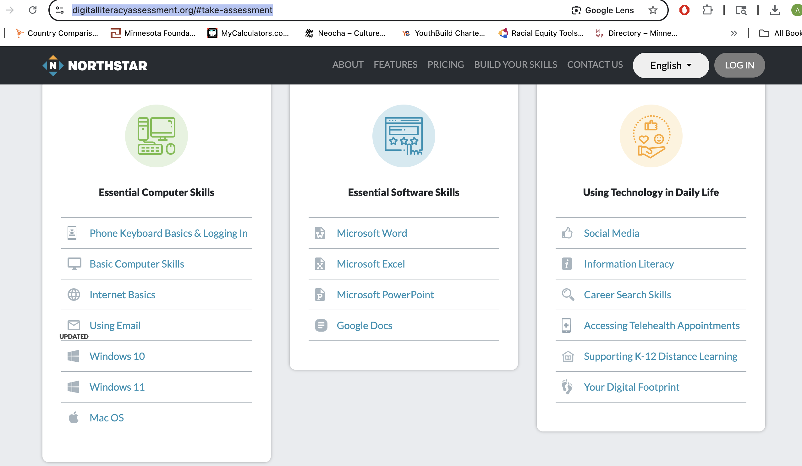
Computer Literacy
Assessment Tools
https://www.digitalliteracyassessment.org/#take-assessment
https://edu.gcfglobal.org/en/computerbasics/basic-parts-of-a-computer/1/
Badges

Slide 9
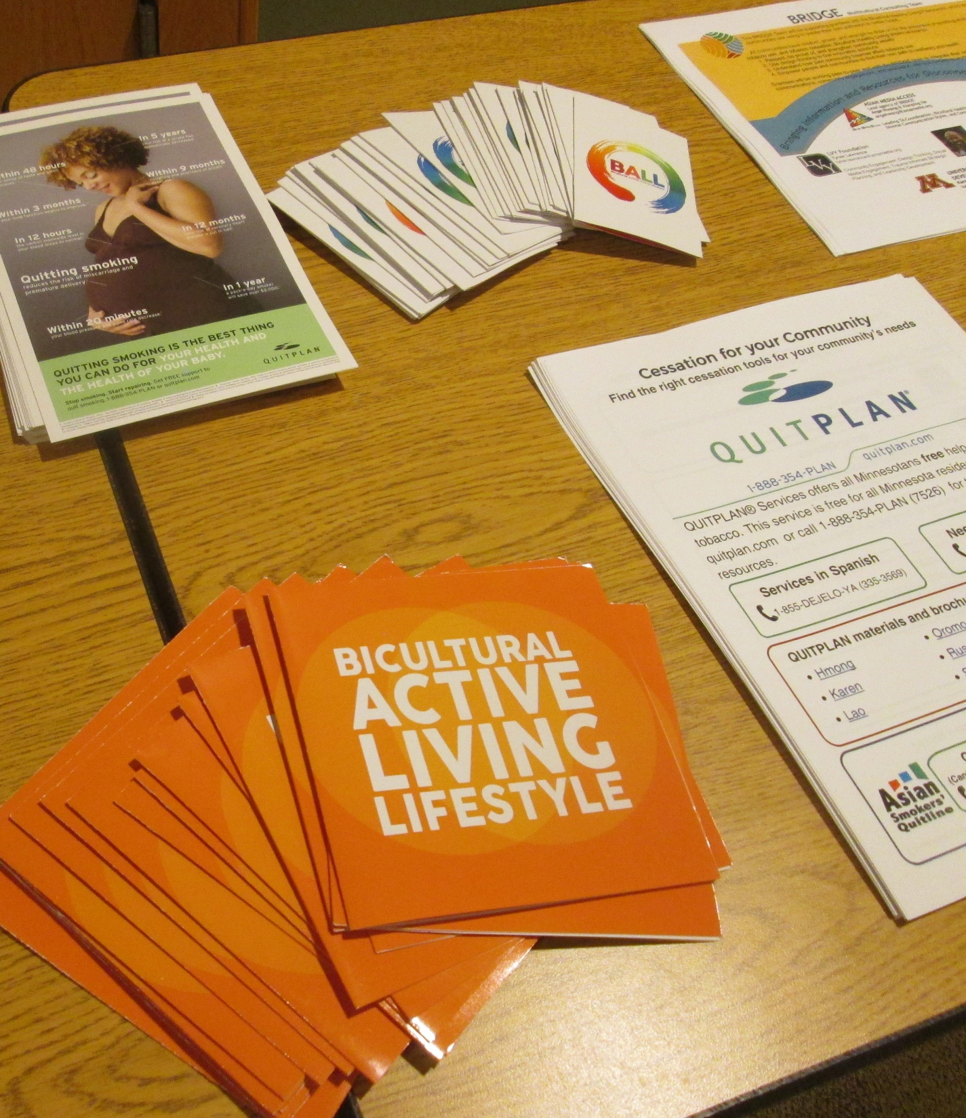
Bicultural Healthy Living with substance free, active and healthy eating lifestyle

Slide 11
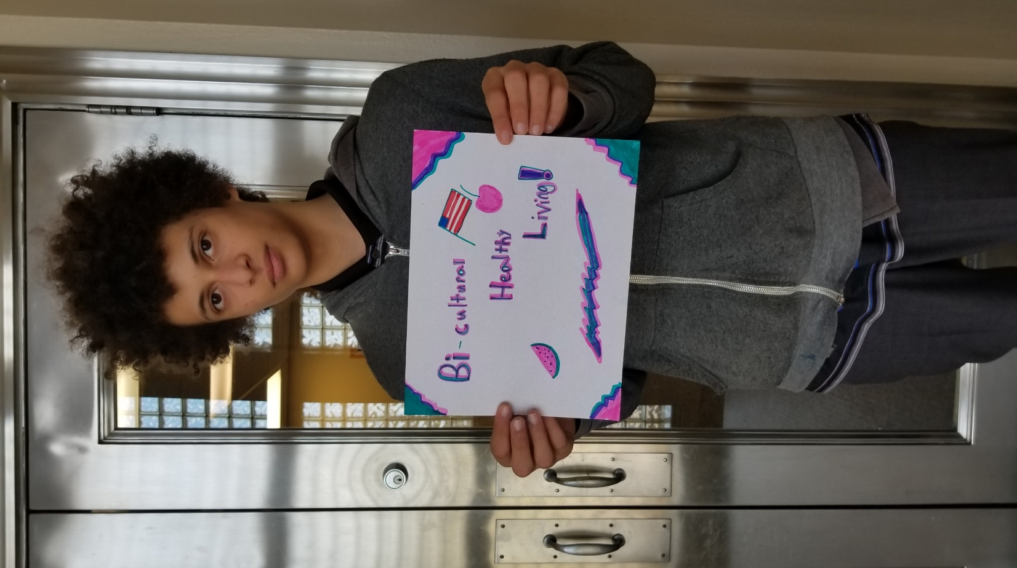
Asian Media Access’ Contacts
Ange Hwang at angehwang@amamedia.org
Stephen Lu at stevelu@amamedia.org
Maya Park at casemanager@amamedia.org
612-376-7715

Slide 12
casemanager@amamedia.org
612-477-4682

