Slide 1








e-Magine! Initiative
Every Mon/Tue 5:30 – 8:30pm

Slide 2


Today’s Agenda
What is WordPress
WordPress.com vs WordPress.org
Typical WordPress development process
WordPress Backend
Creating your WordPress website
Introduction to Gutenberg
Plugins recommendations
Q&A

Slide 3
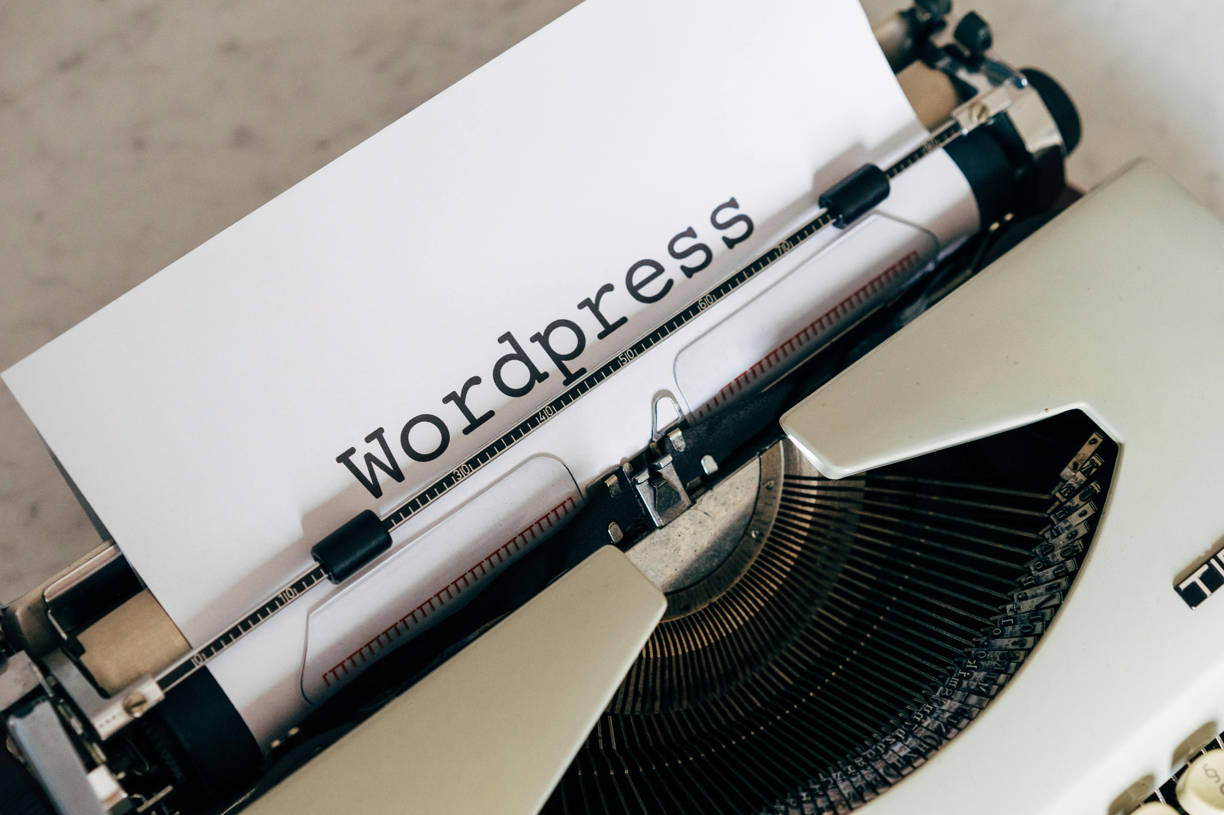

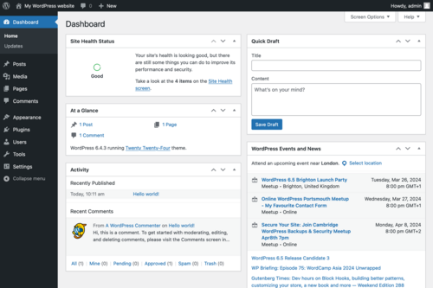
What is WordPress
WordPress is a free, open-source content management system (CMS) that allows users to easily create and manage websites, originally designed for blogging but now used for a wide variety of website types, including blogs, portfolios, and e-commerce stores.
Photo Courtesy: wordpress.org

Slide 4

WordPree.com vs WordPress.org
 | WORDPRESS.COM (HOSTED FOR YOU) | WordPress.org (SELF-HOSTED)
Setup | No setup or hosting needed | You host your own site
Control | Limited control unless you pay | Full control and customization
Ease of Use | Easier for beginners | Requires more setup and maintenance
Cost | Free basic plan (paid upgrades) | Free software (but pay for hosting/domain)
Best For | Personal blogs, small projects | Businesses, stores, serious projects

Slide 5
Typical WordPress Development Process
PLANNING AND RESEARCH | CONTENT WRITING | DESIGN AND WIREFRAMING | DEVELOPMENT | TESTING AND QUALITY ASSURANCE | DEPLOYMENT AND LAUNCH | MAINTENANCE AND UPDATES
Define project goals, target audience, and business requirements & Set up the domain name and hosting | Gather text, images, videos, and other media that will be used on the website | Develop visual representations of the website's layout and structure | Develop the user interface and interactive elements using the web editor | Ensure that the website functions as intended and evaluate the user experience and identify areas for improvement | Make the website live and accessible to users | Track website traffic, user behavior, and identify areas for improvement. Regular updates and maintenance.

Slide 6


WordPress Backend
WordPress dashboard
This is where you, as the administrator, can style your site, install plugins, write blog posts, create new pages, and change site settings.
Dashboard
Posts
Media
Pages
Comments
Appearance
Plugins
Users
Tools
Settings

Slide 7
Posts vs Pages
 | POSTS | PagES
Purpose | Timely content (blogs, news, updates) | Static content (Home, About, Contact)
Organization | Categorized and tagged | Organized in a hierarchy (parent/child)
Display | Appears in blog feed, sorted by date | Standalone; added to site menus
Comments | Usually allows comments | Comments usually off (can be enabled)
Date Sensitive | Yes — organized by publish date | No — stays consistent over time
Examples | Blog post, event update | About page, Services page

Slide 8


Creating Your WordPress Website
Purpose - What is the main goal of your website?
Audience - Who do you want to visit your website?
Website Name - If you could pick any domain name (like mywebsite.com), what would it be?
Images and Media - Do you already have photos, postcards, or videos you want to use?
Design Style - How do you want your website to look and feel? (Pick 2–3 words)(Examples: Modern, Elegant, Friendly, Fun, Minimalist, or write your own)

Slide 9


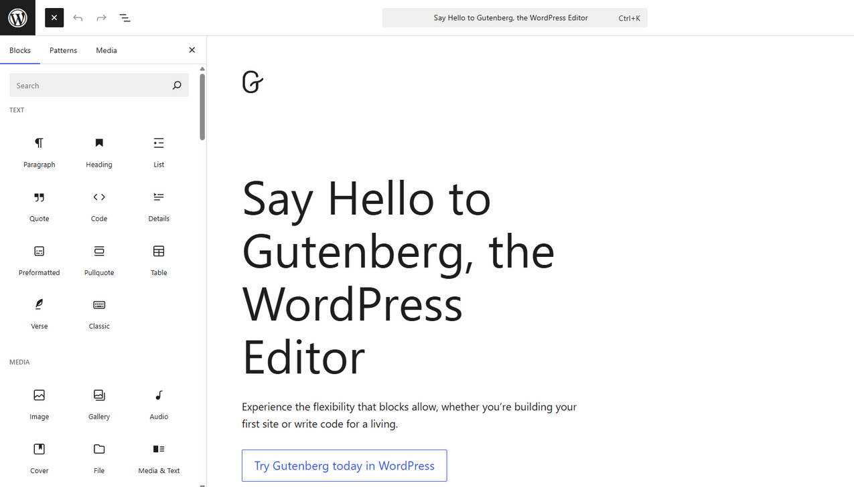
Introduction to Gutenberg
The WordPress Block Editor
Gutenberg is known as the block editor because it provides a library of individual content blocks. These blocks cover use cases such as text formatting, media insertion, and section arrangement.
Photo Courtesy: wordpress.org/gutenberg/

Slide 10

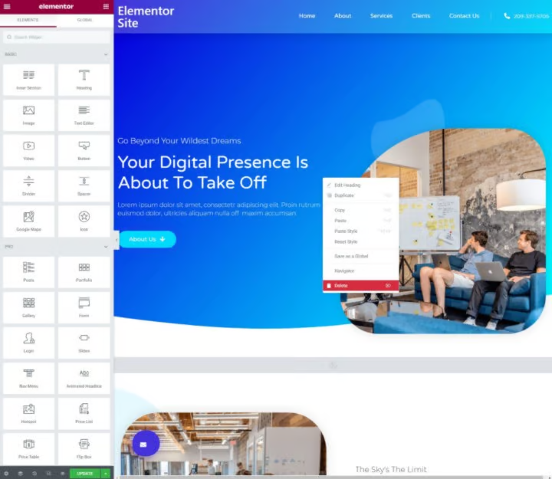
Plugins recommendations
Another Web Editor - Elementor
A popular drag-and-drop WordPress website builder plugin that allows users to create and customize websites visually, without needing extensive coding knowledge
Photo Courtesy: elementor.com/blog/what-is-elementor-for-wordpress/

Slide 11
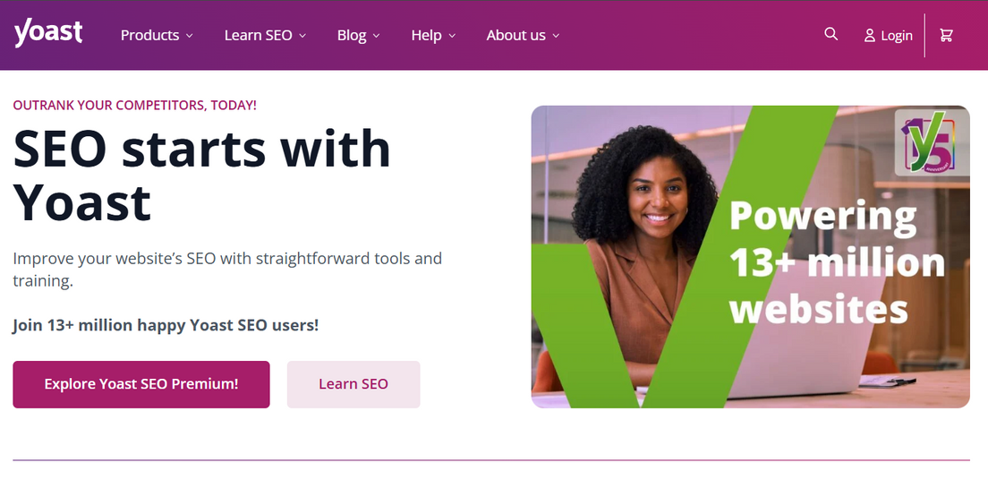
Plugins recommendations
All the help you need for SEO - Yoast SEO
Whether you run a small business, a webshop, or a blog, Yoast SEO Premium ensures your website competes in the search results.
Photo Courtesy: yoast.com/

Slide 12
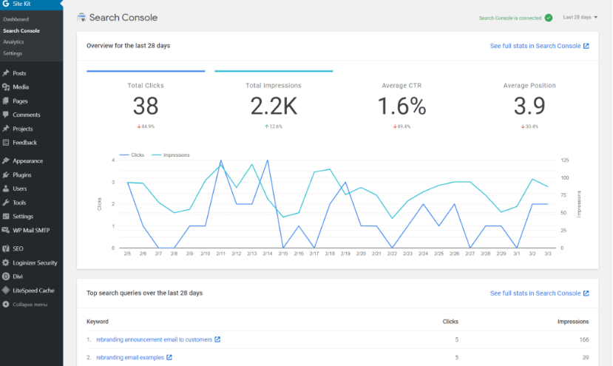
Plugins recommendations
Analytics, Search Console, AdSense, Speed - Site Kit by Google
Site Kit is the official WordPress plugin from Google for insights about how people find and use your site. Site Kit is the one-stop solution to deploy, manage, and get insights from critical Google tools to make the site successful on the web. It provides authoritative, up-to-date insights from multiple Google products directly on the WordPress dashboard for easy access, all for free.
Photo Courtesy: www.webfulcreations.com/site-kit-by-google-analytics-search-console-adsense-speed-for-wordpress/

Slide 13
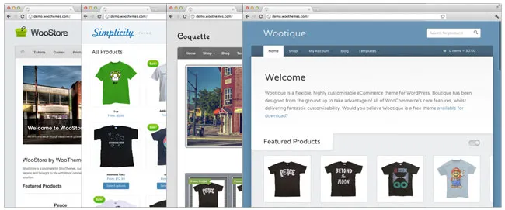
Plugins recommendations
Forget cookie-cutter ecommerce - WooCommerce
WooCommerce turns your site into a fully-functional online store, allowing you to sell anything, including digital files, memberships, and physical products. Installing WooCommerce automatically creates everything you need for your store, including product pages, shopping carts, and the checkout process.
Photo Courtesy: woocommerce.com/posts/woocommerce-has-arrived/

Slide 14
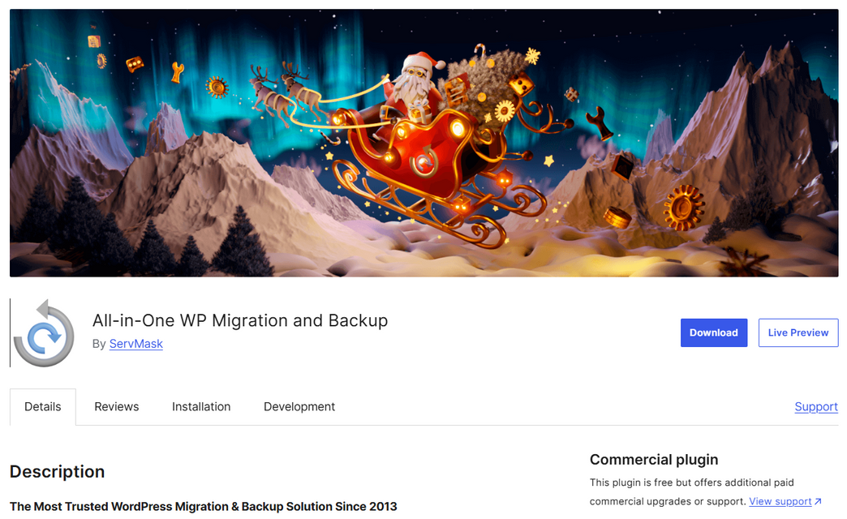
Plugins recommendations
All-in-One WP Migration and Backup
All-in-One WP Migration is the gold standard for WordPress site migration, used by over 60 million websites worldwide – from small blogs to Fortune 500 companies and government agencies. Our plugin offers enterprise-grade reliability with beginner-friendly simplicity.
Photo Courtesy: wordpress.org/plugins/all-in-one-wp-migration/

Slide 15
e-Magine! Initiative
Every Mon/Tue 5:30 – 8:30pm

