Slide 1

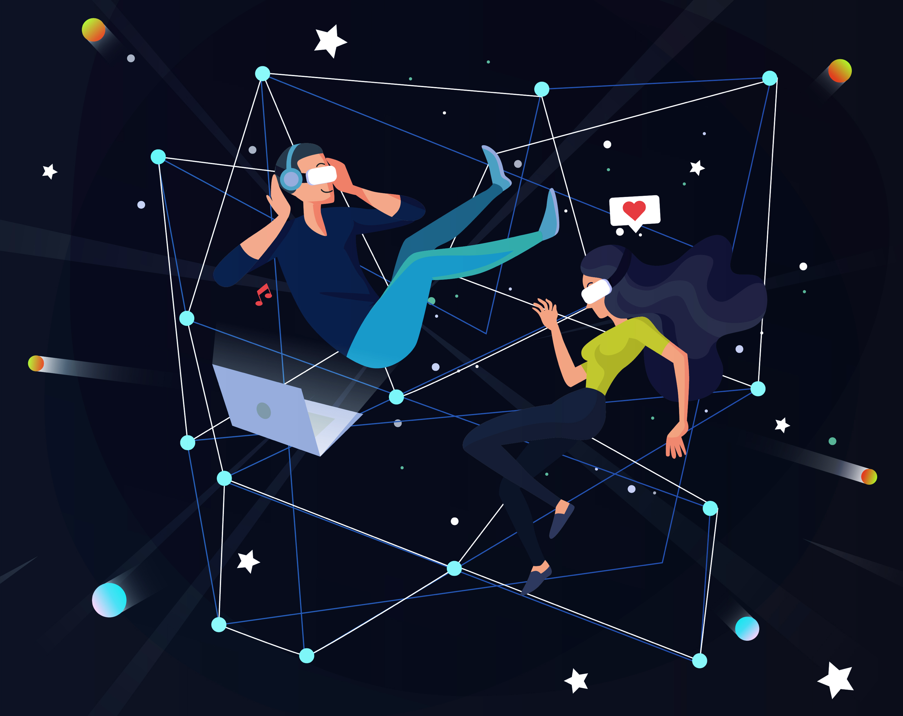





e-Magine! Initiative
Every Mon/Tue 5:30 – 8:30pm

Slide 2

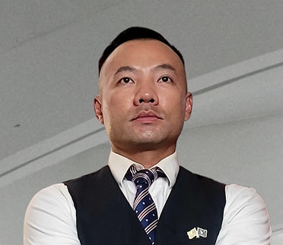
AI Tools, Adoption, Impact
Presentors:
Tiffany Prince, MBA – Prince Performance LLC
Founder & CEO
John B Yang – Executive Director - AABRN
Founder & CEO of Digital Synergy
Notes:
Entered text
Make the slides very easy for entrpenuers to understand, use a lot of vizulization and analogies
Generative AI Overview (10 minutes): Give a high-level overview of generative AI, including its potential and its limitations. Discuss how it's being used in digital marketing, with examples of tasks it can automate or enhance, such as content creation, customer segmentation, ad targeting, and campaign optimization.
Title: "What is Generative AI?"
Content: Definition of generative AI, brief explanation of how it works.
Visualization: A simple diagram showing the input and output of a generative AI model.
Transcript: "Generative AI is a type of artificial intelligence that can create new content. It's like a digital artist that can paint a picture, write a story, or compose a song. But instead of paintbrushes and pens, it uses data and algorithms."
Title: "The Potential of Generative AI"
Content: Explanation of the potential of generative AI, including its ability to automate tasks, enhance creativity, and personalize content.
Visualization: A list or mind map of the potential benefits of generative AI.
Transcript: "Imagine having a personal assistant that can write your emails, create your social media posts, and even design your website. That's the potential of generative AI. It can automate mundane tasks, enhance our creativity by providing new ideas, and personalize content to individual users."
Title: "Generative AI in Digital Marketing"
Content: Explanation of how generative AI is used in digital marketing, with examples of tasks it can automate or enhance.
Visualization: A flowchart showing how generative AI can be used in different stages of a digital marketing campaign.
Transcript: "In digital marketing, generative AI is like a Swiss Army knife. It can write engaging ad copy, segment customers based on their behavior, target ads to the right audience, and optimize marketing campaigns for better results. It's like having a team of expert marketers working 24/7 to help your business grow."
Slide : Limitations of Generative AI
Title: "The Limitations of Generative AI"
Content: Discussion of the limitations of generative AI, including its reliance on training data and the risk of bias.
Visualization: A list or mind map of the limitations of generative AI.
Transcript: "But generative AI is not a magic wand. It's only as good as the data it's trained on. If the data is biased, the AI will be biased too. And while it can generate new content, it doesn't understand the content in the same way a human does. It's like a parrot that can mimic human speech but doesn't understand the meaning of the words."
Deep Dive into GPT, BARD, and CLAUDE (10 minutes): Discuss these three systems in detail. Explain what they are, how they work, and their unique features. Use visuals and simple language to make it easy for your audience to understand.
Title: "Pros and Cons of GPT"
Content: List of pros and cons of using GPT in digital marketing.
Visualization: A simple table or infographic showing the pros and cons.
Transcript: "GPT has many strengths, such as its ability to generate human-like text and its versatility in handling different types of content. However, it also has some limitations. For example, it can sometimes generate text that is nonsensical or inappropriate, and it requires a large amount of data to train."
Title: "Pros and Cons of BARD"
Content: List of pros and cons of using BARD in digital marketing.
Visualization: A simple table or infographic showing the pros and cons.
Transcript: "BARD excels at evaluating and ranking arguments, which can be useful in applications like automated fact-checking or content moderation. However, its ability to generate creative content is limited, and it may not be as effective in contexts where creativity and novelty are important."
Title: "Pros and Cons of CLAUDE"
Content: List of pros and cons of using CLAUDE in digital marketing.
Visualization: A simple table or infographic showing the pros and cons.
Transcript: "CLAUDE is great for generating creative content, which can be a big advantage in fields like advertising or entertainment. However, its output can be unpredictable, and it may require more oversight and editing than other systems."
Title: "Pricing Models for GPT, BARD, and CLAUDE"
Content: Overview of the pricing models for GPT, BARD, and CLAUDE.
Visualization: A simple table or infographic showing the pricing models.
Transcript: "The pricing models for GPT, BARD, and CLAUDE vary. Some charge based on the amount of text generated, while others charge based on the number of API calls. It's important to understand the pricing model before you start using these systems, to ensure that they fit within your budget."
Title: "Understanding Parameters in Generative AI"
Content: Explanation of what parameters are and how they affect the output of generative AI systems.
Visualization: A simple diagram or infographic showing how changing parameters can change the output.
Transcript: "Parameters in generative AI are like the knobs and dials on a sound mixer. They control how the AI generates content. For example, you can adjust the 'temperature' parameter to make the output more or less random, or the 'max tokens' parameter to control the length of the output. Understanding these parameters can help you get the most out of these systems."
Remember, the key to a great presentation is to make complex concepts easy to understand. Use simple language, analogies, and visuals to help your audience understand these concepts.
Entered text
Generative AI Overview (10 minutes): Give a high-level overview of generative AI, including its potential and its limitations. Discuss how it's being used in digital marketing, with examples of tasks it can automate or enhance, such as content creation, customer segmentation, ad targeting, and campaign optimization.
Title: "What is Generative AI?"
Content: Definition of generative AI, brief explanation of how it works.
Visualization: A simple diagram showing the input and output of a generative AI model.
Transcript: "Generative AI is a type of artificial intelligence that can create new content. It's like a digital artist that can paint a picture, write a story, or compose a song. But instead of paintbrushes and pens, it uses data and algorithms."
Title: "The Potential of Generative AI"
Content: Explanation of the potential of generative AI, including its ability to automate tasks, enhance creativity, and personalize content.
Visualization: A list or mind map of the potential benefits of generative AI.
Transcript: "Imagine having a personal assistant that can write your emails, create your social media posts, and even design your website. That's the potential of generative AI. It can automate mundane tasks, enhance our creativity by providing new ideas, and personalize content to individual users."
Slide 3: Generative AI in Digital Marketing
Title: "Generative AI in Digital Marketing"
Content: Explanation of how generative AI is used in digital marketing, with examples of tasks it can automate or enhance.
Visualization: A flowchart showing how generative AI can be used in different stages of a digital marketing campaign.
Transcript: "In digital marketing, generative AI is like a Swiss Army knife. It can write engaging ad copy, segment customers based on their behavior, target ads to the right audience, and optimize marketing campaigns for better results. It's like having a team of expert marketers working 24/7 to help your business grow."
Title: "The Limitations of Generative AI"
Content: Discussion of the limitations of generative AI, including its reliance on training data and the risk of bias.
Visualization: A list or mind map of the limitations of generative AI.
Transcript: "But generative AI is not a magic wand. It's only as good as the data it's trained on. If the data is biased, the AI will be biased too. And while it can generate new content, it doesn't understand the content in the same way a human does. It's like a parrot that can mimic human speech but doesn't understand the meaning of the words."
Deep Dive into GPT, BARD, and CLAUDE (10 minutes): Discuss these three systems in detail. Explain what they are, how they work, and their unique features. Use visuals and simple language to make it easy for your audience to understand.
Title: "Pros and Cons of GPT"
Content: List of pros and cons of using GPT in digital marketing.
Visualization: A simple table or infographic showing the pros and cons.
Transcript: "GPT has many strengths, such as its ability to generate human-like text and its versatility in handling different types of content. However, it also has some limitations. For example, it can sometimes generate text that is nonsensical or inappropriate, and it requires a large amount of data to train."
Title: "Pros and Cons of BARD"
Content: List of pros and cons of using BARD in digital marketing.
Visualization: A simple table or infographic showing the pros and cons.
Transcript: "BARD excels at evaluating and ranking arguments, which can be useful in applications like automated fact-checking or content moderation. However, its ability to generate creative content is limited, and it may not be as effective in contexts where creativity and novelty are important."
Title: "Pros and Cons of CLAUDE"
Content: List of pros and cons of using CLAUDE in digital marketing.
Visualization: A simple table or infographic showing the pros and cons.
Transcript: "CLAUDE is great for generating creative content, which can be a big advantage in fields like advertising or entertainment. However, its output can be unpredictable, and it may require more oversight and editing than other systems."
Title: "Pricing Models for GPT, BARD, and CLAUDE"
Content: Overview of the pricing models for GPT, BARD, and CLAUDE.
Visualization: A simple table or infographic showing the pricing models.
Transcript: "The pricing models for GPT, BARD, and CLAUDE vary. Some charge based on the amount of text generated, while others charge based on the number of API calls. It's important to understand the pricing model before you start using these systems, to ensure that they fit within your budget."
Title: "Understanding Parameters in Generative AI"
Content: Explanation of what parameters are and how they affect the output of generative AI systems.
Visualization: A simple diagram or infographic showing how changing parameters can change the output.
Transcript: "Parameters in generative AI are like the knobs and dials on a sound mixer. They control how the AI generates content. For example, you can adjust the 'temperature' parameter to make the output more or less random, or the 'max tokens' parameter to control the length of the output. Understanding these parameters can help you get the most out of these systems."
Remember, the key to a great presentation is to make complex concepts easy to understand. Use simple language, analogies, and visuals to help your audience understand these concepts.
fit key details in slides and organize it in a way that seems logical. Make the vizulizations easy to read, last time I used SlidesAI.io it wasnt easy to understand so please fix this

Slide 3
AI Digital Marketing Curiculum
03/17 - 5:30-8:30pm
Meow wolf 3D theme park with AIs and Fabrication
AI Digital Marketing (Overview of AI Digital Marketing, Google Gemini, Bing Copilot, ChatGPT)
03/18 - 5:30-8:30pm
AI-Powered SEO & Website Optimization
03/24 - 5:30-8:30pm
AI in Social Media Marketing & Advertising
03/25 - 5:30-8:30pm
AI Google Ads & Analytics (Search, Display & KPI Traffic Tracking)
03/31 - 5:30-8:30pm
AI Content Creation Bootcamp
04/01 - 5:30-8:30pm
AI Tools, Adoption, Impact
04/07 - 5:30-8:30pm
AI Business Automation & CRM Tools

Slide 4



Do not edit
How to change the design
How often are you using generative AI platforms?
The Slido app must be installed on every computer you’re presenting from

Slide 5


-MBA, ACC, CSM
-Founder of Prince Performance LLC
-AI Adoption Sherpa
Notes:
I have an MBA in global business and have lived and worked on 4 continents. I am also a certified coach through ICF and a certified SCRUM master. I’ve been in business for over 8 years now and love working with passionate leaders across industries who want to lead from a more humanistic point-of-view. My ideal client is a leader who has stepped up into a leadership role either for the first time or at the manager-of-manager level who has a growth mindset and knows they have some blind spots and what to build skills so they can be a better leader where their team will follow them anywhere.
One of my clients describe me as a “leadership sherpa” which I love the analogy because [well, my book ToM Leadership] but also that leadership is a journey and too many times we treat it like an event. But let’s face it, there are boulders and canons we need to navigate along the way and we won’t get it right all the time. So my mission to help guide you along your journey to expediate your learning curve and not make as many mistakes as I did along the way.
There is only so much I can cover in the time we have together today but I will provide you with additional resources at the end of the presentation.

Slide 6

Introduction to AI Tools, Adoption & Impact

Slide 7





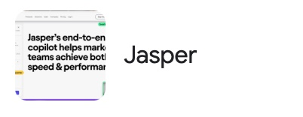
Generative AI Tools – Most Commonly Used

Slide 8

Do not edit
How to change the design
Which generative AI platforms have you used/tested?
The Slido app must be installed on every computer you’re presenting from

Slide 9
OpenAI Imagines Our AI Future
Stages of Artificial Intelligence
Level 1 Chatbots, AI with conversational language
Level 2 Reasoners, human-level problem solving
Level 3 Agents, systems that can take actions
Level 4 Innovators, AI that can aid in invention
Level 5 Organizations, AI that can do the work of an organization
Source: Bloomberg reporting, Marketing AI Institute

Slide 10
Login to HubSpot
Review performance of relevant past emails (optional, but encouraged)
Click Marketing in the main navigation widow
Click Email
Click Create Email
Choose Email Type
Choose a Template
Write copy
Add Design Elements
Create/Add Images
Create/Add CTA
Adjust Format, Text Styles, Etc.
Create A/B Test (optional)
Create Subject Line
Personalize Subject Line (optional)
Add Smart Rule (optional)
Update other Settings (i.e. language, subscription type, campaign, etc.)
Choose Recipients (based on Lists)
Choose Exclusions (based on Lists)
Send or Schedule
Set up Automation of follow-up tasks (optional)

Slide 11
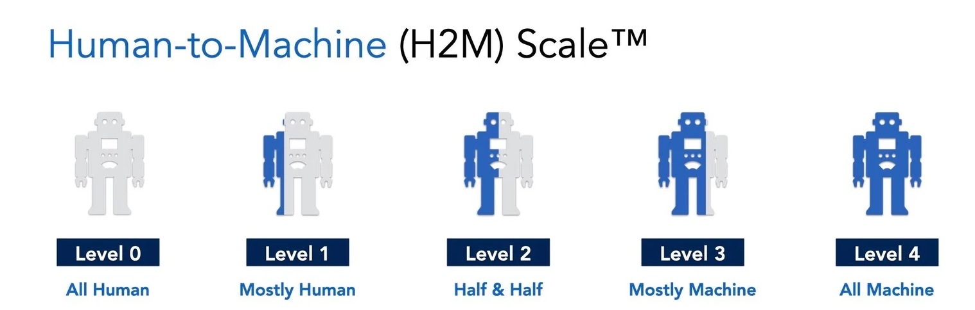


Human-to-Machine (H2M) Scale for Writers™
Level 0
Level 1
Level 2
Level 3
Level 4
All Human
Mostly Human
Half & Half
Mostly Machine
All Machine
Human Writer
Human is the sole creator. Unique human voice is essential.
AI-Assisted
Author leads but uses AI for specific tasks. Author retains control over direction and voice.
Co-Writer
Author and AI work together. Focus on efficiency, but voice and human touch matter.
AI-Driven
AI leads, human refines and approves. Efficiency matters more than human touch.
AI Writer
AI write autonomously with little or no human oversight.
Source: SmarterX, Marketing AI Institute

Slide 12

Building agility for the future workforce

Slide 13
Potential Use Cases for Small Businesses
Strategic:
Tactical:
Employee Onboarding and Training Programs
Workforce Planning and Analytics
Reshape business processes
Employee Engagement and Culture Initiatives
Speeding up innovation
Job Description Writing
Interview Question Generation
Launch a chatbot in 3 days
Summarize email threads and meeting minutes
Create content outlines
Conduct comprehensive research in minutes

Slide 14

Ethical Considerations When Using AI
Harmful or biases content/data
Privacy and data protection issues
Intellectual property concerns
Sources of information

Slide 15

Practicing Responsible AI Usage
Establish clear guidelines on where, when, and how it is used
Create a content review process to ensure it aligns with organizational values and legal requirements
Training and awareness of applied ethics techniques
Employee understanding of the context in which AI is being used
https://hbr.org/2020/10/a-practical-guide-to-building-ethical-ai

Slide 16

Beyond Prompt Engineering
Don’t use it like a Google search
You need to slow it down
You need to give it context or writing samples
Don’t be afraid to regenerate an answer or ask the question in a different way
Think of the platforms as a savvy intern at your company

Slide 17
Crafting Prompt Series – If Your Original Prompt is Not Robust Enough
Start with the overall background/context – provide lots of detail and give it a role
In the original prompt, ask it to summarize what you are asking and let it ask you 5 – 20 questions about your situation
Answer the questions – you may not have the answers to all the questions [and that is ok], but pick the most important ones
Have the platform generate the answer/output
You can ask clarifying questions within this conversation string as it will have the context built in

Slide 18
ChatGPT Enhanced
Different modes
Deep research
GPTs - JobsGPT

Slide 19
Demo: ChatHub.gg
Summer Intern

Slide 20
How To Use?
When do you think you would use a tool like this?
How can it be helpful in your business?

Slide 21
Demo: Notebook LM

Slide 22
Use Cases for Notebook LM
Blog and article creation
Social Media Content Generation
Email Marketing Campaigns
Customer FAQ & customer support
Product descriptions and promotions
Content summarization
Event planning and promotion
Market research and competitor analysis
Idea generation and brainstorming
Audio content creation

Slide 23
Breakouts
20 minutes- each group choose a type of content to generate with Notebook LM

Slide 24
Demo: Gamma.ai

Slide 25
How to Use
How is this tool different than MS PowerPoint or Google Slides?
Do you think you will use it?
If so, how would you use it?

Slide 26
Test Out Gamma
Take any output from a LLM and upload to Gamma.ai

Slide 27
What worked? Where does it lack?

Slide 28
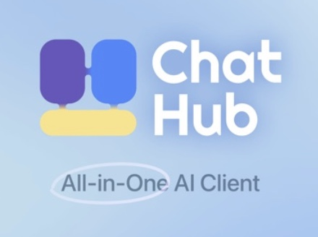


Which tool did you like best and why?

Slide 29
Q & A

Slide 30

e-Magine! Initiative
Every Mon/Tue 5:30 – 8:30pm
John B Yang
Email: John@digitalsynergy.ai, info@aabrn.org
Phone: 888-907-2284

Slide 31




Tiffany Prince, MBA
People-First AI Adoption Strategy & Training
Prince Performance LLC
Explore my website at: www.topofthemountainleadership.com
Email us at tprince@topofthemountainleadership.com
Call us at 312-919-5568

