Slide 1
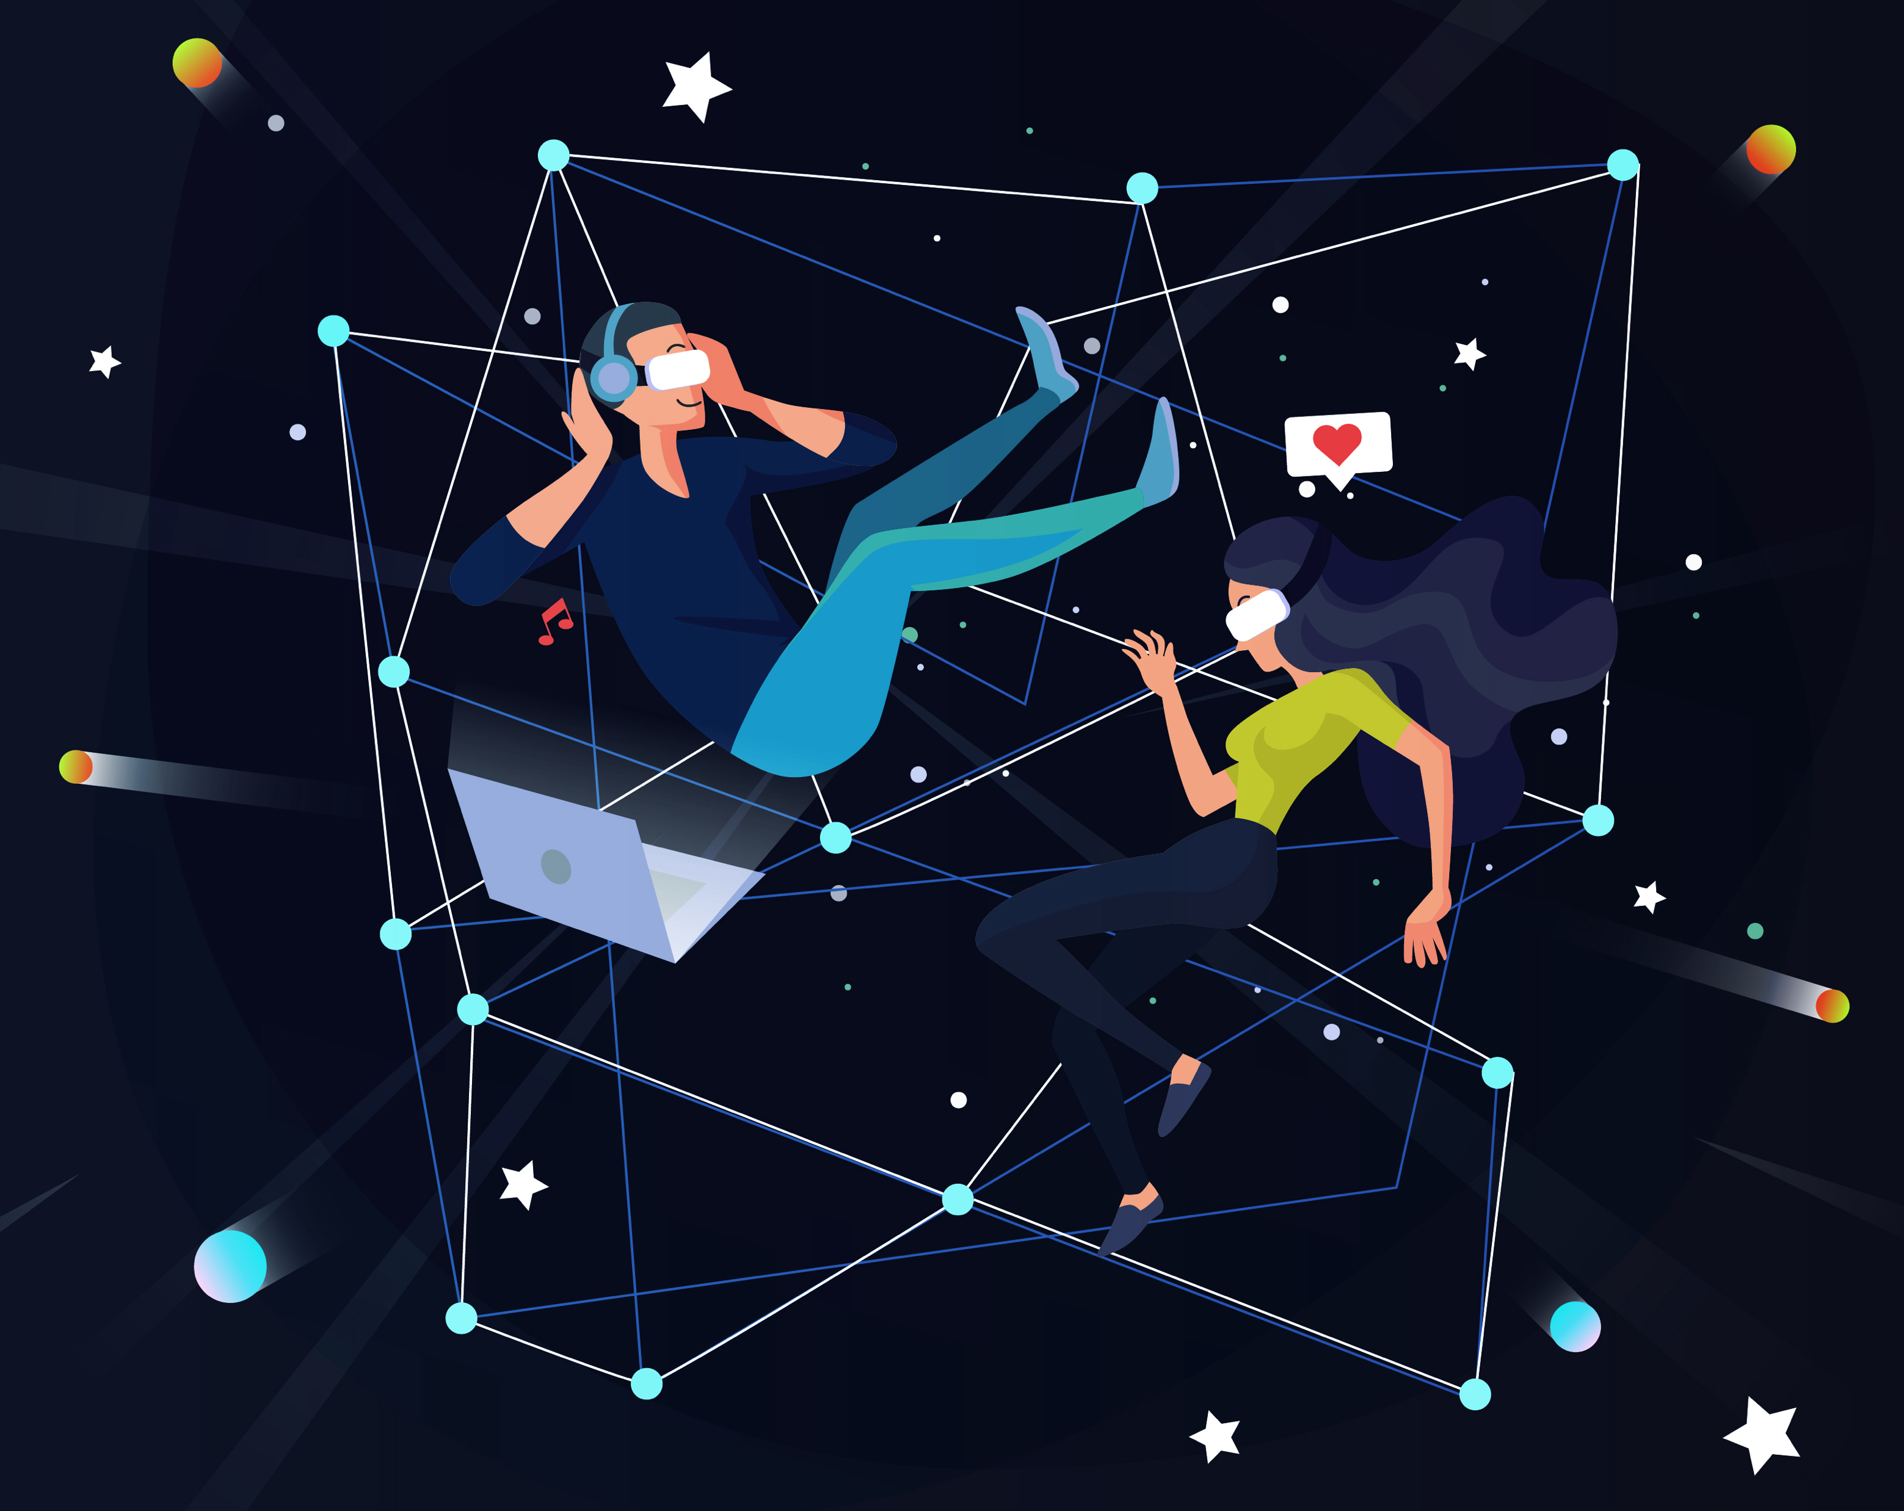
e-Magine! Initiative
Every Mon/Tue 5:30 – 8:30pm

Slide 2
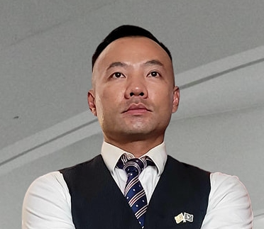
AI DIGITAL MARKETING
Presentor:
John B Yang – Executive Director - AABRN
Founder & CEO of Digital Synergy
Notes:
Entered text
Make the slides very easy for entrpenuers to understand, use a lot of vizulization and analogies
Generative AI Overview (10 minutes): Give a high-level overview of generative AI, including its potential and its limitations. Discuss how it's being used in digital marketing, with examples of tasks it can automate or enhance, such as content creation, customer segmentation, ad targeting, and campaign optimization.
Title: "What is Generative AI?"
Content: Definition of generative AI, brief explanation of how it works.
Visualization: A simple diagram showing the input and output of a generative AI model.
Transcript: "Generative AI is a type of artificial intelligence that can create new content. It's like a digital artist that can paint a picture, write a story, or compose a song. But instead of paintbrushes and pens, it uses data and algorithms."
Title: "The Potential of Generative AI"
Content: Explanation of the potential of generative AI, including its ability to automate tasks, enhance creativity, and personalize content.
Visualization: A list or mind map of the potential benefits of generative AI.
Transcript: "Imagine having a personal assistant that can write your emails, create your social media posts, and even design your website. That's the potential of generative AI. It can automate mundane tasks, enhance our creativity by providing new ideas, and personalize content to individual users."
Title: "Generative AI in Digital Marketing"
Content: Explanation of how generative AI is used in digital marketing, with examples of tasks it can automate or enhance.
Visualization: A flowchart showing how generative AI can be used in different stages of a digital marketing campaign.
Transcript: "In digital marketing, generative AI is like a Swiss Army knife. It can write engaging ad copy, segment customers based on their behavior, target ads to the right audience, and optimize marketing campaigns for better results. It's like having a team of expert marketers working 24/7 to help your business grow."
Slide : Limitations of Generative AI
Title: "The Limitations of Generative AI"
Content: Discussion of the limitations of generative AI, including its reliance on training data and the risk of bias.
Visualization: A list or mind map of the limitations of generative AI.
Transcript: "But generative AI is not a magic wand. It's only as good as the data it's trained on. If the data is biased, the AI will be biased too. And while it can generate new content, it doesn't understand the content in the same way a human does. It's like a parrot that can mimic human speech but doesn't understand the meaning of the words."
Deep Dive into GPT, BARD, and CLAUDE (10 minutes): Discuss these three systems in detail. Explain what they are, how they work, and their unique features. Use visuals and simple language to make it easy for your audience to understand.
Title: "Pros and Cons of GPT"
Content: List of pros and cons of using GPT in digital marketing.
Visualization: A simple table or infographic showing the pros and cons.
Transcript: "GPT has many strengths, such as its ability to generate human-like text and its versatility in handling different types of content. However, it also has some limitations. For example, it can sometimes generate text that is nonsensical or inappropriate, and it requires a large amount of data to train."
Title: "Pros and Cons of BARD"
Content: List of pros and cons of using BARD in digital marketing.
Visualization: A simple table or infographic showing the pros and cons.
Transcript: "BARD excels at evaluating and ranking arguments, which can be useful in applications like automated fact-checking or content moderation. However, its ability to generate creative content is limited, and it may not be as effective in contexts where creativity and novelty are important."
Title: "Pros and Cons of CLAUDE"
Content: List of pros and cons of using CLAUDE in digital marketing.
Visualization: A simple table or infographic showing the pros and cons.
Transcript: "CLAUDE is great for generating creative content, which can be a big advantage in fields like advertising or entertainment. However, its output can be unpredictable, and it may require more oversight and editing than other systems."
Title: "Pricing Models for GPT, BARD, and CLAUDE"
Content: Overview of the pricing models for GPT, BARD, and CLAUDE.
Visualization: A simple table or infographic showing the pricing models.
Transcript: "The pricing models for GPT, BARD, and CLAUDE vary. Some charge based on the amount of text generated, while others charge based on the number of API calls. It's important to understand the pricing model before you start using these systems, to ensure that they fit within your budget."
Title: "Understanding Parameters in Generative AI"
Content: Explanation of what parameters are and how they affect the output of generative AI systems.
Visualization: A simple diagram or infographic showing how changing parameters can change the output.
Transcript: "Parameters in generative AI are like the knobs and dials on a sound mixer. They control how the AI generates content. For example, you can adjust the 'temperature' parameter to make the output more or less random, or the 'max tokens' parameter to control the length of the output. Understanding these parameters can help you get the most out of these systems."
Remember, the key to a great presentation is to make complex concepts easy to understand. Use simple language, analogies, and visuals to help your audience understand these concepts.
Entered text
Generative AI Overview (10 minutes): Give a high-level overview of generative AI, including its potential and its limitations. Discuss how it's being used in digital marketing, with examples of tasks it can automate or enhance, such as content creation, customer segmentation, ad targeting, and campaign optimization.
Title: "What is Generative AI?"
Content: Definition of generative AI, brief explanation of how it works.
Visualization: A simple diagram showing the input and output of a generative AI model.
Transcript: "Generative AI is a type of artificial intelligence that can create new content. It's like a digital artist that can paint a picture, write a story, or compose a song. But instead of paintbrushes and pens, it uses data and algorithms."
Title: "The Potential of Generative AI"
Content: Explanation of the potential of generative AI, including its ability to automate tasks, enhance creativity, and personalize content.
Visualization: A list or mind map of the potential benefits of generative AI.
Transcript: "Imagine having a personal assistant that can write your emails, create your social media posts, and even design your website. That's the potential of generative AI. It can automate mundane tasks, enhance our creativity by providing new ideas, and personalize content to individual users."
Slide 3: Generative AI in Digital Marketing
Title: "Generative AI in Digital Marketing"
Content: Explanation of how generative AI is used in digital marketing, with examples of tasks it can automate or enhance.
Visualization: A flowchart showing how generative AI can be used in different stages of a digital marketing campaign.
Transcript: "In digital marketing, generative AI is like a Swiss Army knife. It can write engaging ad copy, segment customers based on their behavior, target ads to the right audience, and optimize marketing campaigns for better results. It's like having a team of expert marketers working 24/7 to help your business grow."
Title: "The Limitations of Generative AI"
Content: Discussion of the limitations of generative AI, including its reliance on training data and the risk of bias.
Visualization: A list or mind map of the limitations of generative AI.
Transcript: "But generative AI is not a magic wand. It's only as good as the data it's trained on. If the data is biased, the AI will be biased too. And while it can generate new content, it doesn't understand the content in the same way a human does. It's like a parrot that can mimic human speech but doesn't understand the meaning of the words."
Deep Dive into GPT, BARD, and CLAUDE (10 minutes): Discuss these three systems in detail. Explain what they are, how they work, and their unique features. Use visuals and simple language to make it easy for your audience to understand.
Title: "Pros and Cons of GPT"
Content: List of pros and cons of using GPT in digital marketing.
Visualization: A simple table or infographic showing the pros and cons.
Transcript: "GPT has many strengths, such as its ability to generate human-like text and its versatility in handling different types of content. However, it also has some limitations. For example, it can sometimes generate text that is nonsensical or inappropriate, and it requires a large amount of data to train."
Title: "Pros and Cons of BARD"
Content: List of pros and cons of using BARD in digital marketing.
Visualization: A simple table or infographic showing the pros and cons.
Transcript: "BARD excels at evaluating and ranking arguments, which can be useful in applications like automated fact-checking or content moderation. However, its ability to generate creative content is limited, and it may not be as effective in contexts where creativity and novelty are important."
Title: "Pros and Cons of CLAUDE"
Content: List of pros and cons of using CLAUDE in digital marketing.
Visualization: A simple table or infographic showing the pros and cons.
Transcript: "CLAUDE is great for generating creative content, which can be a big advantage in fields like advertising or entertainment. However, its output can be unpredictable, and it may require more oversight and editing than other systems."
Title: "Pricing Models for GPT, BARD, and CLAUDE"
Content: Overview of the pricing models for GPT, BARD, and CLAUDE.
Visualization: A simple table or infographic showing the pricing models.
Transcript: "The pricing models for GPT, BARD, and CLAUDE vary. Some charge based on the amount of text generated, while others charge based on the number of API calls. It's important to understand the pricing model before you start using these systems, to ensure that they fit within your budget."
Title: "Understanding Parameters in Generative AI"
Content: Explanation of what parameters are and how they affect the output of generative AI systems.
Visualization: A simple diagram or infographic showing how changing parameters can change the output.
Transcript: "Parameters in generative AI are like the knobs and dials on a sound mixer. They control how the AI generates content. For example, you can adjust the 'temperature' parameter to make the output more or less random, or the 'max tokens' parameter to control the length of the output. Understanding these parameters can help you get the most out of these systems."
Remember, the key to a great presentation is to make complex concepts easy to understand. Use simple language, analogies, and visuals to help your audience understand these concepts.
fit key details in slides and organize it in a way that seems logical. Make the vizulizations easy to read, last time I used SlidesAI.io it wasnt easy to understand so please fix this

Slide 3
AI Digital Marketing Curiculum
03/17 - 5:30-8:30pm
Meow wolf 3D theme park with AIs and Fabrication
AI Digital Marketing (Overview of AI Digital Marketing, Google Gemini, Bing Copilot, ChatGPT)
03/18 - 5:30-8:30pm
AI-Powered SEO & Website Optimization
03/24 - 5:30-8:30pm
AI in Social Media Marketing & Advertising
03/25 - 5:30-8:30pm
AI-Driven Social Media Strategy & Execution
03/31 - 5:30-8:30pm
AI Google Ads & Analytics (Search, Display & KPI Tracking)
04/01 - 5:30-8:30pm
AI Content Creation Bootcamp
04/07 - 5:30-8:30pm
AI Business Automation & CRM Tools

Slide 4
Table of Contents
AI SEO | Overview of AI SEO, Check List, Flow Chart
AI SEO Tools | Bright Local, SEMRush, ChatGPT
SEO Keyword Research | Google Keyword Planner, Google Trends, SEM Rush
SEO Competitor Analysis
SEO Website Audit
Local vs Organic SEO
Website SEO
Google Business SEO

Slide 5
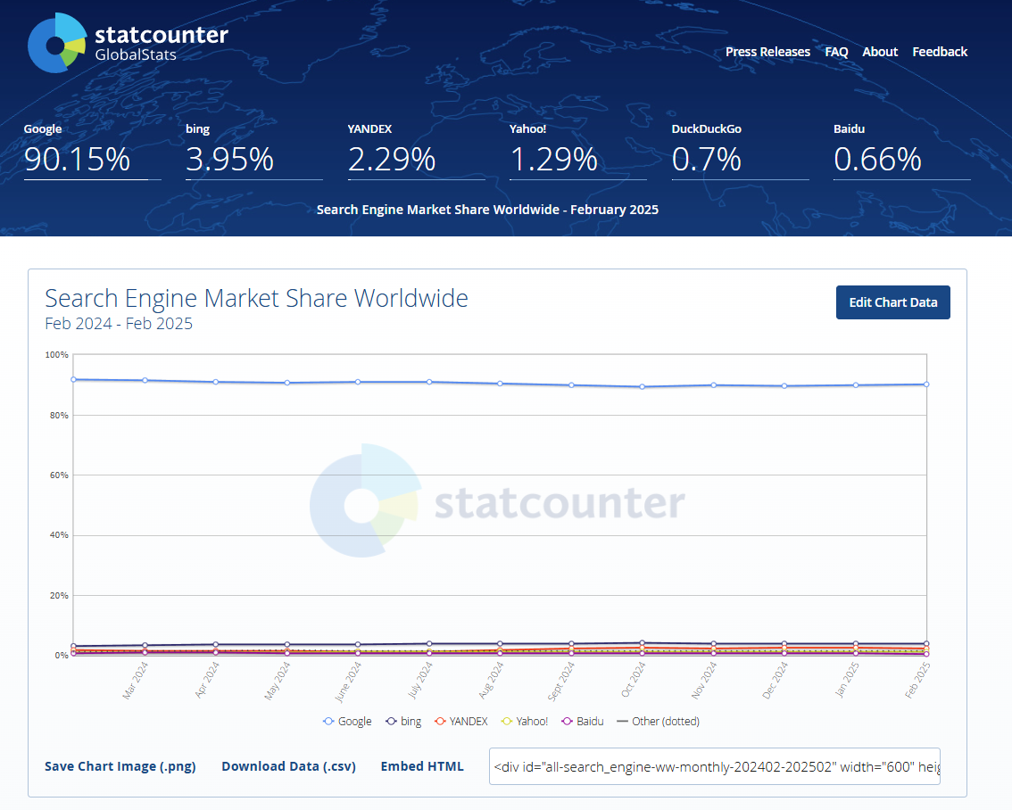
Search Engine Market Share

Slide 6
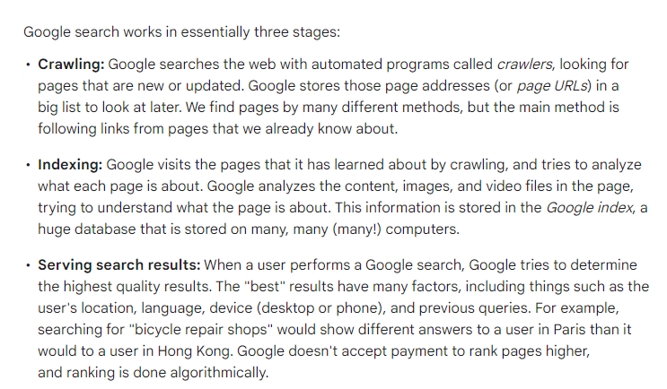
Search Engine Stages
https://support.google.com/webmasters/answer/9128586?hl=en&ref_topic=12425928&sjid=9986167537047200004-NA
Source: https://zapier.com/apps/categories/ai-tools

Slide 7
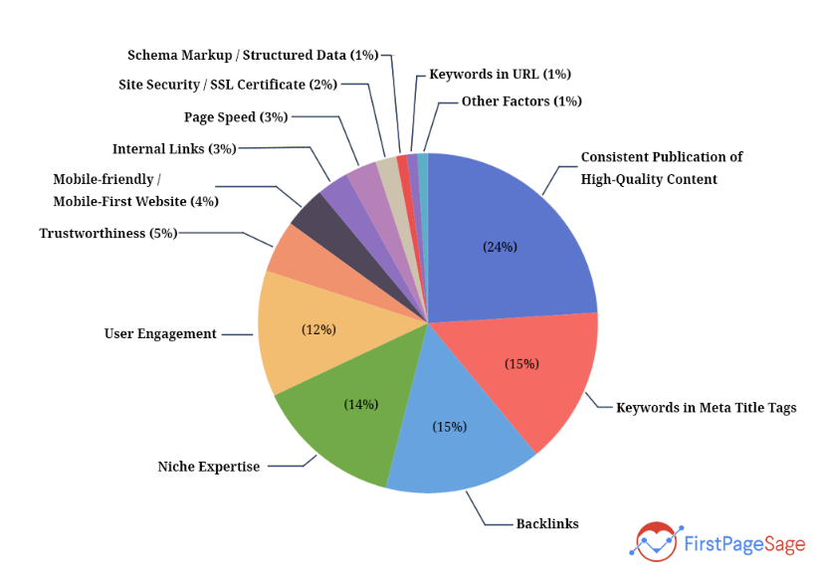
Search Engine Ranking Factors
https://firstpagesage.com/seo-blog/the-google-algorithm-ranking-factors/
Source: https://zapier.com/apps/categories/ai-tools

Slide 8
Google Search Engine Layout

Slide 9
SEO Check List
https://www.semrush.com/blog/on-page-seo-checklist/

Slide 10
Search Engine AI Chat Bot
Bing AI Copliot / Bing Search Engine | https://copilot.microsoft.com/chats/fchNP9VJvuawGjQH3HEpV
Google Gemini / Google Search Engine | https://gemini.google.com/app

Slide 11
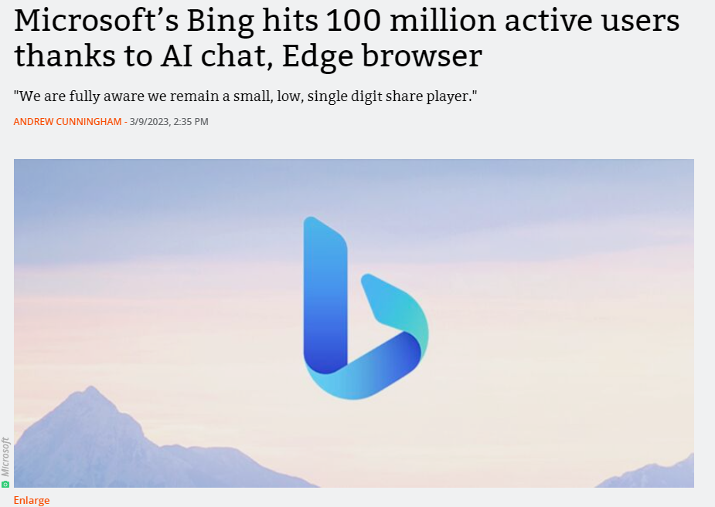
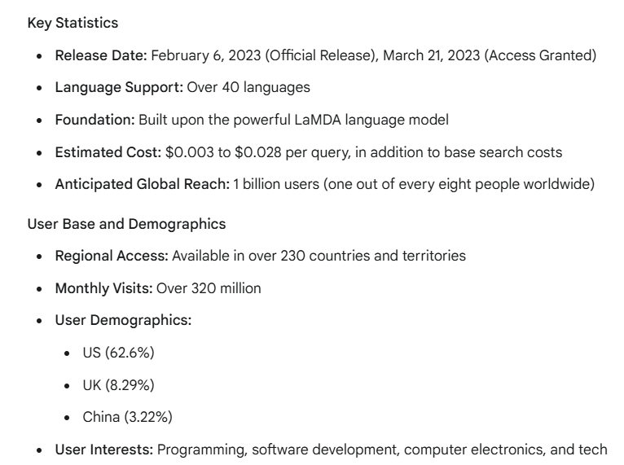
Bing AI Copilot vs Google AI Gemini

Slide 12
SEO WEBSITE AUDIT Demo
Website Mobile Friendly Test | https://search.google.com/test/mobile-friendly/
Website Page Speed Insight | https://pagespeed.web.dev/
Local SEO Audit Tool
Website Audit Tool | https://www.semrush.com/siteaudit/ https://www.seoptimer.com/

Slide 13
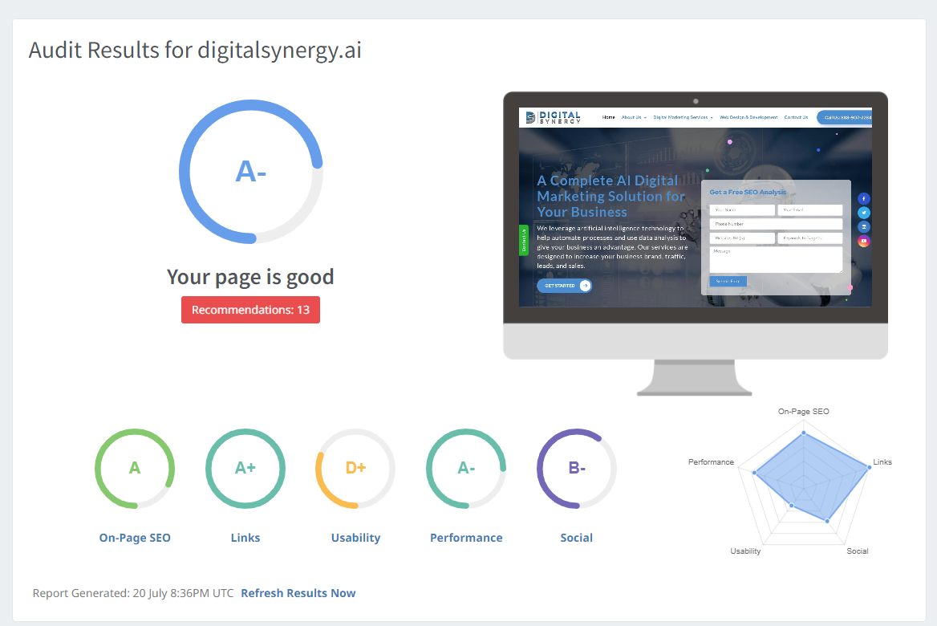
SEO WEBSITE AUDIT - Demo
https://www.seoptimer.com/digitalsynergy.ai
https://search.google.com/test/mobile-friendly/
https://pagespeed.web.dev/
https://www.semrush.com/siteaudit/

Slide 14
KEYWORD RESEARCH/ RoadMap - Demo

Slide 15
COMPETIVE RESEARCH & ANALYSIS - Demo

Slide 16
GOOGLE BUSINESS SEO - Demo

Slide 17
WEBSITE SEO - Demo

Slide 18
Q & A – More Live Sessions

Slide 19
e-Magine! Initiative
Every Mon/Tue 5:30 – 8:30pm
John B Yang
Email: John@digitalsynergy.ai, info@aabrn.org
Phone: 888-907-2284

