Slide 1
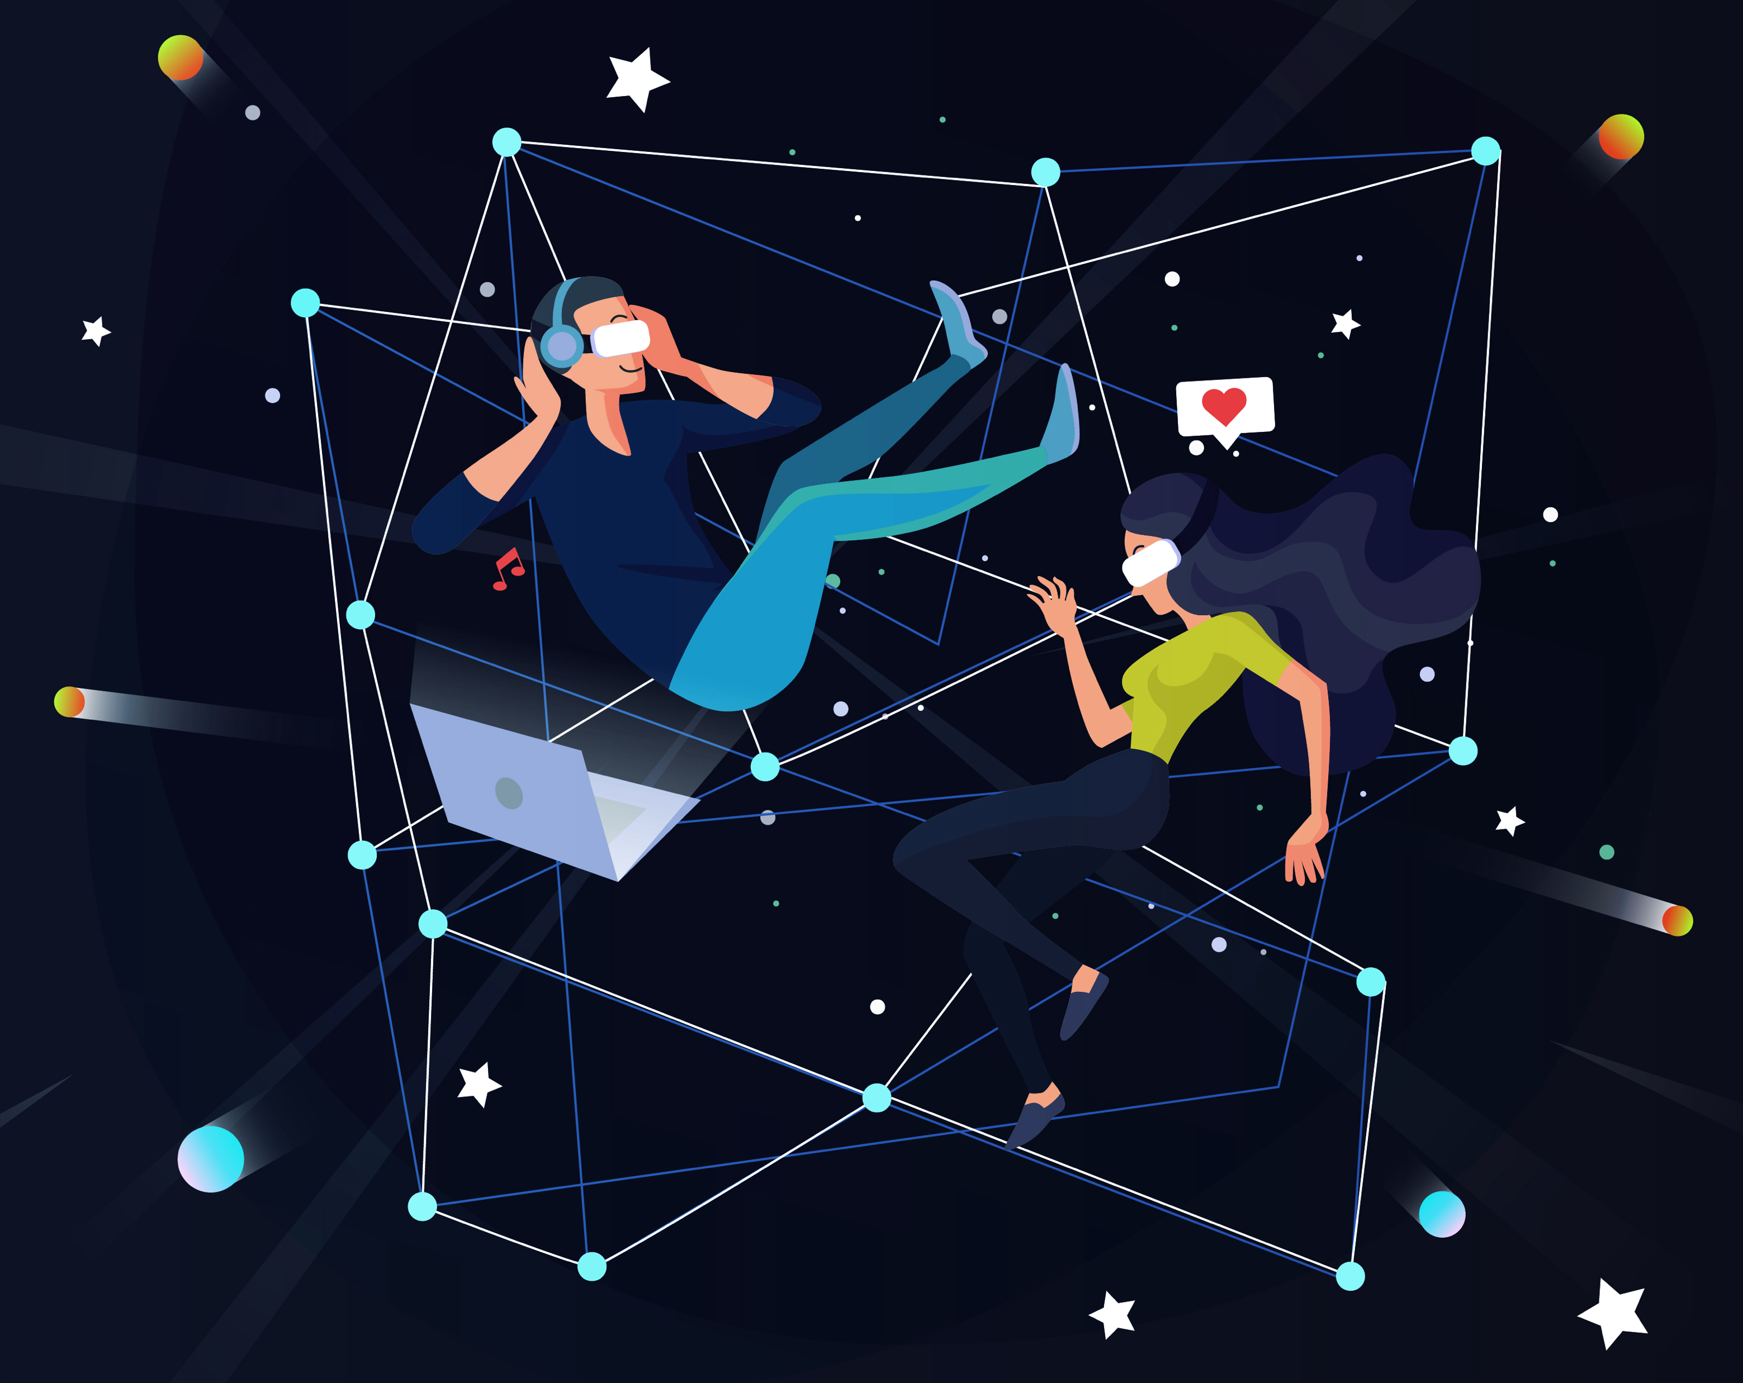
e-Magine! Initiative
Every Mon/Tue 5:30 – 8:30pm

Slide 2
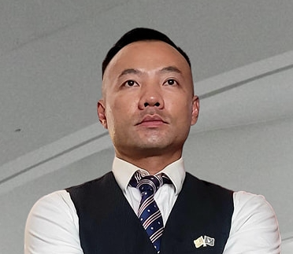
AI DIGITAL MARKETING
Presentor:
John B Yang – Executive Director - AABRN
Founder & CEO of Digital Synergy
Notes:
Entered text
Make the slides very easy for entrpenuers to understand, use a lot of vizulization and analogies
Generative AI Overview (10 minutes): Give a high-level overview of generative AI, including its potential and its limitations. Discuss how it's being used in digital marketing, with examples of tasks it can automate or enhance, such as content creation, customer segmentation, ad targeting, and campaign optimization.
Title: "What is Generative AI?"
Content: Definition of generative AI, brief explanation of how it works.
Visualization: A simple diagram showing the input and output of a generative AI model.
Transcript: "Generative AI is a type of artificial intelligence that can create new content. It's like a digital artist that can paint a picture, write a story, or compose a song. But instead of paintbrushes and pens, it uses data and algorithms."
Title: "The Potential of Generative AI"
Content: Explanation of the potential of generative AI, including its ability to automate tasks, enhance creativity, and personalize content.
Visualization: A list or mind map of the potential benefits of generative AI.
Transcript: "Imagine having a personal assistant that can write your emails, create your social media posts, and even design your website. That's the potential of generative AI. It can automate mundane tasks, enhance our creativity by providing new ideas, and personalize content to individual users."
Title: "Generative AI in Digital Marketing"
Content: Explanation of how generative AI is used in digital marketing, with examples of tasks it can automate or enhance.
Visualization: A flowchart showing how generative AI can be used in different stages of a digital marketing campaign.
Transcript: "In digital marketing, generative AI is like a Swiss Army knife. It can write engaging ad copy, segment customers based on their behavior, target ads to the right audience, and optimize marketing campaigns for better results. It's like having a team of expert marketers working 24/7 to help your business grow."
Slide : Limitations of Generative AI
Title: "The Limitations of Generative AI"
Content: Discussion of the limitations of generative AI, including its reliance on training data and the risk of bias.
Visualization: A list or mind map of the limitations of generative AI.
Transcript: "But generative AI is not a magic wand. It's only as good as the data it's trained on. If the data is biased, the AI will be biased too. And while it can generate new content, it doesn't understand the content in the same way a human does. It's like a parrot that can mimic human speech but doesn't understand the meaning of the words."
Deep Dive into GPT, BARD, and CLAUDE (10 minutes): Discuss these three systems in detail. Explain what they are, how they work, and their unique features. Use visuals and simple language to make it easy for your audience to understand.
Title: "Pros and Cons of GPT"
Content: List of pros and cons of using GPT in digital marketing.
Visualization: A simple table or infographic showing the pros and cons.
Transcript: "GPT has many strengths, such as its ability to generate human-like text and its versatility in handling different types of content. However, it also has some limitations. For example, it can sometimes generate text that is nonsensical or inappropriate, and it requires a large amount of data to train."
Title: "Pros and Cons of BARD"
Content: List of pros and cons of using BARD in digital marketing.
Visualization: A simple table or infographic showing the pros and cons.
Transcript: "BARD excels at evaluating and ranking arguments, which can be useful in applications like automated fact-checking or content moderation. However, its ability to generate creative content is limited, and it may not be as effective in contexts where creativity and novelty are important."
Title: "Pros and Cons of CLAUDE"
Content: List of pros and cons of using CLAUDE in digital marketing.
Visualization: A simple table or infographic showing the pros and cons.
Transcript: "CLAUDE is great for generating creative content, which can be a big advantage in fields like advertising or entertainment. However, its output can be unpredictable, and it may require more oversight and editing than other systems."
Title: "Pricing Models for GPT, BARD, and CLAUDE"
Content: Overview of the pricing models for GPT, BARD, and CLAUDE.
Visualization: A simple table or infographic showing the pricing models.
Transcript: "The pricing models for GPT, BARD, and CLAUDE vary. Some charge based on the amount of text generated, while others charge based on the number of API calls. It's important to understand the pricing model before you start using these systems, to ensure that they fit within your budget."
Title: "Understanding Parameters in Generative AI"
Content: Explanation of what parameters are and how they affect the output of generative AI systems.
Visualization: A simple diagram or infographic showing how changing parameters can change the output.
Transcript: "Parameters in generative AI are like the knobs and dials on a sound mixer. They control how the AI generates content. For example, you can adjust the 'temperature' parameter to make the output more or less random, or the 'max tokens' parameter to control the length of the output. Understanding these parameters can help you get the most out of these systems."
Remember, the key to a great presentation is to make complex concepts easy to understand. Use simple language, analogies, and visuals to help your audience understand these concepts.
Entered text
Generative AI Overview (10 minutes): Give a high-level overview of generative AI, including its potential and its limitations. Discuss how it's being used in digital marketing, with examples of tasks it can automate or enhance, such as content creation, customer segmentation, ad targeting, and campaign optimization.
Title: "What is Generative AI?"
Content: Definition of generative AI, brief explanation of how it works.
Visualization: A simple diagram showing the input and output of a generative AI model.
Transcript: "Generative AI is a type of artificial intelligence that can create new content. It's like a digital artist that can paint a picture, write a story, or compose a song. But instead of paintbrushes and pens, it uses data and algorithms."
Title: "The Potential of Generative AI"
Content: Explanation of the potential of generative AI, including its ability to automate tasks, enhance creativity, and personalize content.
Visualization: A list or mind map of the potential benefits of generative AI.
Transcript: "Imagine having a personal assistant that can write your emails, create your social media posts, and even design your website. That's the potential of generative AI. It can automate mundane tasks, enhance our creativity by providing new ideas, and personalize content to individual users."
Slide 3: Generative AI in Digital Marketing
Title: "Generative AI in Digital Marketing"
Content: Explanation of how generative AI is used in digital marketing, with examples of tasks it can automate or enhance.
Visualization: A flowchart showing how generative AI can be used in different stages of a digital marketing campaign.
Transcript: "In digital marketing, generative AI is like a Swiss Army knife. It can write engaging ad copy, segment customers based on their behavior, target ads to the right audience, and optimize marketing campaigns for better results. It's like having a team of expert marketers working 24/7 to help your business grow."
Title: "The Limitations of Generative AI"
Content: Discussion of the limitations of generative AI, including its reliance on training data and the risk of bias.
Visualization: A list or mind map of the limitations of generative AI.
Transcript: "But generative AI is not a magic wand. It's only as good as the data it's trained on. If the data is biased, the AI will be biased too. And while it can generate new content, it doesn't understand the content in the same way a human does. It's like a parrot that can mimic human speech but doesn't understand the meaning of the words."
Deep Dive into GPT, BARD, and CLAUDE (10 minutes): Discuss these three systems in detail. Explain what they are, how they work, and their unique features. Use visuals and simple language to make it easy for your audience to understand.
Title: "Pros and Cons of GPT"
Content: List of pros and cons of using GPT in digital marketing.
Visualization: A simple table or infographic showing the pros and cons.
Transcript: "GPT has many strengths, such as its ability to generate human-like text and its versatility in handling different types of content. However, it also has some limitations. For example, it can sometimes generate text that is nonsensical or inappropriate, and it requires a large amount of data to train."
Title: "Pros and Cons of BARD"
Content: List of pros and cons of using BARD in digital marketing.
Visualization: A simple table or infographic showing the pros and cons.
Transcript: "BARD excels at evaluating and ranking arguments, which can be useful in applications like automated fact-checking or content moderation. However, its ability to generate creative content is limited, and it may not be as effective in contexts where creativity and novelty are important."
Title: "Pros and Cons of CLAUDE"
Content: List of pros and cons of using CLAUDE in digital marketing.
Visualization: A simple table or infographic showing the pros and cons.
Transcript: "CLAUDE is great for generating creative content, which can be a big advantage in fields like advertising or entertainment. However, its output can be unpredictable, and it may require more oversight and editing than other systems."
Title: "Pricing Models for GPT, BARD, and CLAUDE"
Content: Overview of the pricing models for GPT, BARD, and CLAUDE.
Visualization: A simple table or infographic showing the pricing models.
Transcript: "The pricing models for GPT, BARD, and CLAUDE vary. Some charge based on the amount of text generated, while others charge based on the number of API calls. It's important to understand the pricing model before you start using these systems, to ensure that they fit within your budget."
Title: "Understanding Parameters in Generative AI"
Content: Explanation of what parameters are and how they affect the output of generative AI systems.
Visualization: A simple diagram or infographic showing how changing parameters can change the output.
Transcript: "Parameters in generative AI are like the knobs and dials on a sound mixer. They control how the AI generates content. For example, you can adjust the 'temperature' parameter to make the output more or less random, or the 'max tokens' parameter to control the length of the output. Understanding these parameters can help you get the most out of these systems."
Remember, the key to a great presentation is to make complex concepts easy to understand. Use simple language, analogies, and visuals to help your audience understand these concepts.
fit key details in slides and organize it in a way that seems logical. Make the vizulizations easy to read, last time I used SlidesAI.io it wasnt easy to understand so please fix this

Slide 3
AI Digital Marketing Curiculum
03/17 - 5:30-8:30pm
Meow wolf 3D theme park with AIs and Fabrication
AI Digital Marketing (Overview of AI Digital Marketing, Google Gemini, Bing Copilot, ChatGPT)
03/18 - 5:30-8:30pm
AI-Powered SEO & Website Optimization
03/24 - 5:30-8:30pm
AI in Social Media Marketing & Advertising
03/25 - 5:30-8:30pm
AI-Driven Social Media Strategy & Execution
03/31 - 5:30-8:30pm
AI Google Ads & Analytics (Search, Display & KPI Tracking)
04/01 - 5:30-8:30pm
AI Content Creation Bootcamp
04/07 - 5:30-8:30pm
AI Business Automation & CRM Tools

Slide 4
Class Outline
1: Introduction to AI in Marketing
Why AI is transforming the digital landscape
2: AI in Business Digital Marketing using ChatGPT, Google Gemini, Bing Copilot. What are the differences?
3: Hands-On Activity: Q&A
ChatGPT, Google Gemini, Bing Copilot

Slide 5
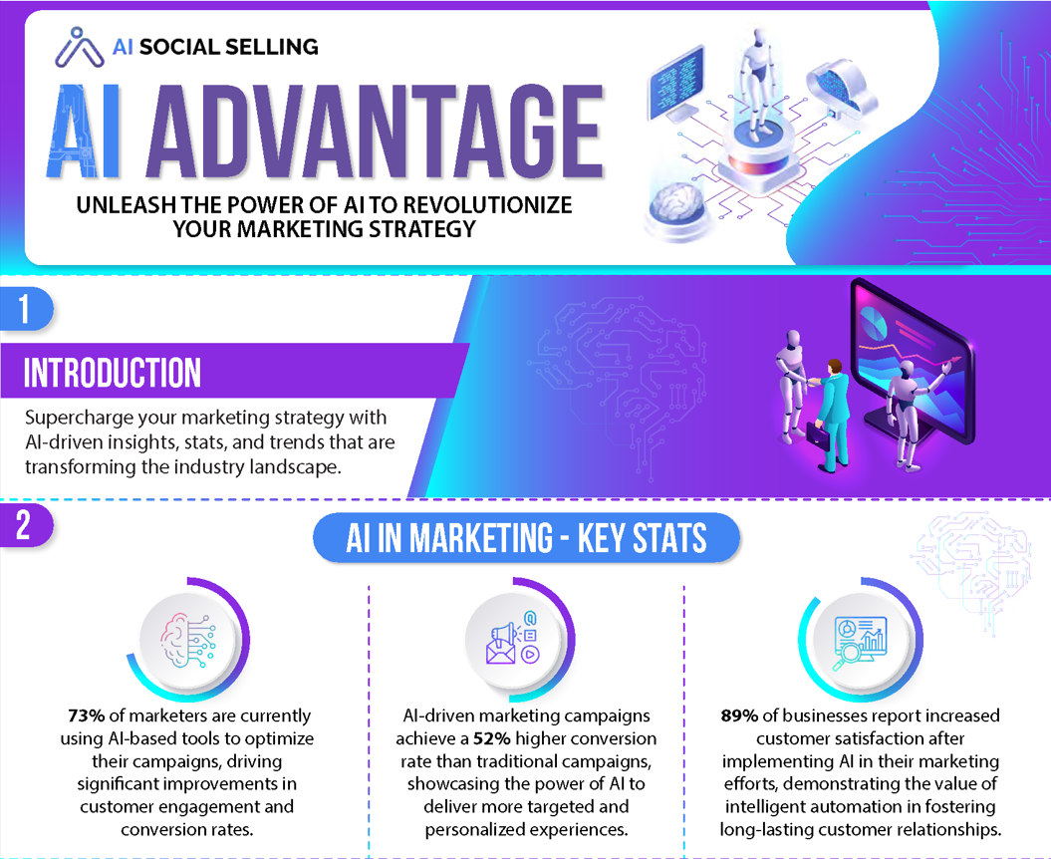

Slide 6
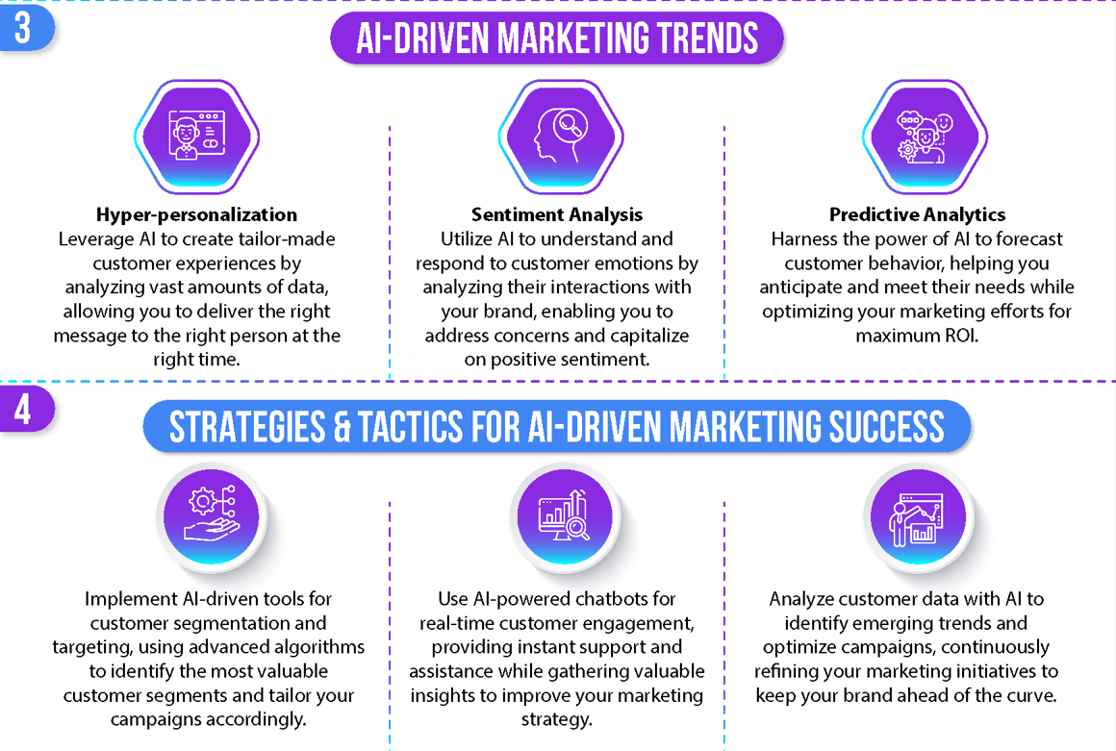

Slide 7
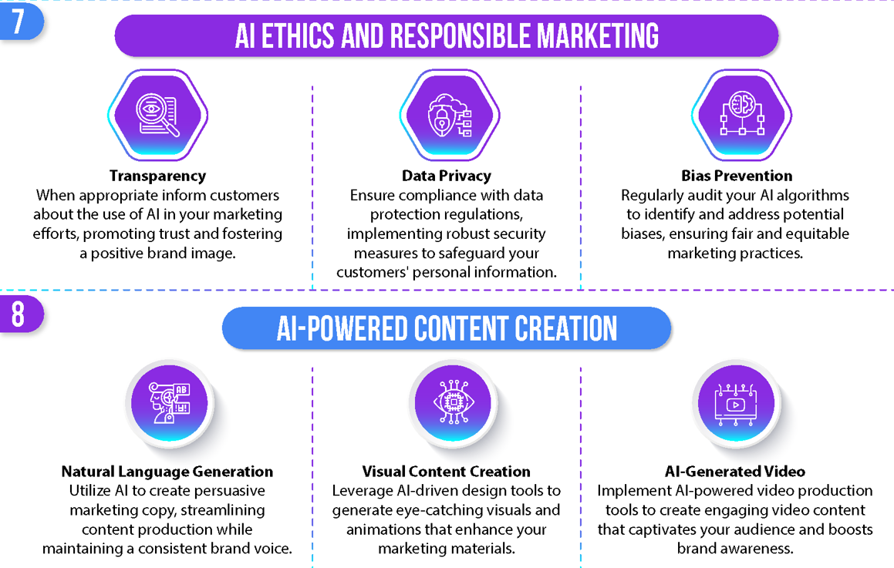

Slide 8
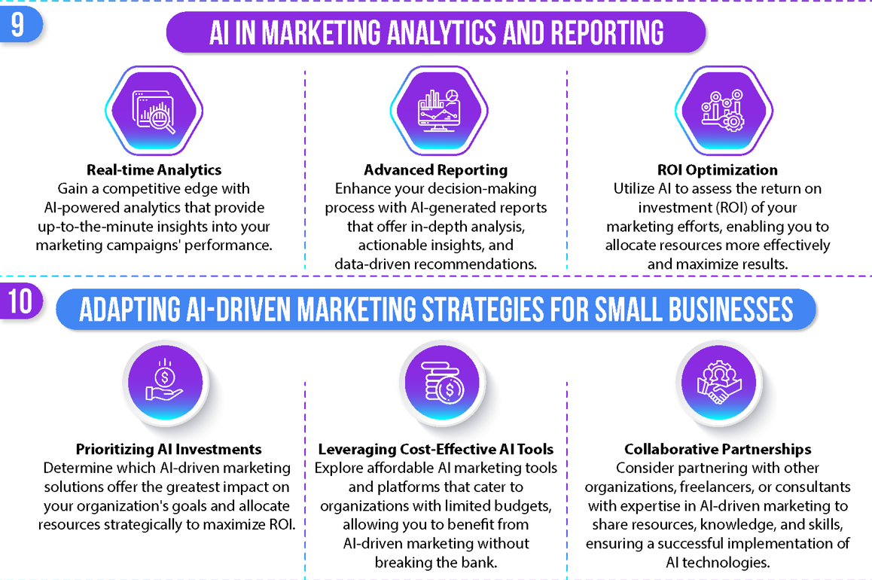

Slide 9
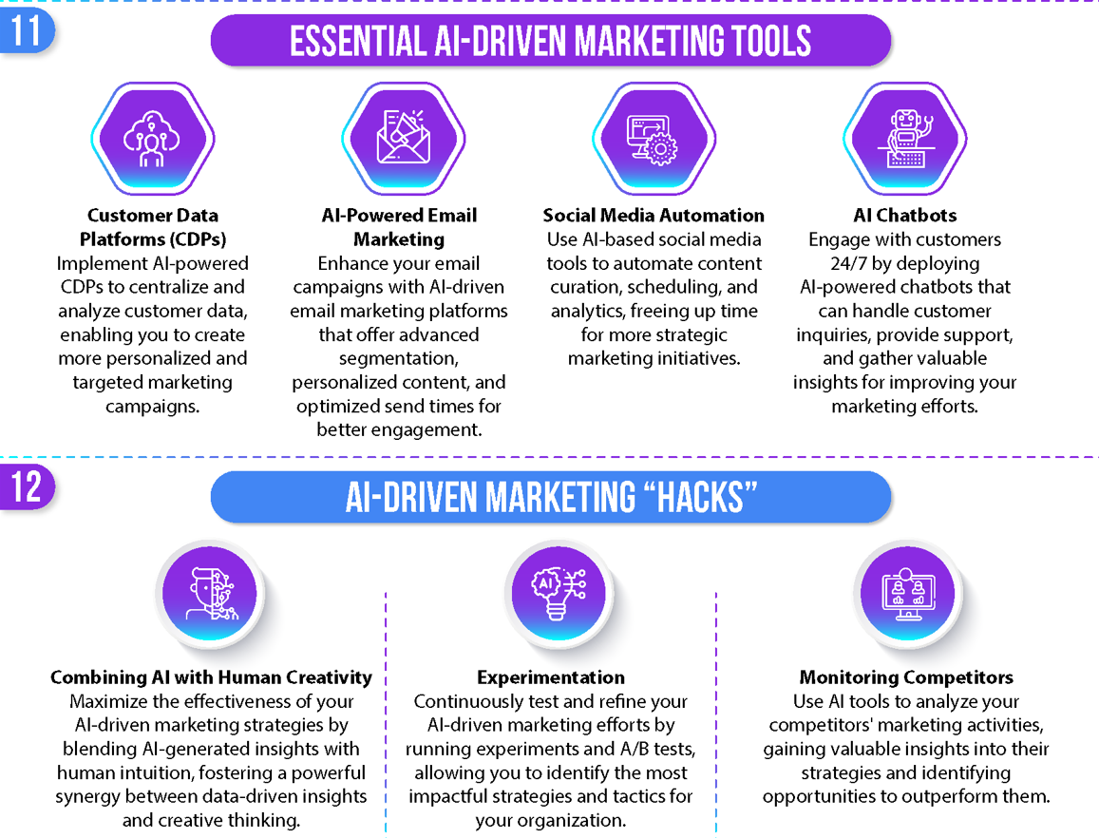

Slide 10
How Can AI help with digital marketing for businesses?
AI is transforming digital marketing by making campaigns more efficient, data-driven, and personalized. Here are some key ways AI can help businesses improve their digital marketing efforts:
1. AI-Powered Content Creation & Automation
Generates high-quality blog posts, social media content, and product descriptions.
Automates email marketing campaigns with AI-driven personalization.
Example: Tools like ChatGPT, Jasper AI, or Copy.ai can generate compelling ad copy.
2. Personalized Customer Experience
AI analyzes customer behavior and tailors recommendations based on their interests.
Chatbots & virtual assistants provide 24/7 support and guide customers through their journey.
Example: AI chatbots like Drift, HubSpot, or ChatGPT-powered bots enhance customer interactions.
3. Predictive Analytics & Data Insights
AI analyzes customer data to predict trends, behaviors, and conversion probabilities.
Helps businesses make data-driven decisions to optimize campaigns.
Example: Google Analytics 4 (GA4) and AI-driven CRM tools predict customer trends.
4. AI-Driven SEO Optimization
AI tools analyze search trends and recommend the best keywords for ranking.
Can generate SEO-friendly content and meta tags automatically.
Example: Surfer SEO, Clearscope, and SEMrush AI help optimize content.
Source: https://zapier.com/apps/categories/ai-tools

Slide 11
How Can AI help with business digital marketing?
5. Automated Ad Targeting & Bidding
AI optimizes Google Ads, Facebook Ads, and Instagram Ads by automatically adjusting bids based on performance.
AI helps businesses target the right audience at the right time using behavioral analysis.
Example: Google Performance Max and Facebook AI Targeting improve ROI.
6. AI for Social Media Marketing
AI can schedule and optimize social media posts for the best engagement.
Helps businesses analyze audience behavior and track competitors.
Example: Hootsuite AI, Buffer, and Sprout Social use AI to optimize social media campaigns.
7. AI-Powered Email Marketing
AI analyzes customer interactions to send personalized email campaigns.
Can predict the best time to send emails for maximum engagement.
Example: Mailchimp AI, HubSpot, and ActiveCampaign offer AI-driven email automation.
Source: https://zapier.com/apps/categories/ai-tools

Slide 12
How Can AI help with business digital marketing?
8. AI-Enhanced Visual and Video Marketing
AI creates video content, generates subtitles, and enhances video editing.
AI image recognition helps in better ad placement and audience targeting.
Example: Synthesia AI creates AI-generated videos, and Canva AI automates design tasks.
9. Voice Search & Conversational AI
AI optimizes websites for voice search (Alexa, Google Assistant, Siri).
Businesses can use AI-powered chatbots and voice assistants to improve engagement.
Example: Dialogflow and Voiceflow help businesses implement conversational AI.
10. AI for Lead Generation & Sales Forecasting
AI identifies potential leads based on customer data and behavior.
Predicts sales trends and suggests personalized marketing strategies.
Example: HubSpot AI, Zoho CRM AI, and Salesforce Einstein help with lead generation.
11. AI for Business Task Automation (auto write blogs, auto post blog, auto respond to customer, etc )
Source: https://zapier.com/apps/categories/ai-tools

Slide 13
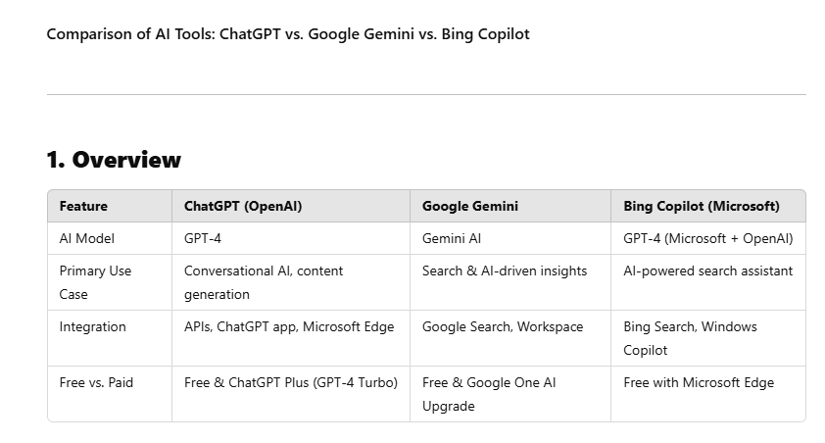

Slide 14
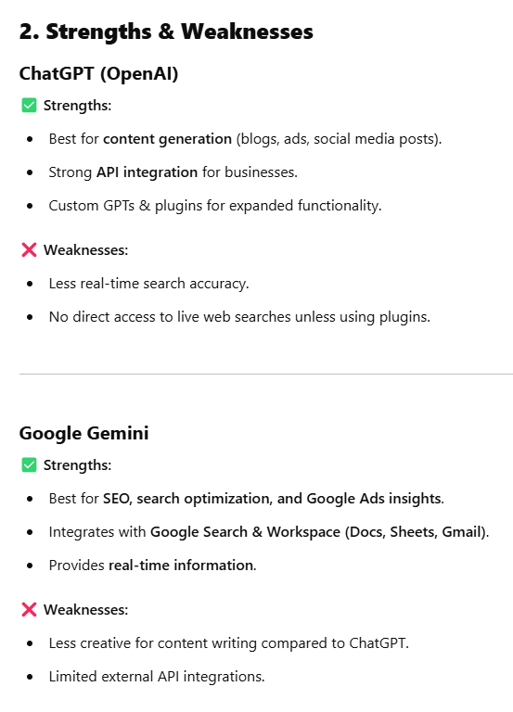

Slide 15
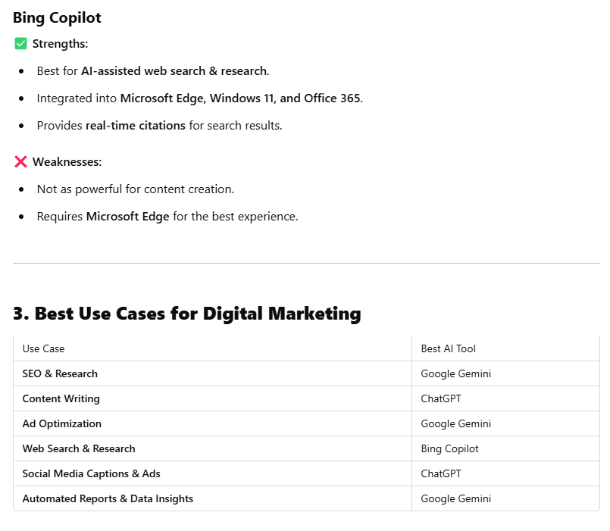
Use ChatGPT for content creation, AI chatbots, and social media posts.
Use Google Gemini for SEO, Google Ads, and research-driven content.
Use Bing Copilot for AI-powered search insights and Microsoft Office integration.

Slide 16
Which One is the Fastest? ChatGPT, Google Gemini, Bing Copilot
The speed of AI models like ChatGPT (OpenAI), Google Gemini (formerly Bard), and Bing Copilot (Microsoft) depends on several factors, including the query complexity, server load, and internet speed. Here’s a comparison based on general performance:
1. ChatGPT (OpenAI)
✅ Speed: Fast & Responsive – One of the fastest AI models for text generation. ✅ Strengths:
Quick responses for text-based queries.
Strong in creative writing, coding, and conversational AI.
Available as ChatGPT-4 Turbo, optimized for both speed and cost efficiency. ❌ Weaknesses:
No real-time web browsing unless using external plugins.
2. Google Gemini (Bard)
✅ Speed: Fast, but sometimes slower than ChatGPT, especially for complex tasks. ✅ Strengths:
Real-time web browsing & access to Google’s search engine.
Strong at summarizing and fact-checking using search results.
Handles multimedia (text + images) better. ❌ Weaknesses:
Responses can be slower for long or complex queries.
Less refined in creative tasks like storytelling.

Slide 17
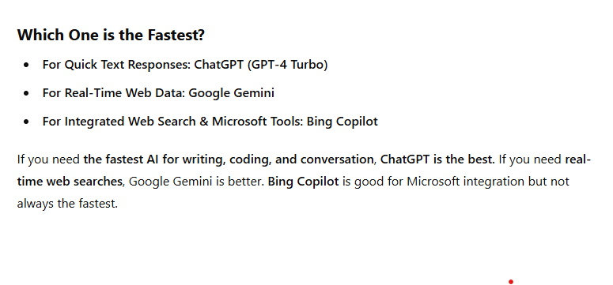
3. Bing Copilot (Microsoft)
✅ Speed: Varies – Can be fast but sometimes slower due to web-based processing. ✅ Strengths:
Integrates with Bing search, providing real-time results.
Available in Microsoft Edge, Windows, and Office tools. ❌ Weaknesses:
Can be slower for deep analytical tasks compared to ChatGPT.
Often redirects users to Bing search instead of answering directly.

Slide 18
3. Bing Copilot (Microsoft)
✅ Speed: Varies – Can be fast but sometimes slower due to web-based processing. ✅ Strengths:
Integrates with Bing search, providing real-time results.
Available in Microsoft Edge, Windows, and Office tools. ❌ Weaknesses:
Can be slower for deep analytical tasks compared to ChatGPT.
Often redirects users to Bing search instead of answering directly.

Slide 19
Are AI Prompts Important?
Yes, prompts are crucial for AI because they determine the quality, relevance, and depth of the AI's response. A well-crafted prompt provides clarity, context, and specific guidance, guiding the AI to generate more useful and accurate results.
Here’s why prompts matter:
Clarity & Precision – The more specific your prompt, the better the AI can understand what you’re asking.
Context Matters – Including relevant background information helps the AI generate responses that align with your needs.
Desired Outcome – A well-structured prompt ensures the response meets expectations, whether for creativity, technical assistance, or factual accuracy.
Efficiency – A clear prompt reduces back-and-forth, saving time in refining responses.

Slide 20
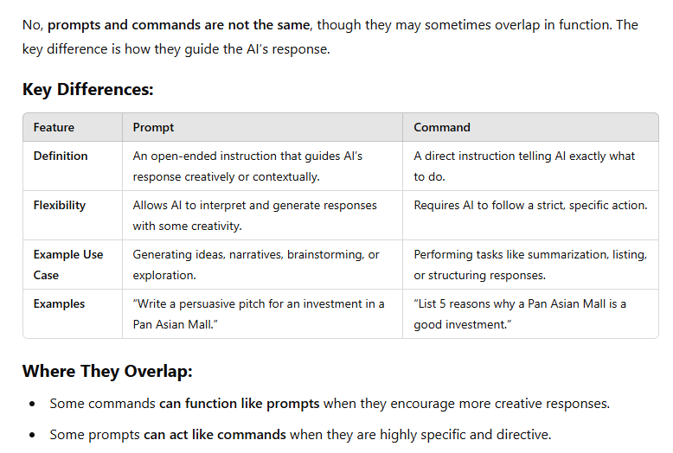

Slide 21
Prompts vs. Questions vs. Commands
Each serves a different purpose when interacting with AI, and understanding their distinctions can help you get the best responses.
1. Prompts
A prompt is an open-ended instruction that provides context or direction for AI to generate a response. It often guides AI toward a specific type of output.
🔹 Example:
“Write a compelling product description for a luxury fashion brand.”
“Generate a persuasive pitch for a Pan Asian Mall investment opportunity.”
“Describe the impact of mixed-use developments on urban communities.”
Use When: You want AI to create detailed, structured, or creative content.

Slide 22
Prompts vs. Questions vs. Commands
Each serves a different purpose when interacting with AI, and understanding their distinctions can help you get the best responses.
2. Questions
A question seeks specific information, clarification, or insight. It usually has a direct answer, whether factual, opinion-based, or explanatory.
🔹 Example:
“What are the benefits of mixed-use developments?”
“How can I market my clothing brand effectively?”
“What is the best way to secure investors for a Kickstarter campaign?”
Use When: You need a factual or well-reasoned answer to a specific inquiry.

Slide 23
Prompts vs. Questions vs. Commands
Each serves a different purpose when interacting with AI, and understanding their distinctions can help you get the best responses.
3. Commands
A command tells the AI exactly what to do in a direct way. It's more instructional and expects a specific action or response.
🔹 Example:
“Summarize this article in three bullet points.”
“List five ways to increase online sales.”
“Generate 10 Facebook ad headlines for a massage therapy business.”
Use When: You want AI to take a specific action, such as summarizing, listing, or generating structured content.

Slide 24
Prompts vs. Questions vs. Commands
Each serves a different purpose when interacting with AI, and understanding their distinctions can help you get the best responses.
3. Commands
A command tells the AI exactly what to do in a direct way. It's more instructional and expects a specific action or response.
🔹 Example:
“Summarize this article in three bullet points.”
“List five ways to increase online sales.”
“Generate 10 Facebook ad headlines for a massage therapy business.”
Use When: You want AI to take a specific action, such as summarizing, listing, or generating structured content.

Slide 25
Generative AI vs Machine Learning
While both machine learning (ML) and generative AI (GenAI) are subsets of Artificial Intelligence (AI), their primary difference lies in their purpose: ML focuses on analyzing data and making predictions or classifications, while GenAI focuses on creating new content, such as text, images, or music.

Slide 26
Generative AI vs Machine Learning

Slide 27
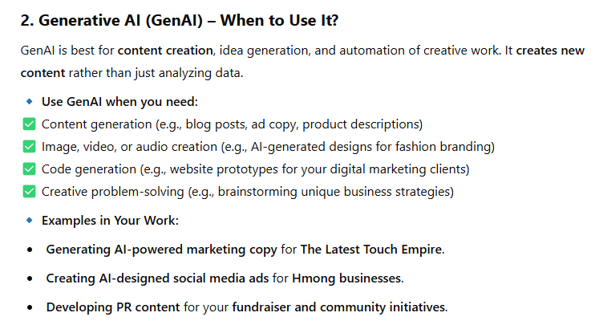
Generative AI vs Machine Learning

Slide 28
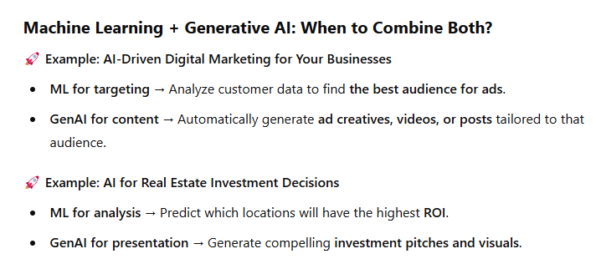
Generative AI vs Machine Learning

Slide 29
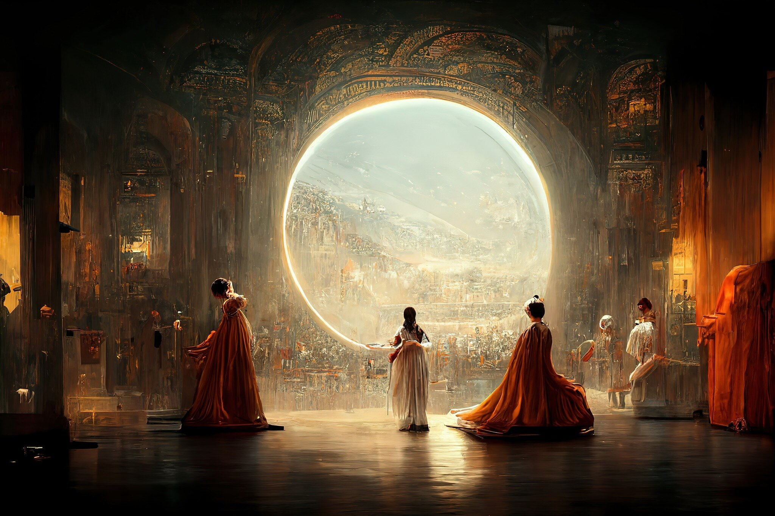
What is Generative AI?
Generative AI is a subset of artificial intelligence that focuses on generating new content from scratch.
The content generated by generative AI can range from text, images, voice, videos, or music depending on the data it has been trained on.
Generative AI creates the output by learning from a lot of data and understanding the patterns and structures in it.
It does not just reproduce the training data but creates new data by understanding the existing patterns.
One of the key tools used by generative AI is deep learning which helps it understand the context and create relevant output.
Photo by Google DeepMind

Slide 30
Generative AI in Digital Marketing Part 1
Content Creation: Generative AI can be used to automate content creation for digital marketing campaigns. This includes writing product descriptions, blog posts, social media posts, and other promotional materials. Tools like OpenAI's GPT-3 and Copy.ai can generate high-quality content in a fraction of the time it would take a human writer.
Personalized Marketing: AI can analyze customer data to create personalized marketing campaigns. It can generate content tailored to individual customer preferences, behavior, and purchase history, improving customer engagement and conversion rates. Tools like Personyze and Optimizely provide such personalization capabilities.
Photo by Mailchimp

Slide 31
Generative AI in Digital Marketing Part 2
Predictive Analysis: Generative AI can be used to predict future trends, customer behavior, and campaign performance. This helps in making data-driven decisions and optimizing marketing strategies. Tools like RapidMiner and Alteryx are popular for predictive analysis in marketing.
Chatbots and Customer Service: AI chatbots can handle customer queries round the clock, providing instant responses and improving customer satisfaction. They can also be used for lead generation, product recommendations, and upselling. Tools like Drift, Intercom, and Ada are widely used for creating AI chatbots
Photo by Mailchimp

Slide 32
How do Professionals need to adapt part 1
Prompt Engineering: Effective AI content generation requires clear, innovative prompts, demanding professionals to understand language, semantics, and AI capabilities.
Data Analysis: Generative AI aids in deriving insights from data to identify business opportunities and challenges, necessitating professionals to understand and apply these analyses.
Photo by Alex Knight

Slide 33
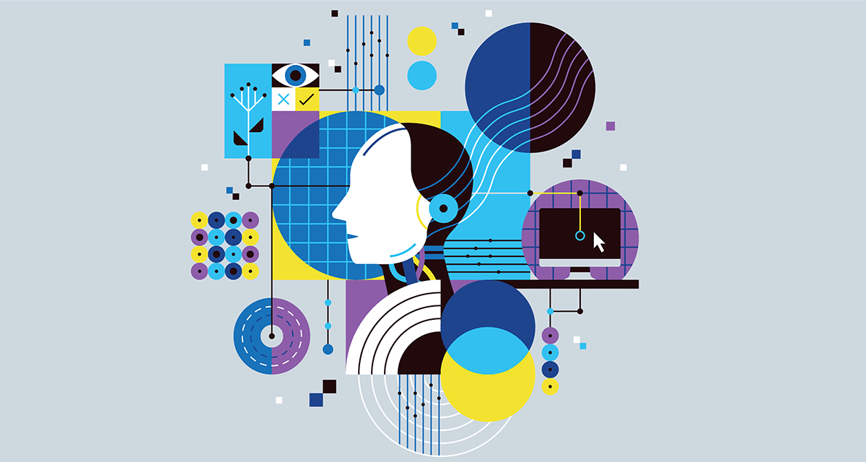
How do Professionals need to adapt part 2
Adaptive Creativity: AI automation of repetitive tasks allows professionals to focus on innovative strategies, making adaptive creativity a crucial skill.
Business Goals Understanding: Despite AI sophistication, professionals need a deep understanding of their business for targeted and effective marketing strategies.
AI Interaction: Professionals should be able to interact effectively with AI, understanding its capabilities, limitations, and training needs.
Legal & Ethical Understanding: Professionals must be aware of legal and ethical considerations in AI use, including privacy and intellectual property laws, to ensure compliance and maintain trust.
Photo by Alex Knight

Slide 34
Q&A and 1 on 1 Live Session
Now, I'd like to open the floor for any questions you may have
Photo by Wesley Tingey

Slide 35
e-Magine! Initiative
Every Mon/Tue 5:30 – 8:30pm
John B Yang
Email: John@digitalsynergy.ai, info@aabrn.org
Phone: 888-907-2284

