Slide 1
e-Magine! Initiative
Every Mon/Tue 5:30 – 8:30pm

Slide 2
Leonardo AI

Slide 3
Leonardo AI is a platform for generating high-quality AI art and 3D assets. It allows users to create images from text prompts, customize AI models for unique styles, and offers tools like a real-time canvas. It's designed for both beginners and professionals, providing powerful AI-driven visual creation.

Slide 4
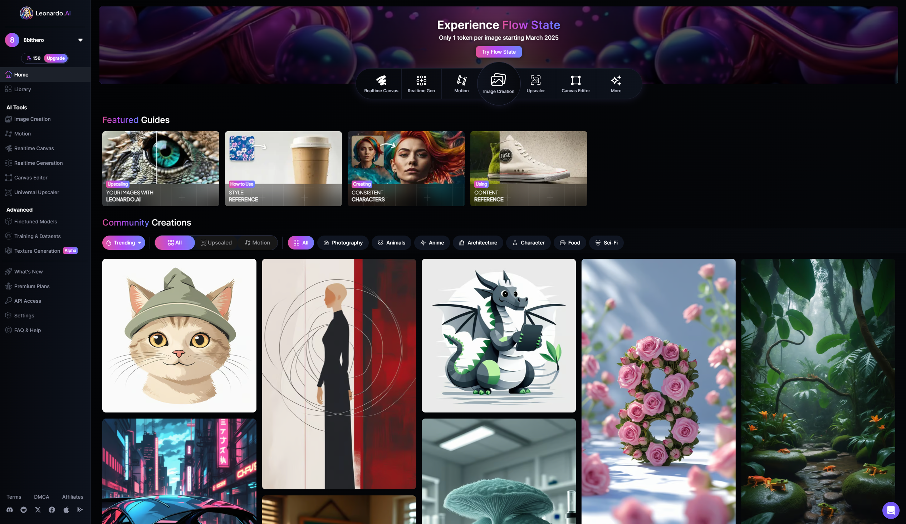
Left hand tool bar
Tool Dashboard
Users Generated Images

Slide 5
Access Leonardo AI:
Go to the Website: Open your web browser and navigate to the Leonardo AI website (app.leonardo.ai) first time user click on "Get Started"
Sign Up/Log In: If you're a new user, you'll need to sign up for an account. If you already have one, log in.

Slide 6
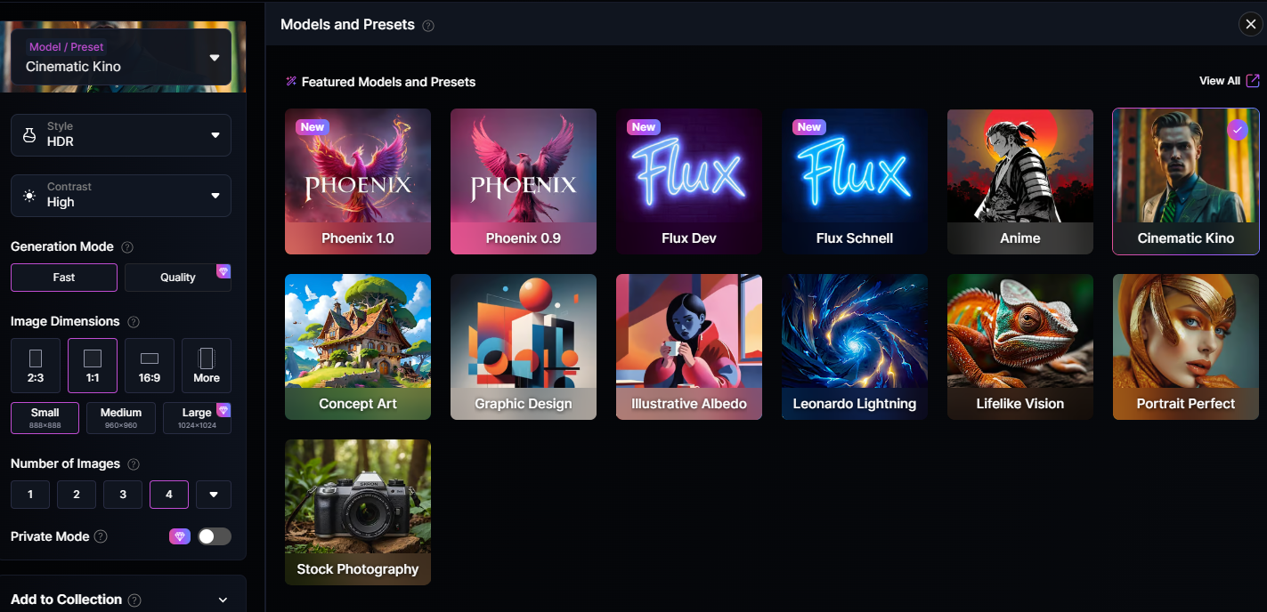
Choose Your AI Model:
Leonardo AI offers various AI models. Select the one that best suits your desired style. Common choices include:
Stable Diffusion models.
Leonardo Diffusion.
3D generation models.
The model you choose will greatly impact the style and quality of your generated images.
Craft Your Prompt:
Enter a Text Prompt: In the prompt box, type a detailed description of the image you want to create. The more specific and descriptive your prompt, the better the results.
Include Details: Specify subjects, objects, settings, colors, lighting, and artistic styles.
Use Negative Prompts: Use the negative prompt box to tell the AI what you don't want in the image. This can help refine your results.
Adjust Settings (Optional):
Image Dimensions: Set the desired width and height of your image.
Guidance Scale: Adjust the guidance scale to control how closely the AI adheres to your prompt. Higher values mean closer adherence.
Sampling Steps: Modify the number of sampling steps to control the level of detail. More steps generally result in higher quality.
Model specific settings: Each model will have its own set of unique settings. Explore these settings to fine tune your generations.
Image generation settings: Adjust things such as the number of images to generate per prompt.
Notes:
Most Asian traditional cultures are based on Confucius philosophy and Buddhism. The traditional view of the human body is as a derivative of the natural world, and need to be in balance between Yin and Yang, and promotes self-sustaining, workout according to seasons, and simple living philosophies. Confucian culture also shapes family structure, in which the family relationship is hierarchical in nature. Consequently the male who is head of household has more power than the female, than the children. Familial decision-making usually includes extended family members, such as grandparents and other significant relatives. Children are expected to obey elders and to put the family’s needs above their own.

Slide 7
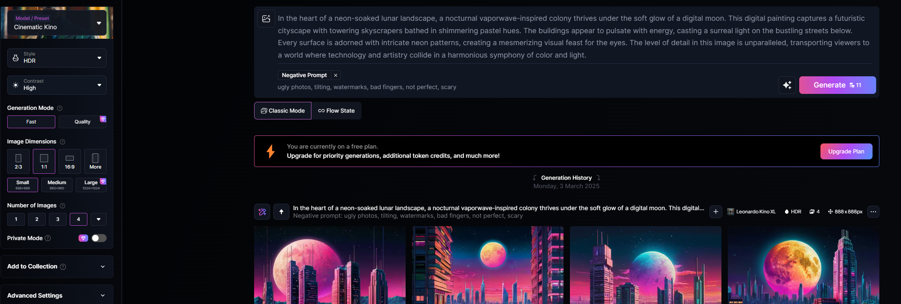
Generate Your Image:
Click "Generate": Once you're satisfied with your prompt and settings, click the "Generate" button.
Wait for Processing: The AI will process your request, which may take a few moments depending on the complexity of your prompt and the chosen settings.
Review and Refine:
View Results: After processing, the generated images will appear.
Download: If you like an image, you can download it to your device.
Refine: If you're not satisfied, you can:
Modify your prompt.
Adjust the settings.
Use the "Variations" feature to generate similar images.
Use the Canvas editor to edit the generated images.
Notes:
Most Asian traditional cultures are based on Confucius philosophy and Buddhism. The traditional view of the human body is as a derivative of the natural world, and need to be in balance between Yin and Yang, and promotes self-sustaining, workout according to seasons, and simple living philosophies. Confucian culture also shapes family structure, in which the family relationship is hierarchical in nature. Consequently the male who is head of household has more power than the female, than the children. Familial decision-making usually includes extended family members, such as grandparents and other significant relatives. Children are expected to obey elders and to put the family’s needs above their own.

Slide 8
Choose Your AI Model:
Leonardo AI offers various AI models. Select the one that best suits your desired style. Common choices include:
Stable Diffusion models.
Leonardo Diffusion.
3D generation models.
The model you choose will greatly impact the style and quality of your generated images.
Craft Your Prompt:
Enter a Text Prompt: In the prompt box, type a detailed description of the image you want to create. The more specific and descriptive your prompt, the better the results.
Include Details: Specify subjects, objects, settings, colors, lighting, and artistic styles.
Use Negative Prompts: Use the negative prompt box to tell the AI what you don't want in the image. This can help refine your results.
Adjust Settings (Optional):
Image Dimensions: Set the desired width and height of your image.
Guidance Scale: Adjust the guidance scale to control how closely the AI adheres to your prompt. Higher values mean closer adherence.
Sampling Steps: Modify the number of sampling steps to control the level of detail. More steps generally result in higher quality.
Model specific settings: Each model will have its own set of unique settings. Explore these settings to fine tune your generations.
Image generation settings: Adjust things such as the number of images to generate per prompt.
Notes:
Most Asian traditional cultures are based on Confucius philosophy and Buddhism. The traditional view of the human body is as a derivative of the natural world, and need to be in balance between Yin and Yang, and promotes self-sustaining, workout according to seasons, and simple living philosophies. Confucian culture also shapes family structure, in which the family relationship is hierarchical in nature. Consequently the male who is head of household has more power than the female, than the children. Familial decision-making usually includes extended family members, such as grandparents and other significant relatives. Children are expected to obey elders and to put the family’s needs above their own.

Slide 9
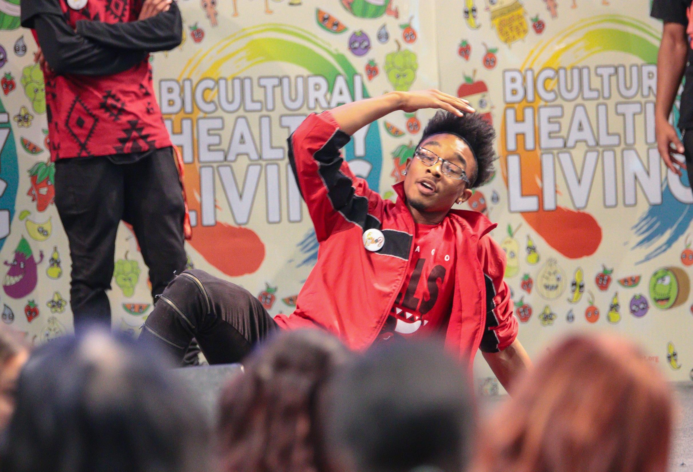
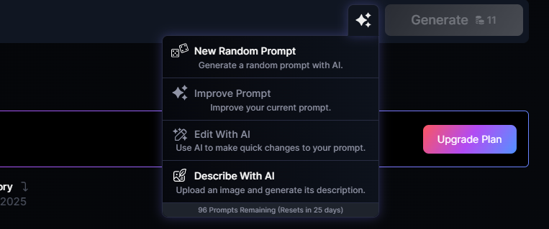
New Random Prompt
The "Random Prompt" button in Leonardo AI is a feature that provides users with instant, randomly generated text prompts. Clicking it produces a new, often unexpected, description that you can use to generate an image. This is useful for:
Inspiration: Overcoming creative blocks by providing fresh ideas.
Exploration: Discovering new styles and subjects you might not have considered.
Experimentation: Testing the AI's capabilities with diverse and unusual prompts.
Improve Prompt
The "Improve Prompt" button in Leonardo AI is a helpful feature designed to refine and enhance your text prompts for better image generation. When clicked, it analyzes your existing prompt and:
Adds Detail: It can expand on your description by including more specific adjectives, nouns, and verbs.
Refines Language: It may adjust the phrasing for clarity and conciseness, making it easier for the AI to understand.
Suggests Keywords: It might add relevant keywords that are known to produce better results with the AI model.

Slide 10
Final Thoughts
User-Friendly Power: Combines an intuitive interface with robust AI capabilities.
Customization Focus: Strong emphasis on fine-tuning AI models for personalized results.
Versatile Applications: Caters to a wide range of creative needs, from art to 3D asset generation.
Continuous Evolution: Actively developing new features and improvements.
Accessibility: Offers a platform for both beginners and professionals to explore AI art.
Creative Empowerment: Enables users to translate their visions into visual realities.
Community Driven: Growing community that helps to provide inspiration and examples.
Token-Based System: Utilizes a token or credit system, influencing generation limits and encouraging mindful usage. This system allows for free usage, and paid tiers for heavier users.

