Slide 1
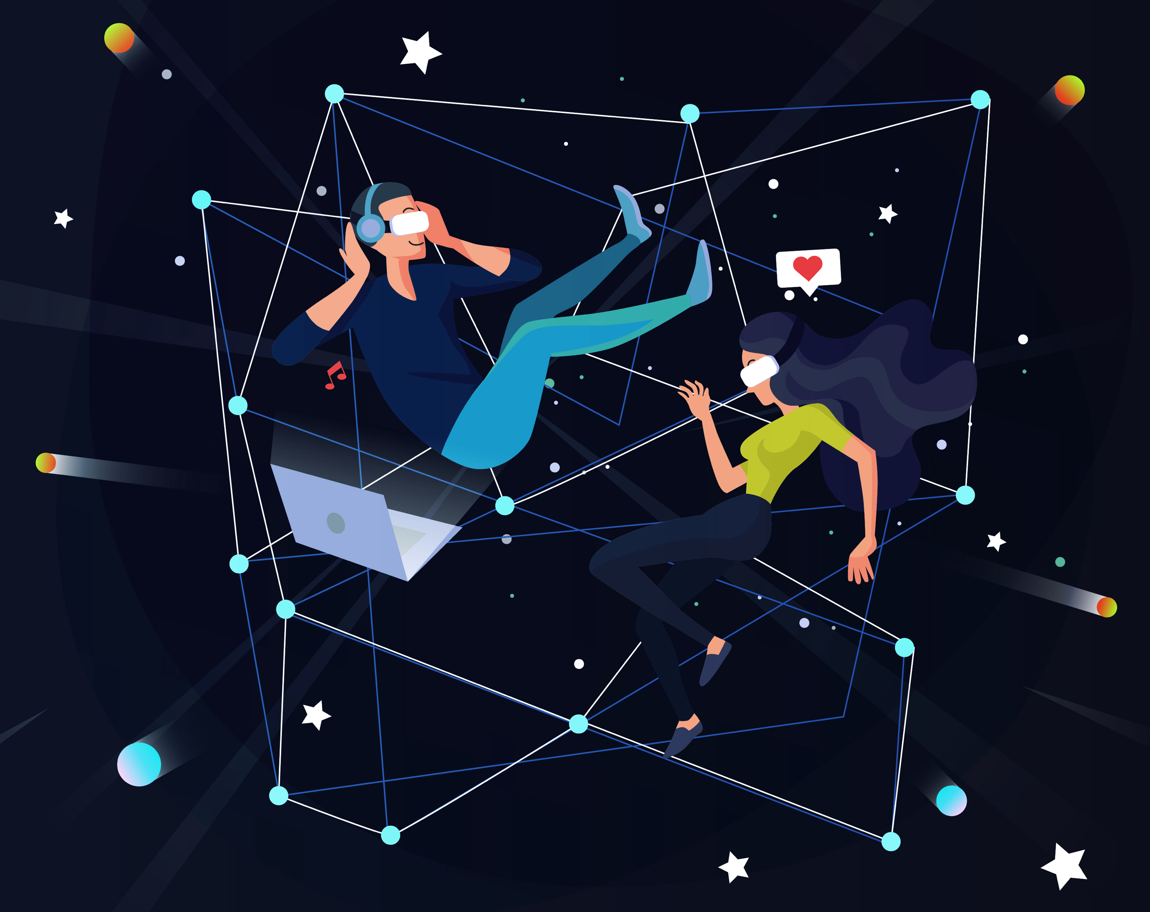
e-Magine! Initiative
Every Mon/Tue 5:30 – 8:30pm

Slide 2
Night Cafe AI

Slide 3
Getting Started: The "Create" Interface
When you enter NightCafe, you will find a button that says "create". After pressing that button, you will be taken to the creation page. This page is where you will input all of the information that the AI will use to create your image.
Visually, you'll see a prominent text box for your prompt, and various drop-down menus and sliders for settings.
Daily points
Next to the account button you'll see the bell icon. By logging in everyday you can accumulate 5 points daily.
By clicking on Explore in the sub menu you can see other users generated images, by liking 25 photos you can accumulate 5 points daily.

Slide 4
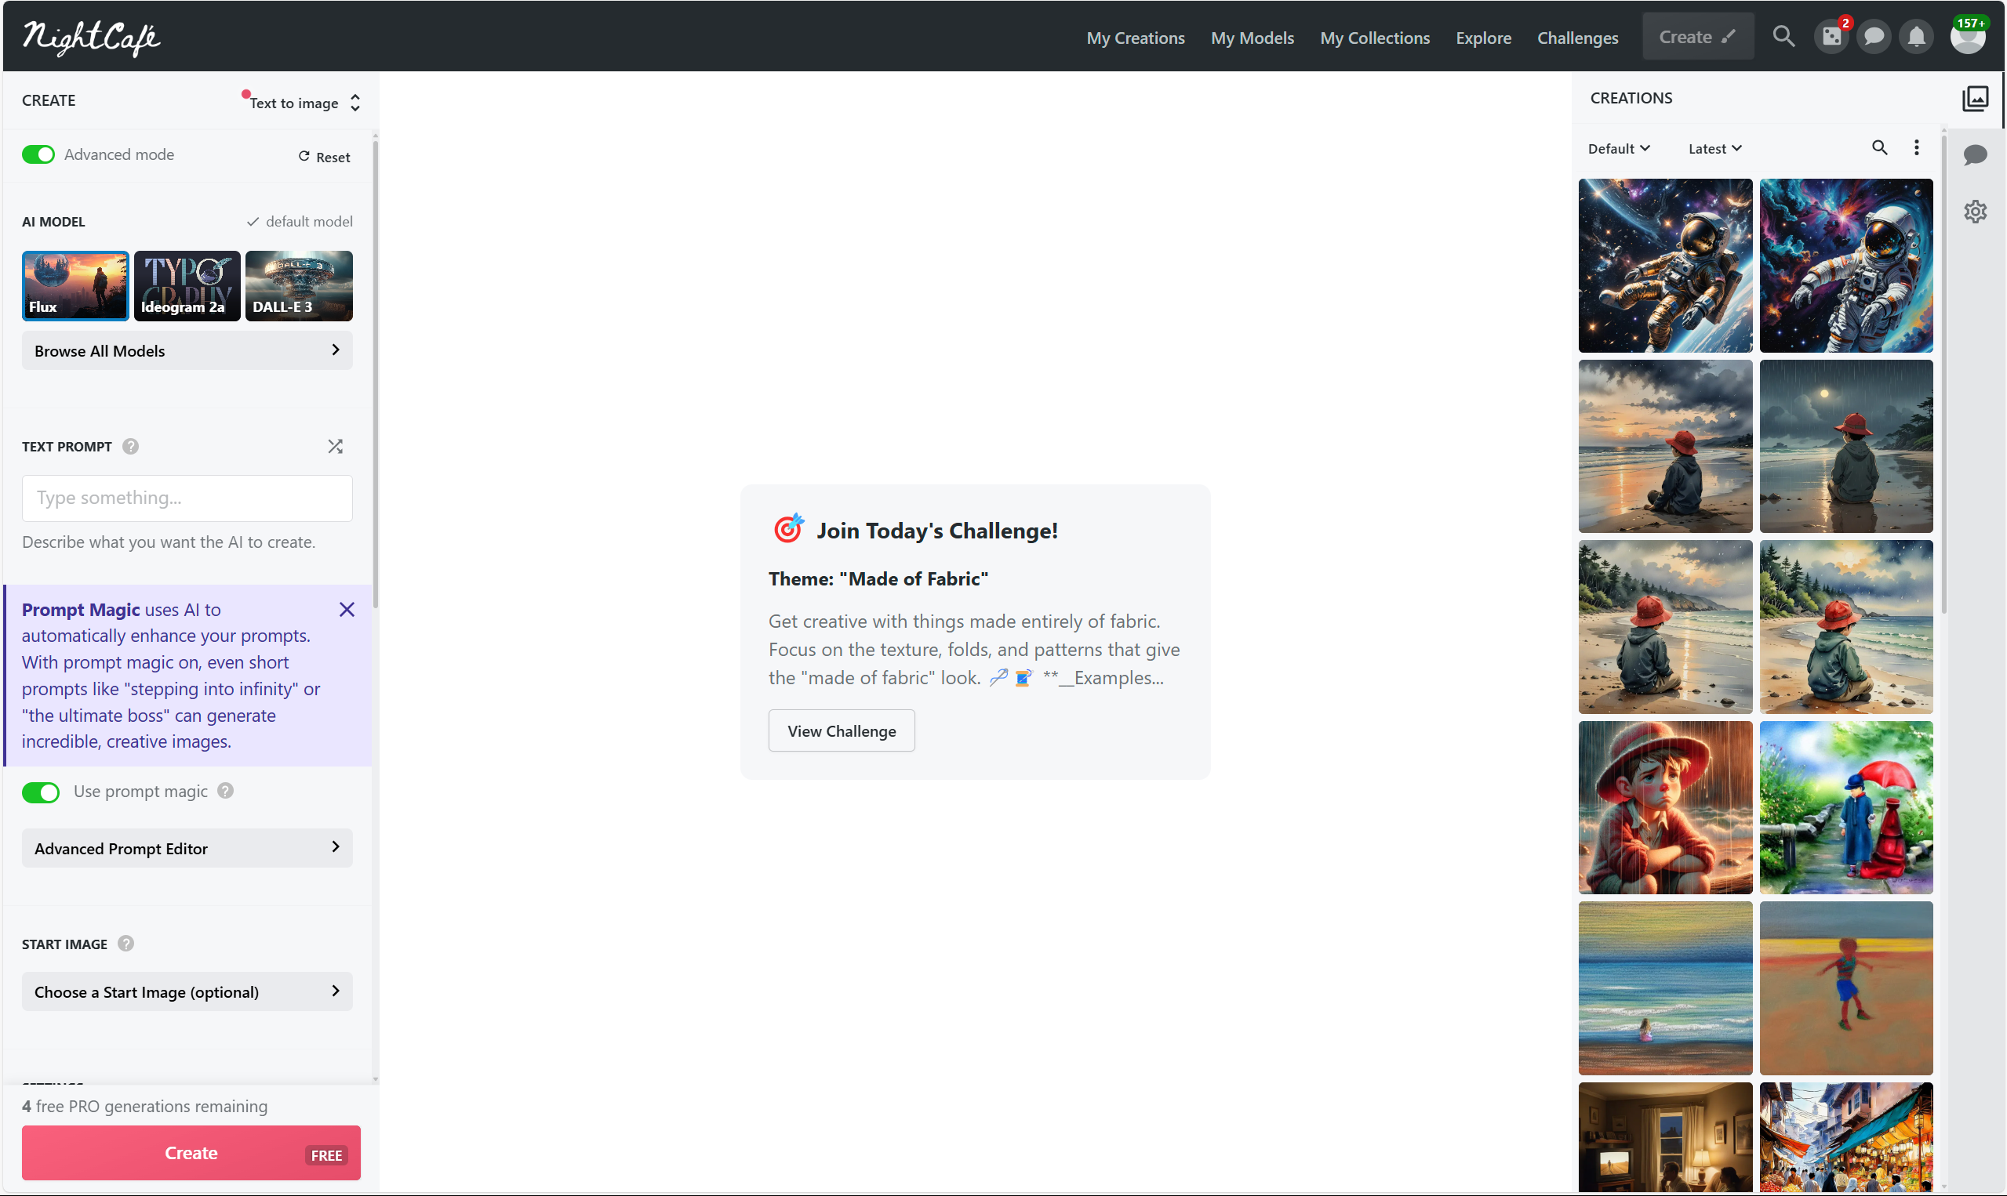
Entering Your Prompt
This is where you type in your desired image description. For Example "A vibrant sunset over a mountain range, painted in the style of impressionism".
Imagine a blank text box, ready for you to fill it with your creative vision.

Slide 5
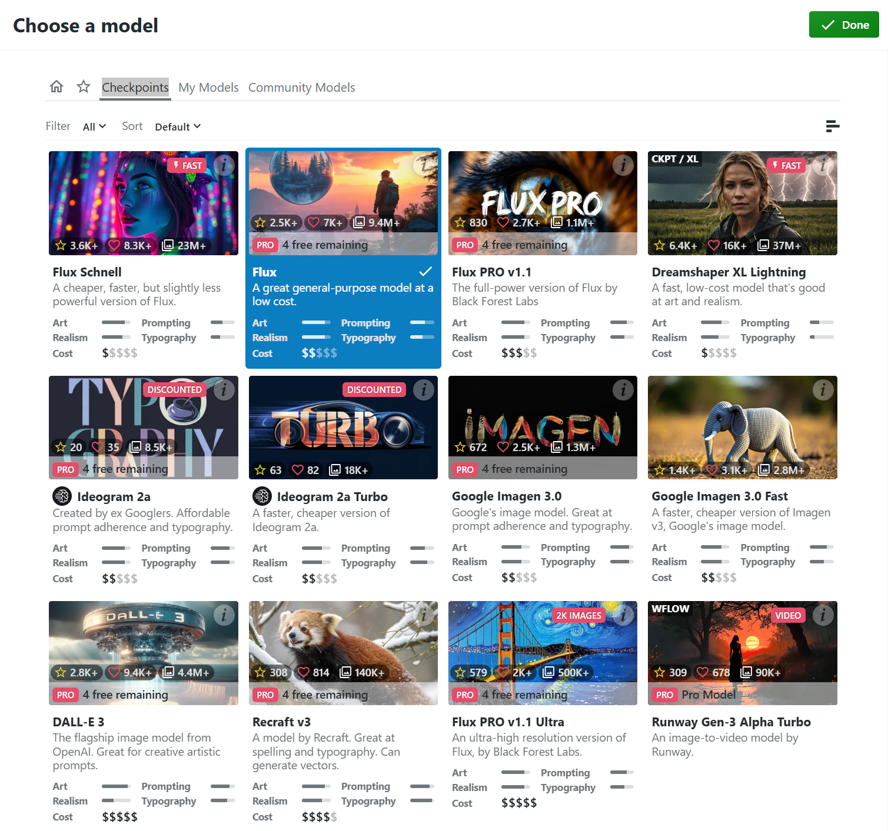
Selecting an AI Model and Settings
You'll choose from models like Stable Diffusion, DALL-E, etc. Each has its own style.
Below the model selection, you'll find settings:
Style: Presets (e.g., "realistic," "fantasy") or custom options.
Resolution: Image size (e.g., 512x512, 1024x1024).
Runtime: How long the AI processes the image.
These settings are generally displayed in drop down menus, and sliders.
Imagine drop-down menus with various options, and sliders that adjust the image properties.

Slide 6
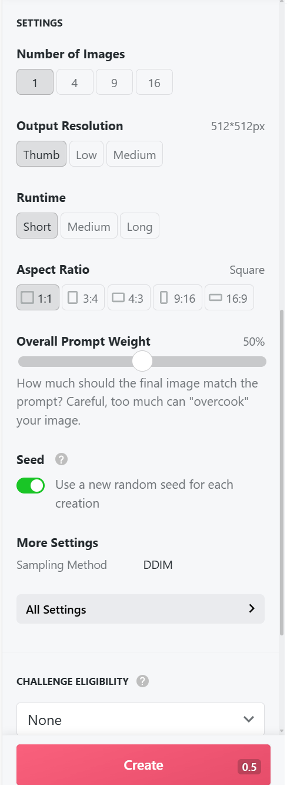
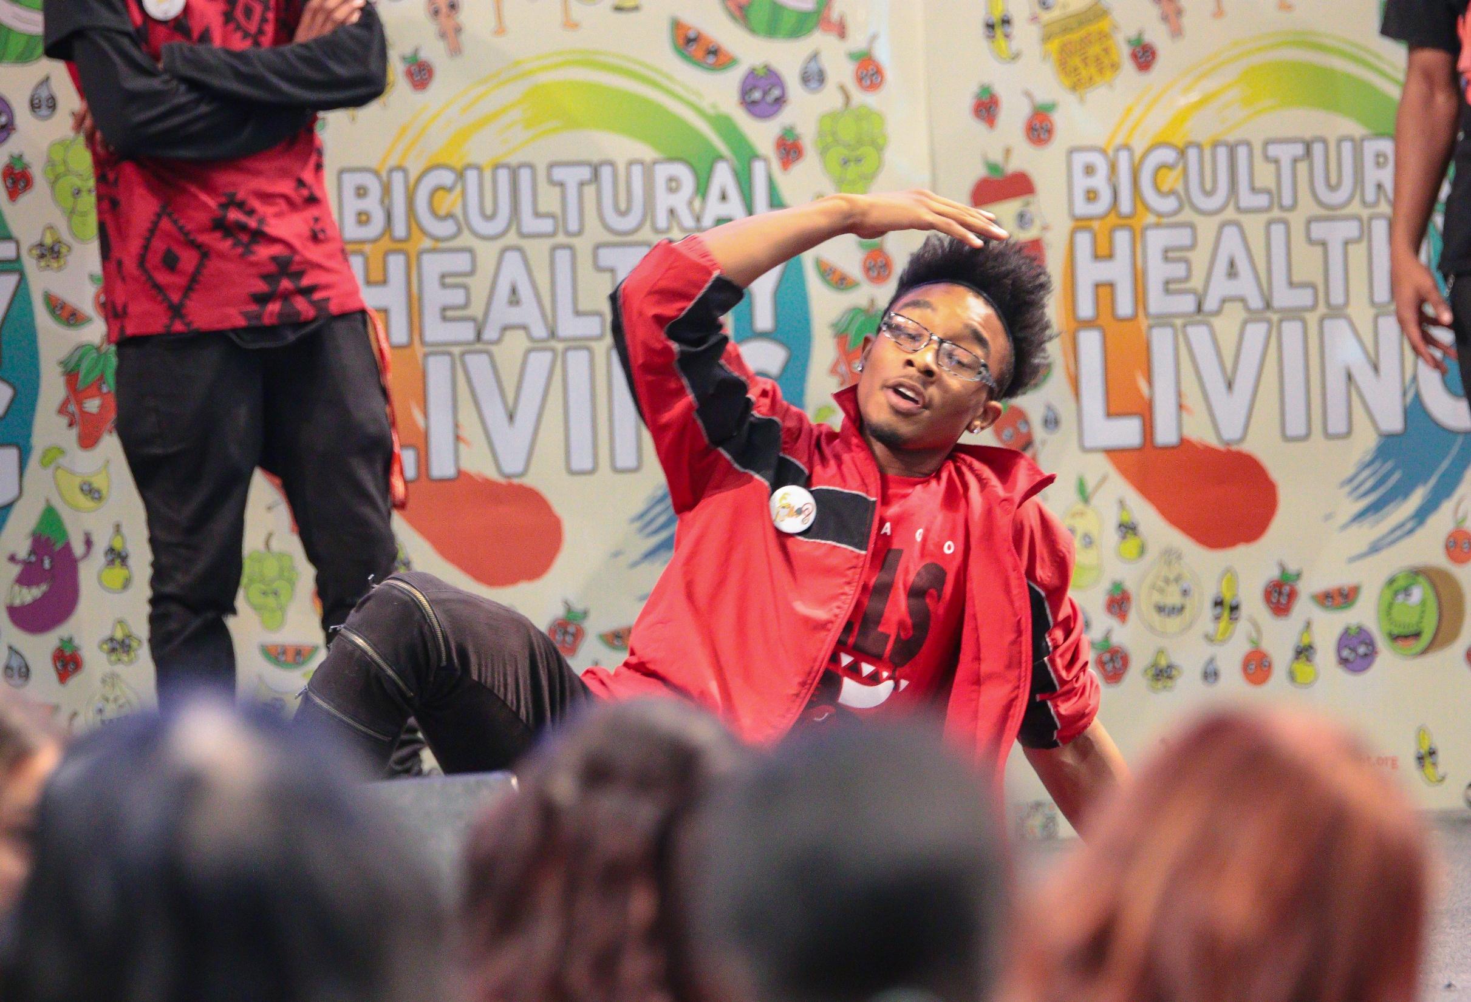
Generating the Image
Click the "Create" button. The AI processes your prompt and settings.
Visualise a loading bar, or a spinning icon, indicating that the AI is working.

Slide 7
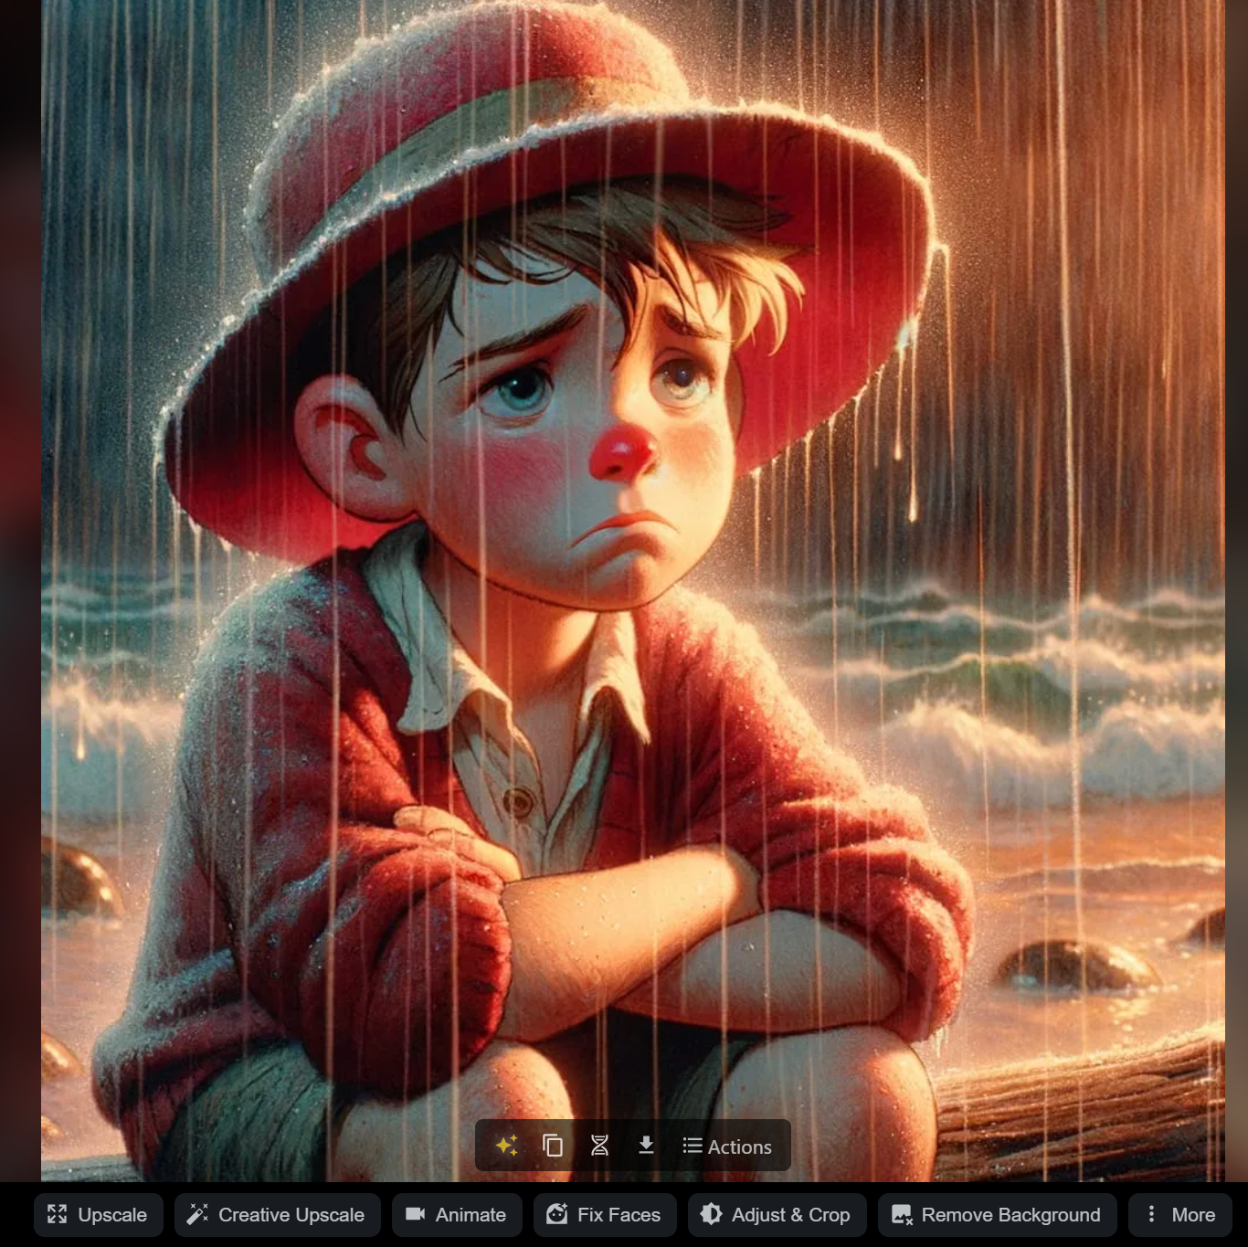
Reviewing and Refining
Your generated images appear.
You'll see thumbnail previews of your creations.
Options appear below each image:
"Upscale": To increase resolution.
"Evolve": To create variations.
Download: To save the image.
Imagine a grid of generated images, with buttons below them.
Notes:
Most Asian traditional cultures are based on Confucius philosophy and Buddhism. The traditional view of the human body is as a derivative of the natural world, and need to be in balance between Yin and Yang, and promotes self-sustaining, workout according to seasons, and simple living philosophies. Confucian culture also shapes family structure, in which the family relationship is hierarchical in nature. Consequently the male who is head of household has more power than the female, than the children. Familial decision-making usually includes extended family members, such as grandparents and other significant relatives. Children are expected to obey elders and to put the family’s needs above their own.

Slide 8
Final Thoughts
Key Visual Elements:
Text Prompts: The core input, driving the AI.
AI Model Selection: Drop-down menus to pick the AI engine.
Settings Sliders/Menus: For fine-tuning image properties.
Image Grids: Where generated images are displayed.
Buttons: For actions like "Create," "Upscale," and "Download."
NightCafe addresses copyright concerns, allowing users to use their creations for commercial purposes, provided they have the necessary rights to any input images.
NightCafe fosters a strong community where users share their creations, provide feedback, and participate in challenges. This social aspect distinguishes it from some other AI art generators.
They have daily and community challenges that encourage users to push their creative boundries.
The platform is designed to be accessible to both beginners and experienced users, with an intuitive interface.
It is available through web browsers, and also has a mobile app.
NightCafe provides access to a wide range of AI models, including popular ones like Stable Diffusion, DALL-E 3, and others. This variety allows users to experiment with different artistic styles and outputs.
They are constantly updating and adding new models.

