Slide 1
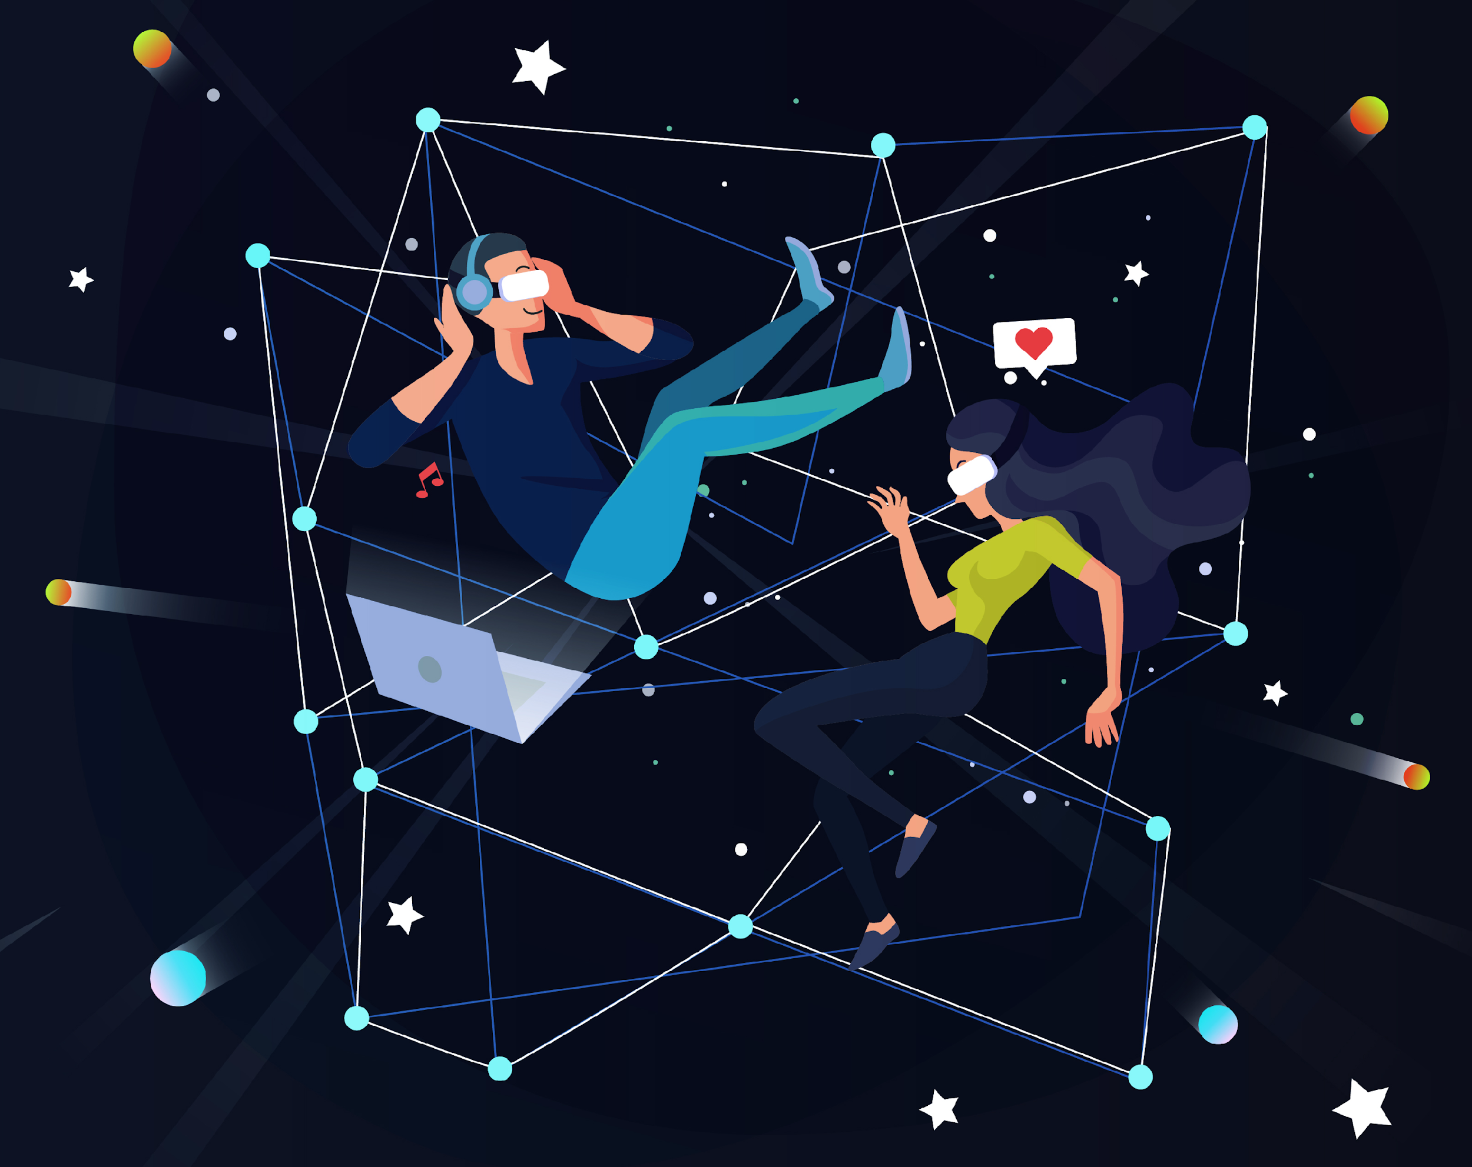
E-Magine! Initiative
Every Mon/Tue 5:30 – 8:30pm

Slide 2
Create your Canva account
Table of contents
Creating an account
Free Function
Generating text & images
Basic, intermediate, and advanced
Applications/plug-ins
Exporting & tips
Notes:
How many of you have used Canva before?
What do you normally use Canva for?
What would you like to learn?

Slide 3
Free Canva Functions
Templates & Styles
Elements
Brand
Uploads
Draw
Projects
Apps

Slide 4
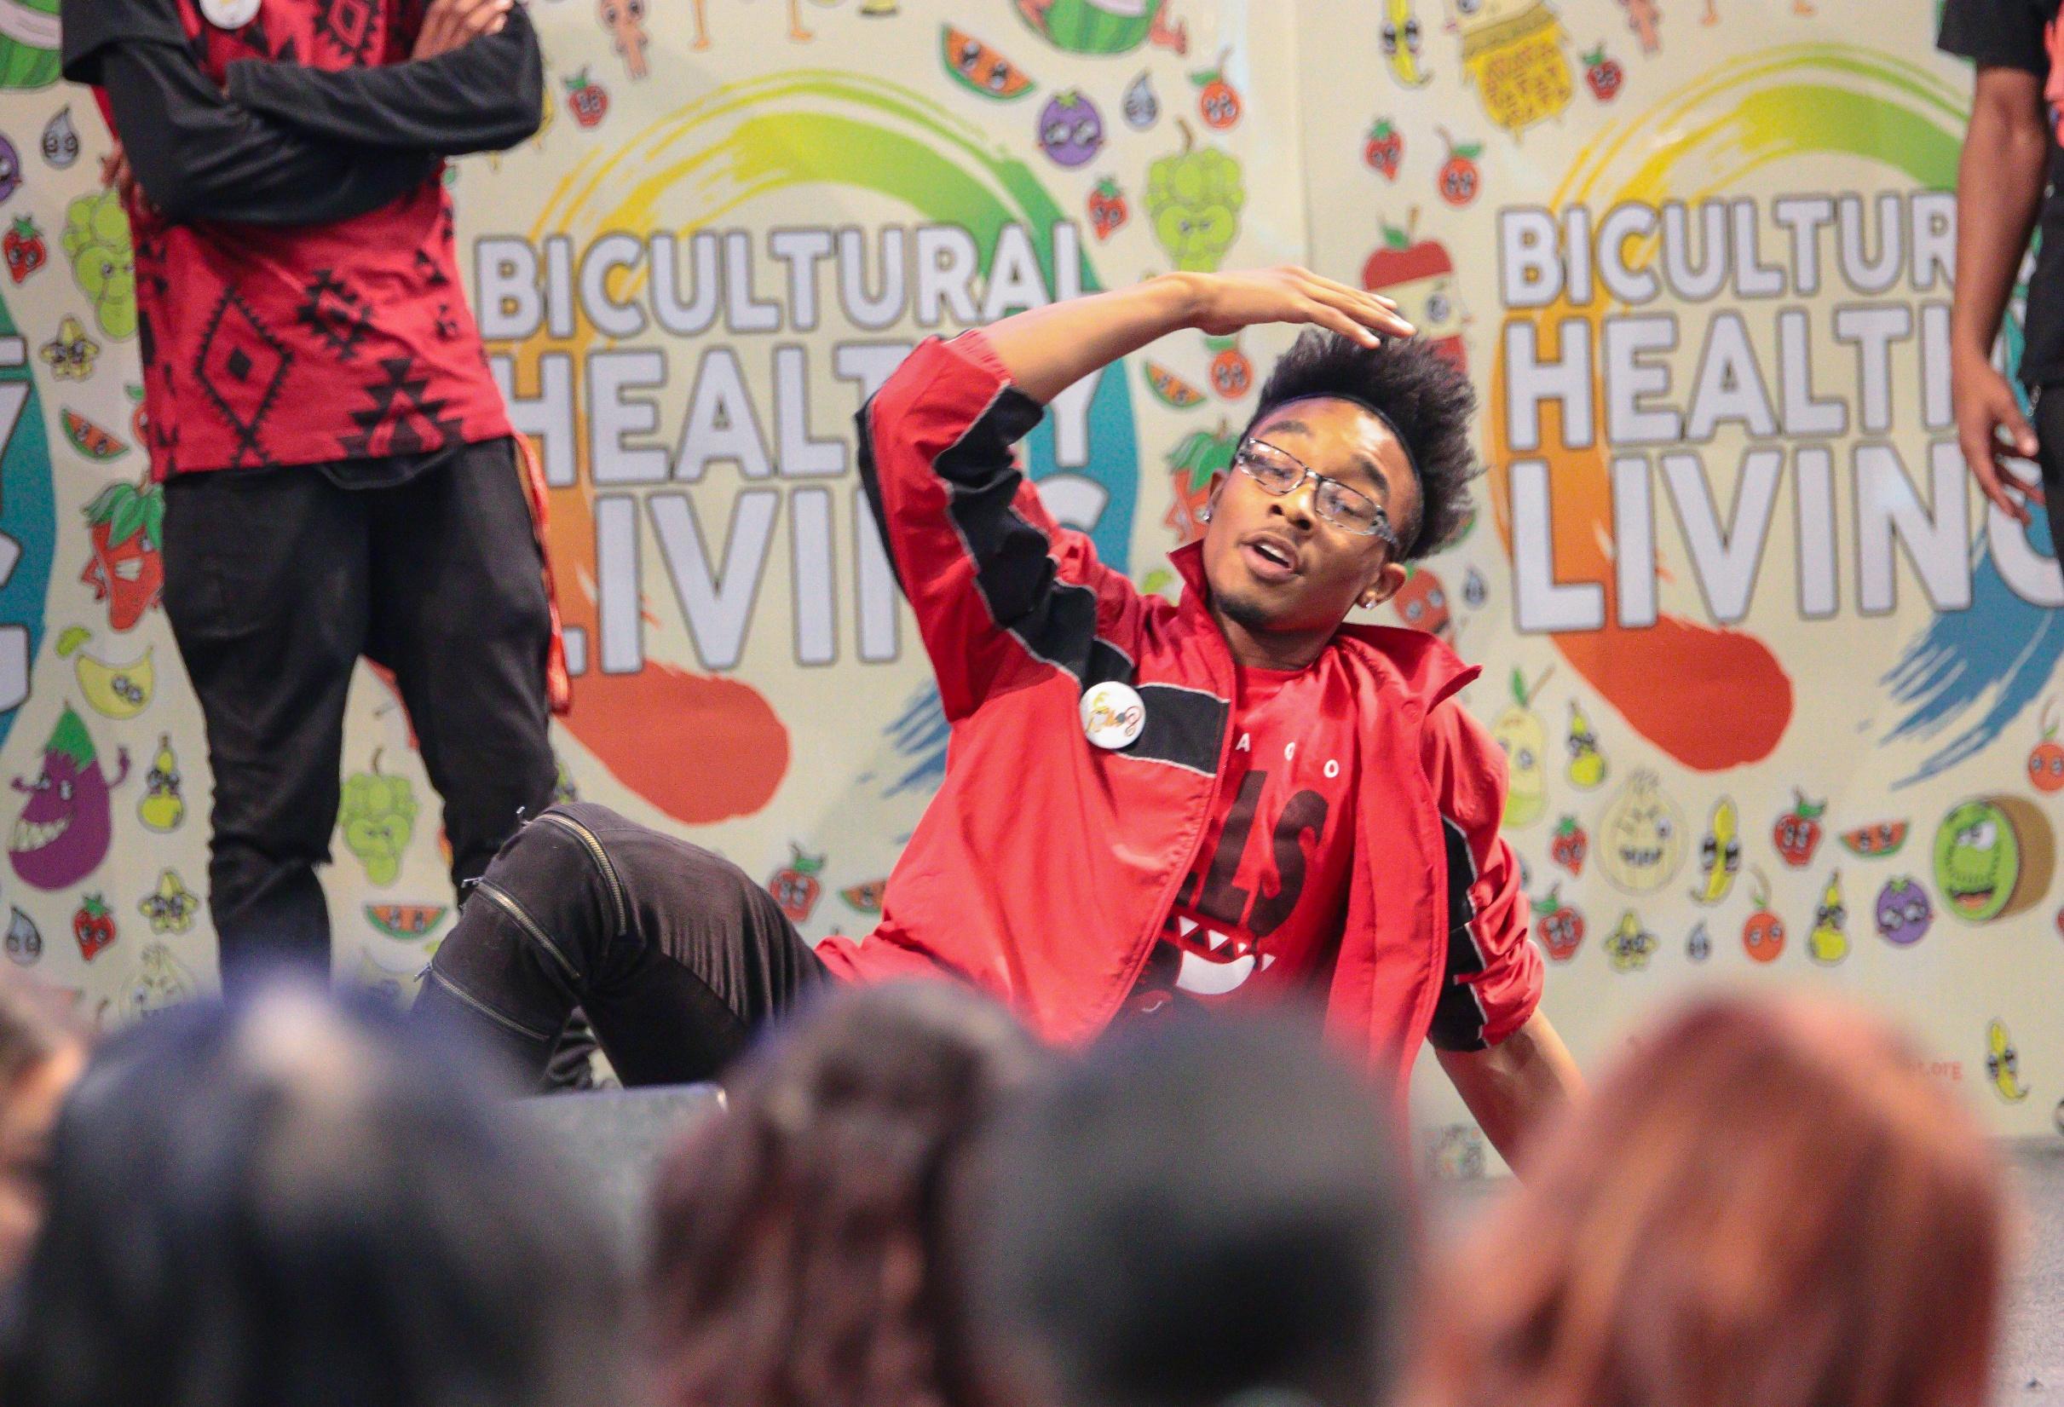
Templates
Useful to start off your designs
Generate ideas
See trends
Can save a lot of time and effort, but lacks creativity, personalization, and skill
With Canva, different templates are available based on the dimensions

Slide 5
Basic: In the Design Tab: use Layouts & Styles to update the color palette and fonts in 1 click
Using elements to create new graphics, sticking to what is available in canva

Slide 6
Changing the style
Notes:
Most Asian traditional cultures are based on Confucius philosophy and Buddhism. The traditional view of the human body is as a derivative of the natural world, and need to be in balance between Yin and Yang, and promotes self-sustaining, workout according to seasons, and simple living philosophies. Confucian culture also shapes family structure, in which the family relationship is hierarchical in nature. Consequently the male who is head of household has more power than the female, than the children. Familial decision-making usually includes extended family members, such as grandparents and other significant relatives. Children are expected to obey elders and to put the family’s needs above their own.

Slide 7
The request was to show “connection on social media”
These were the free elements on Canva (a few years ago)
All the ones I wanted to use were only on the premium/paid version of canva

Slide 8
with FREE elements only
The design:
How it was used:

Slide 9
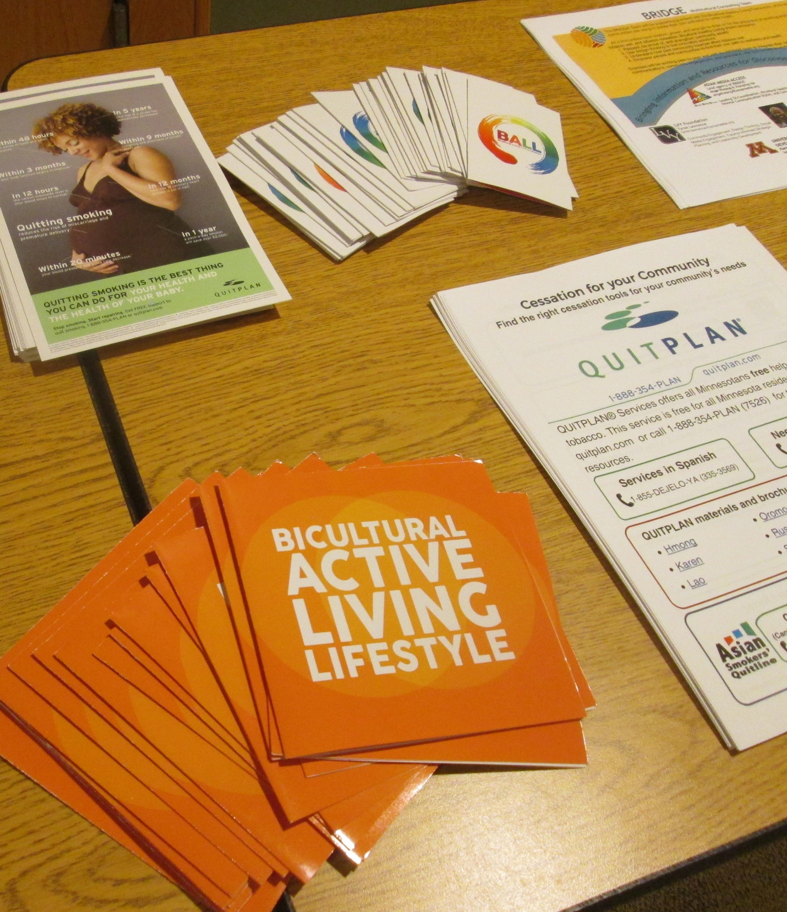
Intermediate:
Edit Photos
If you find images online and want to make them more unique
Tip for Mac Users: Background remover is free.
For PC users: Adobe Express Cloud has this feature for free

Slide 10
Using Photo edit:
The inspiration to replicate
Using a google image

Slide 11
Using Photo edit:
Layering filters
Using paint tool

Slide 12
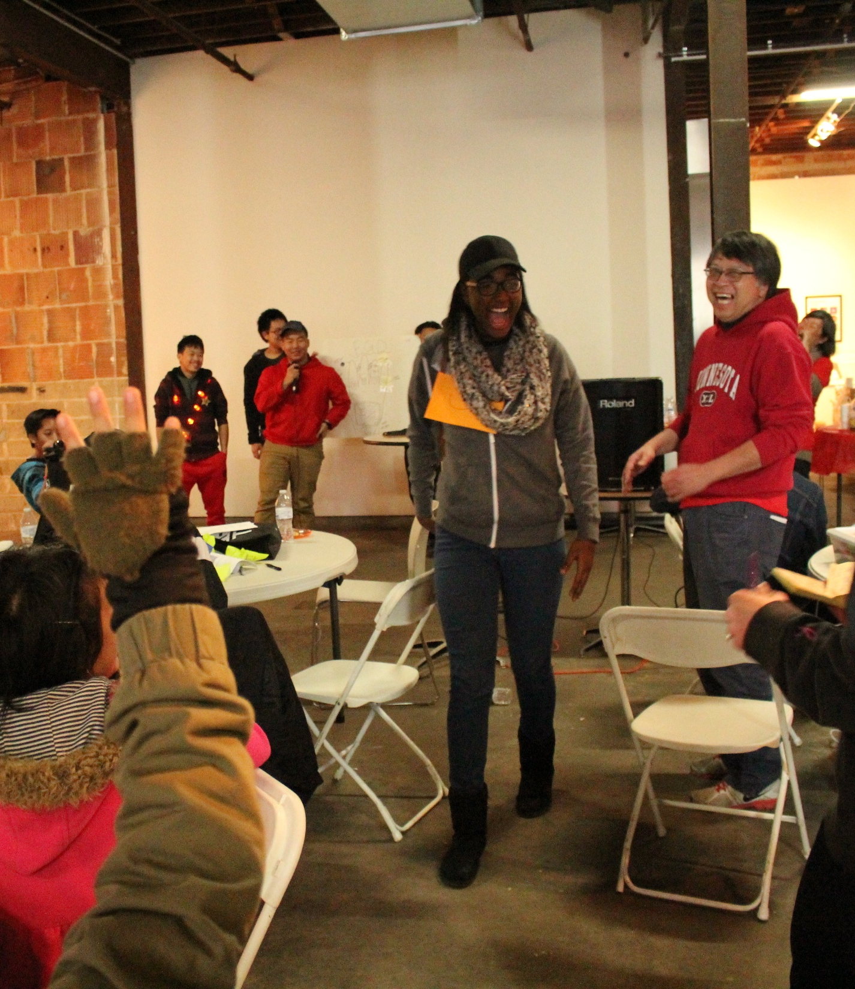
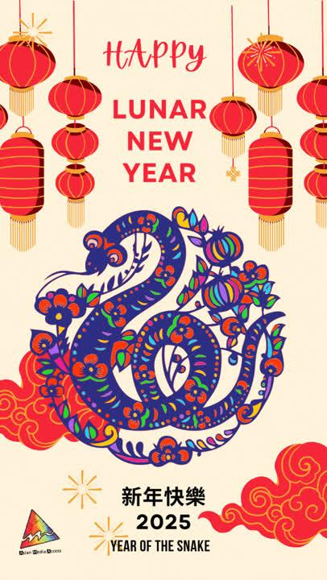
How we used it

Slide 13
Advanced:
Use AI to generate your own photos and edit the photo with drawing, photoshop, etc.

Slide 14
Before
After

Slide 15
Before
After

Slide 16
Before
After

Slide 18
How we used it

Slide 19
AI Prompt: Sculptural clay art postcard style, with monsters, a little creepy atmosphere, dark tones unsettling details, modeled shapes, textured clay, smiling young BIPOC soccer players at front, text We Win the Game by Choosing Sports, Not Smoking, in bold font

Slide 20
AI prompt: Black and white drawing postcard depicting Hmong and Somali ball players with sharp lines and detailed structures. Bold text We Win the Game by Choosing Sports, Not Smoking!
Raised awareness about issues that could or do affect them (teen pregnancy, violence)
Learning about how research and data can help tell a story about these topics
Paycheck/job experience

Slide 21
Magic Write
Provide a prompt (list/bullet points or outline) for Magic Write to provide the information to you
Can be helpful for presentations, social media posts, blogs, and marketing
Helpful if you need to generate texts from scratch
Highlight a field to have Magic Write summarize
Magic Media
Provide a prompt to generate a image, graphic, or videos
Using apps available

Slide 22
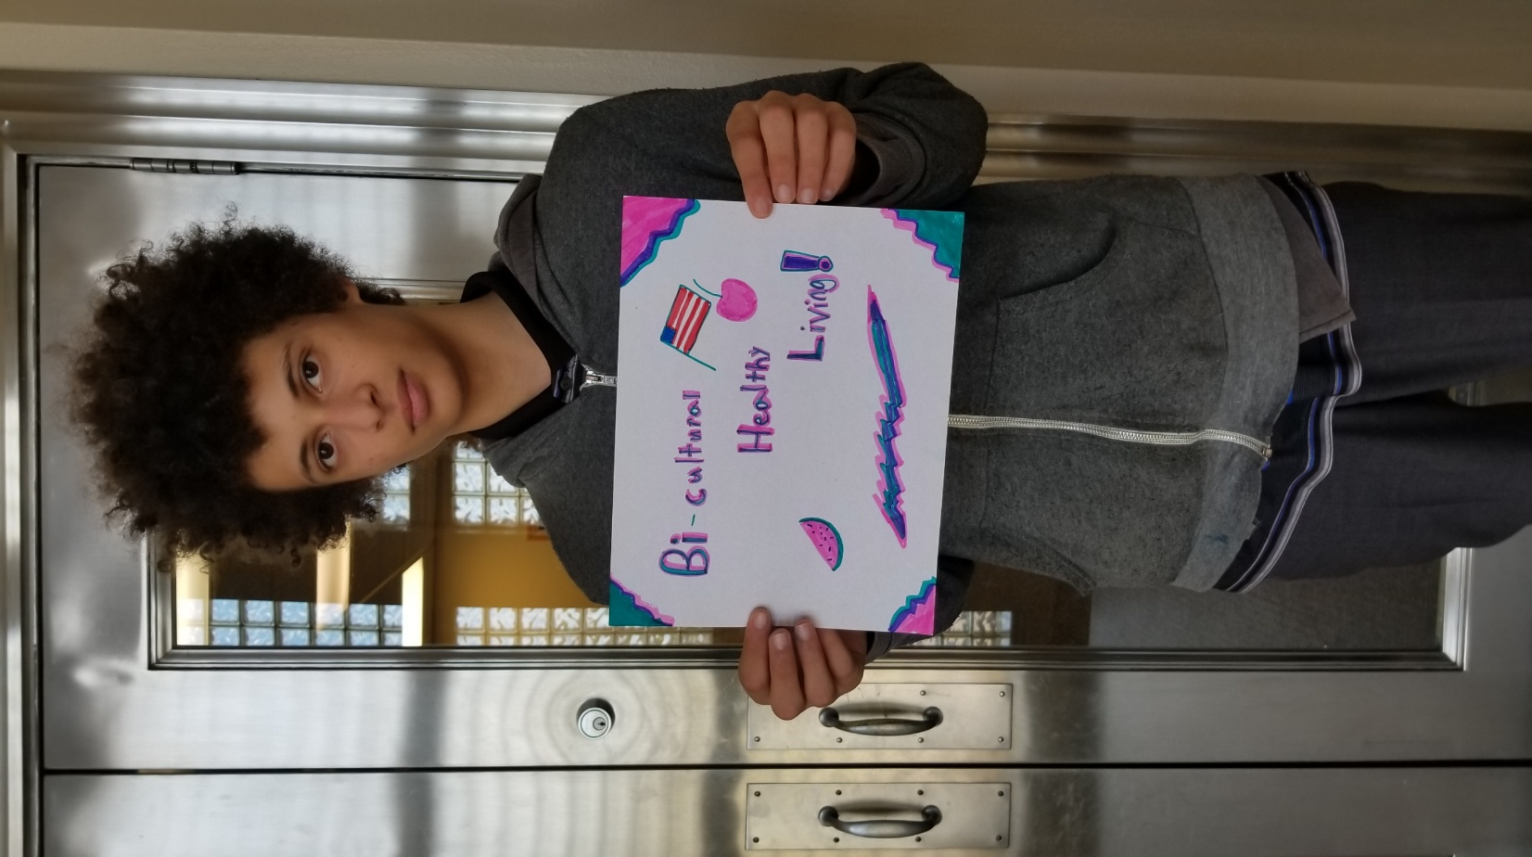
The apps I use the most are
-QR code generators
-Translate
-creating characters/avatars

Slide 23
Exporting & Tips
PNG
Image format. Best for sharing on social media, have the capability for transparent backgrounds. Pixel images (can’t enlarge well)
JPEG
Image format. Compressed only. Supported on more devices (because its so old!), Pixel images (can’t enlarge well)
PDF
Document format. Great for clickable information such as links

