Slide 1
E-Magine! Initiative
Every Mon/Tue 5:30 – 8:30pm

Slide 2
Enhancing
Article Writings
With Generative AI
AMA_Meejoo Choi

Slide 3
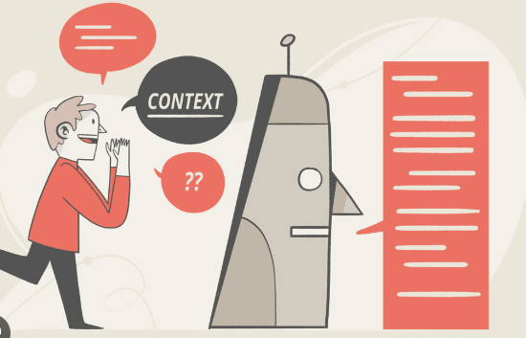
Prompt Engineering

Slide 4
Why Prompt Engineering is Important
Purpose:
To maximize the quality and relevance of the output generated by an AI model by providing well-structured and detailed prompts
more effectively, saving time and getting closer to your ideal outcome

Slide 5
How to use
Prompt Engineering:

Slide 6
1. Provide Specific and Detailed information
Clearly state what you need, including context, preferred tone, and any constraints.
Example: Instead of saying, “Write an article,” try: “Write a 500-word article on the [impact of social media on mental health], using simple language and including at least two expert quotes.”

Slide 7
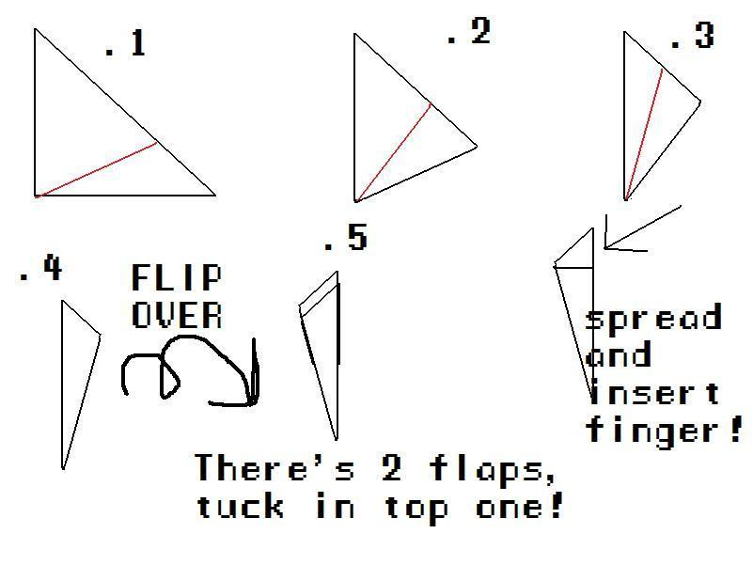
2. Break Down Complex Requests
If you need help with a complex task, break it down into smaller parts.
Step-by-Step Approach Example:
“Can you create an outline for an article about [topic]?”
“Now, can you expand on the first section of the outline with about 200 words?”
“Can you edit the draft to make it more engaging and concise?”

Slide 8
3. Provide Examples or Style Preferences
If you want a specific style or format, give an example or describe the tone and structure you’re aiming for.
Example:
“Write a product description in a playful and persuasive tone, similar to how Apple markets its products. Make it around 150 words and focus on highlighting the unique features.”
ask for variations: “Can you rewrite this paragraph in a more conversational style?”

Slide 9
How to use Generative AI
for Writing

Slide 10
1. Basic Grammar and Syntax Correction
Grammar Check:
"Can you check the grammar in this paragraph, “----” ?"
"Are there any grammatical errors in the following text?"
Syntax Improvement:
"Can you suggest a better way to phrase this sentence for clarity?"
"How can I improve the syntax in this complex sentence?"
2. Style and Tone Consistency
Style Adherence:
"Is this sentence consistent with academic writing standards?"
Tone Consistency:
"Can you check if the tone is consistent throughout this article?"
Stylistic Suggestions:
"How can I make the tone of this paragraph more engaging for a younger audience?"

Slide 11
3 Story Structuring
Organizing Content:
"How should I structure an article about the — — — ?"
Placing Key Points:
"How can I incorporate expert opinions into my investigative report seamlessly?"
4 Networking and Collaboration
Drafting Professional Emails:
"Can you help me draft an email to request an interview with a local politician?"
"How should I write a follow-up email to a source who hasn't responded?"

Slide 12
What kind of app/tools
are available?

Slide 13
Chat GPT
Deepseek
Getliner

Slide 14
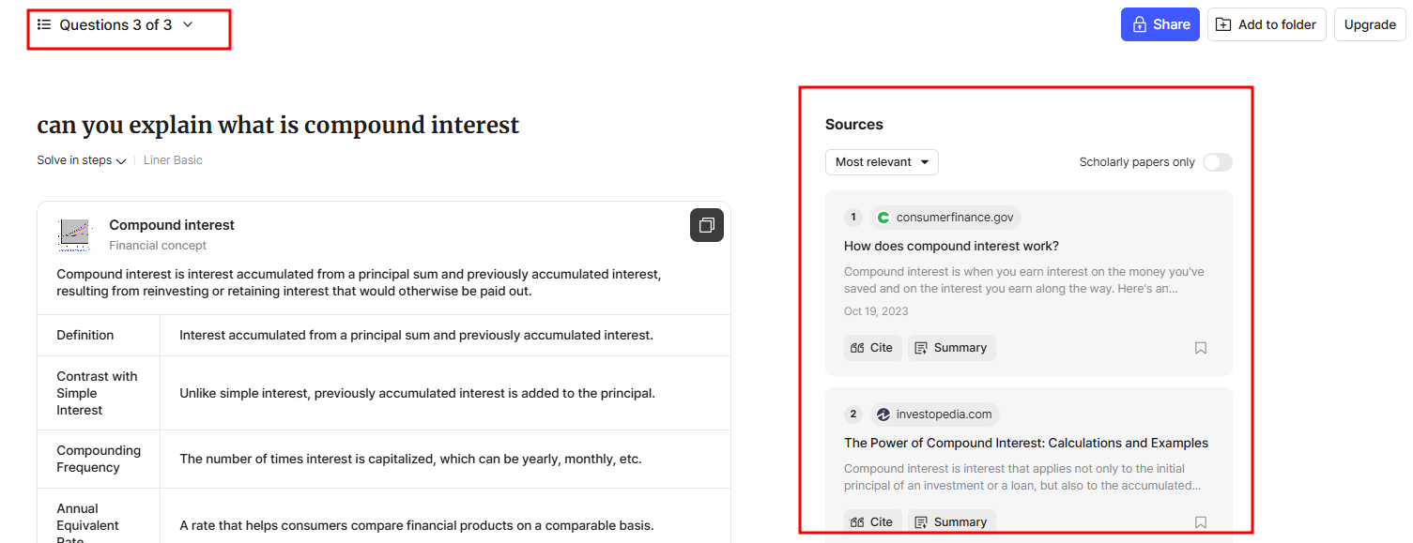
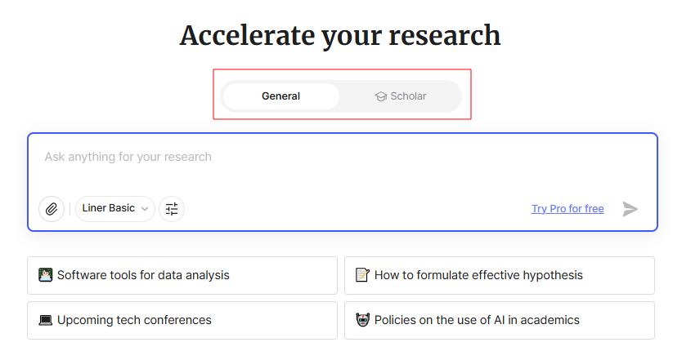
Getliner
“Best research AI for your academic papers”
Provides sources on the right side of the response
Useful for researching
Friendly user interface (easier navigation)

Slide 15
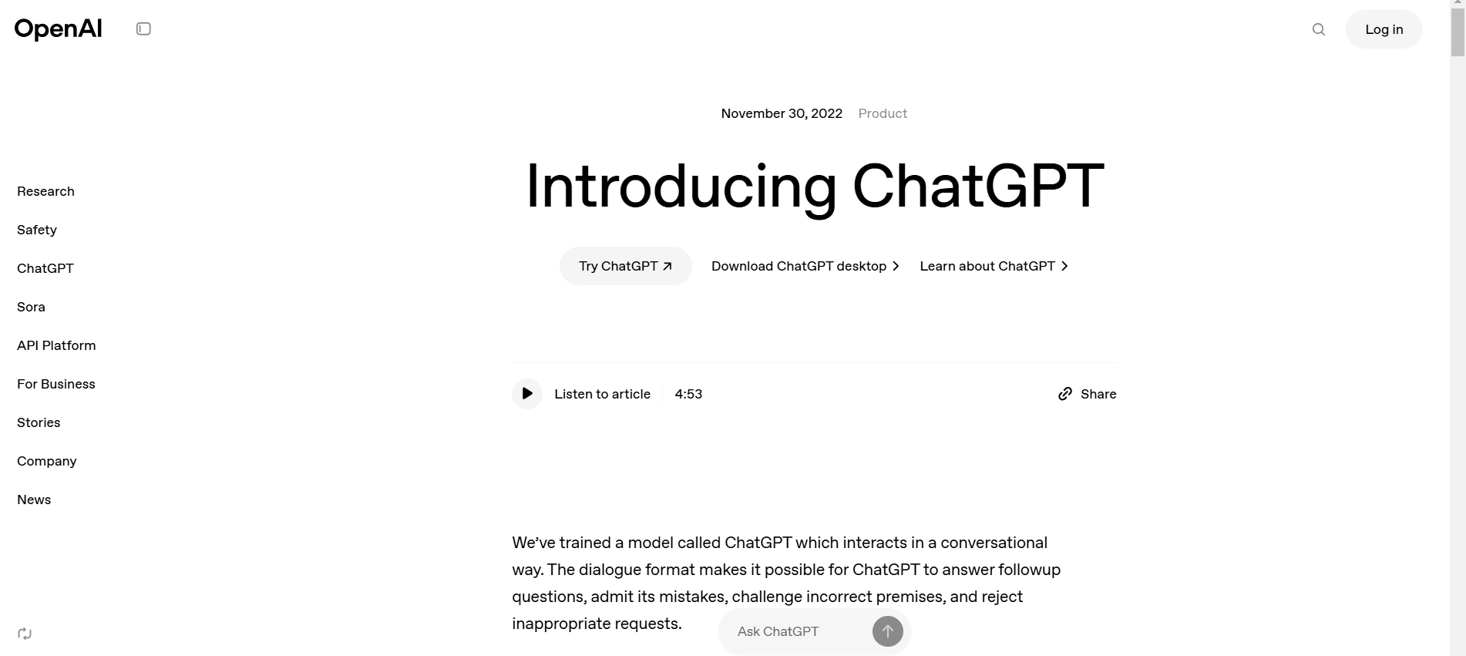
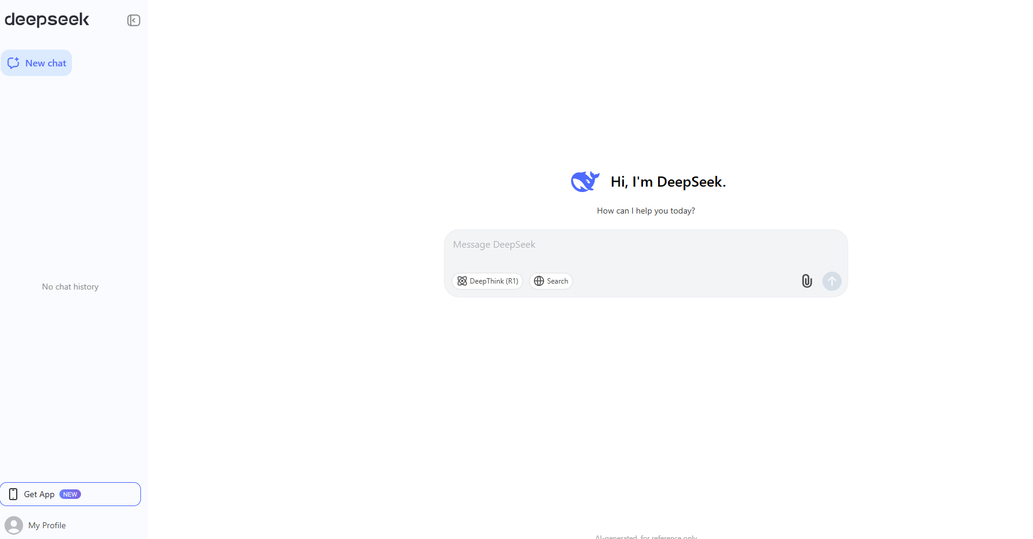
Chat GPT vs Deepseek
Chat GPT
Focus
conversational AI and natural language generation
Use cases
casual conversations, content creation
Strengths
Creative, easy to use
DeepSeek
Focus
Technical writing and data analysis
Use cases
Technical problem-solving, data project documentation
Strengths
open-source (cost-effective), precise

Slide 16
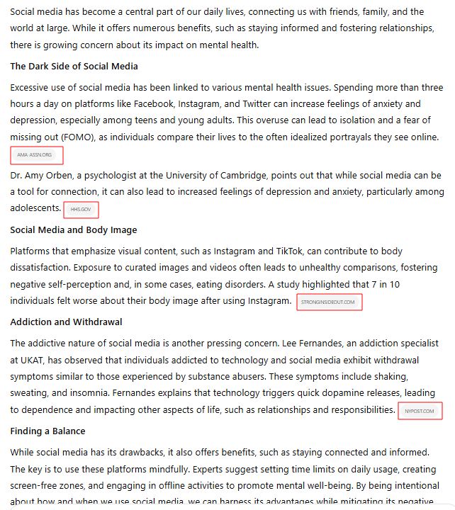
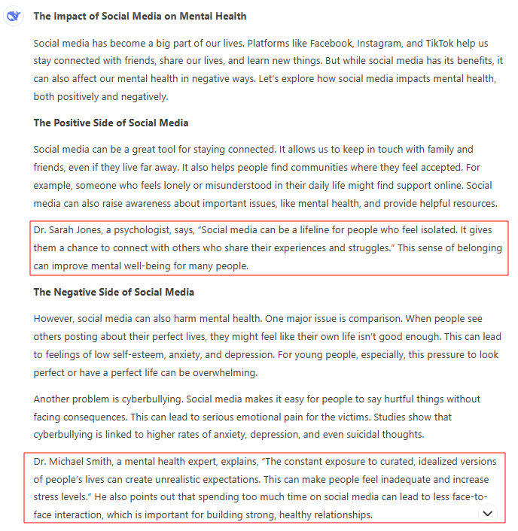
Chat GPT vs Deepseek
“Write a 500-word article on the impact of social media on mental health, using simple language and including at least two expert quotes.”
Chat GPT
Deepseek

Slide 17
Chat GPT vs Deepseek
“Write a 500-word article on the impact of social media on mental health, using simple language and including at least two expert quotes.”
Chat GPT
Deepseek
*depends on the prompt
Contents
Chat GPT > Deepseek (provide sources)
Tone
Both simple and professional
Chat GPT sounds more natural than Deepseek
Word Count
Deepseek > Chat GPT
Chat GPT (about 357)
Deepseek (about 534)

Slide 18
Any questions?

